Slide 1
Mental Addition and Subtraction

Slide 2
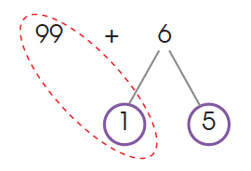
Mental Addition and Subtraction
LET’S LEARN!
1. What is the sum of 99 and 6?
Method 1: Make tens.
6 = 1 + 5 Use number bonds.
99 + 1 = 100 Make tens.
100 + 5 = 105 Add the results.

Slide 3
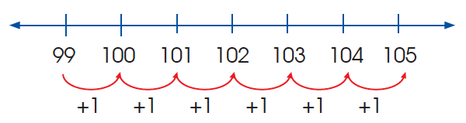
1. What is the sum of 99 and 6?
Method 2: Count on 6 ones.
So, 99 + 6 = 105

Slide 4
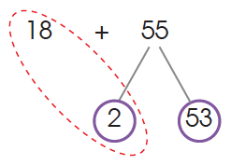
2. What is the sum of 18 and 55?
Method 1: Make tens.
55 = 2 + 53 Use number bonds.
18 + 2 = 20 Make tens.
20 + 53 = 73 Add the results.

Slide 5
2. What is the sum of 18 and 55?
Method 2: Add in tens and ones.
18 + 50 = 68 Add the tens first.
68 + 5 = 73 Then add the ones by counting on.
20 + 53 = 73
So, 18 + 55 = 73

Slide 6
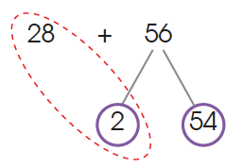
3. What is the sum of 28 and 56?
Method 1: Make tens.
56 = 2 + 54 Use number bonds.
28 + 2 = 30 Make tens.
30 + 54 = 84 Add the results.

Slide 7
3. What is the sum of 28 and 56?
Method 2: Add in tens and ones.
28 + 50 = 78 Add the tens first.
78 + 6 = 84 Then add the ones by counting on.
So, 28 + 56 = 84

Slide 8
4. What is the sum of 40 and 30?
Method: Add the tens. Add the digits in the tens place.
40 + 30 = 4 tens + 3 tens 4 + 3 = 7
= 7 tens 10 has 1 zero.
= 70 So we add 1 zero behind 7 to get 70.

Slide 9
5. What is the sum of 400 and 300?
Method: Add the hundreds. Add the digits in the hundreds place.
400 + 300 = 4 hundreds + 3 hundreds 4 + 3 = 7
= 7 hundreds 100 has 2 zeros.
= 700 So we add 2 zeros behind 7 to get 700.

Slide 10
6. What is the sum of 50 and 60?
Method: Add the tens Add the digits in the tens place.
50 + 60 = 5 tens + 6 tens 5 + 6 = 11
= 11 tens 10 has 1 zero.
= 1 hundred 1 ten So we add 1 zero behind 11 to get 110.
= 110

Slide 11
7. What is the sum of 500 and 600?
Method: Add the hundreds. Add the digits in the hundreds place.
500 + 600 = 5 hundreds + 6 hundreds 5 + 6 = 11
= 11 hundreds 100 has 2 zeros.
= 1 thousand 1 hundred So we add 2 zeros behind 11 to get = 1100 1100.

Slide 12
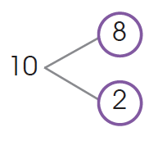
8. What is the difference between 78 and 7?
Method: Expand the number.
78 – 7 = 7 tens 8 ones – 7 ones
= 7 tens 1 one
= 71
10. What is the difference between 80 and 8?
Method: Subtract by making a ten.
10 = 8 + 2 Make a ten.
80 – 10 = 70 Subtract the tens.
70 + 2 = 72 Add the results.
So, 80 – 8 = 72
9. What is the difference between 59 and 18?
Method: Expand the number.
59 – 18 = 5 tens 9 ones – 1 ten 8 ones
= 4 tens 1 one
= 41

Slide 13
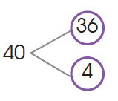
11. What is the difference between 72 and 36?
Method 1: Subtract in tens and ones.
72 – 30 = 42 Subtract the tens.
42 – 6 = 36 Then subtract the ones.
So, 72 – 36 = 36
Method 2: Subtract by making tens.
40 = 36 + 4 Use number bonds.
72 – 40 = 32 Subtract the tens.
32 + 4 = 36 Add the ones.
So, 72 – 36 = 36

Slide 14
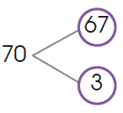
12. What is the difference between 90 and 67?
Method 1: Subtract in tens and ones.
90 – 60 = 30 Subtract the tens.
30 – 7 = 23 Then subtract the ones.
So, 90 – 67 = 23
Method 2: Subtract by making a ten.
70 = 67 + 3 Use number bonds.
90 – 70 = 20 Subtract the tens.
20 + 3 = 23 Add the ones.
So, 90 – 67 = 23

Slide 15
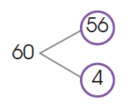
13. What is the difference between 800 and 56?
Method 1: Subtract in tens and ones.
800 – 50 = 750 Subtract the tens.
750 – 6 = 744 Then subtract the ones.
So, 800 – 56 = 744
Method 2: Subtract by making tens.
60 = 56 + 4 Use number bonds.
800 – 60 = 740 Subtract the tens.
740 + 4 = 44 Add the ones.
So, 800 – 56 = 744

Slide 16
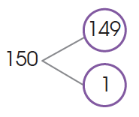
14. What is the difference between 700 and 149?
Method 1: Subtract in hundreds, tens and ones.
700 – 100 = 600 Subtract the hundreds first.
600 – 40 = 560 Then subtract the tens.
560 – 9 = 551 Then subtract the ones.
Method 2: Subtract by making tens.
150 = 149 + 1 Use number bonds.
700 – 150 = 550 Subtract the tens.
550 + 1 = 551 Add the results.
So, 700 – 149 = 551

