Slide 1
Word Problems

Slide 2

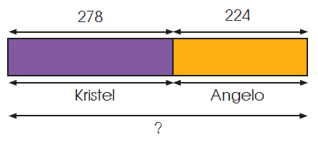
Word Problems
1. Kristel has 278 shells and Angelo has 224 shells. How many shells do Kristel and Angelo have altogether?
Step 1
Read and understand the question.
Step 2
Plan. Draw a model. We add to find the total.

Slide 3
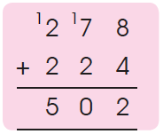
Word Problems
1. Kristel has 278 shells and Angelo has 224 shells. How many shells do Kristel and Angelo have altogether?
Step 3
Carry out the plan.
278 + 224 = 502
Kristel and Angelo have 502 shells.
Step 4
Check. Estimate your answer by rounding each of the numbers to the nearest ten before adding.
278 ≈ 280
224 ≈ 220
280 + 220 = 500
502 is close to our estimate of 500, so our answer is reasonable.

Slide 4
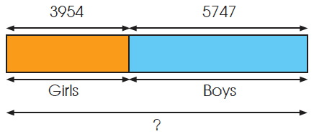
Word Problems
2. There are 3954 girls and 5747 boys in a school. How many pupils are there in the school altogether?
Step 1
Read and understand the question.
Step 2
Plan. Draw a model. We add to find the total.

Slide 5
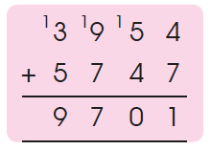
Word Problems
2. There are 3954 girls and 5747 boys in a school. How many pupils are there in the school altogether?
Step 3
Carry out the plan.
3954 + 5747 = 9701
Step 4
Check. Estimate your answer by rounding each of the numbers to the nearest hundred.
3954 ≈ 4000
5747 ≈ 5700
3954 + 5747 ≈ 4000 + 5700
= 9700
9701 is close to our estimate of 9700, so our answer is reasonable. There are 9701 pupils in the school altogether.

Slide 6
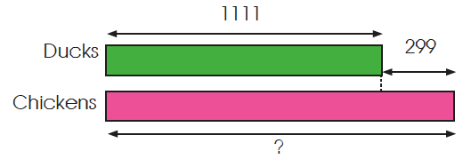
Word Problems
3. There are 1111 ducks in a farm. There are 299 fewer ducks than chickens.
(a) How many chickens are there?
Add to find the number of chickens.
1111 + 299 = 1410

Slide 7
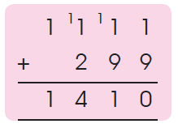
Word Problems
3. There are 1111 ducks in a farm. There are 299 fewer ducks than chickens.
(a) How many chickens are there?
Check your answer by rounding each number to the nearest hundred before adding.
1111 + 299 ≈ 1100 + 300
= 1400

Slide 8
Word Problems
3. There are 1111 ducks in a farm. There are 299 fewer ducks than chickens.
(a) How many chickens are there?
1410 is close to our estimate of 1400, so the answer is reasonable.
There are 1410 chickens.

Slide 9
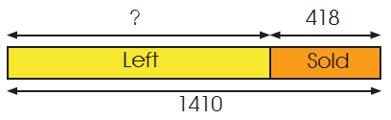
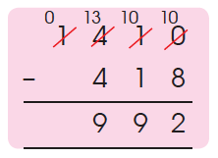
Word Problems
3. There are 1111 ducks in a farm. There are 299 fewer ducks than chickens.
(b) How many chickens will be left if 418 chickens are sold?
Find the difference.
1410 – 418 = 992
There will be 992 chickens left.
Check your answer by rounding each number to the nearest ten before subtracting.

Slide 10
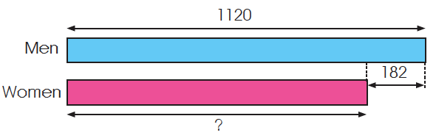
Word Problems
4. There are 1120 men at a concert. There are 182 fewer women than men. How many women are there?
Read and understand the question.
What do you know?
What do you need to find?

Slide 11
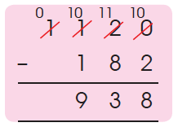
Word Problems
4. There are 1120 men at a concert. There are 182 fewer women than men. How many women are there?
Subtract to find the number of women.
1120 – 182 = 938
There were 938 women.
Check your answer by estimating the difference using rounding.
1120 – 182 ≈ 1100 – 200
= 900
900 is close to our estimate of 938, so our answer is reasonable.

Slide 12
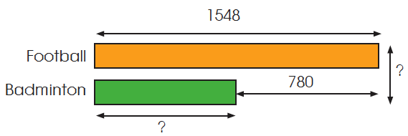
Word Problems
5. 1548 football match tickets were sold in a week. In the same week, 780 fewer badminton match tickets than football match tickets were sold. How many tickets were sold altogether in that week?
Read and understand the question. What do you need to find first?
(a) How many badminton tickets were sold? (b) How many tickets were sold altogether?

Slide 13
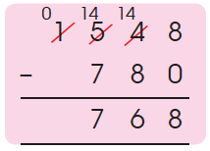
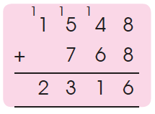
Word Problems
5. 1548 football match tickets were sold in a week. In the same week, 780 fewer badminton match tickets than football match tickets were sold. How many tickets were sold altogether in that week?
1548 – 780 = 768
768 badminton tickets were sold.
Subtract first to find the number of badminton tickets sold. Then add to find the number of tickets sold altogether.
1548 + 768 = 2316
2316 tickets were sold altogether in that week.

Slide 14
Word Problems
5. 1548 football match tickets were sold in a week. In the same week, 780 fewer badminton match tickets than football match tickets were sold. How many tickets were sold altogether in that week?
Work backward to check your answer.
Subtract to find the number of football match tickets.
Estimate by using rounding to calculate quickly.
2316 – 768 ≈ 2300 – 800
= 1500
1548 is close to our estimate of 1500, so the answer is reasonable.

Slide 15
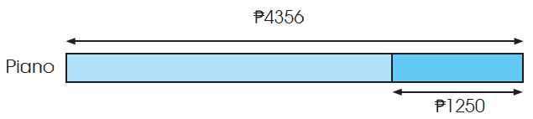
Word Problems
6. The usual price of a piano was ₱4356. During a sale, the price was ₱1250 less. Mr. Aquinos had 4000. How much did he have left after buying the piano during the sale?
What do you need to find first?
How much did the piano cost during the sale?

Slide 16
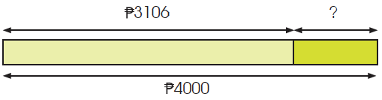
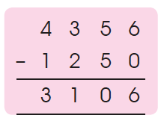
Word Problems
6. The usual price of a piano was ₱4356. During a sale, the price was ₱1250 less. Mr. Aquinos had 4000. How much did he have left after buying the piano during the sale?
Subtract to find the price of the piano. Then subtract to find the amount of money left.
₱4356 – ₱1250 = ₱3106

Slide 17
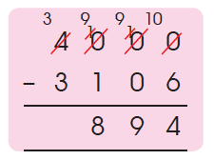
Word Problems
6. The usual price of a piano was ₱4356. During a sale, the price was ₱1250 less. Mr. Aquinos had 4000. How much did he have left after buying the piano during the sale?
₱4000 – ₱3106 = ₱894
Mr. Aquinos had 894 left.
Check your answer by estimation. Remember to write the units!

