Slide 1
Parts and Functions of the Different Digestive Organs

Slide 2
Parts and Functions of the Different Digestive Organs
Functions of the Digestive System
Ingestion – The process of putting food into the mouth. When you eat, you put the food in your mouth. This is the process of eating.
Transport of food – Transportation of food along the different organs of the digestive tract. This happens due to the alternate contraction and relaxation (wave-like movement) of the muscular walls of the digestive organs called peristalsis.
Secretion of materials – The different digestive glands produce and discharge materials that contain substances called enzymes that simplify complex food materials and other substances (saliva, acids, bile, and bicarbonate ions) that soften, liquefy, and adjust the pH (acidity or alkalinity) of the food that is being digested.

Slide 3
Parts and Functions of the Different Digestive Organs
Digestion of food – This process is the breaking down of food physically into small pieces by the action of some accessory organs, and chemically through enzyme action that changes the composition of the food into forms, that the body cells can absorb and utilize.
Absorption – This process is the movement of the final products of digestion (called nutrients) from the digestive organs to the connecting blood vessels (capillaries) and lymph vessels (lacteal) for distribution to all parts of the body.
Excretion – The process of eliminating the undigested residue or waste products of digestion. Waste products of digestion are expelled from the body through defecation via the anus.

Slide 4
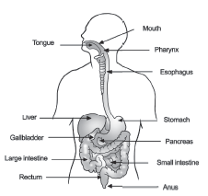
Parts and Functions of the Different Digestive Organs
The Different Organs of Digestion
The human digestive system is a tube-like structure because of the presence of two openings on both ends. The organs of the alimentary tract are the mouth, pharynx, esophagus, stomach, small intestine, large intestine, rectum, and anus. The different digestive glands are the liver, pancreas, and the other glands located within the organs of digestion.

Slide 5
Parts and Functions of the Different Digestive Organs
Mouth or Oral Cavity
The mouth or oral cavity is the anterior opening of the digestive tract. The mouth functions for ingestion. It is composed of the following accessory structures:
Lips that bound the mouth (upper and lower lips).
Cheek forms the side of the mouth.
Gums are the organs where the teeth are embedded.
Palate forms the roof of the mouth. It consists of two parts—the hard and the soft palates.
Teeth function for chewing or mastication.
Tongue is a muscular organ covered with taste buds. The tongue performs three functions—for tasting, aids in chewing, and swallowing.
Salivary glands secrete saliva, a chemical substance that lubricates food and plays an important role in the chemical digestion of starch.

Slide 6
Parts and Functions of the Different Digestive Organs
The Pharynx or Throat
The pharynx is about 6 inches long and located at the back part of the mouth. It is the common passageway for digestion and respiration. However, breathing and swallowing do not happen at the same time. Since the opening that leads to the trachea is always open, the swallow reflex raises the flap of muscle called the epiglottis to cover the opening of the trachea so the food finds its right way into the esophagus.
Esophagus
The esophagus is the muscular tube that brings the bolus from the pharynx to the stomach. Once the food is swallowed and reaches the esophagus, the wavelike contraction called peristalsis brings the bolus from the esophagus down the stomach as well as to the different organs of digestion.

Slide 7
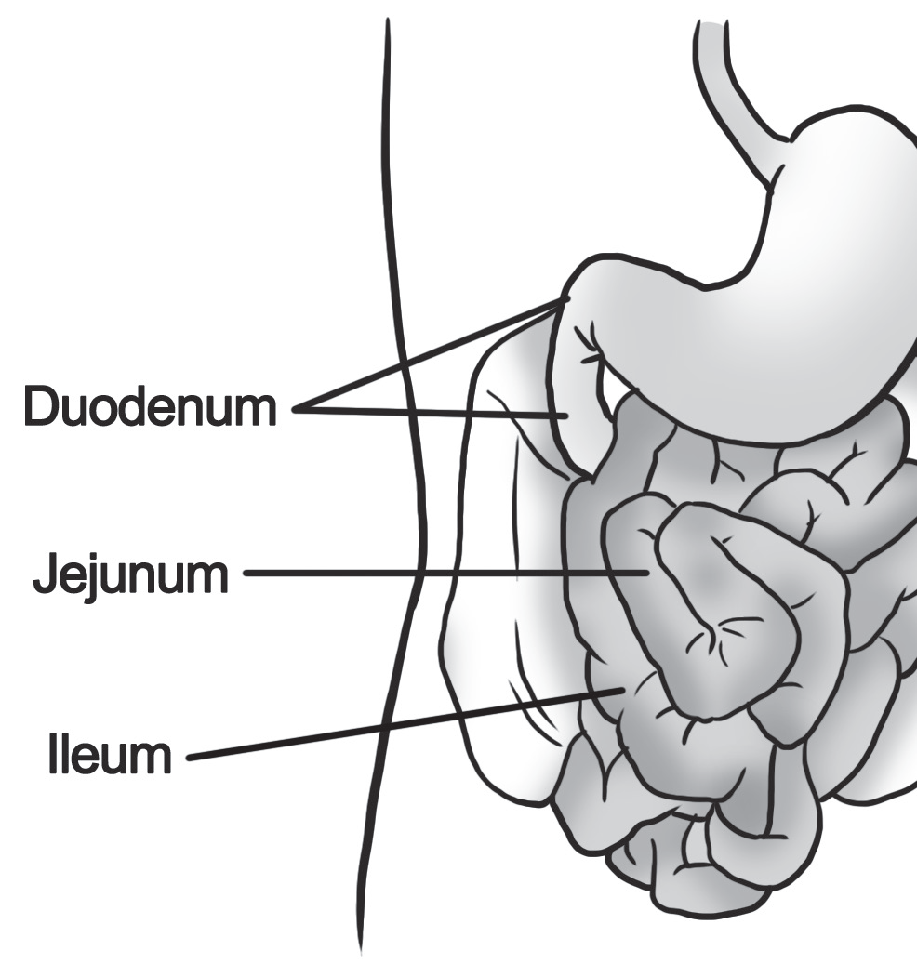
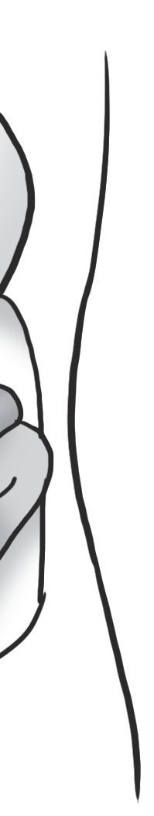
Parts and Functions of the Different Digestive Organs
Small Intestine
The small intestine is the longest organ of the digestive tract. It is about 6 m long and 2.5 cm in diameter. It is divided into three portions: the duodenum is the shortest and most fixed portion of the small intestine; the jejunum is the middle and freely movable portion, and the ileum is the longest and highly coiled portion. The small intestine is the site of complete digestion and absorption. The intestinal glands secrete the final enzymes that chemically change the foods into their simplest forms.

Slide 8
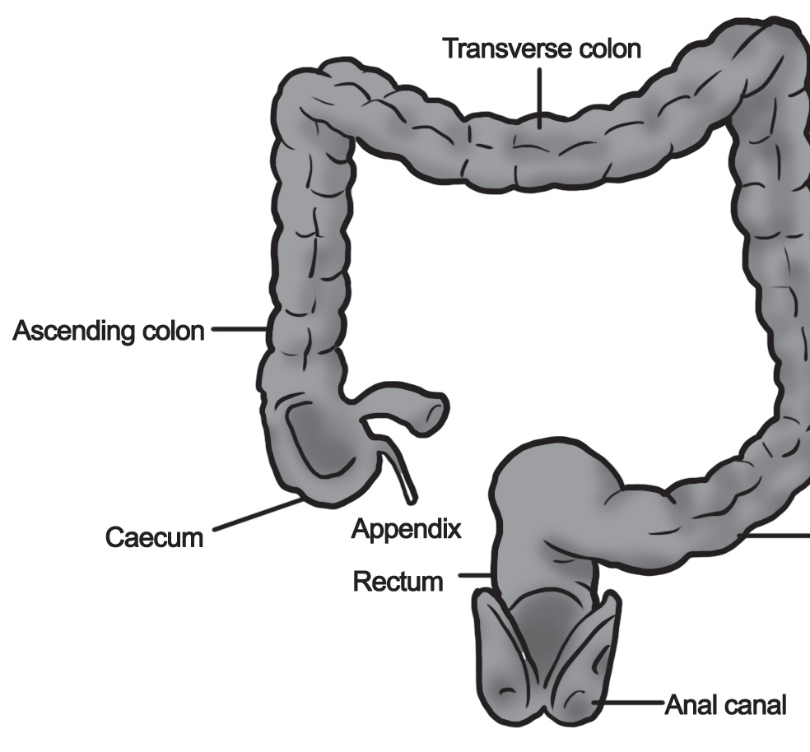
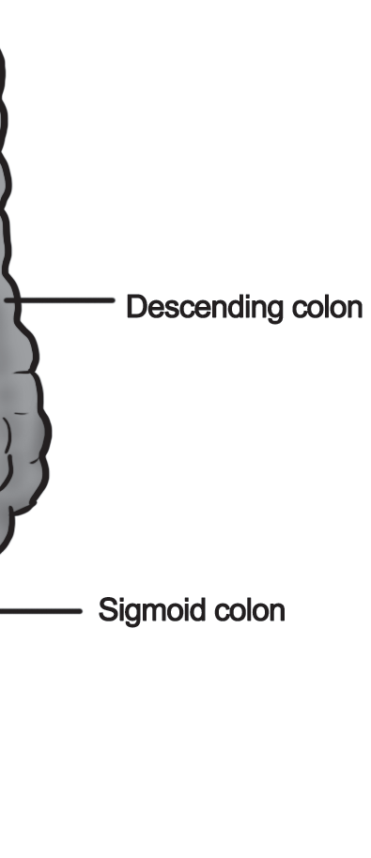
Parts and Functions of the Different Digestive Organs
Large Intestine
The large intestine, also called the colon. It is divided into four regions: colon, cecum, rectum, and anus. The colon has three distinct regions: ascending colon, transverse colon, and descending colon. The cecum is the blind elongated pouch that bears at its base the vermiform appendix. The end part of the descending colon is the sigmoid colon, so named because of its S-shaped position within the pelvic cavity. Most of the water from the undigested residue is absorbed in the large intestine and redistributed to the body. What is left is a solid waste matter called feces. The large intestine contains a rich flora of symbiotic bacteria (Escherichia coli) that live and feed on the undigested residue. The bacterial flora unlocks some vitamins (like Vitamin K) and minerals from the undigested residue, which like water, are absorbed by our body.

Slide 9
Parts and Functions of the Different Digestive Organs
Rectum and Anus
The rectum is located at the far end of the sigmoid colon. It is about 8 inches long and basically serves as a warehouse for the undigested residue or feces. At the end part of the rectum is the anal canal or anus, which is the posterior opening of the digestive tract that functions as the exit point (egestion) for fecal materials during defecation.

Slide 10
Parts and Functions of the Different Digestive Organs
The Accessory Organs of Digestion
The accessory organs are the different digestive glands. Glands are organs capable of secreting materials. The digestive glands are structurally exocrine glands. Exocrine glands have ducts and openings that secrete chemical substances into the organs of digestion. Their secretions facilitate the digestion process.
Salivary Glands
The salivary glands are located in the mouth. These glands secrete saliva – a substance that is a combination of water and a small amount of mucus. The saliva lubricates the mouth and aids in swallowing. It also contains the enzyme ptyalin – a salivary amylase that chemically digests carbohydrates in the mouth. About one liter of saliva is secreted by these glands every day.

Slide 11
Parts and Functions of the Different Digestive Organs
Gastric Glands
The gastric glands are embedded in the folded inner linings (called rugae) of the stomach. A gastric gland is composed of three kinds of cells: the zymogenic or chief cells that secrete pepsinogen, a precursor of the enzyme pepsin, the parietal cells that secrete Hcl, and the mucus-secreting epithelial cells. Pepsinogen, an inactive substance in the presence of HCl, changes to its active form, pepsin – a protein-digesting enzyme. The secretions of all these cells compose the gastric juice.
Intestinal Glands
The intestinal glands line the inner linings of the small intestine. They secrete an alkaline (basic) substance that contains the final enzymes of digestion.

Slide 12
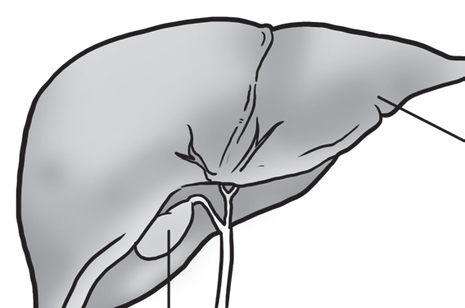


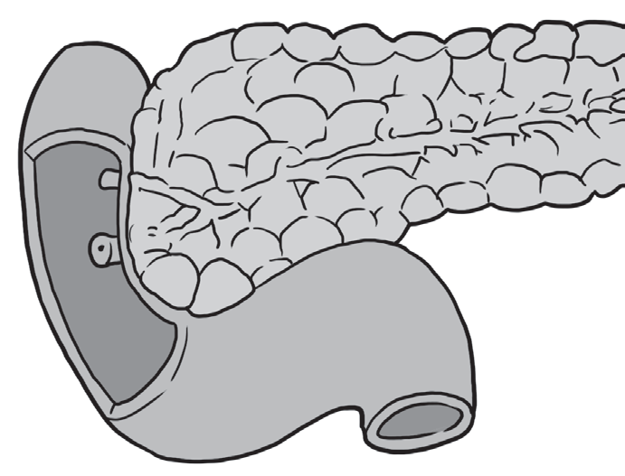

Parts and Functions of the Different Digestive Organs
The Liver and Gall Bladder
The liver is the largest organ in the body. The function of the liver related to digestion is the production of bile. Bile performs two important functions in digestion: emulsifies fats and neutralizes the acidity of the partly digested food (chyme) that comes from the stomach. Bile is stored and concentrated in the gall bladder, just under the liver. About 500–1000 ml of bile is stored and concentrated in the gall bladder every day.
The Pancreas
The pancreas is a large and elongating organ lying behind the stomach. This is both endocrine (ductless) and exocrine in function. The exocrine part is connected to the duodenum. The pancreas secretes pancreatic juice, which is just like the bile, also neutralizes the acidity of the chyme. The five enzymes of digestion present in the pancreatic juice are: amylopsin, trypsin, steapsin, chymotrypsin, and carboxypeptidase.

Slide 13
Parts and Functions of the Different Digestive Organs
The Digestive Process
Digestion is the process by which food is broken down into simple materials. As food enters the mouth, it undergoes two phases of digestion: the physical phase and the chemical phase. In the physical phase, food undergoes mechanical digestion or is broken down into small pieces by the process of chewing or mastication, and lubricated and softened by the action of the digestive juices.
In the chemical phase, food is acted upon by chemical substances called enzymes that are secreted together with the digestive juices. These enzymes act on the food and change them into their simplest equivalents, which the body cells can absorb and utilize. Enzymes hasten or slowdown chemical reactions. They are also referred to as organic catalysts because they are made up of proteins. The substance or material acted upon by enzymes is called substrate.
There are three groups of digestive enzymes: carbohydrases, proteinases, and lipases. The suffix ase pertains to enzymes and the key word where the ase is connected is the substrate. Thus, the different food groups are substrates for specific groups of enzymes. Enzyme action is specific. This means a protein-digesting enzyme will not react with a carbohydrate-rich food, just like how a key fits into a lock. Some enzymes (like pepsin) act well in an acidic medium. Changes in temperature also affect enzyme activity.

Slide 14
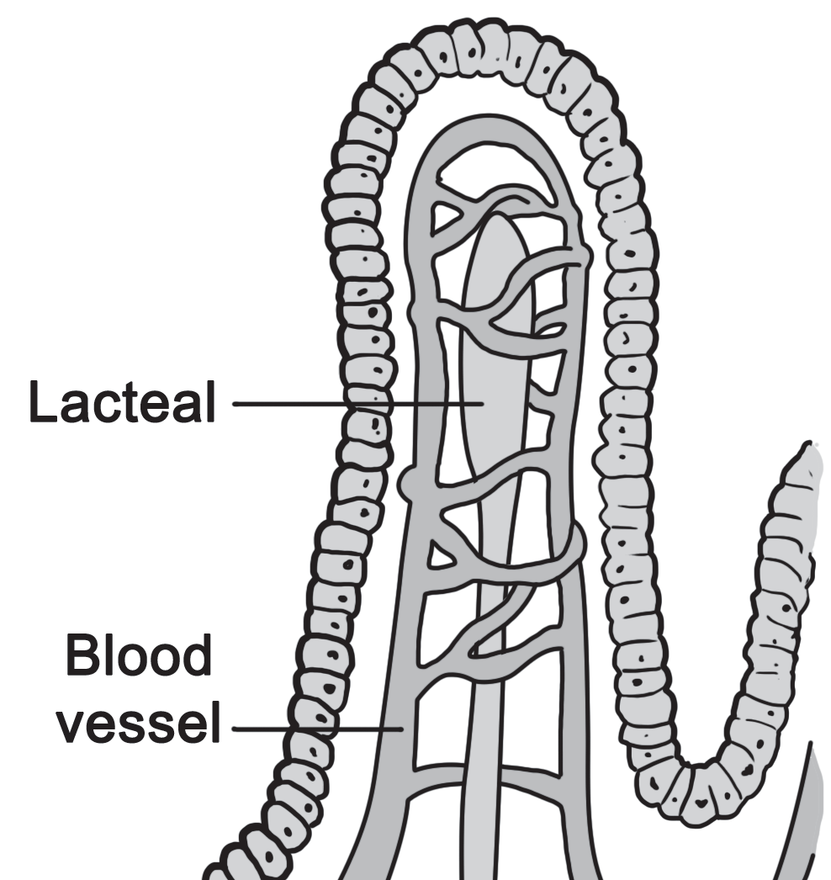
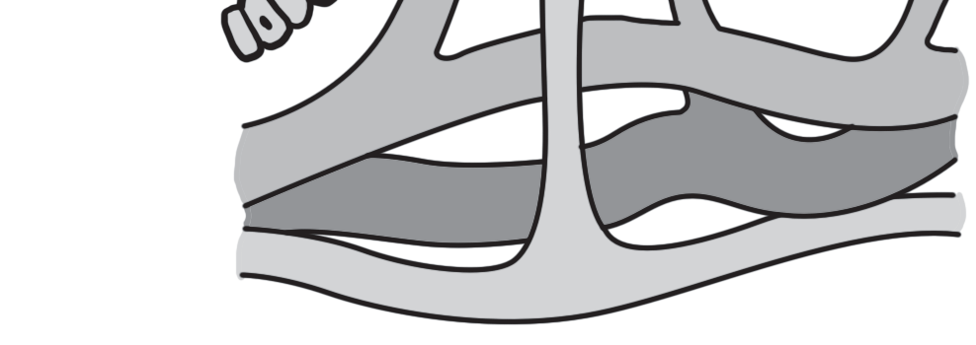
Parts and Functions of the Different Digestive Organs
Absorption and Transport of the Final Products of Digestion
Absorption of the end products of digestion takes place in the small intestine. The lining of the small intestine contains microscopic folds called villi (singular villus). The villi look like fingerlike projections.They increase the surface area of absorption, making the small intestine more efficient in nutrient absorption. The core of each villus is traversed with networks of blood vessels called capillaries and lymph vessels called lacteal vessels. The end products of digestion are absorbed across the villi and across the thin walls of the capillaries and lacteal vessels. Glucose, fructose, and galactose are absorbed by the network of capillaries and brought to the different parts of the body as energy sources. Likewise, amino acids are absorbed by the network of capillaries and are used by the body for growth and to repair worn out tissues.Fatty acids and glycerol are absorbed by the lacteal vessels and are carried to the lymphatic circulation. They are sources of energy and assimilated as a component of the cells. Some are stored in the different parts of the body.

Slide 15
Parts and Functions of the Different Digestive Organs
The Digestive System and Its Interactions with the Respiratory, Circulatory, and Excretory Systems
The digestive system, with the help of the different organs that compose it, processes food into products, which the body cells can absorb and utilize. However, the digestive system, just like the other organ systems that compose the human body, works in conjunction with other systems to ensure that a stable internal environment (called homeostasis) is maintained.
Respiration supplies the different digestive organs with the oxygen they need, and at the same time, removes carbon dioxide from them. Oxygen is utilized by the cells composing the digestive organs to breakdown the products of digestion (glucose) into a form of energy called adenosine triphosphate (ATP). ATP is a high-energy molecule, which the body cells can readily use in performing their functions efficiently. The process where glucose is broken down by the cells to release energy is called cellular respiration.

Slide 16
Parts and Functions of the Different Digestive Organs
As glucose is broken down, carbon dioxide and water are released as waste products (also called metabolic wastes). Carbon dioxide is expelled out of the body during exhalation, which is a phase of respiration. Water may be reabsorbed by the cells; the excess water exits the body in the form of urine or sweat.
The circulatory system plays an important role in the digestive process. The oxygen, which the cells of the organs of digestion need, is transported to them by the blood. The blood is the circulating medium of the circulatory system. Take a note that the villi of the small intestine contain small blood vessels called capillaries and lymph vessels called lacteal vessels. From the small intestine, these vessels transport and distribute the final products of digestion to all the cells composing the body. This is how important the circulatory system is not only in the process of digestion but also in the processes of respiration and excretion.

Slide 17
Parts and Functions of the Different Digestive Organs
Waste products are formed as glucose, the final product of digestion, is broken down into their simplest forms (during cellular respiration). These waste products are carbon dioxide and water. Likewise, amino acid, the final product of protein digestion, is also broken down to suit the body’s needs (e.g., growth and repair of damaged tissues). As amino acid is broken down, urea is formed as waste product. As the various food groups are broken down, a lot of water is being released. Excess water and urea are brought by the blood to the kidneys and sweat glands for elimination; this is where the excretory system plays an important role. The excretory system functions in releasing wastes out of the body. Waste products released are not only in the form of liquid but also in the form of solid. The large intestine eliminates the solid waste products of digestion in the form called feces.

Slide 18
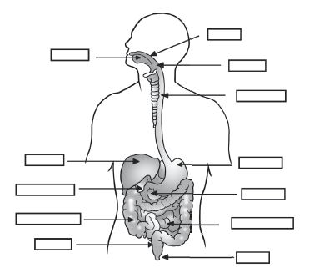
Parts and Functions of the Different Digestive Organs
Directions. Label the different organs of the digestive system. Choose your answer in the box. In state the function of each organ in your own words.
stomach
mouth
anus
rectum
liver
small intestine
large intestine
gall bladder
pancreas
esophagus
pharynx
tongue

Slide 19
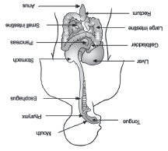
Parts and Functions of the Different Digestive Organs
Answer key
Mouth or oral cavity, is the anterior opening of the digestive tract.
Pharynx is the passage way for digestion and respiration.
Esophagus brings the bolus from the pharynx to the stomach.
Stomach is the organ that functions mainly for storage and as a mixing chamber for food.
Pancreas produces pancreatic juice, which contains enzymes that aid in digestion.
Small intestine is the site where digestion is completed and absorption of nutrients occurs.
Most of the water from the undigested residue is absorbed in the large intestine and redistributed to our body.
The liver produces bile.Bile is stored and concentrated in the gall bladder.
Rectum connects the colon to the anus.
Anus is the posterior opening of the digestive tract that functions as the exit point (egestion) for fecal materials during defecation

