Slide 1
The Musculoskeletal, Integumentary and Excretory Systems

Slide 2
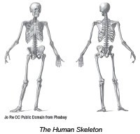
The Musculoskeletal, Integumentary, and Excretory Systems
Musculoskeletal System
➢
Is composed of the human skeleton and the muscles. The skeleton serves as the framework and support for the body.
➢
The bones and muscles work together, enabling the body to move and perform various activities.
➢
the musculoskeletal system also protects vital organs, such as the brain, heart, lungs, and any other similar organs.
WWW.REX.COM.PH

Slide 3
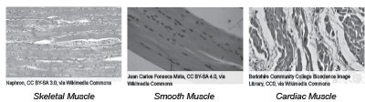
The Musculoskeletal, Integumentary, and Excretory Systems
Our musculoskeletal system is primarily composed of the bones and different kinds of muscles, such as the smooth, skeletal, and cardiac muscles.
These types of muscles are found in specific parts of the body where they play vital roles for locomotion, the passage of materials inside the body, as well as the beating of the heart.
WWW.REX.COM.PH

Slide 4
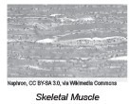
The Musculoskeletal, Integumentary, and Excretory Systems
The skeletal muscles are those that are attached to the bones.Together with the bones that they are attached to, they enable us to perform locomotion; thus, we can do activities such as walking, running, and any other related physical activities. Skeletal muscles are also described as striated and voluntary. As you may see in the figure above, the skeletal muscles are marked with striations that are long, thin parallel streaks as they are attached to the bones. They are voluntary muscles as well; hence, we can control them at will. This is evident when we walk, run, or use our hands to grab onto something.
WWW.REX.COM.PH

Slide 5
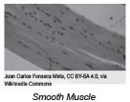
The Musculoskeletal, Integumentary, and Excretory Systems
Smooth muscle
This muscle is commonly present in the digestive tract that allows the passage of the chewed food from the mouth to the stomach through a wavelike contraction of the muscle called peristalsis.
In addition, the blood vessels that serve as the passageway of blood are also made up of smooth muscles. Unlike the skeletal muscles, smooth muscles are non-striated and involuntary. For this reason, they cannot be controlled at will.
WWW.REX.COM.PH

Slide 6
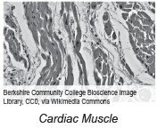
The Musculoskeletal, Integumentary, and Excretory Systems
Cardiac Muscle
This muscle can only be found in the heart. Cardiac muscles make up the walls of the heart and are striated, like the skeletal muscles, but involuntary, just like the smooth muscles.
WWW.REX.COM.PH

Slide 7
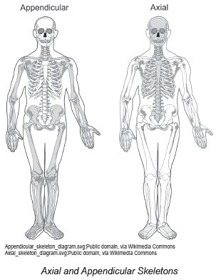
The Musculoskeletal, Integumentary, and Excretory Systems
The musculoskeletal system is also composed of two kinds of skeletons in the body: the
axial skeleton and the appendicular skeleton .
The axial skeleton is composed of the skull, spinal column, and rib cage.
The appendicular skeleton is composed of the bones of the appendages, arms, legs, and hips.
WWW.REX.COM.PH

Slide 8
The Musculoskeletal, Integumentary, and Excretory Systems
Some muscles are attached to the bone through a structure known as the tendon.
Tendons are structures that are made up of tough fibers of structural proteins called collagen. When we initiate movement to our muscles,the tendon pulls the bone, causing it to move.
Examples of these structures are located in areas including the ankles and the wrists.
Aside from being the framework of the body, bones also do other functions. Among these functions involve the process of making blood cells known as hematopoiesis. This process happens in the bone marrow, which is present in some bones, such as the hip bones and the thigh bones.
WWW.REX.COM.PH

Slide 9
The Musculoskeletal, Integumentary, and Excretory Systems
Integumentary System
It is composed primarily of the skin.
➢
The skin does not only protect the body from physical harm, but this organ also serves as one of the body’s first lines of defense against bacterial, fungal, and viral infections. Aside from this, the skin also prevents dehydration and abrupt temperature changes. It is called thermoregulation or the regulation of body temperature.
➢
Our body regulates heat through perspiration. When the temperature is high, we tend to produce sweat. As it evaporates, it absorbs body heat, thereby cooling the body. On the other hand, when the temperature is low, goose bumps may occur. Goose bumps result in the erection of epidermal hairs due to low temperature. The skin acts as a receptor for senses, such as touch, pressure, pain, and temperature changes. The nerve endings in the skin enable us to feel and detect stimuli.
WWW.REX.COM.PH

Slide 10

The Musculoskeletal, Integumentary, and Excretory Systems
Aside from the skin, the integumentary system is also composed of hair and nails.
Our nails protect the sensitive tips of our fingers and toes. They protect them from injury, and they help us pick small items.
The hair, on the other hand, functions for protection and helps in the evaporation of perspiration.
WWW.REX.COM.PH

Slide 11
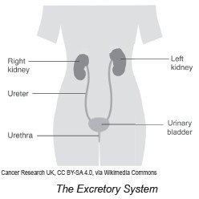
The Musculoskeletal, Integumentary, and Excretory Systems
Excretory System
It is responsible for the excretion of wastes and excess water from the body. Excretion is a way for the body to maintain homeostasis. Homeostasis is a mechanism by which the body maintains and regulates body processes to ensure that the body works properly.
Main organs of the excretory system
These organs involve the kidneys, the ureter, the urinary bladder, and the urethra.
Generally, the function of this organ system is to filter waste products and excess water from the blood and eventually excrete them from the body through the process of urination.
WWW.REX.COM.PH

Slide 12
The Musculoskeletal, Integumentary, and Excretory Systems
The kidneys are bean-shaped organs that are located slightly above the waist. The main function of the kidneys is to filter waste products from the blood and to produce urine, which is the liquid waste product of the body. Inside the kidneys are the nephrons that are known as the structural and functional units of the kidney.
As the blood enters the kidney through an artery and into the capillaries, the blood pressure forces some water and dissolved substances in the blood to cross the capillary walls into the structures known as the Bowman’s capsule. The filtered substances then pass through the tubes of the nephron in which some of the filtered substances are reabsorbed to the bloodstream. Other substances are then secreted into a fluid that passes through a duct. This duct reabsorbs some of the water and returns it to the bloodstream. The fluid that remains in the collecting duct then becomes the urine. The urine is considered a waste product; hence, it needs to leave the body.From the collecting ducts of the kidney, the urine will enter the ureters, which are muscular tubes that are connected to the urinary bladder. The urinary bladder serves as temporary storage of urine. When the bladder is about half full, nerve impulses are sent to a sphincter, which relaxes it to allow the passage of the urine to the urethra, which is a tube that carries the urine out of the body. This completes the process of urination.
WWW.REX.COM.PH

Slide 13
The Musculoskeletal, Integumentary, and Excretory Systems
Direction. Answer the following questions.
1. What are the main functions of the musculoskeletal system?
2. How does the skin help the body regulate the temperature during hot weather?
3. What are the main functions of the excretory system?
WWW.REX.COM.PH

Slide 14
The Musculoskeletal, Integumentary, and Excretory Systems
Answer Key:
The musculoskeletal system provides the framework and support for the body.
The body regulates heat through perspiration. When the temperature is high, we tend to produce sweat. As it evaporates, it absorbs body heat, thereby cooling the body.
The excretory system is responsible for the excretion of wastes and excess water from the body.
WWW.REX.COM.PH

Slide 15


