Slide 1
The Digestive, Circulatory, Respiratory and Nervous Systems

Slide 2
The Digestive, Circulatory, Respiratory and Nervous Systems
The Digestive System
The digestive system performs three primary functions: digestion, absorption, and elimination.
Digestion is the process by which the food is broken down into simpler forms.
Absorption is the process by which the nutrients are absorbed by the body through the digestive system.
Elimination is referred to as the removal of fecal material or solid waste.
WWW.REX.COM.PH

Slide 3
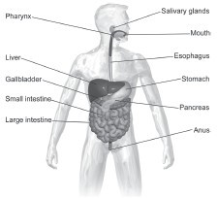
The Digestive, Circulatory, Respiratory and Nervous Systems
The digestive system is composed of :
mouth esophagus stomach
small intestine, large intestine, rectum,
and anus.
➢
➢
➢
➢
➢
➢
Accessory organs of digestive system
Pancreas Liver Spleen gallbladder
➢
➢
➢
WWW.REX.COM.PH

Slide 4
The Digestive, Circulatory, Respiratory and Nervous Systems
The process of digestion involves two phases: Mechanical phase and the chemical phase.
In the mechanical phase, the food is reduced in size through the process of chewing or mastication. In the mouth, the saliva moistens the food, and the teeth reduce it into small pieces. The tongue then moves to put the food between the teeth and mixes it thoroughly with the saliva.
When enzymes act on the food, the chemical phase of digestion begins.
Example:
When enzymes act on the sugar molecules that are present in rice, the larger sugar molecules are broken down into simpler ones.
With this, there is now a change in the chemical composition of the food. Through the action of enzymes, the digestive system can chemically digest the food that we eat.
WWW.REX.COM.PH

Slide 5
The Digestive, Circulatory, Respiratory and Nervous Systems
Parts of the Digestive System
Mouth
The mouth is composed of the teeth, tongue, and palates. The initial digestion happens in the mouth, where food is broken down into smaller pieces through the process of chewing. The enzymes present in the saliva also break down sugars.
Esophagus
As food is swallowed, the chewed food or the bolus will travel to the esophagus. The esophagus is a muscular tube that brings the bolus to the stomach through the process of muscular wavelike contraction known as peristalsis.
WWW.REX.COM.PH

Slide 6
The Digestive, Circulatory, Respiratory and Nervous Systems
Stomach
The stomach secretes acids and enzymes that further digest the food. Upon being in the stomach, the bolus will now be turned into chyme, which is composed of gastric juices and partly digested food. Periodically, the stomach muscles contract to churn the chyme and further enhance the process of digestion.
Small Intestine
The small intestine is also known as the small bowel. Most of the absorption of nutrients happens in the small intestine through its lining that contains finger-like projections known as the villi.
WWW.REX.COM.PH

Slide 7
The Digestive, Circulatory, Respiratory and Nervous Systems
Large Intestine
As the nutrients are absorbed in the small intestine, what is left unabsorbed will then be transported to the large intestine or the colon. Water is reabsorbed in the large intestine. The waste material or the feces also passes through this area as the wastes are being prepared for elimination through defecation.
Rectum
The rectum is found at the lower end of the large intestine and serves as temporary storage for the fecal material.
Anus
This is the last part of the digestive system where the fecal material passes through to leave the body.
WWW.REX.COM.PH

Slide 8
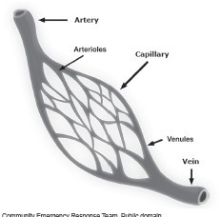
The Digestive, Circulatory, Respiratory and Nervous Systems
Circulatory System
It is composed of the heart, blood, and blood vessels. The blood vessels are then classified into the arteries, veins, and capillaries.
Arteries
are the blood vessels that carry blood away from the heart. The blood will then return to the heart through the veins.
Capillaries
➢
are the smallest blood vessels that surround different tissues
and organs of the body. The walls of the capillaries are one thick cell that allows the exchange of materials such as nutrients, oxygen, carbon dioxide, and wastes. At the end of capillary beds are the small arteries known as arterioles and small veins known as the venules.
WWW.REX.COM.PH

Slide 9
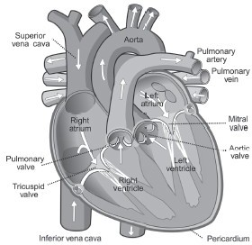
The Digestive, Circulatory, Respiratory and Nervous Systems
Heart
is a muscular organ composed of cardiac muscles that function as the pump of the circulatory system. It is roughly the size of a clenched fist located at the middle part of the chest with its tip tilted toward the left side of the chest. The heart is covered with a membrane known as the pericardium.
WWW.REX.COM.PH

Slide 10
The Digestive, Circulatory, Respiratory and Nervous Systems
The human circulatory system performs two types of circulation:
pulmonary circulation systemic circulation
●
Pulmonary circulation
transports the blood between the heart and lungs. It transports deoxygenated or oxygen-poor blood to the lungs to absorb oxygen and release carbon dioxide.
The alveoli in the lungs are tiny sacs that are composed of capillaries where gas exchange occurs. The oxygenated or oxygen-rich blood then flows back to the heart.
Systemic circulation then moves blood between the heart and the rest of the body.
WWW.REX.COM.PH

Slide 11
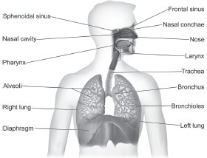
The Digestive, Circulatory, Respiratory and Nervous Systems
The Respiratory System
➢
is composed of the following parts: sinuses, nasal conchae, nasal cavity, nose, pharynx, larynx, trachea, bronchi, bronchioles, alveoli, lungs, and diaphragm.
WWW.REX.COM.PH

Slide 12
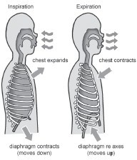
The Digestive, Circulatory, Respiratory and Nervous Systems
Breathing is the process of drawing air in and out of the lungs. In the breathing process, the diaphragm constantly contracts and relaxes, causing the chest cavity to expand and relax.
During inhalation or inspiration, the diaphragm contracts, which then enlarges the chest cavity and the chest volume. The expansion of the chest cavity reduces air pressure, causing air outside that has high pressure to enter the lungs and inflate the lungs. On the other hand, during the exhalation or expiration phase, the diaphragm relaxes, thus
returning to its original dome-shaped position.
WWW.REX.COM.PH

Slide 13
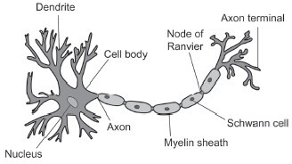
The Digestive, Circulatory, Respiratory and Nervous Systems
The Nervous System
The basic structural unit of the nervous system is known as the neuron or the nerve cell.
Neurons are responsible for transmitting information to and from the different parts of the body.
WWW.REX.COM.PH

Slide 14
The Digestive, Circulatory, Respiratory and Nervous Systems
A stimulus is anything that can trigger a reaction. When you react to something, impulses are sent from the sense organs to the brain. The brain will then send signals for you to have the appropriate response to the stimulus. The transmission of these impulses is made possible by the neurons.
The nervous system is classified into two major parts known as the
Central nervous system (CNS) and the Peripheral nervous system (PNS).
WWW.REX.COM.PH

Slide 15
The Digestive, Circulatory, Respiratory and Nervous Systems
The CNS is composed of the brain and the spinal cord.
➢
the brain performs different functions. These involve cognition and learning, speech generation, emotions, memory, reasoning, and logic.
the brain is also responsible for body coordination and balance through the cerebellum.
spinal cord serves as a pathway of information from the brain to the body and from the body to the brain. It is also responsible for the reflexes in our body.
➢
➢
The brain performs diff erent functions. These involve cognition and learning, speech generation, emotions, memory, reasoning, and logic.
The brain is also responsible for body coordination and balance through the cerebellum.
WWW.REX.COM.PH

Slide 16
The Digestive, Circulatory, Respiratory and Nervous Systems
The other component of the CNS is the spinal cord. The spinal cord serves as a pathway of information from the brain to the body and from the body to the brain. It is also responsible for the reflexes in our body.
A reflex is an involuntary and nearly instantaneous movement in response to a stimulus.
The PNS includes the autonomic nervous system that is concerned with maintaining homeostasis by controlling involuntary body functions, such as digestion, respiration, circulation, and other related functions, so that they respond automatically in unison with each other.
WWW.REX.COM.PH

Slide 17
The Digestive, Circulatory, Respiratory and Nervous Systems
The autonomic nervous system is further divided into the sympathetic division and the
parasympathetic division.
The sympathetic division performs a fight or flight response in stressful situations.
The parasympathetic division activates in a rest and digest phase. During the parasympathetic phase, energy is usually conserved, whereas the sympathetic phase usually consumes energy in response to stressful situations.
WWW.REX.COM.PH

Slide 18
The Digestive, Circulatory, Respiratory and Nervous Systems
Directions. Match column A with column B to link the parts to the respective functions. Write the letter on the blank.
Column A
Column B
A. is a muscular organ composed of cardiac muscles that function as the pump of the circulatory system.
1. Neurons
2. Arteries
B. is the process by which the food is broken down into simpler forms.
C. are the blood vessels that carry blood away from the heart
3. heart
4. breathing
D. It is the process of drawing air in and out of the lungs.
5. digestion
E. are responsible for transmitting information to and from the different parts of the body.
WWW.REX.COM.PH

Slide 19
The Digestive, Circulatory, Respiratory and Nervous Systems
Answer Key:
1. E
2. C
3. A
4. D
5. B
WWW.REX.COM.PH

Slide 20


