Slide 1
Basic Principles of Mendelian Genetics

Slide 2
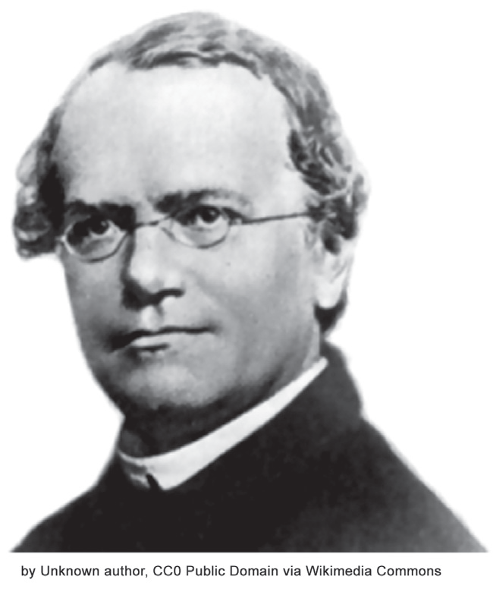
Basic Principles of Mendelian Genetics
The Father of Genetics and the Pea Plants
Gregor Johann Mendel
- He was born in the Silesian town of Hynčice in the Czech Republic.
An excellent student in high school, Mendel studied philosophy, and was admitted to the Augustinian Monastery of St. Thomas where he had the opportunity to conduct a series of breeding experiments on Pisum sativum, the garden pea. Mendel spent eight years conducting genetic research on pea plants.
- In 1866, he published the results of his experiments that laid the foundation of the discipline of genetics. He put forward the major postulates that explain inheritance. This gained him the title of “Father of Genetics.”

Slide 3
Basic Principles of Mendelian Genetics
He chose the pea plants in his experiment because of the following reasons:
1. The pea plant has a number of visible traits that can vary, so results are easy to observe.
Examples: traits are flower color, seed color and shape, pod color and shape, flower positions, and stem length.
2. The generation of the pea plant is short, and the offspring are many; so, data are easy to gather.
3. It is easy to control the pollination of pea plants, which can be done by removing the stamens so he could cross-pollinate one plant to any other plants. Cross-pollination is a type of pollination wherein pollen from the anther of one flower is transferred to another flower on a different individual but same species.

Slide 4
Basic Principles of Mendelian Genetics
There were total of seven traits of pea plants that Mendel observed during the entire research and experimentations. These were stem height (traits: tall or short), flower location (traits: the tip of the stem or along the stem), pod shape (traits: inflated or constricted), pod color (traits: green or yellow), seed shape (traits: round or wrinkled), seed color (traits: green or yellow), and seed coat color (traits: gray or white).
Mendel’s Experiment
Mendel began his work by allowing the population of the garden pea plants to self pollinate and produce pure-breeding strains. Self-pollination is a pollination wherein pollen from the anther of a flower is transferred to the stigma of the same flower. By this, he was able to collect seeds with only one particular trait.
In one of his experiments, Mendel crossed a pure breeding variety of garden pea with purple flower and another pure-breeding garden pea with white flower. He called each pure breeding variety of garden pea as the parental generation or P generation.
When the garden peas produced seeds, he gathered and planted them separately. Mendel found out that the garden peas all produced purple-colored flowers. He labeled this first set off offspring as F1 or the first filial generation.

Slide 5
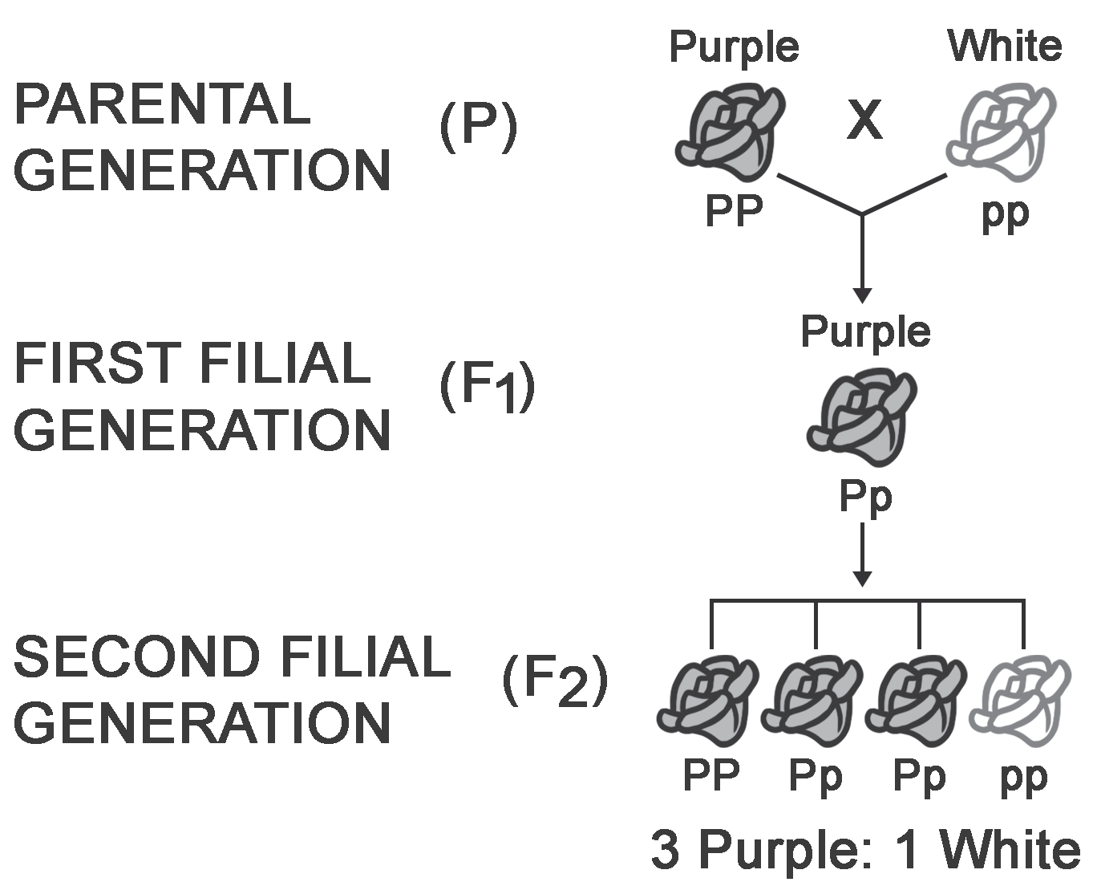
Basic Principles of Mendelian Genetics
Mendel pollinated the F1 generation and now called this as P2 or second parental generation. Just like in the previous procedure, he collected and planted the seeds. When the seeds germinated and produced flowers, he noticed that 75% of the garden peas had purple colored flowers and the 25% had white-colored flowers. He labeled the second offspring as the F2 or second filial generation. The white-colored flowers that did not appear in the F1 generation appeared in a ratio of 3:1.
Traits are inherited characteristics that vary from individual to individual. Each trait had two different forms known as alleles.
For example, the height of the pea plant can be tall (T) or short (t). If there are two identical alleles for a trait, it is said to be, homozygous, as in the case of TT or tt, which represents a true-breeding pea plant. On the other hand, if there are two different alleles for a particular trait like Tt, this condition is described as heterozygous, and the organism is called a hybrid.

Slide 6
Basic Principles of Mendelian Genetics
Using the consistent pattern of results in his experiments, Mendel proposed/formulated the following postulates or principles of inheritance, which are referred to as the Mendelian laws of heredity or simply Mendelian Laws.
Mendelian Laws of Heredity
Principle of Unit Factors in Pairs
According to this principle, the genetic characteristics carried by any organism are controlled by unit factors that exist in pairs. These factors being referred to are actually the “genes.” Mendel claimed that the characteristics of an organism are determined by certain factors, which he described as elemente, as he did not know, that time, what a gene is. These factors are in pairs which we now call as alleles.
The Law of Dominance
This law states that the dominant allele will always conceal or mask the recessive allele. Dominant traits are the traits that are phenotypically or physically expressed in an organism, while recessive traits are those that are only expressed if the offspring has two copies of the recessive allele that code for the trait.

Slide 7
Basic Principles of Mendelian Genetics
The Law of Segregation
During gamete formation (gametogenesis), the pair of genes randomly segregates. Under normal conditions, one and only member of a pair of genes goes to a gamete. It is only during the process of fertilization that genes/alleles recombine. As a result, new gene combinations are produced. Segregation and recombination of genes happen when two individuals that are heterozygous for a trait are crossed as shown in the crossing of the F1 offspring in Mendel’s experiment.
Law of Independent Assortment
This law states that segregating pairs of genes assort independently of each other during gamete formation. This means that if there is more than one character that needs to be separated, the genes or alleles of each character separate and segregate independently of each other, similar to how gametes are produced.

Slide 8
Basic Principles of Mendelian Genetics
Monohybrid Inheritance
Monohybrid inheritance pertains to inheritance involving one pair of contrasting characters. When Mendel crossed the true-breeding tall (TT) and true-breeding short plants (tt) in the P generation, he expected medium-sized plants in F1 generation. But, to his surprise, the resulting offspring are all tall plants. The results of his monohybrid crosses were extremely consistent. This means that the pure tall pea plant crossed with the short pea plant always produced tall offspring plants.
The experiment can be explained by the use of a Punnett square. This diagram, which was first devised by Reginald Punnett, can be used to predict the expected results of a certain genetic cross, such as the ratio of phenotypes in the offspring of a cross from known genotypes. A genotype refers to the genetic makeup of an organism, while the phenotype is the sum of all observable characteristics of an organism, which can be influenced by the genotype and the environment.
For example, “TT” denotes the genotype of a pea plant that has a tall phenotype.

Slide 9
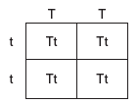
Basic Principles of Mendelian Genetics
Study the sample Punnett square in Figure 3 to further understand how to use it to produce the possible genotypes of offspring which in turn can be used to interpret or predict the phenotypes of offspring.
(Genetic makeup) Genotypic ratio: 4 Tt: 0 tt
Interpretation: 100% Heterozygous plants
(Physical appearance) Phenotypic ratio: 4 tall: 0 short
Interpretation: 100% tall plants

Slide 10
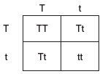
Basic Principles of Mendelian Genetics
The Punnett square above shows the results of the cross between a tall (TT) pea plant and a short (tt) plant which can be interpreted by using ratio and percentage. It shows that an F1 generation of 100% tall plants was produced from the cross. The question, “Have the recessive alleles disappeared?” was answered when Mendel got the results of F2 Generation from the self-pollination of F 1 plants.
Based on the results, it can be said that recessive traits will appear only in homozygous condition, that is when the dominant allele is not present.
(Genetic makeup) Genotypic ratio: 1 TT: 2 Tt: 1 tt
(Physical appearance) Phenotypic ratio: 3 tall: 1 short
Interpretation: 75% tall and 25% short plants

Slide 11
Basic Principles of Mendelian Genetics
Dihybrid Inheritance
In real life, more than one trait gets passed on from parents to offspring. You may also study the inheritance of two traits simultaneously by the use of dihybrid crossing. Dihybrid cross is the cross involving two characters.
Character | Trait | Allele
Seed Shape | Round | R
 | Wrinkled | r
Color of the Cotyledon | Yellow | Y
 | Green | y

Slide 12
Basic Principles of Mendelian Genetics
Using the data in the table below about the traits of seed shape and color of the cotyledon, we can get the possible combinations as shown in the table.
Genotypes | Phenotypes
RRYY | Round Yellow
RRYy | Round Yellow
RrYY | Round Yellow
RrYy | Round Yellow
RRyy | Round Green
Rryy | Round Green
rrYY | Wrinkled Yellow
rrYy | Wrinkled Yellow
rryy | Wrinkled Green

Slide 13
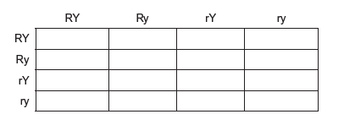
Basic Principles of Mendelian Genetics
Sample Problem:
Pea plants with round (R) seeds and yellow (Y) cotyledons undergo self-pollination. If they are heterozygous for the trait, find the possible phenotypes of their offspring.
Given: Genotypes of the P generation: RrYy Å x RrYy
Step 1: Use the FOIL (First, Outer, Inner, and Last) method to create the combinations of
alleles out of RrYy.
Alleles of one parent: RY, Ry, rY, ry
Since both parents have the same genotype, the other parent also has the same set of alleles.
Step 2: After determining the alleles, construct the Punnett square (a 4 Å~ 4 table) and write the alleles of one parent on one side (vertically) and the alleles of the other parent on another side (horizontally).

Slide 14
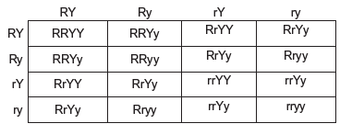
Basic Principles of Mendelian Genetics
Step 3: Cross the alleles.
Step 4: Interpret the Punnett square. Count the number of different combinations of alleles(represented by letters) formed in each box. Use ratio, fraction, or percentage to interpret the resulting genotypes and phenotypes of the cross.
Tally of Possible Genotypes: 1 RRYY, 2 RRYy, 1 RRyy, 2 RrYY, 4 RrYy, 2 Rryy, 1 rrYY, 2 rrYy, 1 rryy
Genotypic Ratio = 1:2:1:2:4:2:1:2:1
Tally of Possible Phenotypes: 9 round and yellow, 3 round and green, 3 wrinkled and yellow, and 1 wrinkled and green
Phenotypic Ratio = 9:3:3:1

Slide 15
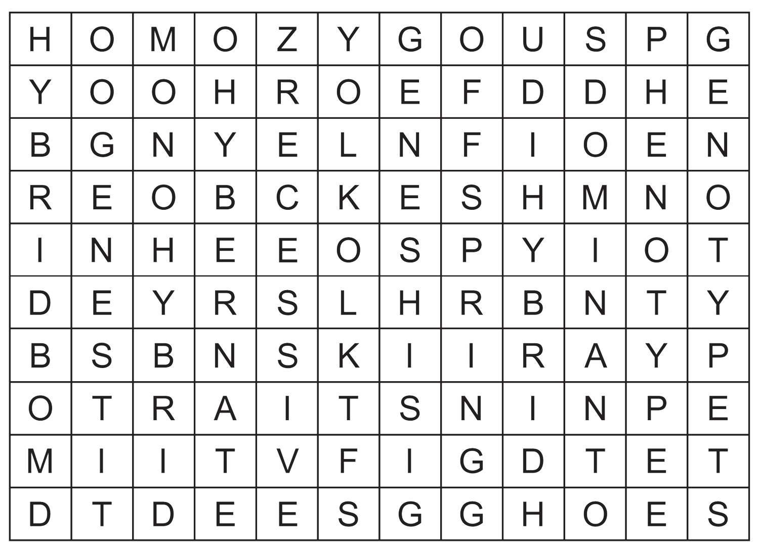
Basic Principles of Mendelian Genetics
Activity
Directions: Write the words related to Mendelian genetics in the word grid. Then, using
these words, identify the term/s described or defined in each test item in Part II.
1. ______________________________
2. ______________________________
3. ______________________________
4. ______________________________
5. ______________________________
6. ______________________________
7. ______________________________
8. ______________________________
9. ______________________________
10. _____________________________

Slide 16
Basic Principles of Mendelian Genetics
Part II. Identify the term/s described or defined in each test item using the words you crossed out in the word grid. Write your answer in the space before each number.
_________________ 1. the physical or observable trait of an individual
_________________ 2. the trait that can mask the other trait
_________________ 3. having identical alleles of a particular gene
_________________ 4. the genetic makeup of an organism
_________________ 5. having different alleles for a particular gene
_________________ 6. a cross involving one character
_________________ 7. a cross for alleles of two different genes
_________________ 8. the basic and physical function of heredity
_________________ 9. a distinguishing quality or characteristic of an organism
_________________10. the offspring of two plants or animals of different varieties

Slide 17
Basic Principles of Mendelian Genetics
Answer Key
1. Phenotype
2. Dominant
3. Homozygous
4. Genotype
5. Heterozygous
6. Monohybrid
7. Dihybrid
8. Gene
9. Trait
10. Hybrid

