Slide 1
Classification of Organisms

Slide 2
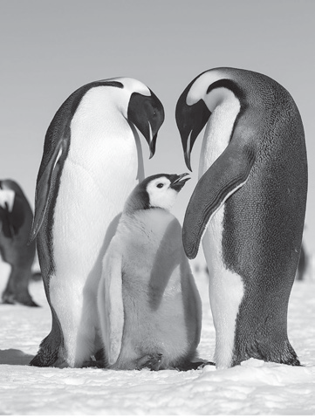
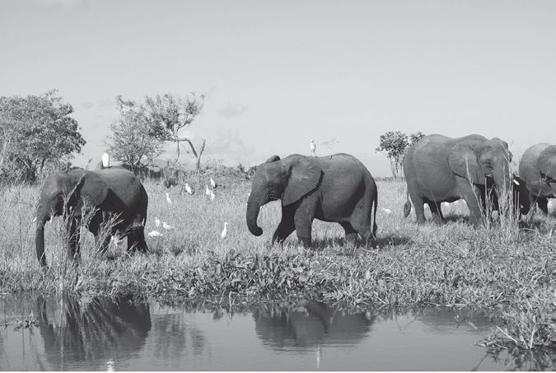
Classification of Organisms
Biological Species Concept
Species are groups of interbreeding natural populations of organisms that are reproductively isolated from other organisms.
1. Reproductive Community:
For reproduction, the individuals of a species recognize one another as potential mates
2. Ecological Unit:
The species’ members differ in many attributes, but all the members cooperatively form a unit. They interact with other species as a unit in any environment. Figure shows a herd of elephants interacting with a flock of birds.

Slide 3
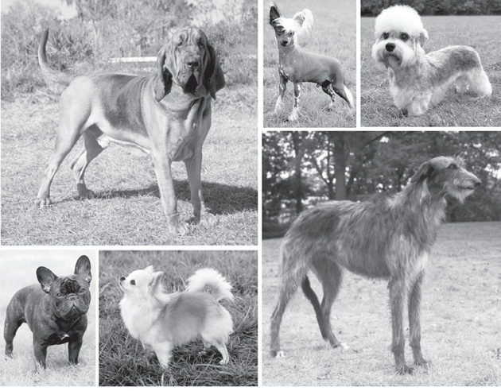
Classification of Organisms
3. Genetic Unit:
Members of a species vary due to the genetic information within and among individuals in a population. This is exemplified by the variation within members of dog species.

Slide 4
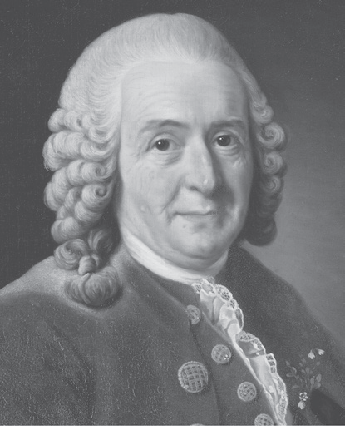
Classification of Organisms
Taxonomists have been trying their best to organize and classify the estimated 10–14 million species of living organisms. One method that taxonomists use to classify organisms is called the Linnaean system of classification.
Carolus von Linnaeus designed a classification system of living things using structural similarity as a basis. There are two key features in the Linnaean system of classification—the classification of living things and the binomial nomenclature. In his classification scheme, organisms are grouped according to ranks. Each rank is called a taxon (taxa, plural form). A domain is the highest rank in the biological classification system. There are three domains of life: Archaea, Bacteria, and Eukarya. Plants, fungi, protists, and animals belong to Eukarya. To see how a taxonomic hierarchy looks like, look at how human beings.
Carolus von Linnaeus

Slide 5
Classification of Organisms
Table 1: Classification of Human Beings Using the Taxonomic Hierarchy
Levels | Description | Classification | Composition
Domain | the highest taxon that classifies living things in the most general way | Eukarya | have membrane-bound organelles including the nucleus
Kingdom | a group of related phyla | Animalia | actively mobile, heterotrophic, multicellular, and eukaryotic
Phylum | a group of related classes | Chordata | with pairs of appendages and dorsal nerve cord that extends the entire length of the body

Slide 6
Classification of Organisms
Class | a group of related orders | Mammalia | with vertebral column (backbone) that supports and houses the spinal cord
Order | a group of related families | Mammalia | have body covered with hair, mammary glands
Family | a group of related genera | Primates | erect; uses two legs for walking
Genus | a group of related species | Homo | has human-like features; uses tools
Species | a group of similar organisms capable of interbreeding and producing fertile offsprings | Sapiens | modern human; has the ability to reason

Slide 7
Classification of Organisms
Binomial nomenclature is the system of giving living things a Latinized two-part name (scientific name). The Latin language is used since it is descriptive. It is also a dead language that does not change with time. The scientific name is the combined names of the genus and species of an organism. An example of this is the Homo sapiens, the scientific name of humans. Scientific names are always italicized. In handwritten text, they are underlined instead.
The use of scientific names addresses the confusion brought about by using common names. Let us take, for example, Chanos chanos. In the Philippines, this is commonly known as bangus. In Qatar, it is called Aifa, Salmani in Saudi Arabia, Maitokala in Finland, Yawa in Fiji, and milkfish in the US.
What could have happened if there was no scientific name to identify this fish species? Different species may be identified and clearly distinguished around the world using the scientific names.

Slide 8
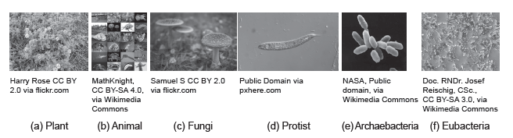
Classification of Organisms
The Six-Kingdom Scheme of Classification
In the former five-kingdom scheme of classification, Archaebacteria and Eubacteria are listed under one kingdom called Monera. The other four kingdoms are kingdoms Protista, Fungi, Plantae, and Animalia. However, taxonomists proved that Archaebacteria and Eubacteria should not belong under the same kingdom. They vary in nucleotide and amino acid sequence in their genes and the composition of their cell wall. Thus, the six-kingdom scheme of classification emerged
The six kingdoms of life

Slide 9
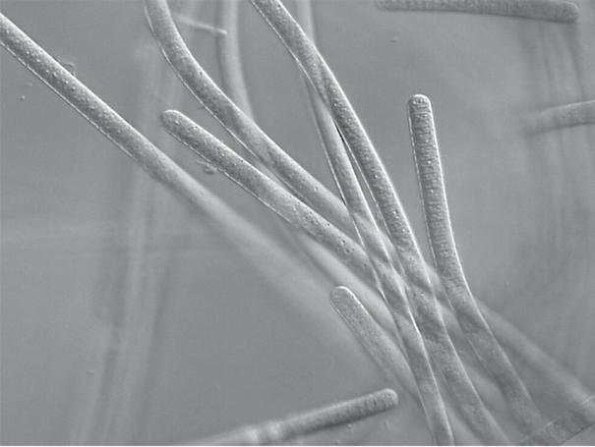
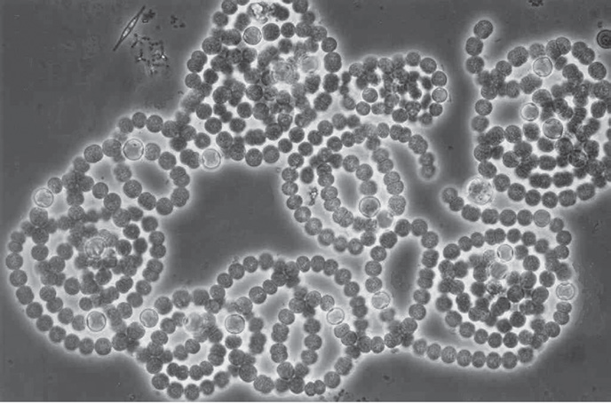
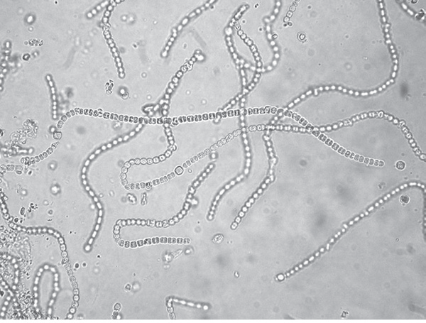
Classification of Organisms
Kingdom Archaebacteria
Distinguishing characteristics:
Prokaryotes. They lack distinct nuclei.
Autotrophic. They are capable of making their own food. Some are photosynthetic—those that manufacture food using the energy from the Sun. Others are chemosynthetic that use chemicals to make their own food and live in extreme environments. These include halophiles (extremely salty), acidophiles (extremely acidic), and thermophiles (extremely hot).
Examples of archaebacteria
(a) Methanobacter
(b) Halococcus
(c) Haloferax sp.

Slide 10
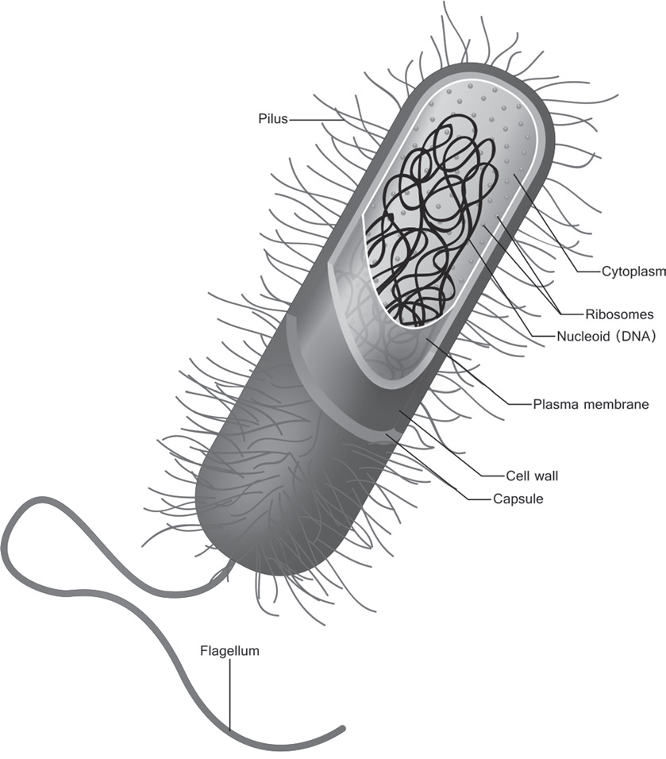
Classification of Organisms
Kingdom Eubacteria
Distinguishing characteristics:
Prokaryotes. They lack distinct nuclei.
Autotrophic and Heterotrophic. Some are autotrophic and can undergo photosynthesis. Others cannot make their own food. Some are saprophytic which obtain nutrients from decaying organic matter (e.g., Escherichia coli, and Spirochaeta). Others are parasitic which obtain nutrients from a living host and cause diseases.
Some examples of Eubacteria are Bacillus cereus, which causes food poisoning; Streptococcus pneumoniae, which causes pneumonia; and Clostridium tetani, which causes tetanus.
The structure of a bacterium

Slide 11
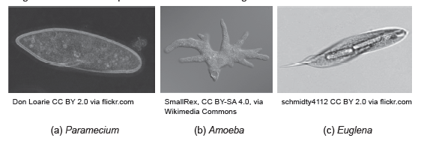
Classification of Organisms
Kingdom Protista
Distinguishing characteristics:
Eukaryotes. They are organisms with a defined nucleus.
Some are single-celled and microscopic, with species capable of forming colonies. Others are multicellular but lack the definite complex tissue organization of plants, animals, and fungi.
Classifications of Protists:
1. Animal-like Protists (Protozoans) – They have structures for locomotion and are heterotrophic. These include representative organisms, such as Paramecium, which uses cilia to move and Amoeba, which uses pseudopodia to move. Euglena uses the whip-like structure called flagellum to move.

Slide 12
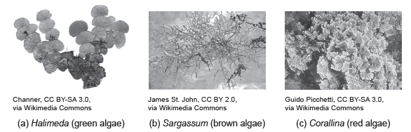
Classification of Organisms
2. Plant-like Protists (Algae) – They have chlorophyll that enables them to make their own food. In addition to chlorophyll pigment, they have other pigments that give them their characteristic colors. Plant-like protists include Chlorophyta or green algae, Baccilariophyta or diatoms with golden color, Chrysophyta or golden algae, Dinoflagellates or golden-brown algae, Phaeophyta or greenish-brown algae, Rhodophyta or the red-brown algae, and Euglenophyta the euglenoid green algae.
Examples of marine algae:

Slide 13
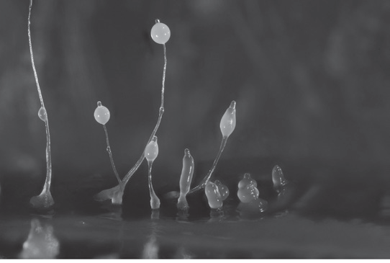
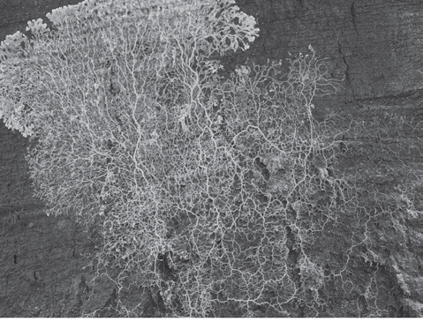
Classification of Organisms
3. Fungus-like Protists – They exhibit a life cycle of an alternate protozoan-like in one stage of development and fungus-like in another stage. They are saprophytic heterotrophs. Some examples are cellular slime molds and plasmodial slime molds. Examples of fungus like protists
(a) Dictyostelium sp.
(b) Physarum sp.

Slide 14
Classification of Organisms
Kingdom Plantae
Distinguishing Characteristics:
• multicellular eukaryotes
• photosynthetic autotrophs
• have cell walls composed of cellulose
Classifications of Plants:
1. Nonvascular plants or the bryophytes – They lack vascular tissues that transport materials, such as food (phloem) and water (xylem) throughout the plant body. The body of a nonvascular plant is called a thallus. Such plants reproduce through the alternation of sporophyte and gametophyte generations.

Slide 15
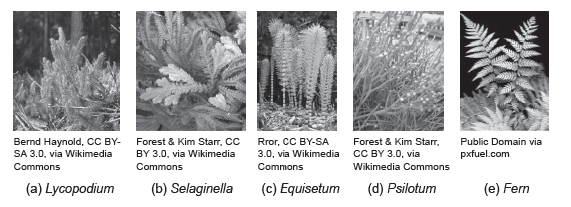
Classification of Organisms
2. Vascular plants – They have a complex body structure consisting of a network of vascular tissues that run through the entire plant body. Vascular plants are divided into spore-bearing and seed-bearing. The image below shows some spore-bearing vascular plants, which include Lycophyta (Lycopodium and Selaginella), Sphenophyta (Equisetum or horsetail), Psilophyta (Psilotum or the whisk ferns), and Pteridophyta (ferns).

Slide 16
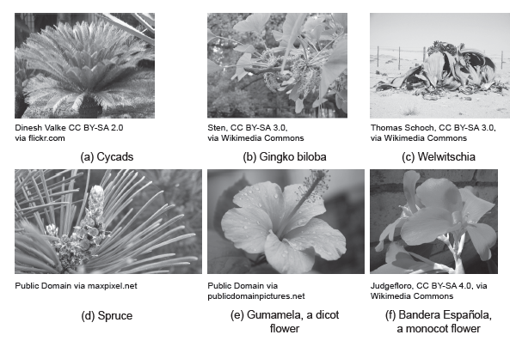
Classification of Organisms
The seed-bearing vascular plants, include gymnosperms and angiosperms. Gymnosperms have seeds produced on the surface of reproductive structures called cones, while angiosperms are those whose seeds are enclosed in an ovary that develops into a fruit. Angiosperm is divided into Monocotyledoneae/Liliopsida that contain one-seed leaf in their seeds and Dicotyledoneae/Magnoliopsida that contain two-seed leaves.

Slide 17
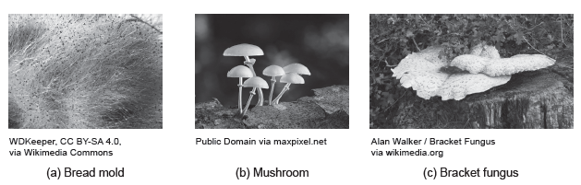
Classification of Organisms
Kingdom Fungi
Distinguishing Characteristics:
• eukaryotic, nonvascular, heterotrophic, and nonmotile
• the life cycle exhibits alternation of generation (sexual and asexual)
• dikaryotic or an organism having two nuclei in a cell and cell walls are made of chitin

Slide 18
Classification of Organisms
Kingdom Animalia
Distinguishing Characteristics:
Being multicellular is a characteristic that makes animals similar to plants, fungi, and some plant-like protists.
They have eukaryotic cells, a characteristic they share with plants, fungi, and protists, making them different from archaea and bacteria.
They are heterotrophic, just like fungi, bacteria, and protozoans. This characteristic makes animals different from plants, algae, and archaea, which are autotrophic.
Animal cells lack cell walls, a characteristic that distinguishes animals from plants, fungi, and algae.
They are capable of locomotion in some stage of their lives; they can respond quickly to external stimuli.

Slide 19
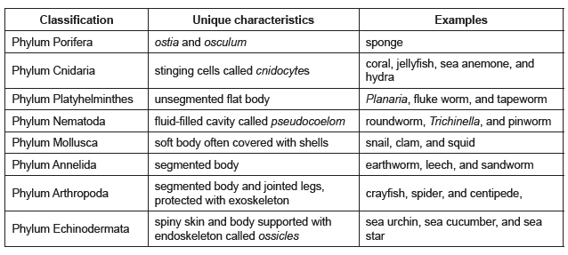
Classification of Organisms
Classifications of Animals:
Animals are classified into two distinct groups: Invertebrates and vertebrates.
Invertebrates are animals without backbones such as sponges, jellyfish, and tapeworm.
Vertebrates or chordates are animals with backbones such as frogs, eagles, and fish.
Invertebrates range from microscopic to macroscopic. Their body forms, structures, and survival modes vary tremendously.

Slide 20
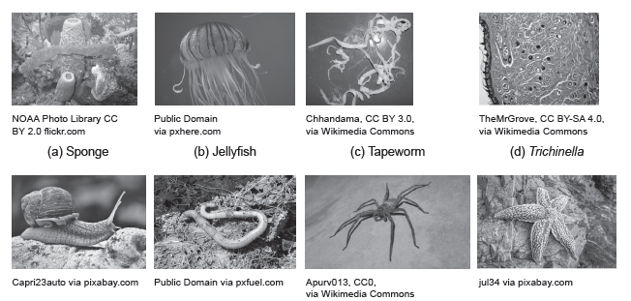
Classification of Organisms
The invertebrates

Slide 21
Classification of Organisms
Classification | Unique characteristics | Examples
Invertebrate Chordates | chordates without vertebrae or backbone | Urochordates (tunicates) and Cephalochordates (lancelets)
Vertebrate Chordates | chordates with vertebrae or backbone
Agnatha | jawless, finless fish-like marine animals | lampreys and hagfish
Chondrichthyes | cartilaginous fish; with jaws and fins | sharks, stingrays, and skates
Osteichthyes | bony fish | catfish, milkfish, and seahorse
Amphibia | have gills at a young stage and lungs in the adult stage | frogs, salamanders, and caecilians
Reptilia | bodies covered with dry skin; covered with a tough, hard, and heavily keratinized scales | snakes, crocodiles, turtles, and lizards
Aves | have feathers, wings, bones with air spaces, and horny and toothless beaks | sparrows, storks, ostrich, penguins, parrots, and eagles
Mammalia | with hair and mammary glands | Monotremes or egg laying (Platypus), Marsupials or with marsupium (kangaroo), and the Placentals or viviparous (young undergoes development inside the uterus)

Slide 22

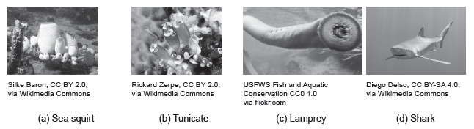
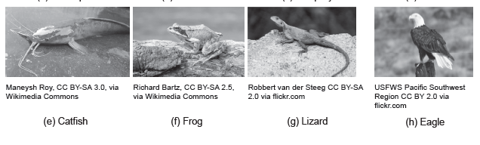
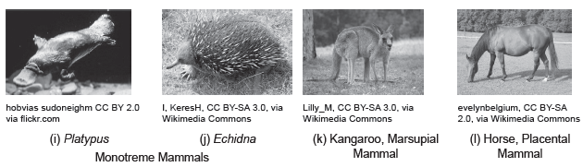
Classification of Organisms
The vertebrate animals

Slide 23
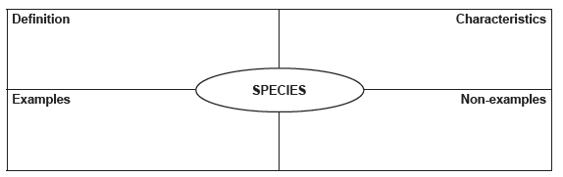
Classification of Organisms
Activity
Directions: Applying your understanding of the concept of species, give the required information in each corner of the graphic organizer below.

Slide 24
Classification of Organisms
Answer Key
Definition: Species are groups of interbreeding natural populations of organisms that are reproductively
isolated from other organisms.
Characteristics: They can reproduce, they interact with other species, and their members vary due to
the difference in genetic information within and among individuals in the population.
Examples: humans, birds, fish, plants
Non-examples: rocks, paper, cell phone, etc.

