Slide 1
Photosynthesis

Slide 2
Photosynthesis
Plants are one of the most essential living organisms on Earth. They play an important role in the ecosystem. One of the wonderful characteristics of plants is that they can produce their own food through photosynthesis. These producers are important to many life forms on Earth by providing food. They feed the consumers that are not able to make their own food. Earlier, you recalled the things that are needed in photosynthesis and the products of this process.

Slide 3
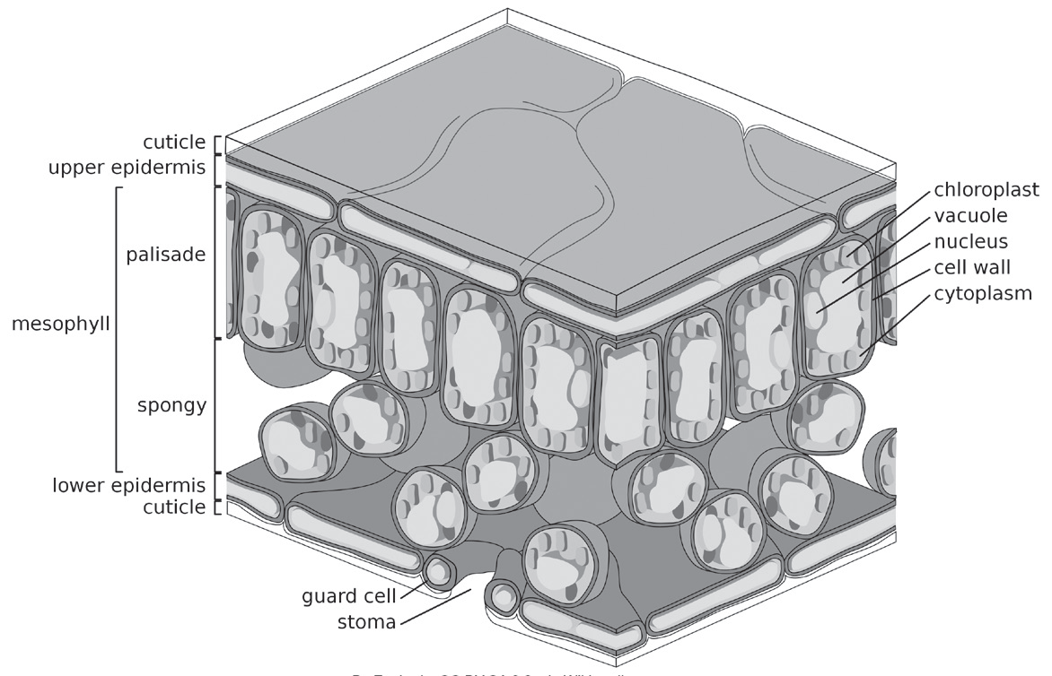
Photosynthesis
The leaves of plants consist of several layers of cells. Plants, being autotrophic eukaryotes (organisms in which cells have a nucleus), have an organelle called a chloroplast. Chloroplast-containing cells are found in mesophyll. The mesophyll is the internal leaf tissue or a layer of cells found between the upper and lower epidermis. It is the major site of photosynthesis because it holds a large amount of chloroplasts.
Zephyris, CC BY-SA 3.0, via Wikimedia commons

Slide 4
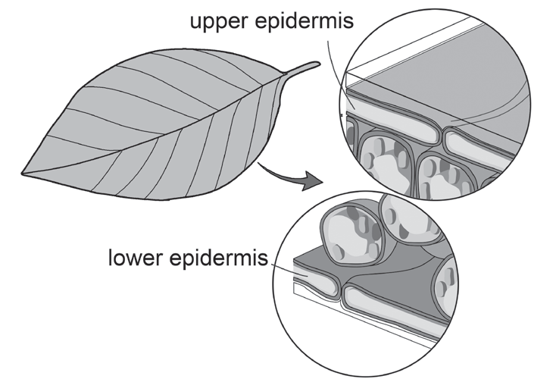
Photosynthesis
The most important internal parts of the leaf that are working during photosynthesis.
Epidermis – It protects the upper and lower surfaces of the leaf. It secretes a waxy cuticle, which prevents the evaporation of water from the leaf tissue. It can trap a layer of moisture that prevents water loss.

Slide 5
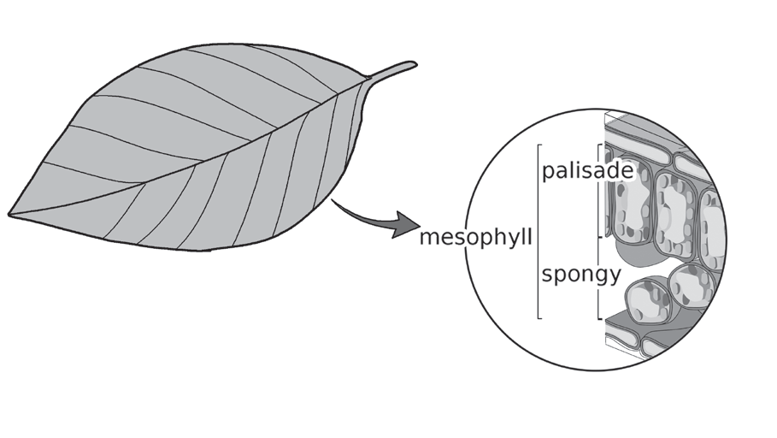
Photosynthesis
Mesophyll – It makes up most of the interior part of the leaves. The word mesophyll comes from two Greek words mesos, which means middle, and phyllo, which means leaf. It is one of the specialized tissues that allows photosynthetic activities in a leaf. It consists mainly of two types of cells: palisade cells and spongy parenchymal cells.

Slide 6
Photosynthesis
Palisade Cells – These are found on the top part of a leaf exposed to the light beneath the upper epidermis. They are packed full of chlorophyll and specialized cells for trapping light and hence, facilitate the penetration of the light. These cells are closely packed together and have elongated and cylindrical shapes that enable them to hold around 70% of chloroplasts, which plays a significant role in photosynthesis.
Spongy Cells – Unlike the palisade cells, these cells have an irregular shape and are packed loosely, giving them more space for gas exchange during photosynthesis. Fewer chloroplasts are found in these cells as compared to the palisade cells.

Slide 7
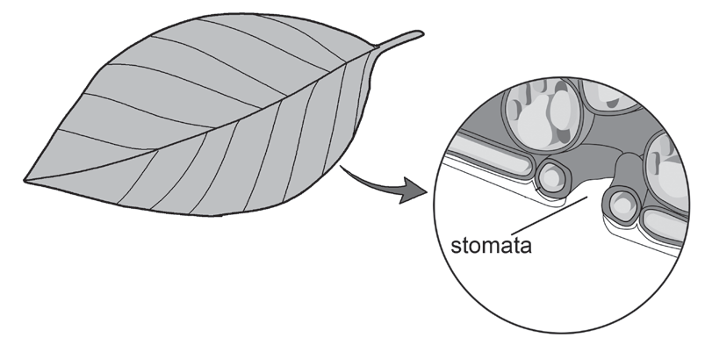
Photosynthesis
Stomata – This term came from the Greek word stoma, which means “mouth.” These are pores or openings found in the leaves and the stem epidermis. They serve as the doorway for the carbon dioxide (CO2) to diffuse into the leaves, making its way through the gaps in the airy-layer cells (spongy mesophyll) and then to the palisade layers for photosynthesis. The sausage-shaped guard cells control the opening and closing of these pores.

Slide 8
Photosynthesis
Vascular bundles – These contain xylem and phloem tubes that make up the vascular Tissue of the plants.
a. Xylem – It transports water and minerals from roots through the stem or trunks, branches, and leaves.
    b. Phloem – It moves important sugar or food substances that plants have produced into the branches, fruits, trunks, and roots.
Chlorophyll – It is a green pigment that can absorb light at different wavelengths. It can be found in the chloroplast. Primarily, chlorophyll gives plants a green color. It plays a vital role in photosynthesis by trapping light (sunlight). The absorbed radiant energy is used to produce glucose and oxygen from carbon dioxide and water during photosynthesis.

Slide 9
Photosynthesis
Chloroplast – It is an organelle that can be found in the cells of the mesophyll and contains the green pigment called chlorophyll. It is the main site for photosynthesis. It has the following parts:
Outer Membrane (Smooth Outer Membrane) – It is the “envelope” that encloses the chloroplast. It serves as the physical barrier between the organelle and the surrounding environment.
Inner Membrane – It regulates the passage of materials in and out of the chloroplast. It surrounds the stroma and grana.
Stroma – It is a colorless fluid within the inner membrane of the chloroplast that is rich in protein and contains enzymes that incorporate carbon dioxide into sugars. It surrounds the thylakoid membrane and grana.

Slide 10
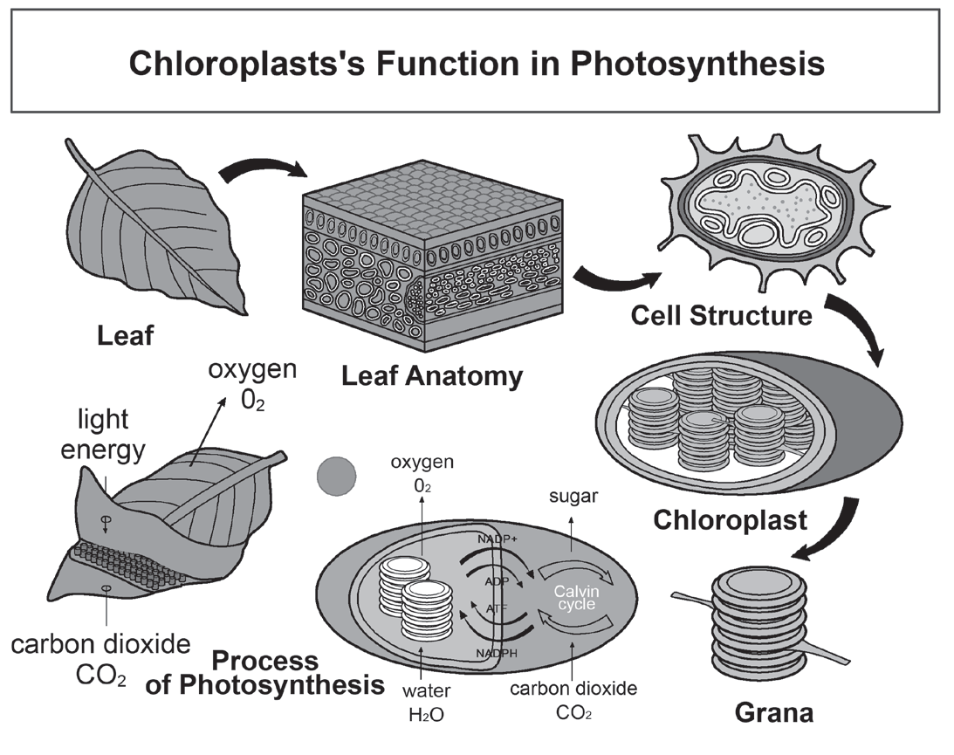
Photosynthesis
d). Grana – These are groups of granum known as stacks of thylakoid structures (coin-shaped) and are surrounded by stroma. They are useful during the light reactions of photosynthesis. There are around 40 to 60 grana in a plant cell.
e). Thylakoid – It is a pancake-like structure inside the chloroplasts. It is where the light reaction of photosynthesis takes place where adenosine triphosphate (ATP) is produced.

Slide 11
Photosynthesis
Stages of Photosynthesis
The term photosynthesis came from two Greek words: photo, which means light, and synthesis, which means put together. Literally, photosynthesis means putting together with the help of light. This process involves the redox (reduction-oxidation) reactions. In these reactions, some atoms give away or lose electrons (oxidation), while other atoms receive or gain these electrons (reduction).

Slide 12
Photosynthesis
Photosynthesis consists of two major steps: the light-dependent and the light independent reactions.
Light-dependent Reaction
It is the first stage of photosynthesis that takes place in the thylakoid membranes within the chloroplast. As its name implies, this stage requires light. Light energy is captured and stored as ATP, the energy-carrying molecule found in the cells of all living things, and nicotinamide adenine dinucleotide phosphate hydrogen (NADPH), the electron carrier.
In the light-dependent reaction, light energy is absorbed by photosystems: photosystem I (PSI) and photosystem II (PSII). They are the structures embedded in the thylakoid membrane responsible for harvesting light and converting it to chemical energy. Light-dependent reactions begin at the photosystem II where the chlorophyll molecules absorb the photons of light.

Slide 13
Photosynthesis
Next, the light energy is transferred to a higher energy level called the chlorophyll reaction center. Here, the electrons become energized and excited, allowing them to escape the photosystem II and move to a nearby electron carrier molecule or the primary electron acceptor.
Meanwhile, water splits into an oxygen ion, two hydrogen ions, and two electrons to replace the electrons leaving the photosystem II. The oxygen is released into the air as a by-product of this reaction. The other products, such as protons and hydrogen ions, are absorbed inside the thylakoid or lumen.

Slide 14
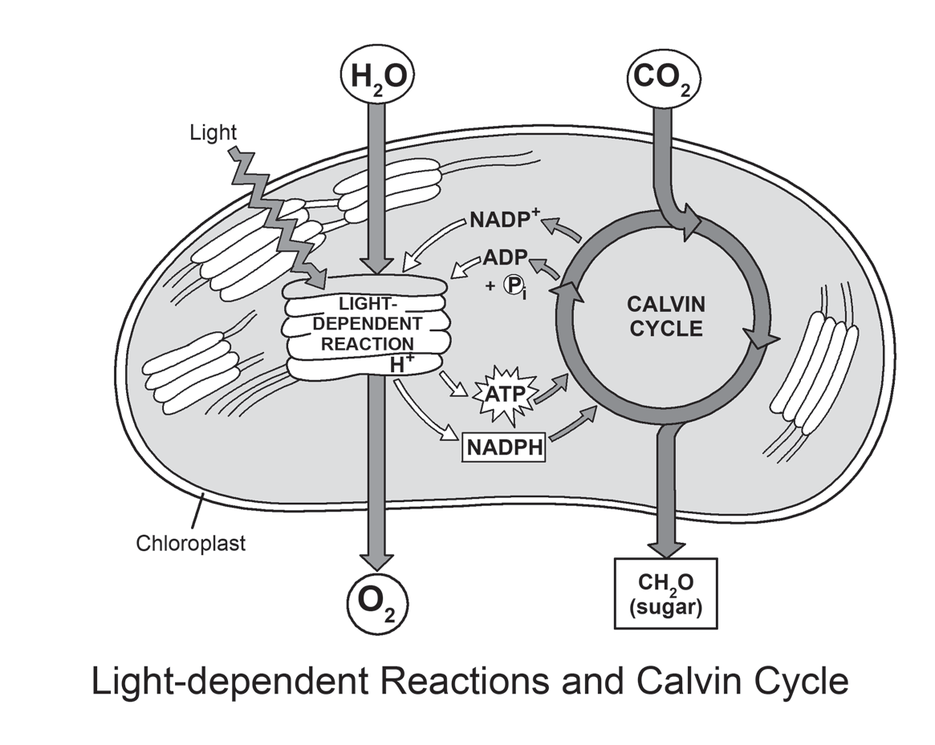
Photosynthesis
An electron carrier, a protein found inside the lumen, receives the electrons and transports them to the photosystem I. After this process, ATP and NADPH molecules are produced. Both ATP and NADPH have stored energy to make sugar in the next stage of photosynthesis, the Calvin cycle.

Slide 15
Photosynthesis
Light-independent Reaction (Calvin Cycle) It is commonly known as the dark reaction. It occurs in the stroma of the chloroplast. In this stage, photosynthesis can proceed even in the absence of light. However, it needs the energy and electrons produced during the light-dependent reactions with the aid of ATP and NADPH molecules. In this reaction, CO2 is used to produce carbohydrates. This cycle is divided into three phases: carbon fixation, carbon reduction, and regeneration.
In carbon fixation (carboxylation), CO2 from the atmosphere diffuses through the stoma and then enters the fluid-filled inner space of chloroplasts called stroma, just outside the thylakoid. For each CO2 that enters the cycle, 3-carbon compounds called 3-phosphoglycerate (3-PGA) molecules are produced.

Slide 16
Photosynthesis
In carbon reduction, a sequence of reactions using electrons from NADPH and some of the energy of the ATP will reduce CO2. In chemistry, the term “reduction” is the process of donating electrons. In this phase, NADPH donates electrons to the 3-Phosphoglyceric acid (3-PGA) molecules to convert it into a simpler sugar, glyceraldehyde-3phosphate (G3P), which is then turned into carbohydrates. After the reduction reaction, the molecules of adenosine diphosphate (ADP) and NADP+ are left and returned to the thylakoids to be reenergized and convert to ATP and NADPH by the light-dependent reactions.
In the regeneration phase, ribulose bisphosphate (RuBP), a molecule containing five carbon atoms and a phosphate group at each end, is recreated. Some of the G3P molecules are set aside to be used as a building block for glucose. Other G3P molecules are used to regenerate the RuBP in order for it to accept new carbon molecules to keep the cycle going.
These two reactions are made possible with the help of the enzymes during the breaking down and bonding of the molecules.

Slide 17
Photosynthesis
Activity
Directions: Answer the following questions.
1. Why is ATP production important
2. Does the light-independent reaction need sunlight? Why or why not?
3. Which phase of photosynthesis is the most significant part of the process? Why?

Slide 18
Photosynthesis
Answer Key
1. Why is ATP production important
- ATP carries the energy to be released to the cells.
2. Does the light-independent reaction need sunlight? Why or why not?
- No. Because they rely on the products of the light-dependent reaction.
3. Which phase of photosynthesis is the most significant part of the process? Why?
- Both. Because light-dependent and light-independent reactions are interrelated. The light- independent reaction cannot proceed without the light-dependent reaction.

