Slide 1
The Structure of an Atom

Slide 2
The Structure of an Atom
Historical Development of the Atomic Theory
The word atom comes from the Greek word atomos, which means “cannot be divided”. In 400 BC, a philosopher named Democritus thought that all materials can go smaller by cutting them, but a certain limit will be met. Imagine cutting a paper into half as many times as you can, but at a certain point, you cannot continue cutting if it becomes too small. Through this idea, Democritus concluded that all materials are made of tiny indivisible particles, which he called atomos.
Aristotle, a far more famous philosopher, strongly opposed the idea of atoms and believed that there was no limit to subdividing matter. This derailed further ideas and studies about atoms. The idea of Democritus was overlooked and got lost through time.

Slide 3
The Structure of an Atom
In 1803, a British scientist named John Dalton revived the idea of atoms when he presented his atomic theory. His atomic theory consists of the following major assumptions.
1. Matter is made up of tiny, invisible, and indivisible particles called atoms.
2. Atoms cannot be created nor destroyed in any chemical reaction.
3. Atoms combine in whole number ratios to form compounds.
4. Atoms of one element are all the same. Atoms of different elements are different.
Dalton’s atomic theory became the baseline of further studies about the atom. It was accepted for some time. But, because of the progress in Science and technology, and the development of sophisticated tools and processes, weak points were found in the theory. Atoms are not indivisible since they are further composed of subatomic particles. They can also be split during nuclear reactions. Moreover, atoms of the same element are not always the same. There are atoms of the same element but with different masses.

Slide 4
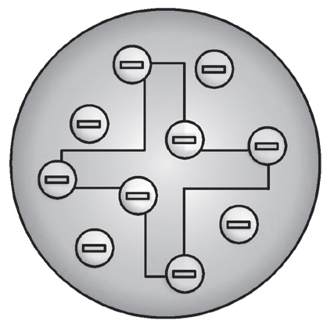
The Structure of an Atom
The table below summarizes the important discoveries in our conception of atoms through time.
Table 1: Development of atomic models
Model Conception | Model Description | Illustration
1904: Plum Pudding Model – Joseph John Thomson
Through the cathode ray tube, a vacuum tube connected to an electric source, Joseph John Thomson discovered the negatively charged subatomic particles, the electrons, in 1897. Joseph John Thomson first estimated the mass of an electron, and later successfully measured its negative charge in 1899. | This model describes the atom as a positively charged sphere where the negatively charged electrons are embedded. This is similar to raisin bread (bread is the positively charged sphere; raisins are electrons).
Plum pudding model

Slide 5
The Structure of an Atom
1911: Nuclear Model – Ernest Rutherford
During the conduct of the gold foil experiment, Ernest Rutherford observed that most of the alpha particles went straight through the gold foil, and very few were deflected or bounced back when he aimed a beam of alpha particles at a thin sheet of gold foil. Based on these observations, he concluded that an atom is mostly empty space (because most alpha particles passed through the foil), and that it has a positively charged central massive part called the nucleus (as supported by the few particles that were deflected). | This model highlights the presence of a positively charged nucleus at the center which contains most of the mass of the atom. On the other hand, electrons were assumed to be moving around the nucleus at a further distance. Ernest Rutherford described the nucleus to be too small when compared to the size of the atom itself.

Slide 6
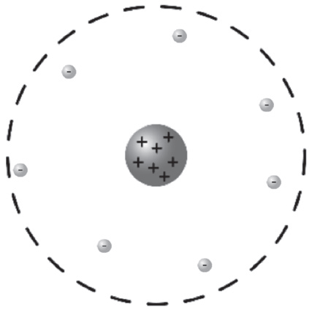
The Structure of an Atom
Ernest Rutherford suggested the existence of positively charged particles of matter which he later discovered as protons. He also predicted that electrically neutral particles exist in the nucleus. In 1932, James Chadwick discovered these particles which were identified as neutrons.
Nuclear atom

Slide 7
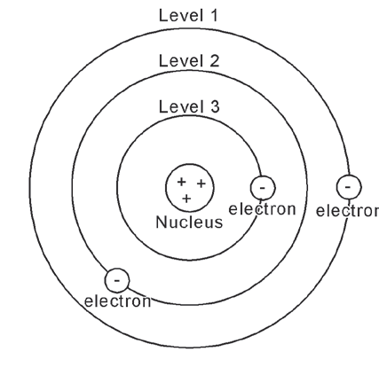
The Structure of an Atom
1913: Planetary Model – Niels Bohr
Through his studies on the hydrogen atom, Niels Bohr found that electrons do not move around the nucleus at random. Bohr proposed that electrons occupy and move in orbits called energy levels or shells, like how planets move around the Sun. Bohr identified electrons as capable of jumping from one energy level to another by absorbing or emitting energy. | In this model, electrons are found in definite distances around the nucleus called the energy levels. The electron has fixed energy at a specific energy level. The farther the energy level from the nucleus, the higher the energy of the electron.
Planetary model

Slide 8
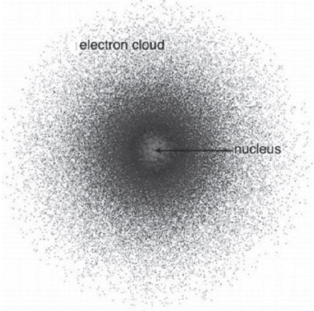
The Structure of an Atom
1926: Quantum Mechanical Model – Erwin Schrodinger
Erwin Schrodinger, an Austrian physicist, developed a model of an atom based on the wave, such as properties of the electron. Also incorporated in this model is Werner Heisenberg’s Uncertainty, which states that it is impossible to know the exact position and velocity of an electron at the same time. He developed wave functions or wave equations that can describe the behavior of electrons. | This model is more of a mathematical model than a physical model. It highlights that electrons do not move in fixed orbits but in a certain region of space described as an electron cloud. This electron cloud is now called orbital and may have different shapes and energies.
The Structure of an Atom
Quantum mechanical model

Slide 9
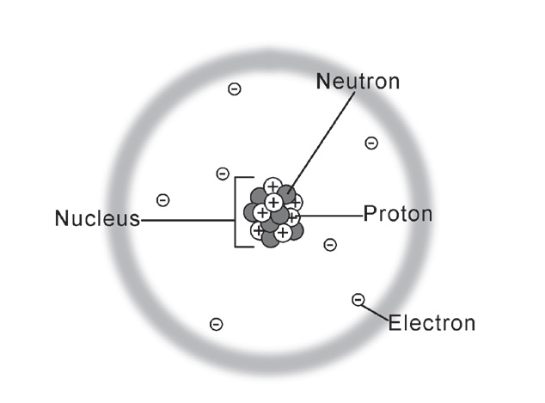
The Structure of an Atom
The Subatomic Particles
Figure 6 shows that an atom consists of subatomic particles, namely protons, neutrons, and electrons. The protons and neutrons constitute the dense, central core of an atom, which is called the nucleus. The electrons, which are very much lighter than protons and neutrons, move around the nucleus. Atoms have different properties based on the number and arrangement of these subatomic particles.
Protons (p+) are the positively charged particles found inside the nucleus of an atom. Atoms of different elements have different numbers of protons. If the number of protons in an atom changes, the atom becomes an atom of a different element.

Slide 10
The Structure of an Atom
Electrons (e–) are negatively charged particles found outside the nucleus of an atom, in a region called an atomic orbital. Compared with protons and neutrons, they are significantly smaller in mass and size. Electrons influence the way an atom will behave in the presence of another atom. An atom may lose, gain, or share electrons with another atom during chemical reactions.
Neutrons (n°) are neutral particles, which means that they have no charge. The number of neutrons varies for each element and often increases as the number of protons in an atom increases. Atoms of similar elements sometimes have variations because of the difference in the number of neutrons. Atoms with a similar number of protons but with a different number of neutrons are called isotopes.

Slide 11
The Structure of an Atom
Table 2: Properties of the three subatomic particles
Name | Symbol | Charge Unit | Mass (g) | Location
Proton | p⁺ | +1 | 1.673 x 10^{–24} | nucleus
Neutron | n⁰ | 0 | 1.675 x 10^{–24} | nucleus
Electron | e⁻ | –1 | 9.109 x 10^{–28} | outside nucleus

Slide 12
The Structure of an Atom
Atomic Charge
The presence of protons gives an atom a positive charge, while that of electrons gives it a negative charge. An atom is always neutral since the number of protons in an atom is always equal to the number of its electrons. In other words, the positive charge of protons and the negative charge of electrons cancel each other out. However, as discussed, an atom may lose, gain, or share electrons during a chemical change. If there are more electrons than protons, the atom will acquire a net negative charge; if there are fewer electrons than protons, the atom will have a net positive charge. These resulting charged species are called ions.

Slide 13
The Structure of an Atom
Atomic Number and Mass Number
Each element in the periodic table of elements is identified by a specific atomic number. The atomic number (Z) refers to the number of protons in an atom. With this, whenever the number of protons is changed, the identity of the atom is also changed.
Mass number (A) is the total number of protons and neutrons in the nucleus of an atom. The atomic number of each element is constant, but the mass number may differ due to isotopes. Mass number is different from atomic mass, which is the weighted average mass of an atom of an element considering the abundance of all its isotopes. For convenience, the mass number is used instead of atomic mass.

Slide 14
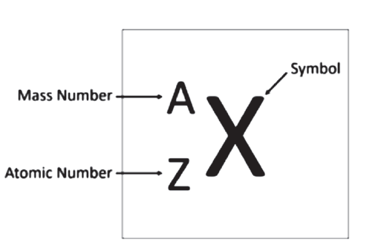
The Structure of an Atom
Atomic number = number of protons
Mass number = number of protons + number of neutrons
A common way of writing the mass number and atomic number is through the use of the nuclear symbol. As shown in Figure 7, a nuclear symbol consists of the symbol of an element (X), its mass number (A), and its atomic number (Z).
Let us apply the concepts of atomic number and mass number in determining the number of protons, electrons, neutrons, and the identity of an atom. Which shows how you can address different problems involving atomic number and mass number.

Slide 15
The Structure of an Atom
Examples
Case 1 | Case 2 | Case 3 | Case 4
Given: Beryllium Z = 4 A = 9 | Given: Boron Z = 5 n⁰ = 6 | Given: Unknown Element p⁺ = 7 n⁰ = 7 | Given: Unknown Element p⁺ = 11 A = 23
p⁺ = Z = 4 | p⁺ = Z = 5 | Z = p⁺ = 7 | Z = p⁺ = 11
A = p+ + n⁰ n⁰ = A – p⁺ n⁰ = 9 – 4 = 5 | A = p+ + n⁰ A = 5 + 6 = 11 | A = p+ + n⁰ A = 7 + 7 = 14 | A = p⁺ + n⁰ n⁰ = A – p⁺ n⁰ = 23 – 11 = 12

Slide 16
The Structure of an Atom
For neutral atom: e– = p⁺ e– = 4 | For neutral atom: e– = p⁺ e– = 5 | For neutral atom: e– = p⁺ e– = 7 Knowing that Z determines the element’s identity, look for the element in the periodic table whose Z = 7. The unknown element is nitrogen. | For neutral atom: e– = p⁺ e– = 11 Knowing that Z determines the element’s identity, look for the element in the periodic table whose Z = 11. The unknown element is sodium.

Slide 17
The Structure of an Atom
Electron Configuration
The electron configuration is a detailed way of showing the arrangement or distribution of electrons around the nucleus. It is the shorthand representation of how each electron is arranged in the energy levels, sub levels, and orbitals.
Electrons are located in energy levels, which are identified by numbers 1, 2, 3, 4, and so on and so forth. Energy levels are further divided into sub-levels. Sub-levels s, p, d, and f are differentiated by the number and shape of atomic orbitals they have. The s sub-level has one orbital and is spherical in shape. The p sub-level consists of three orbitals and has a dumbbell-like shape. The d sub-level consists of five orbitals and has a four-leaf clover shape. The f sub-level has seven orbitals and has complex shapes. An orbital is a region in space outside the nucleus where there is a high probability of finding the electrons. Each orbital can only contain up to two electrons.

Slide 18
The Structure of an Atom
Table 3 summarizes the energy levels, the available sub-levels in each energy level, the number of orbitals that make up each sub-level, and the maximum number of electrons in each sub-level.
Energy Level | Available sub-levels | No. of orbitals | Designation | Maximum no. of Electrons
1 | S | 1 | 1s | 2
2 | S | 1 | 2s | 2
 | P | 3 | 2p | 6
3 | S | 1 | 2p | 2
 | P | 3 | 3s | 6
 | D | 5 | 3d | 10

Slide 19
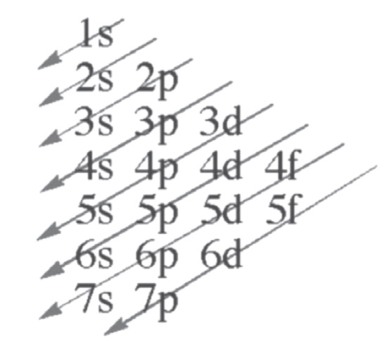
The Structure of an Atom
4 | S | 1 | 4s | 2
 | P | 3 | 4p | 6
 | D | 5 | 4d | 10
 | F | 7 | 4f | 14
In writing the electron configuration of an atom, the following rules serve as a guide in order to easily predict the electron’s location:
Aufbau Principle – states that electrons occupy the atomic orbitals in the order of increasing energy. The mnemonic device in Figure 9 shows the orbitals that are arranged according to increasing energy. When distributing the electrons of an atom, you need to follow the electron configuration mnemonic device as a reference.

Slide 20
The Structure of an Atom
Pauli’s Exclusion Principle – states that no more than two electrons in an atom can occupy an orbital. They must spin in opposite directions. Electrons are said to be paired if two electrons with opposite spins occupy an orbital, and they are unpaired if only a single electron is present in the orbital.
Hund’s Rule – states that every orbital in a sub-level should be occupied first with one electron before any one of the orbital is doubly occupied. In other words, doubling of electrons in an orbital will occur only after all the orbitals in a sub-level are filled with one.
To discuss Pauli’s Exclusion Principle and Hund’s Rule, we need to introduce another way of showing the distribution of electrons. Orbital notation is a visual representation of the electron configuration that allows the descriptions of orbitals of each sub-level and the spins of each orbital. The box represents the orbitals, while the arrows represent the electrons.

Slide 21
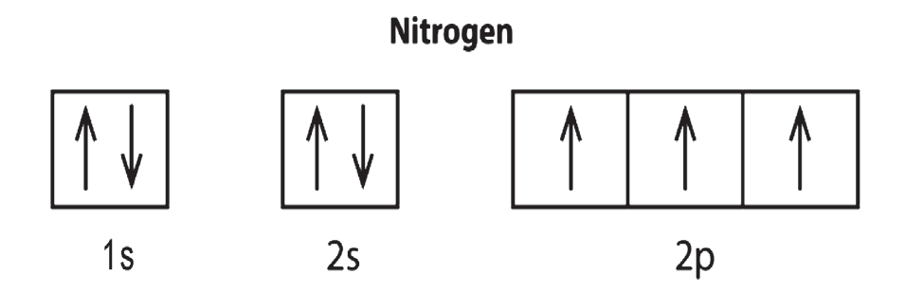
The Structure of an Atom
Look at the orbital notation of nitrogen (Electron configuration: 1s² 2s² 2p³) in Figure 10. Notice that each orbital can only accommodate a maximum of 2e-. This reflects Pauli’s Exclusion Principle. On the other hand, following Hund’s rule, you will see that all p-orbitals are filled with only one electron. It is wrong to put two electrons in one p-orbital and one p-orbital without electron.

Slide 22
The Structure of an Atom
Writing Electron Configuration
Table below shows the electron configuration of the first seven elements in the periodic table. The first important thing to consider in writing the electron configuration of an atom/ element is to know the number of electrons of the element. In a neutral atom, the number of electrons is equal to the number of protons, thus it is also equal to the atomic number.
Element | Atomic number | Electron Configuration
Hydrogen | 1 | 1s¹
Helium | 2 | 1s²
Lithium | 3 | 1s² 2s¹
Beryllium | 4 | 1s² 2s²

Slide 23
The Structure of an Atom
Boron | 5 | 1s² 2s² 2p¹
Carbon | 6 | 1s² 2s² 2p²
Nitrogen | 7 | 1s² 2s² 2p³
For a detailed example, let us write the electron configuration of oxygen [Z = 8]. With its atomic number equal to 8, there are 8 electrons to be distributed. Use the mnemonic device to distribute the electrons in the orbitals. As you do this, follow the arrow in the mnemonic device until the sum of electrons reaches 8. With 2 electrons in the first sub-level, another 2 in the second sub-level, and only 4 electrons are needed for the third sub-level, to get the sum of 8. Remember that you can go below the maximum capacity of each sub-level, but you cannot go beyond. If a sub-level is already filled with maximum capacity, then proceed to the next sub-level following the mnemonic device. Hence, the electron configuration of oxygen is 1s2 2s2 2p4.

Slide 24
The Structure of an Atom
Activity
Directions: Fill in the blanks with the correct word to complete each sentence. Choose your answer from the list of words below.
orbital notation | atomic orbital | spherical | mass number
neutral | neutrons | atomic number | electrons
The (1) ______________ is equal to the number of protons in an atom.
Atoms are always (2) ____________.
The (3) ______________ is computed by adding the number of protons and number of (4)______________ in the nucleus of an atom. An
(5) ______________ is a region of space around the nucleus where (6) ______________ are most likely be found.

Slide 25
The Structure of an Atom
Answer Key
The (1) ______________ is equal to the number of protons in an atom.
Atoms are always (2) ____________.
The (3) ______________ is computed by adding the number of protons and number of (4)______________ in the nucleus of an atom. An
(5) ______________ is a region of space around the nucleus where (6) ______________ are most likely be found.
atomic number
neutral
mass number
neutrons
atomic orbital
electrons

