Slide 1





Slide 2
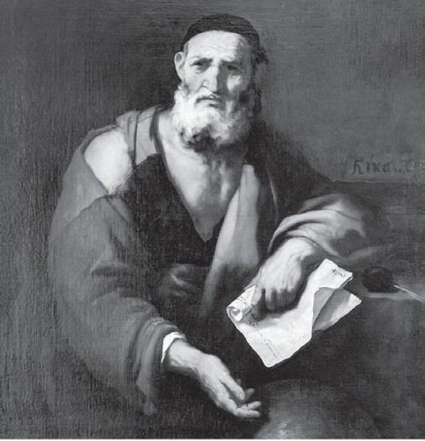
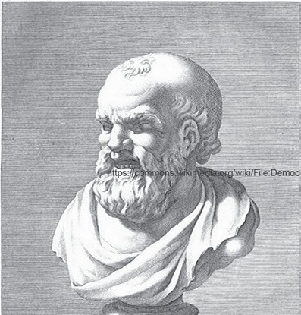
Timeline of the Development of Atomic Theory
Scientists/Contributions
Leucippus (480 BC–420 BC)
There are few records about him, but he is credited as the first person who introduced atoms’ concept. His student, Democritus, later adopted it.
Democritus (460 BC–370 BC)
He is a Greek philosopher who adopted Leucippus’ idea that everything is made up of very tiny indivisible particles of matter. In 465 BC, he named these particles after the Greek term atomos, which means indivisible.
WWW.REX.COM.PH

Slide 3
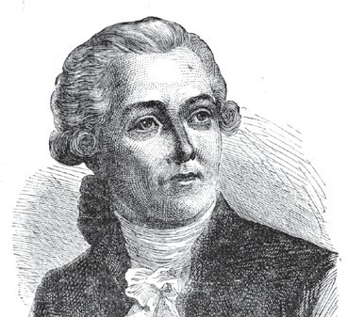
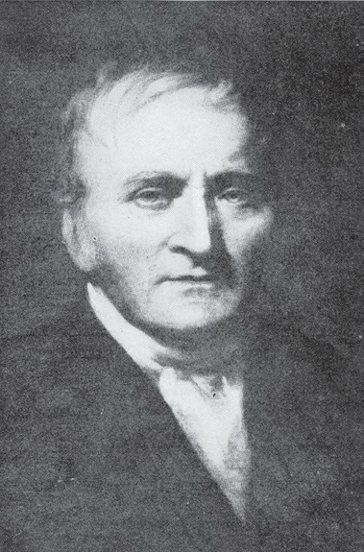
Antoine-Laurent Lavoisier (1743–1794)
He was a prominent French chemist and was considered the Father of Modern Chemistry. In 1789, he proposed the law of conservation of mass, which states that atoms can neither be created nor destroyed. This idea originated from his experiments where he observed that the total mass of the reactants is always equal to the total mass of products in a chemical reaction.
John Dalton (1776–1844)
He was an English chemist who first introduced the atomic theory of Democritus in the scientific community in 1803. He improved this idea and later proposed the atomic theory known as Dalton’s atomic theory. He was considered the Father of Atomic Theory because of this.
WWW.REX.COM.PH

Slide 4
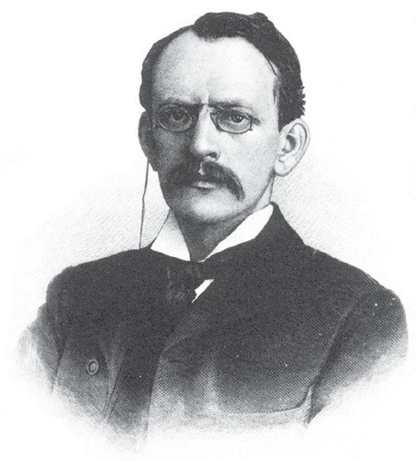
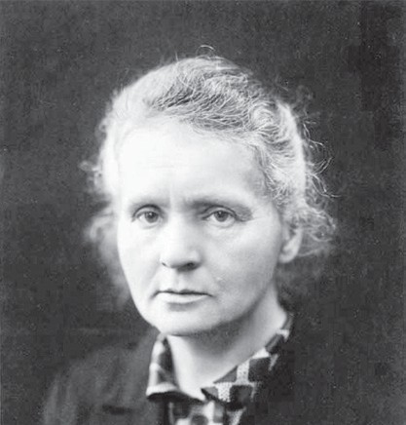
Sir John Joseph Thomson (1856–1940)
J. J. Thompson was a Nobel Prize-winning physicist who discovered that there are smaller particles inside an atom. In 1897, he was credited for discovering the electron, a negatively charged subatomic particle, through cathode-ray tubes. He also proposed the plum pudding model of the atom.
Marie Sklodowska Curie (1867–1934)
She was the only scientist who won both the Nobel Prize in Chemistry and Physics due to her discovery of radioactivity in 1898. In her studies together with his husband Pierre Curie, they discovered that radioactive particles break the atoms down, releasing radiation in the form of energy and subatomic particles.
WWW.REX.COM.PH

Slide 5
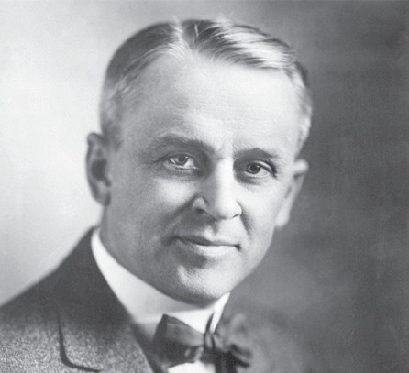
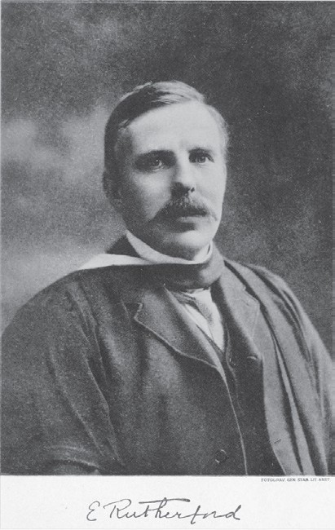
Robert Andrews Millikan (1868–1953)
His primary contribution to the atomic theory development was his discovery of electron charge in 1909 after J. J. Thomson discovered the particles. He confirmed the charge of the electron through his oil-drop experiment.
Ernest Rutherford (1871–1937)
He was a physicist from New Zealand who confirmed that atoms have a positive center called the nucleus. His atomic model with the nucleus at the center and electrons orbiting around was proposed from his conclusions in his gold foil experiment in 1911. This model proved Thomson’s model inaccurate.
WWW.REX.COM.PH

Slide 6
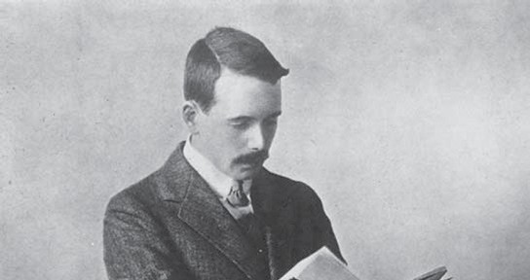
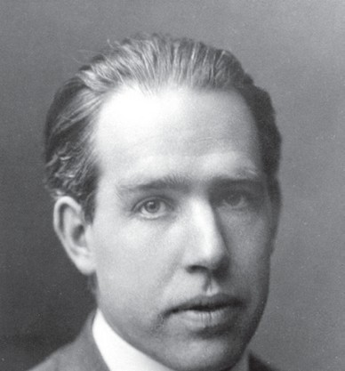
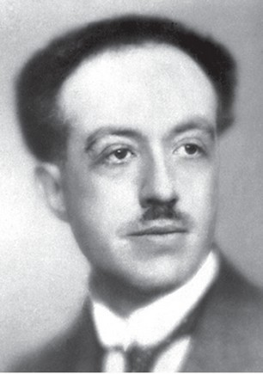
Henry Moseley (1887–1915)
In 1914, using his X-ray spectrometer, he discovered that the elements’ wavelengths determine the number of positive charges in an atom’s nucleus. This discovery led to the identification of the atomic number of an element.
Niels Bohr (1885–1962)
He was a Danish physicist who improved Rutherford’s model of an atom. In 1922, he proposed the planetary model with a positively charged nucleus at the center and electrons orbiting around it. His model differs from Rutherford’s in terms of the orbits in which the electrons revolve.
Louis De Broglie (1892–1987)
He was a well-known French physicist who received a Nobel Prize upon discovering the particle-wave duality nature of electrons in 1923. His discovery described some electrons’ behavior, which can only be explained when an electron acts as a wave.
WWW.REX.COM.PH

Slide 7
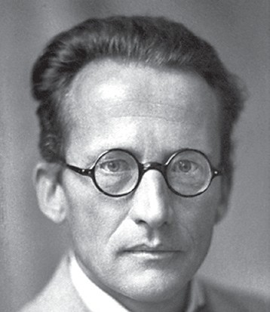
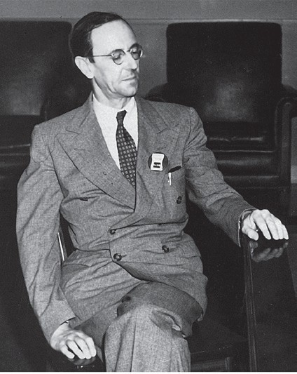
Erwin Schrödinger (1887–1961)
He was an Austrian-Irish physicist who also won the Noble Prize because of his contribution to atomic theory. In 1926, he adopted De Broglie’s discovery to propose his atomic model, the electron cloud model, later known as the atom’s quantum mechanical model.
Sir James Chadwick (1891–1974)
He was an English physicist who was also awarded the Nobel Prize for discovering neutron s in 1932. He completed the recent atomic models proposed by Rutherford, Bohr, and Schrödinger, placing the neutrons along with the protons in the atom’s nucleus.
WWW.REX.COM.PH

Slide 8

John Dalton’s Atomic Theory
Dalton’s atomic theory is the first idea about atoms presented to the scientific community after the prominent Greek classicists took Democritus’ and Leucippus’ atomic theories to the sidelines. The postulates and limits of his theory are the following:
All types of matter are made up of small indivisible particles called atoms.
Atoms of the same elements have the same properties and masses, while atoms of different elements have different properties and masses.
Atoms can neither be created nor destroyed. These are only rearranged in a chemical reaction to form a new product out of given reactants.
Atoms of different elements combine in a fixed numerical ratio to form a compound.
Besides these postulates, he also proposed that an atom looks like a billiard ball. He imagined that atoms are spherical, hard, massive, impenetrable, and movable particles.
Comparison of Dalton’s atomic model to a billiard ball
WWW.REX.COM.PH

Slide 9

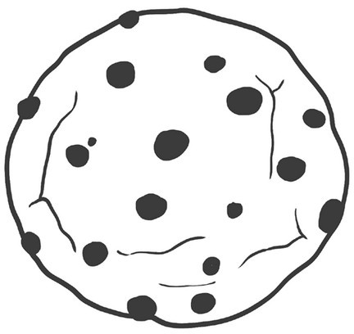
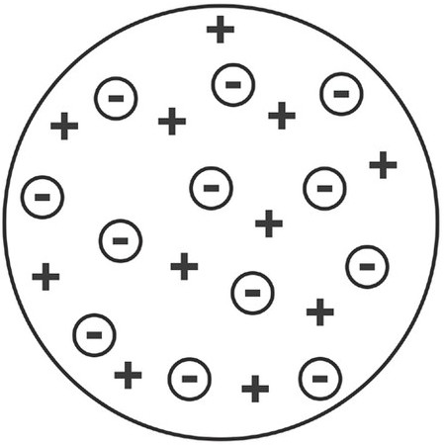
J. J. Thomson’s Plum Pudding Model
Sir John Joseph Thomson’s discovered the electron using a cathode-ray tube (CRT). An electron is a negatively charged particle found inside an atom. He did not refer to it as an electron at first; instead, he identified those particles as corpuscles. This discovery revolutionized the atomic theory because atoms were thought to be indivisible spheres for a long time.
He proposed that atoms are made up of a positively charged core with electrons embedded in it with his discovery. This model was referred to as the plum pudding model, also known as the chocolate chip cookie model. The plums or the chocolate chips represent the electrons, while the pudding bread or cookie represents the positively charged core. He further explained that the positive charges inside the core are equal to the negatively charged electrons, making the whole atom neutral in charge.
WWW.REX.COM.PH

Slide 10
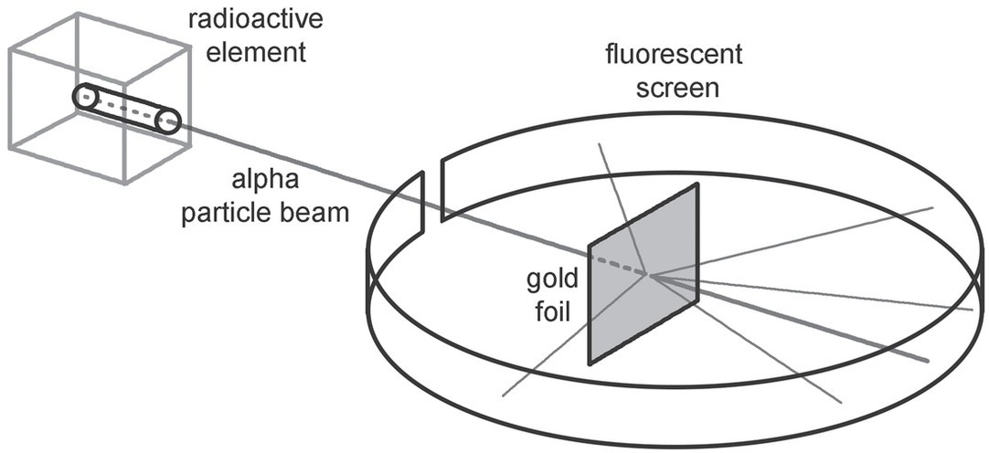
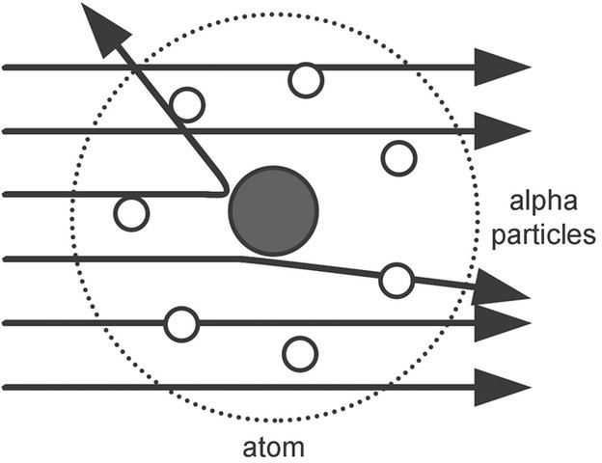
Ernest Rutherford’s Nuclear Model
Ernest Rutherford overturned J. J. Thomson’s atomic model through his gold foil experiment. In this, he beamed alpha particles through a hole into a gold foil. These alpha particles, composed of two protons and two neutrons, are emitted by a radioactive element.
Rutherford then formulated the following conclusions:
Atoms are composed mainly of empty space. It is evident when alpha particles went through the gold foil.
Atoms have a very dense center called the nucleus. Rutherford concluded this when some alpha particles bounced back, resulting from striking of the particles to something very dense inside the atom.
The nucleus of the atom is composed of positively charged particles. When alpha particles strike the gold foil, some were deflected. It is due to the particles’ repulsion from other particles inside the atom’s nucleus.
WWW.REX.COM.PH

Slide 11
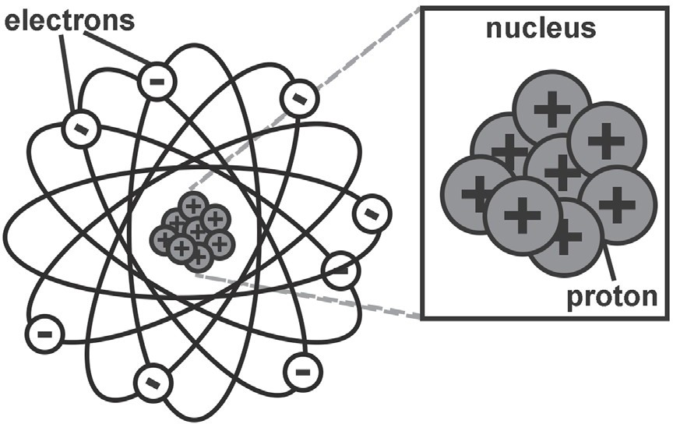
Using the results of his experiment, Rutherford recreated the atomic model proposed by J. J. Thomson. His model has a resemblance to that of the solar system. Since his investigation highlighted the atom’s nucleus, his model is often referred to as the atom’s nuclear model. This model has the electrons moving around the nucleus, which
is composed of protons.
Rutherford revolutionized our understanding of the atom’s structure using his gold foil experiment results. However, his atomic model failed to explain the stability of atoms. Stable atoms are those with a balanced nucleus and do not have any excess energy.
WWW.REX.COM.PH

Slide 12

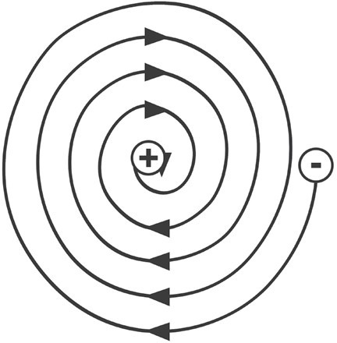
1. In Rutherford’s model, he did not explain the behavior of electrons thoroughly. The charges of the electrons and the nucleus create a problem for his model. Since electrons are negatively charged, they should be attracted to the nucleus, which is positively charged, making the atom unstable.
2. In his model, the electrons orbit around the nucleus. It should cause the electrons to radiate energy as they move, causing the particles to slow down and move toward the nucleus, making the atom unstable.
WWW.REX.COM.PH

Slide 13
Points of Comparison between Rutherford’s and Bohr’s Models of Atom
Points of Comparison | Rutherford’s Nuclear Model | Bohr’s Planetary Model
Evidence of atomic model | Gold foil experiment | Line spectra of hydrogen atom
Energy levels of electrons | No presence of energy levels of electrons | Energy levels of electrons are present.
Position of electrons | Electrons move in orbits around the nucleus. | Electrons move in fixed shells (orbit) with discrete energy levels around the nucleus.
Number of electrons per orbit | No specific number of electrons per orbit | The number of electrons per shell (orbit) is specified.
WWW.REX.COM.PH

Slide 14
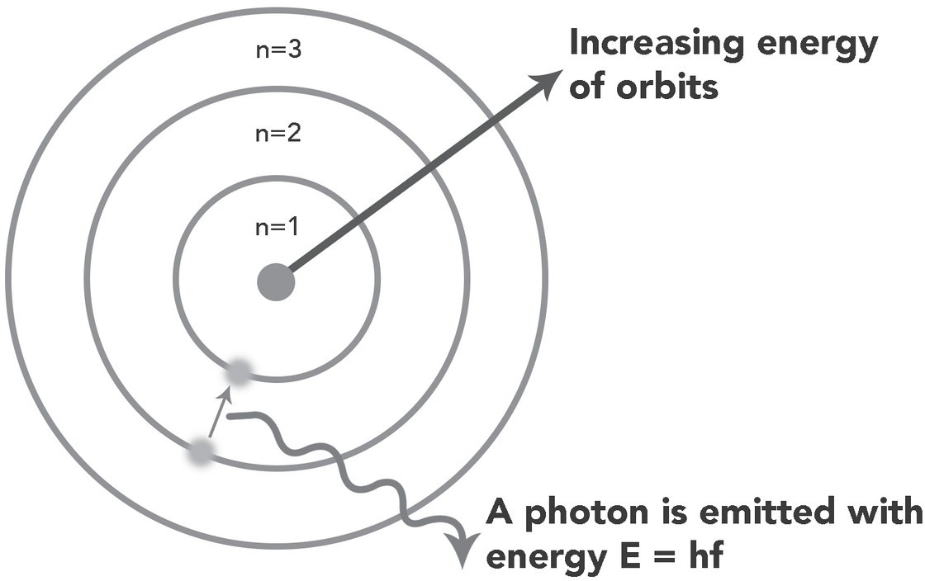
Bohr based his model on the line spectra of hydrogen atoms. Line spectra are the set of colors produced by an atom whenever it emits energy. When an atom absorbs energy, usually in the form of heat or electricity, it often reemits this energy in the form of light. Line spectra are like fingerprints of elements. Each atom has a unique line spectrum set of colors of light produced depending on the amount of energy it emits.
By limiting the movement of electrons in a circular orbit with the fixed distances from the nucleus, he could explain the light emitted by the atom of hydrogen. According to Bohr, colors of light are produced whenever an electron jumps from a higher energy orbit to a lower energy orbit. This transition involves energy changes that influence the color of light emitted. With this, he proposed the planetary model of an atom with electrons orbiting around the atom’s nucleus at a fixed distance from the nucleus and a discrete energy level.
WWW.REX.COM.PH

Slide 15
Directions: Create a side-by-side comparison by illustrating Bohr’s and Rutherford’s atomic models in the boxes below.
Rutherford’s Nuclear Model
Bohr’s Planetary Model
1.
2.
WWW.REX.COM.PH

Slide 16

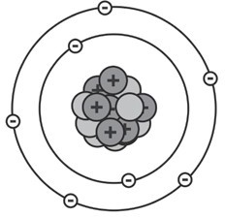
Answer Key:
Rutherford’s Nuclear Model
Bohr’s Planetary Model
1.
2.
WWW.REX.COM.PH

Slide 17


