Slide 1
History of the Periodic Table of Elements

Slide 2
History of the Periodic Table of Elements
Alchemy is an early form of the investigation of nature. Alchemists were famous for the process of changing some elements into gold. They were the first to use the symbols of the elements during the Middle Ages; the symbols helped preserve their works with confidentiality. The practice of using symbols for each element has influenced modern chemists. They use symbols for each element for convenience and ease in writing.
As chemists discovered more elements, they became overwhelmed with new scientific data about the elements and their properties. The use of symbols for each element was not enough; what they needed was a way to organize all the facts associated with the elements. They tried to arrange the elements in patterns. This arrangement in patterns paved the way for the tabulation of the elements based on their chemical and physical properties, which was suitably called the periodic table of elements.

Slide 3
History of the Periodic Table of Elements
Like other discoveries, the periodic table also underwent some modifications before it was finalized. Its evolution was made possible through the works of different chemists. As we proceed with the lesson, let us get to know the scientists who contributed to the development of the periodic table.
Lavoisier’s First Classification
In 1789, Antoine Lavoisier, a French physicist-chemist, identified 33 elements and classified them based on their similar properties. He arranged the elements into four categories:
a. Gases – such as light, heat, fire, vital air, and inflammable gas
b. Nonmetals – such as sulfur, phosphorus, and charcoal
c. Metals – such as antimony, silver, copper, tin, iron, nickel, gold, and lead
d. Earths – such as chalk, magnesia, barote, clay, and siliceous earth

Slide 4
History of the Periodic Table of Elements
Döbereiner’s Triads
In 1817, Johannes Wolfgang Döbereiner, a German chemist, studied three elements (Ca, Ba, and Sr) and noticed similarities among their properties. He proceeded to study another group of three elements (Cl, Br, and I). He called such groups triads. He noticed similarities in the three elements and predicted that there is closeness in the atomic masses of the said elements in each triad. He concluded that the atomic mass and the density of the middle element in each triad are the approximate averages of the atomic masses and densities of the first and the third elements.
Attempts were made to arrange the elements into triads in 1850. Nevertheless, more reliable measurements were introduced, and speculations on the atomic mass of the middle element became less accurate.

Slide 5
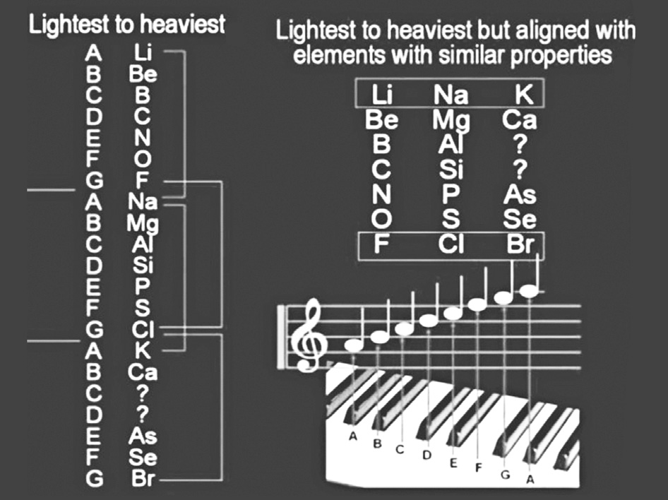
History of the Periodic Table of Elements
Newlands’ Octaves
In 1869, John Newlands, an English chemist, presented another way of classifying elements. He noticed that when arranged according to increasing atomic mass, the properties of elements repeated every eighth element. He compared their relationships to the octaves of musical notes. He then called this pattern the law of octaves.
However, the law of octaves worked only for the first 16 elements. Because of that and the way he related his work to musical notes, his idea was ridiculed by some chemists, and his proposal was not accepted by many chemists at that time. However, his idea of repetition of similar properties provided the groundwork or basis for the periodic table of elements.

Slide 6
History of the Periodic Table of Elements
Mendeleev’s Periodic Table and Meyer’s Periodic Property Graph
In 1869, two chemists coincidentally presented closely identical versions of elements arranged according to their increasing atomic masses. Dmitri Ivanovich Mendeleev, a Russian chemist, and Julius Lothar Meyer, a German chemist, proposed the periodic law, which states that the properties of elements are the periodic functions of their atomic masses. However, Mendeleev is usually given more credit than Meyer for publishing his work earlier and for successfully demonstrating the value of his table. Like Newlands, Mendeleev noticed that when elements were arranged based on increasing atomic masses, there was a periodic repetition of the properties of the elements. His work became the basis for the system used today known as the periodic table.

Slide 7
History of the Periodic Table of Elements
Mendeleev focused on the proper placement of the elements in the table, which is the most important feature of his table. He deliberately left empty spaces for the elements yet-to-be discovered at that time, and he made predictions of their properties like color, density, melting point, and atomic mass. Surprisingly, Julius Lothar Meyer had also developed a very similar table in the same year, yet these two scientists neither knew nor had met each other.
The predictive value of Mendeleev’s table and his nearly accurate predictions of the existence of yet undiscovered elements and their expected properties had made him more popular than Meyer; therefore, his table was widely recognized and accepted. On the other hand, Meyer prepared a graph showing the periodic properties of the elements. He based his work on the physical properties of elements as a function of their atomic weights

Slide 8
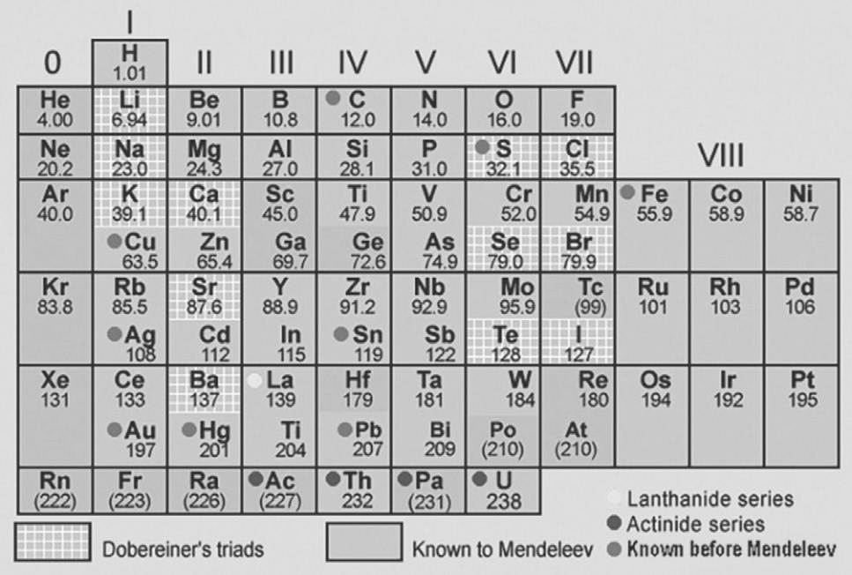
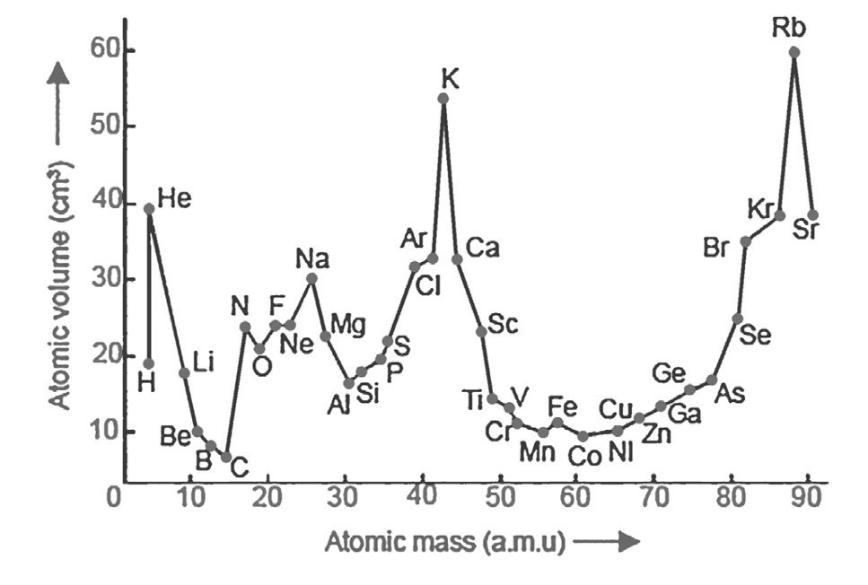
History of the Periodic Table of Elements

Slide 9
History of the Periodic Table of Elements
Moseley’s Works on Atomic Number
Mendeleev’s work was not entirely correct. The periodic law and its classification according to increasing atomic masses caused several elements to be placed in the table incorrectly. This led scientists to think that there must be another basis, other than atomic masses, that will prove the similarities in the properties of elements.
In 1913, Henry Moseley, an English physicist, suggested that atomic mass is not the property that governs periodicity. Moseley discovered that the atoms of an element have a unique number of protons in their nuclei. This unique number of protons is equal to the atom’s atomic number.

Slide 10
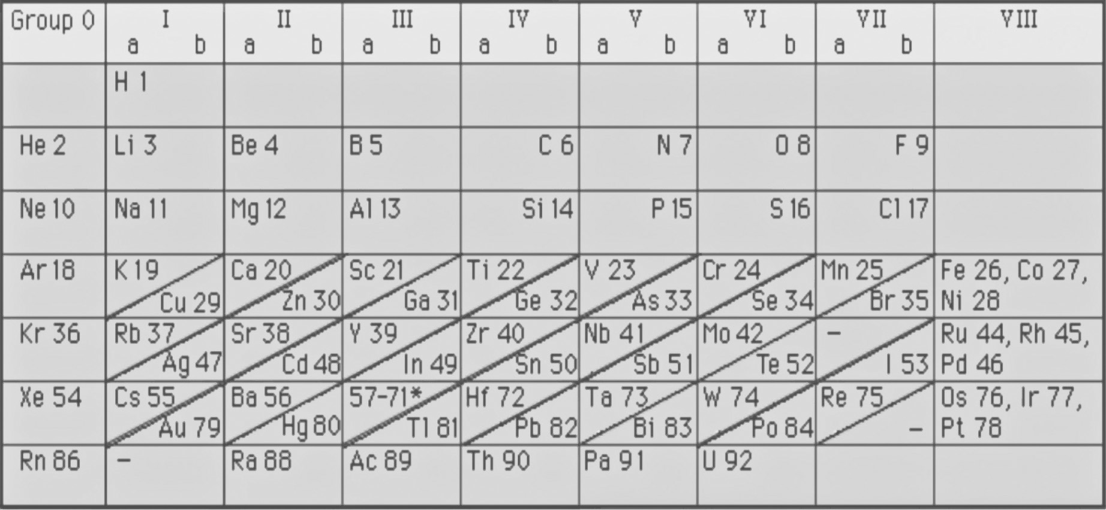
History of the Periodic Table of Elements
Figure below shows Moseley’s periodic table of elements. He observed that arranging the elements according to their increasing atomic numbers solves the irregularities in Mendeleev’s periodic table. He concluded that it was easier to explain the trends in Mendeleev’s table if the elements were arranged according to their increasing atomic numbers. Hence, the periodic law was restated as, “The properties of the elements are periodic functions of their atomic numbers.”

Slide 11
History of the Periodic Table of Elements
Activity
Directions: Find the names of the scientists listed on the right side who made contributions to the development of the periodic table of elements. You may find them vertically, horizontally, or diagonally.
D | O | R | M | E | Y | E | N | S | Y
M | E | N | E | W | L | A | N | D | S
E | E | L | R | B | O | S | L | W | N
N | E | Y | T | L | I | S | I | E | Y
D | O | B | E | R | E | I | N | E | R
E | K | S | B | R | E | O | L | S | Y
L | A | V | I | O | S | E | R | L | Z
E | N | H | J | P | S | K | W | E | I
E | L | A | V | O | I | D | I | E | R
V | O | I | M | E | N | D | E | L | A
Find:
Lavoisier Mendeleev
Newlands Meyer
Moseley Döbereiner

Slide 12
History of the Periodic Table of Elements
Answer Key
D | O | R | M | E | Y | E | N | S | Y
M | E | N | E | W | L | A | N | D | S
E | E | L | R | B | O | S | L | W | N
N | E | Y | T | L | I | S | I | E | Y
D | O | B | E | R | E | I | N | E | R
E | K | S | B | R | E | O | L | S | Y
L | A | V | I | O | S | E | R | L | Z
E | N | H | J | P | S | K | W | E | I
E | L | A | V | O | I | D | I | E | R
V | O | I | M | E | N | D | E | L | A

