Slide 1
Arrangement of Elements and Trends in the Periodic Table

Slide 2
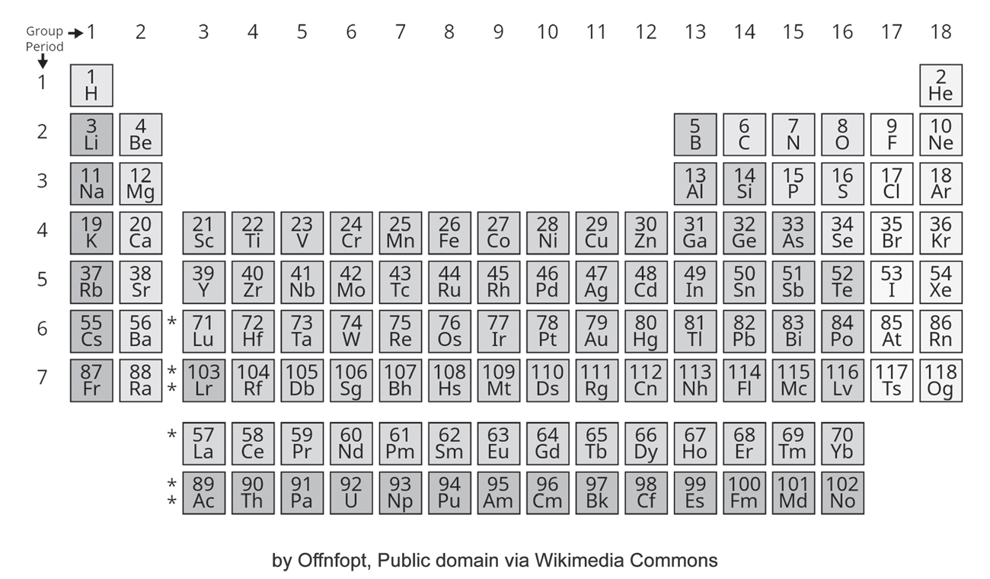
Arrangement of Elements and Trends in the Periodic Table
After a series of revisions, the early periodic table has evolved into its current version. In the modern periodic table, the elements are horizontally arranged in the order of increasing atomic numbers. Each element can be identified by its symbol; the atomic number is also indicated.

Slide 3
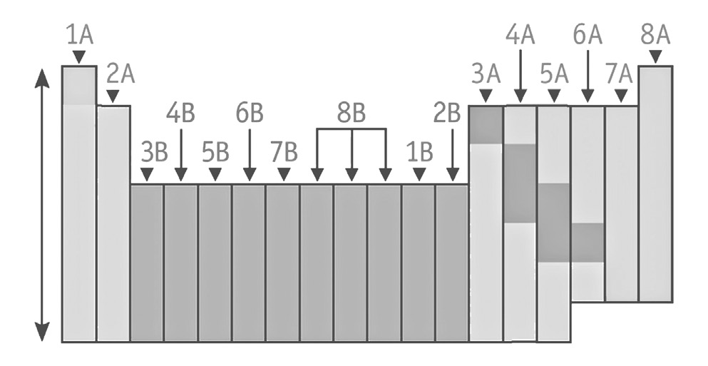
Arrangement of Elements and Trends in the Periodic Table
The vertical columns in the periodic table are called groups or families. The periodic table has 18 columns. The elements in each group have similar chemical properties because of the number of electrons in their outer shells or their highest principal energy level.
As shown in Figure below, the elements in a group are also classified into two categories, namely: Family A or the representative elements, and Family B or the transition metals.

Slide 4
Arrangement of Elements and Trends in the Periodic Table
Group A or Family A (Representative Elements)
Group IA: Alkali Metals
Group IIA: Alkaline Earth Metals
Group IIIA: Aluminum Group or Boron Family
Group IVA: Carbon Family
Group VA: Nitrogen Family
Group VIA: Oxygen Family or Chalcogens
Group VIIA: Halogens
Group VIIIA: Group O or Noble/Inert Gases

Slide 5
Arrangement of Elements and Trends in the Periodic Table
Group B or Family B (Transition Metals)
Transition metals are found between Group IIA and Group IIIA, while the inner transition metals (lanthanides and actinides) are found at the bottom of the table.
The periodic table consists of horizontal rows called periods or series. There are seven periods in the periodic table. The elements belonging to the same period have different properties. The periods can be described as follows:
Period 1 has two elements corresponding to the number of electrons in the s-sublevel that has electrons occupying only one main energy level.
Periods 2 and 3 have eight elements each corresponding to the eight electrons in the s- and p-sublevels.

Slide 6
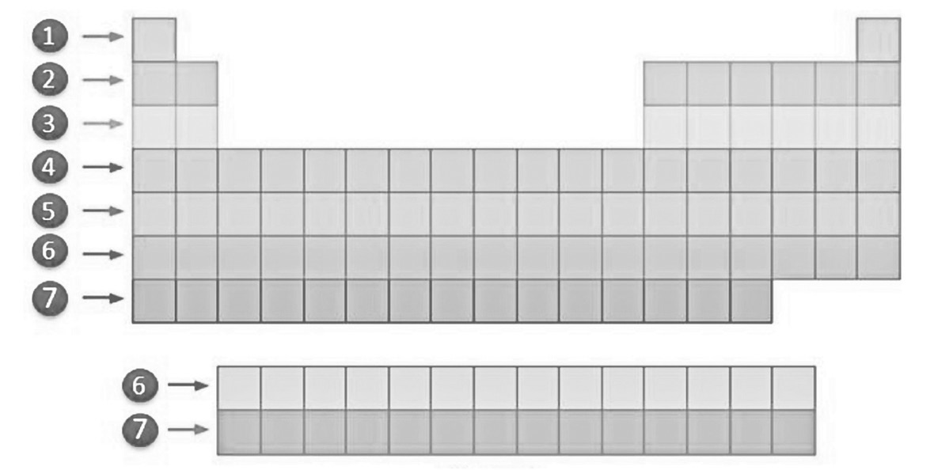
Arrangement of Elements and Trends in the Periodic Table
Periods 4 and 5 have 18 elements each corresponding to the 18 electrons in the s-, p-, and d-sublevels.
Period 6 has 32 elements corresponding to the 32 electrons in the s-, p-, d-, and f-sublevels.
Period 7 also has 32 elements (from atomic number 87 to 118). Elements 90 to 103 which are placed at the bottom part of the table form the actinide series.
The last two periods are called the inner transition metals. The lanthanide series is also called the rare earth elements, while the actinide series is also called the heavy rare earth elements.

Slide 7
Arrangement of Elements and Trends in the Periodic Table
Looking at the periodic table from the previous slide you may notice that elements belonging to the same group have similar last sublevel configuration (lsc). Using the electron configuration of the elements, the periodic table can be divided into four regions or blocks: s-, p-, d-, and f-blocks.
The following points should be considered in determining the electron configuration and/or position of elements in the periodic table:
1. The number of electrons in the outermost energy level or the valence electron in Family A resembles the group number.
2. The highest main energy level occupied by the electrons of the atom corresponds to the period where the element is located in the periodic table.

Slide 8
Arrangement of Elements and Trends in the Periodic Table
Trends in the Periodic Table
The properties of elements vary within a group and across the period. The periodic table will help us in predicting the properties of elements that are not directly visible, such as atomic radius, ionization energy, ionic size, electron affinity, metallic and nonmetallic properties, and electronegativity.
1. Atomic Radius
Atomic radii generally decrease from left to right across a period. The atomic radius is used in determining the atomic volume. Atoms with larger atomic radii have larger atomic sizes or atomic volume. The concept of the atomic radius is connected with the value of the highest principal energy level (n).
Atomic radii generally increase down a group with increasing atomic numbers. When electrons are added to the principal energy level, the electrons become farther away from the nucleus. The addition of a new shell increases atomic radii down the group.

Slide 9
Arrangement of Elements and Trends in the Periodic Table
2. Ionization Energy
Ionization Energy (IE) refers to the energy required to remove an electron from an isolated, gaseous atom or ion in its ground state. The loss of an electron is an endothermic process. An atom must absorb energy to separate the most loosely held electron from the gaseous atom. Ionization energies measure how tightly electrons are bound in an atom. The lower the ionization energy, the easier it is to remove an electron and the easier it is to form a positive ion.
The ionization energy increases as atoms become smaller because in this case, electrons are more attracted to the nucleus. Thus, the ionization energy increases from left to right in a period and increases from bottom to top in a family. Across the period, the nuclear charge increases, while down the group, the atomic size increases due to an increase in the principal energy level; thus, the electrons are far from the nucleus and will be easily removed from the atom requiring only a small amount of ionization energy.

Slide 10
Arrangement of Elements and Trends in the Periodic Table
3. Metallic Property
Generally, elements are classified as metals if their outer energy levels have three or less electrons, while those with five electrons or more are considered nonmetals. The metallic property is the ability of atoms to lose electrons, while the nonmetallic property is the ability of the atom to gain or accept electrons. The trend is described based on the electron configuration of the element.
The most metallic elements are found on the left and at the bottom of the periodic table. In general, the metallic property is greater for larger atoms. Across the period in the periodic table, the atomic radii and the metallic property of an atom decrease. Going from top to bottom within a group, the atomic radii increase and so do the metallic properties.

Slide 11
Arrangement of Elements and Trends in the Periodic Table
4. Electron Affinity
Electron Affinity (EA) is the energy released when an incoming electron is finally added to an isolated atom or neutral atom in its ground state. The gain of an electron is an exothermic process. Electron affinity depends upon the electron configuration of the elements. Noble gases are examples of elements that are not reactive and that have sublevels that are completely filled. These elements do not accept additional electrons at all because they are considered stable. Therefore, noble gases have zero electron affinity.
The greater the tendency of an atom to accept an electron, the more negative the electron affinity is. Thus, the electron affinities become smaller (more negative) from left to right across a period in the periodic table and become larger (less negative) from top to bottom within a group

Slide 12
Arrangement of Elements and Trends in the Periodic Table
Elements with valence electrons that are not strongly attached to the nucleus can easily detach an electron from the atom. Generally, the electron affinity increases within a period from left to right and from bottom to top. Take note that fluorine is an exception to the general rule due to its small size, and this causes more repulsion among the valence electrons.
5. Electronegativity
Electronegativity of an element is the attractive force of an atom for a shared pair of electrons when chemically combined with another element. The greater the electronegativity, the greater the attraction for electrons. Electronegativity depends on the following: (a) the number of shells shielding the nucleus from the outer shell electrons; (b) the charge of the nucleus; and (c) the distance of the outer electrons from the nucleus.

Slide 13
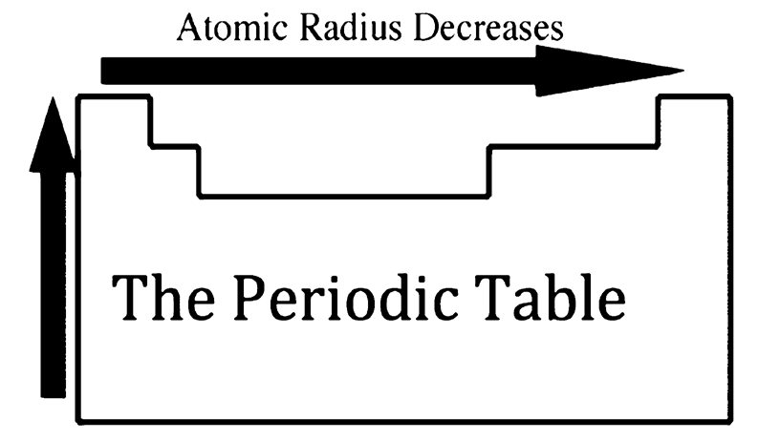
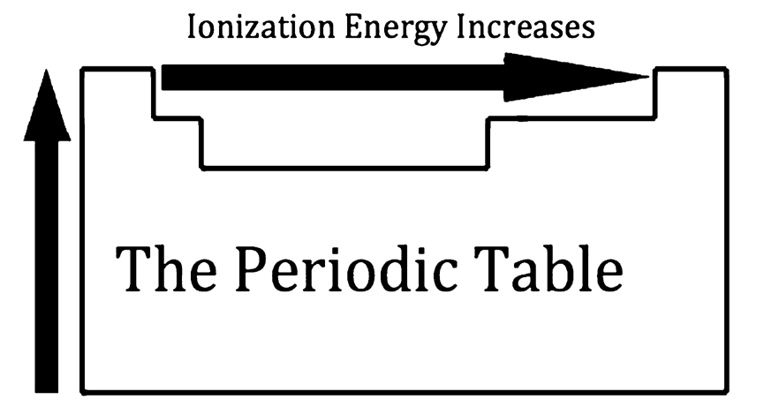
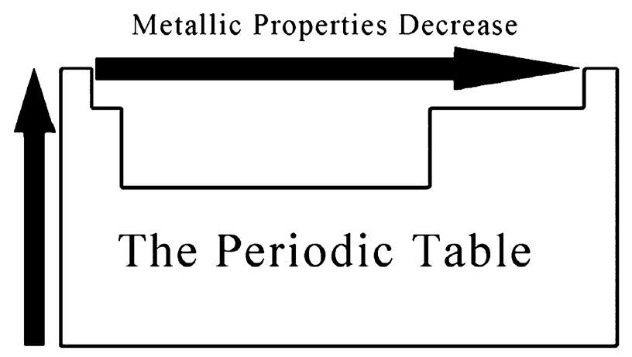
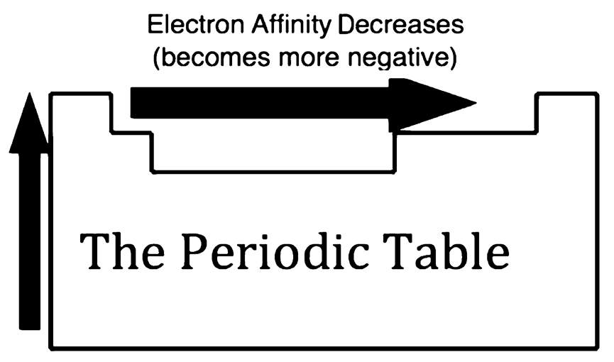
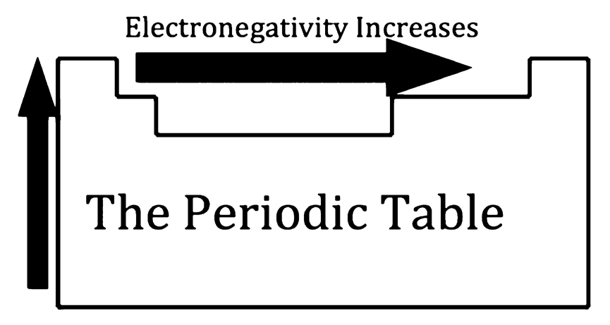
Arrangement of Elements and Trends in the Periodic Table
Electronegativity increases from left to right across the period in the periodic table. Electronegativity decreases within a group as you go from top to bottom. These trends for electronegativity indicate that atoms of metals have a greater tendency to lose electrons than atoms of nonmetals. Likewise, those nonmetals have a greater tendency to gain electrons than metals.
Trends in the Periodic Table

Slide 14
Arrangement of Elements and Trends in the Periodic Table
Activity
Directions: Read and answer each item carefully. Give the letter of the correct answer.
1. What group of elements do alkaline earth metals belong to?
A. Group IA B. Group IIA C. Group IIIA D. Group IVA
2. The periodic table has 18 groups. What is the other name for groups?
A. families B. blocks C. series D. triads
3. Which of the following groups of elements belong to Group VIIA?
A. chalcogens B. Halogens C. noble gases D. transition elements
4. The periodic table has 7 periods. What is the other name for periods?
A. blocks B. families C. series D. triads
5. Which of the following refers to the energy released when an incoming electron is finally added to an isolated atom or neutral atom in its ground state?
A. atomic radius B. ionization energy C. electronegativity D. electron affinity

Slide 15
Arrangement of Elements and Trends in the Periodic Table
Answer Key
1. What group of elements do alkaline earth metals belong to?
A. Group IA B. Group IIA C. Group IIIA D. Group IVA
2. The periodic table has 18 groups. What is the other name for groups?
A. families B. blocks C. series D. triads
3. Which of the following groups of elements belong to Group VIIA?
A. chalcogens B. Halogens C. noble gases D. transition elements
4. The periodic table has 7 periods. What is the other name for periods?
A. blocks B. families C. series D. triads
5. Which of the following refers to the energy released when an incoming electron is finally added to an isolated atom or neutral atom in its ground state?
A. atomic radius B. ionization energy C. electronegativity D. electron affinity

