Slide 1
Visualizing Division of Fractions Using Models

Slide 2
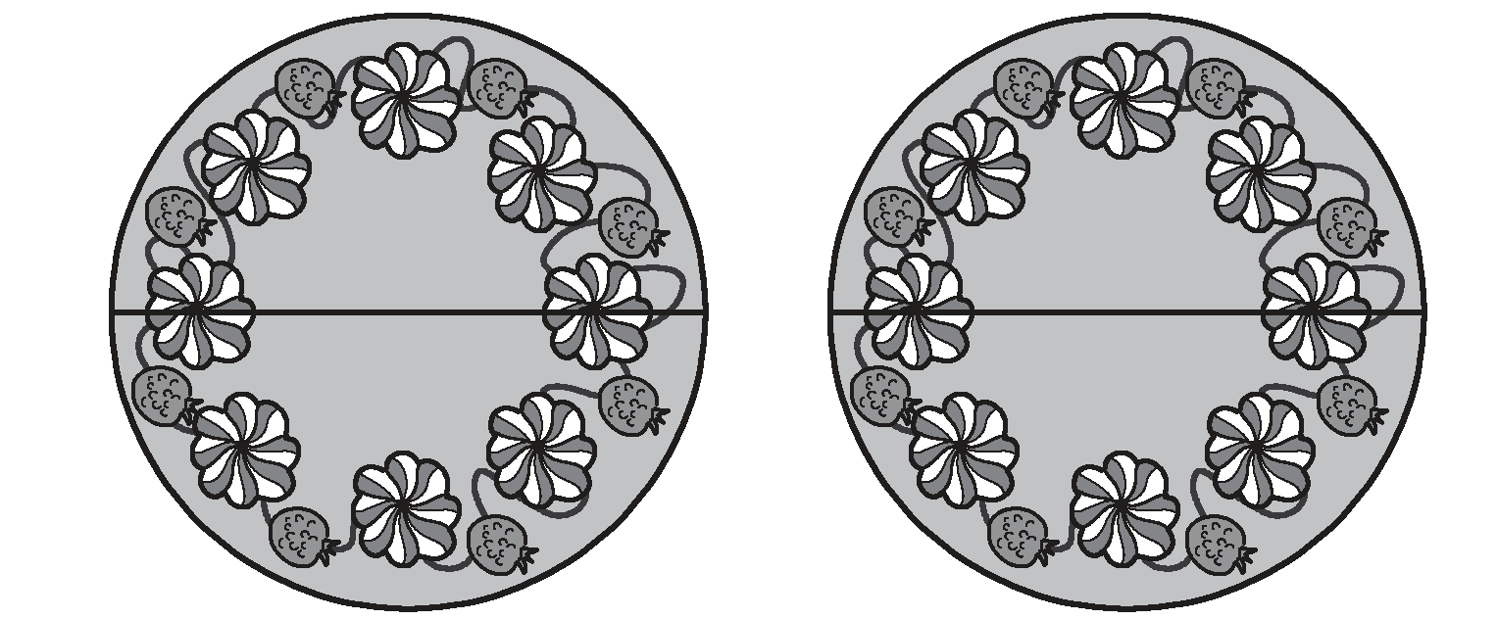

Visualizing Division of Fractions Using Models
Let us see how division of a fraction and another fraction can be illustrated by a fraction circles.
Example 1:
Tina baked 2 cakes for her twins’ birthday party. She wanted to share the cakes with another pair of twins. So, she cut the cakes into halves.
How many halves are there in 2 cakes?
A cake has 2 halves.
Two cakes have 4 halves.
Tina will now have 4 half cakes.
.

Slide 3
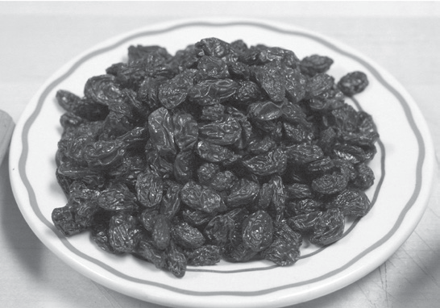
Visualizing Division of Fractions Using Models
Let’s have another problem.
Example #2.
Mrs. Garcia packed 5/7 kilogram of raisins equally into 5 bags. What was the weight
of the raisins in each bag?
How do you find the weight of the raisins in each bag? What operation is
involved here?
Let us see how division of a fraction and a whole number can be illustrated by a fraction bar. A fraction bar is a visual representation which helps in carrying out operations with fractions.

Slide 4


Visualizing Division of Fractions Using Models
Cont.
Step 1:
Draw a bar and cut it into 7 parts.
Step 2:
Shade
To show
Each bag has kilogram of raisins.

Slide 5

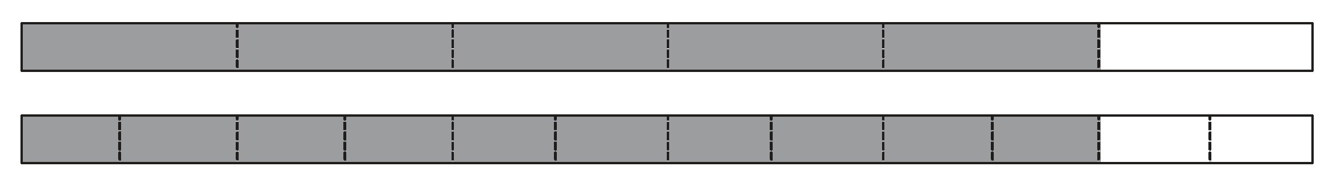

Visualizing Division of Fractions Using Models
Example #3.
Santiago has 5/6 ton of scrap metal. He sold it to 10 different clients. How much scrap metal did each client get?
Step 1:Draw a bar and cut it into sixth parts.
Step 2: Shade
To show
Each client will receive ton of scrap metal.

Slide 6
Visualizing Division of Fractions Using Models
I. Fraction bars is a visual representation of fractions in carrying out operations of fractions.
II. In creating a visual model of a fraction or fraction bars, first, draw a bar containing the number of parts the whole was divided into. Second, shade the part given in the problem. Then, divide again the fraction bars in the opposite direction and shade the given fraction. Lastly, find the common shaded part of the fractions. The common shaded part is the answer to the problem.

