Slide 1
Dividing a Fraction by a Whole Number

Slide 2
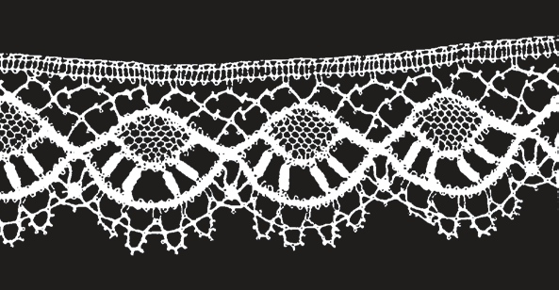

Dividing a Fraction by a Whole Number
In dividing a fraction to a whole number, get the reciprocal of the divisor and proceed to the multiplication of fractions.
Let’s have a example.
How many pieces of 1/3 meter lace can be cut from 4 meters of lace?
To solve the above problem, you need to divide 4 by .
Is the same as 4 x 3.

Slide 3

Dividing a Fraction by a Whole Number
Cont.
What rule should you follow in dividing fractions? To divide fractions, change the divisor to its reciprocal, and then perform multiplication instead.
There are twelve pieces of meter lace that can be cut from 4 meters of lace.
,

Slide 4


Dividing a Fraction by a Whole Number
Here is another example:
Gladys can prepare for an exam for 1/4 day. If she has 2 days to prepare, how many exams can she be ready to take?
To solve the problem on the previous page, you need to divide 2 by 1/4.
is just the same as 2 x 4.
So, we have
Gladys can prepare for 8 exams in 2 days.
.

Slide 5



Dividing a Fraction by a Whole Number
Example #3. Chie can sew a yard of cloth for 3/4 hour using a machine. If she has 6 hours to sew, how many yards of cloth can she sew?
To solve the problem, you need to divide 6 by 3/4.
is the same as
So, we have
Chie can sew 8 yards of cloth in 6 hours.
.

Slide 6
Multiplying a Fraction by a Whole Number
Additional examples. Answers
1. 1/2 ÷ 6 1. 1/2 ÷ 6 = 1/12
2. 2/5 ÷ 5 2. 2/5 ÷ 5 = 2/25
3. 3/4 ÷ 10 3. 3/4 ÷ 10 = 3/40
4. 5/2 ÷ 3 4. 5/2 ÷ 3 = 5/6
5. 5/12 ÷ 4 5. 5/12 ÷ 4 = 5/48

