Slide 1
Dividing a Fraction by a Fraction

Slide 2
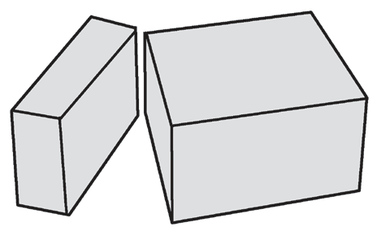


Dividing a Fraction by a Fraction
To divide whole numbers/fractions, multiply the dividend by the reciprocal of the divisor.
Example 1:
Queenie bought cheese that weighs 3/4 pound. If she divides it into portions that are each 1/8 of a pound, how many portions can she make?
is just the same as
Queenie can make 6 portions.

Slide 3
Dividing a Fraction by a Fraction
Additional Examples: Answers
1. 2/3 ÷ 2/4 1. 2/3 ÷ 2/4 = 2/3 x 4/2 = 8/6 or 4/3
2. 3/7 ÷ 5/8 2. 3/7 ÷ 5/8 = 3/7 x 8/5 = 24/35
3. 4/5 ÷ 2/5 3. 4/5 ÷ 2/5 = 4/5 x 5/2 = 20/10 or 2
4. 4/7 ÷ 1/3 4. 4/7 ÷ 1/3 = 4/7 x 3/1 = 12/7
5. 3/4 ÷ 5/7 5. 3/4 ÷ 5/7 = 3/4 x 7/5 = 21/20

