Slide 1
Solving One-step and Multistep Word Problems
Involving Division of Fractions

Slide 2
Solving One-step and Multistep Word Problems Involving Division of Fractions
• To solve routine and non-routine word problems, we can use Polya’s Fourstep Problem-solving Model.
• To divide fractions, get the reciprocal of the divisor, and then change the operation from division to multiplication
• Express the quotient in its simplest form, whenever possible.

Slide 3
Solving One-step and Multistep Word Problems Involving Division of Fractions
Polya’s Four-step Problem-solving Model.
Step 1: Understand the problem.
a. Know what is/are given and what is/are asked.
b. Find word/s or clue/s to the operation/s involved.
Step 2: Devise/make a plan.
a. Know how the facts relate to each other.
b. Make a plan to solve the problem. Devising more than one plan is often useful so that you can compare the effectiveness of each one.
Here are some strategies:
• Writing equations or number statements; and
• Making a model

Slide 4
Solving One-step and Multistep Word Problems Involving Division of Fractions
Cont.
Step 3: Carry out the plan/Solve.
Solve the problem according to the chosen plan.
Step 4: Look back.
Read the problem again and check whether the answer makes sense.
• To multiply fractions:
a. Write the product of the numerators over the product of the denominators.
b. Simplify the product of the fractions whenever possible.

Slide 5
Solving One-step and Multistep Word Problems Involving Division of Fractions
Example #1:
Mrs. Santos, a TLE teacher, gave a 3-yard cloth per group. She wanted each group to make different types of pillowcases for their project. If each pillowcase needed 3/4 yard of cloth, how many pillowcases would each group make?
Solution:
Step 1: Understand the problem.
What is asked in the problem?
Answer: The number of pillowcases that each group would make.
• What are given?
Answer: 3-yard cloth 3/4 yard in each pillowcase

Slide 6
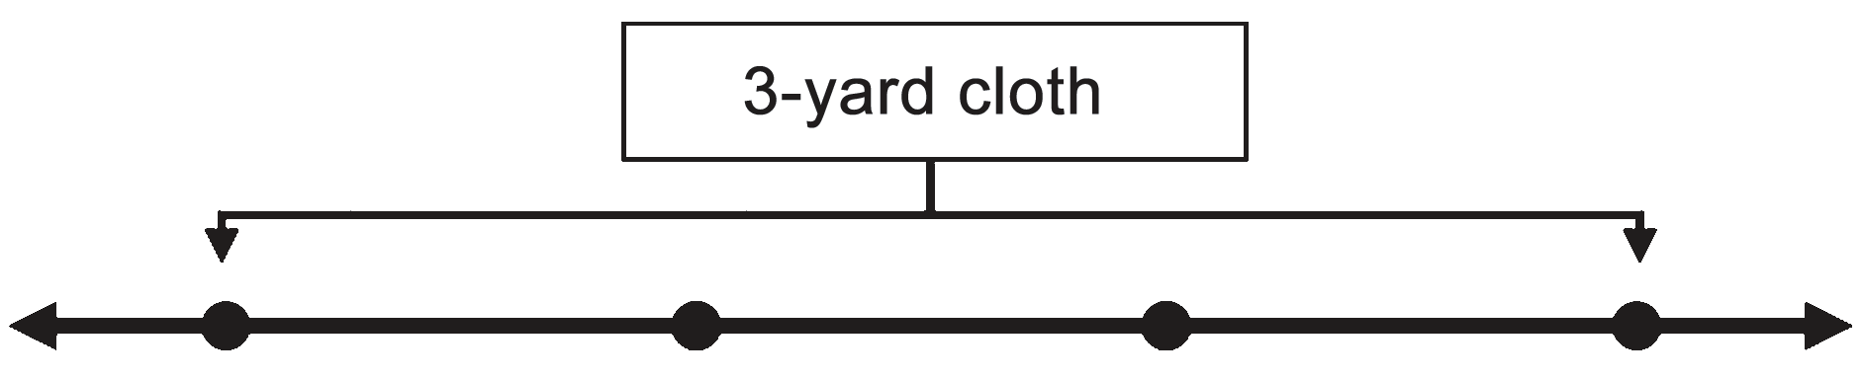
Solving One-step and Multistep Word Problems Involving Division of Fractions
Cont.
Step 2: Devise/Make a plan.
• What strategy or operation should be used?
Answer: Using Number Line or Writing an Equations
Step 3: Carry out or use the plan.
We can solve this using these strategies or tools:
1st Strategy: Number Line
• Draw a line and write numbers 0 to 3 to represent a 3-yard cloth.

Slide 7
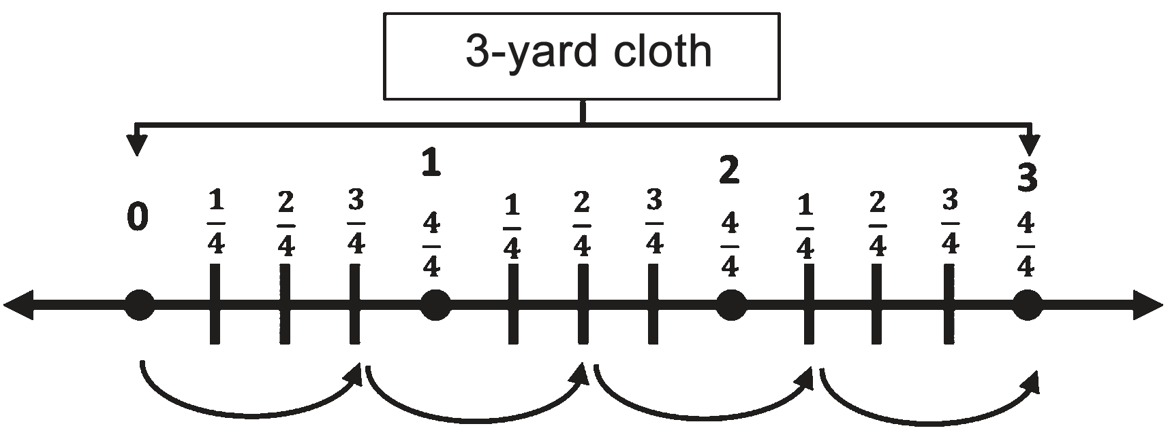
Solving One-step and Multistep Word Problems Involving Division of Fractions
Cont.
• Divide each yard into 4 equal parts and make an arc in every 3 parts of 4.

Slide 8
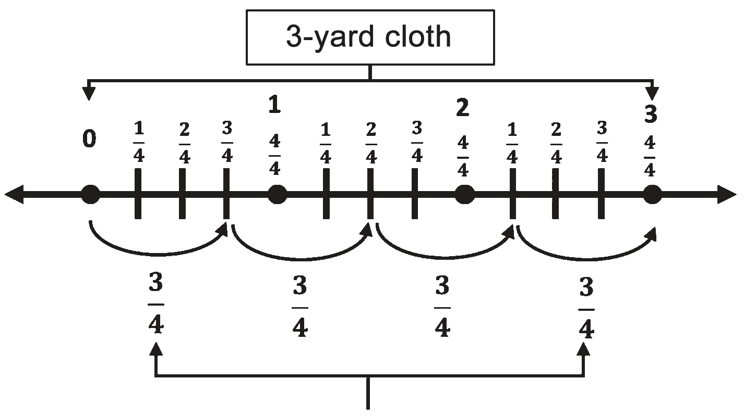
Solving One-step and Multistep Word Problems Involving Division of Fractions
Cont.
• It shows that there are 4 pieces of 3/4 parts of cloth in a 3-yard cloth.
Therefore, we can cut four pieces of 3/4 yard in 3-yard cloth.

Slide 9




Solving One-step and Multistep Word Problems Involving Division of Fractions
2nd Strategy: Writing an Equation
• Write the number sentence.
• Get the reciprocal of the divisor, and then change the operation from division to multiplication.
• Multiply the whole number to the numerator, then copy the denominator.
• Divide the numerator by the denominator.
Therefore, there are 4 pieces of 3/4 parts of cloth in a 3-yard cloth.
.

Slide 10
Solving One-step and Multistep Word Problems Involving Division of Fractions
Step 4: Look back and check.
• Use the reverse order of operations.
4 × 3 = 12 ÷ 4 = 3
Therefore, the answer to the given problem is correct.
The given problem is a routine word problem because it involves one of the arithmetic operations. To get the answer to the problem, we use division.
In solving nonroutine problems, we can also use the same strategy given. Analyze the situation given.
.

Slide 11
Solving One-step and Multistep Word Problems Involving Division of Fractions
Example #2:
Mang Lito owned 4/5 hectare of land. He decided to divide it to his two sons, Mark and Josh. If Mark had 1/4 hectare of land before receiving his father’s heritage, how many hectares of land did Mark have?
Solution:
• What is asked in the problem?
Answer: The total number of hectares of land that Mark had
• What are given?
Answer: 4/5 hectare of land that Mang Lito had 2 sons (Mark and Josh) 1/4 hectare of land that Mark already had
.

Slide 12
Solving One-step and Multistep Word Problems Involving Division of Fractions
Step 2: Devise/Make a plan.
What strategy or operation should be used?
Answer: Using Number Line or Order of Operations
Step 3: Carry out or use the plan.
We can solve this using a number line.
The given problem is a nonroutine word problem because it involves two or more arithmetic operations. To get the answer to the problem, we use division and addition.
.

Slide 13

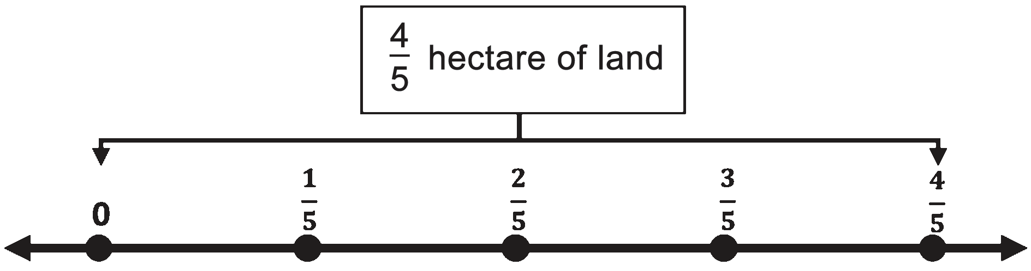
Solving One-step and Multistep Word Problems Involving Division of Fractions
Cont.
• Draw a line and write number 0, to represent Mang Lito’s , 4/5 hectare of land.
.

Slide 14
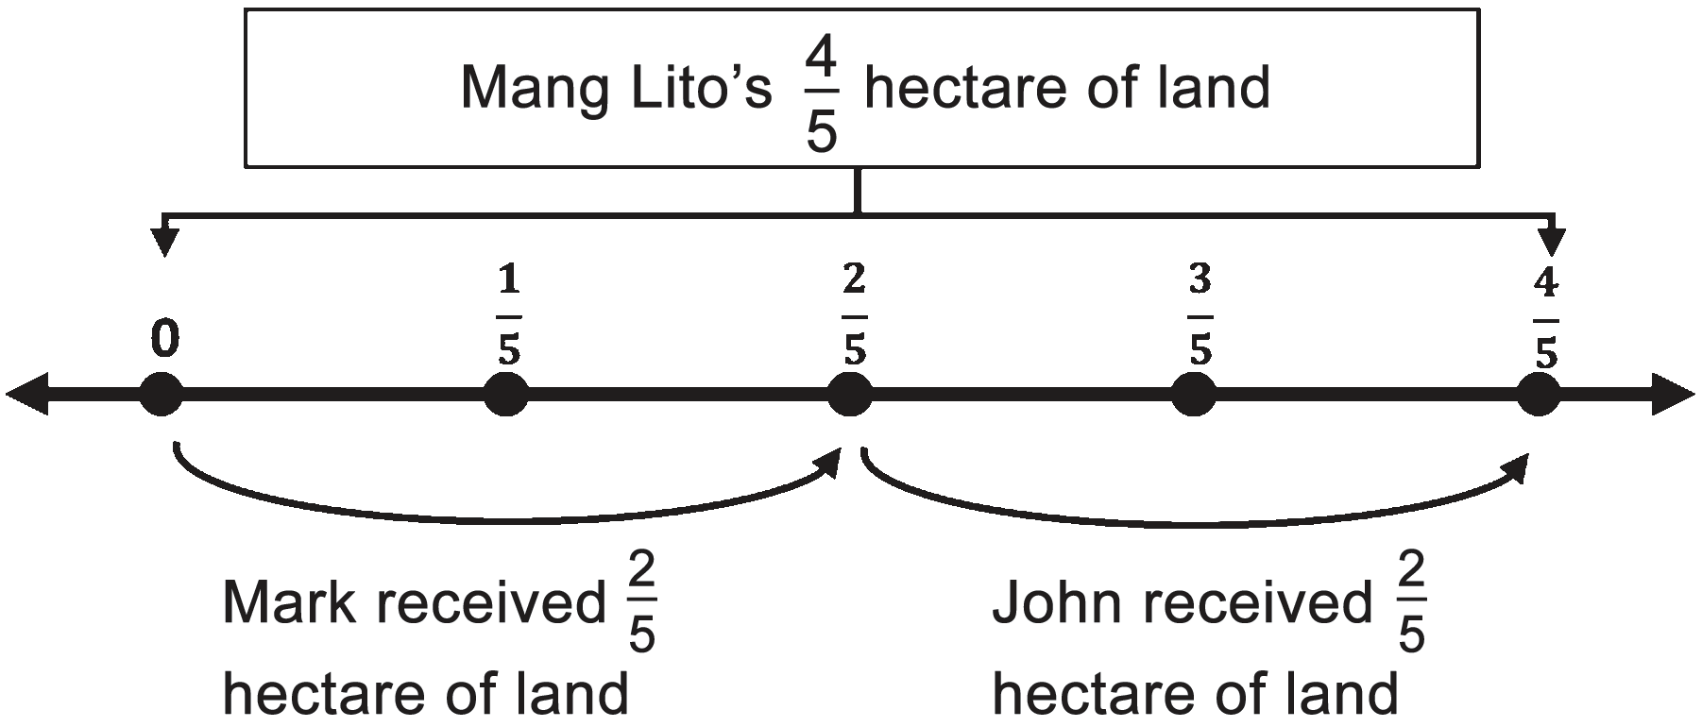
Solving One-step and Multistep Word Problems Involving Division of Fractions
Cont.
• Draw an arc in every 2 parts to get the number of hectares each son received.
.

Slide 15




Solving One-step and Multistep Word Problems Involving Division of Fractions
Writing an Equation
• Write the equation
• Get the reciprocal of the divisor, then cheange the operation from division to multiplication.
• Multiply the fractions and add the result to 1/4.
Remember to reduce your answer to its simplest form.
Therefore, Mark has a total of 13/20 hectare of land.
.

Slide 16

Solving One-step and Multistep Word Problems Involving Division of Fractions
Step 4: Look back and check.
• Use the reverse order of operations.
Therefore, the answer to the given problem is correct.
.

