Slide 1
Plate Boundaries

Slide 2
Plate Boundaries
Plate Boundaries
There are two types of lithospheric or tectonic plates. They are the continental plate and the oceanic plate, which are topped by their own kind of crust. The solid ground where you stand is called the continental crust. It is less dense than the oceanic crust and measures around 10 to 70 kilometers thick. Continental crusts are formed through volcanic eruptions. Meanwhile, the oceanic crust is made of heavier basalt and gabbro rocks. Oceanic crust is younger than the continental crust and measures only around 7 kilometers thick. Like the continental crust, the oceanic crust is formed by magma, when a volcanic eruption occurs underwater.

Slide 3
Plate Boundaries
The lithosphere forms the Earth’s relatively rigid shell. But unlike the shell of a chicken egg, the lithospheric shell contains many breaks that separate it into distinct pieces. We call these pieces plates. The break between two tectonic plates is called a boundary. There are three types of plate boundaries: convergent, divergent, and transform fault.
Convergent Boundary
Convergent boundary is also called destructive plate boundary. It occurs where two plates are pushing toward each other. Here, the crust is destroyed and recycled back into the interior of the Earth while the other plate dives under the other.
This happens when a moving plate of dense oceanic lithosphere collides with a plate moving in the opposite direction. One of the plates subducts beneath the other.

Slide 4
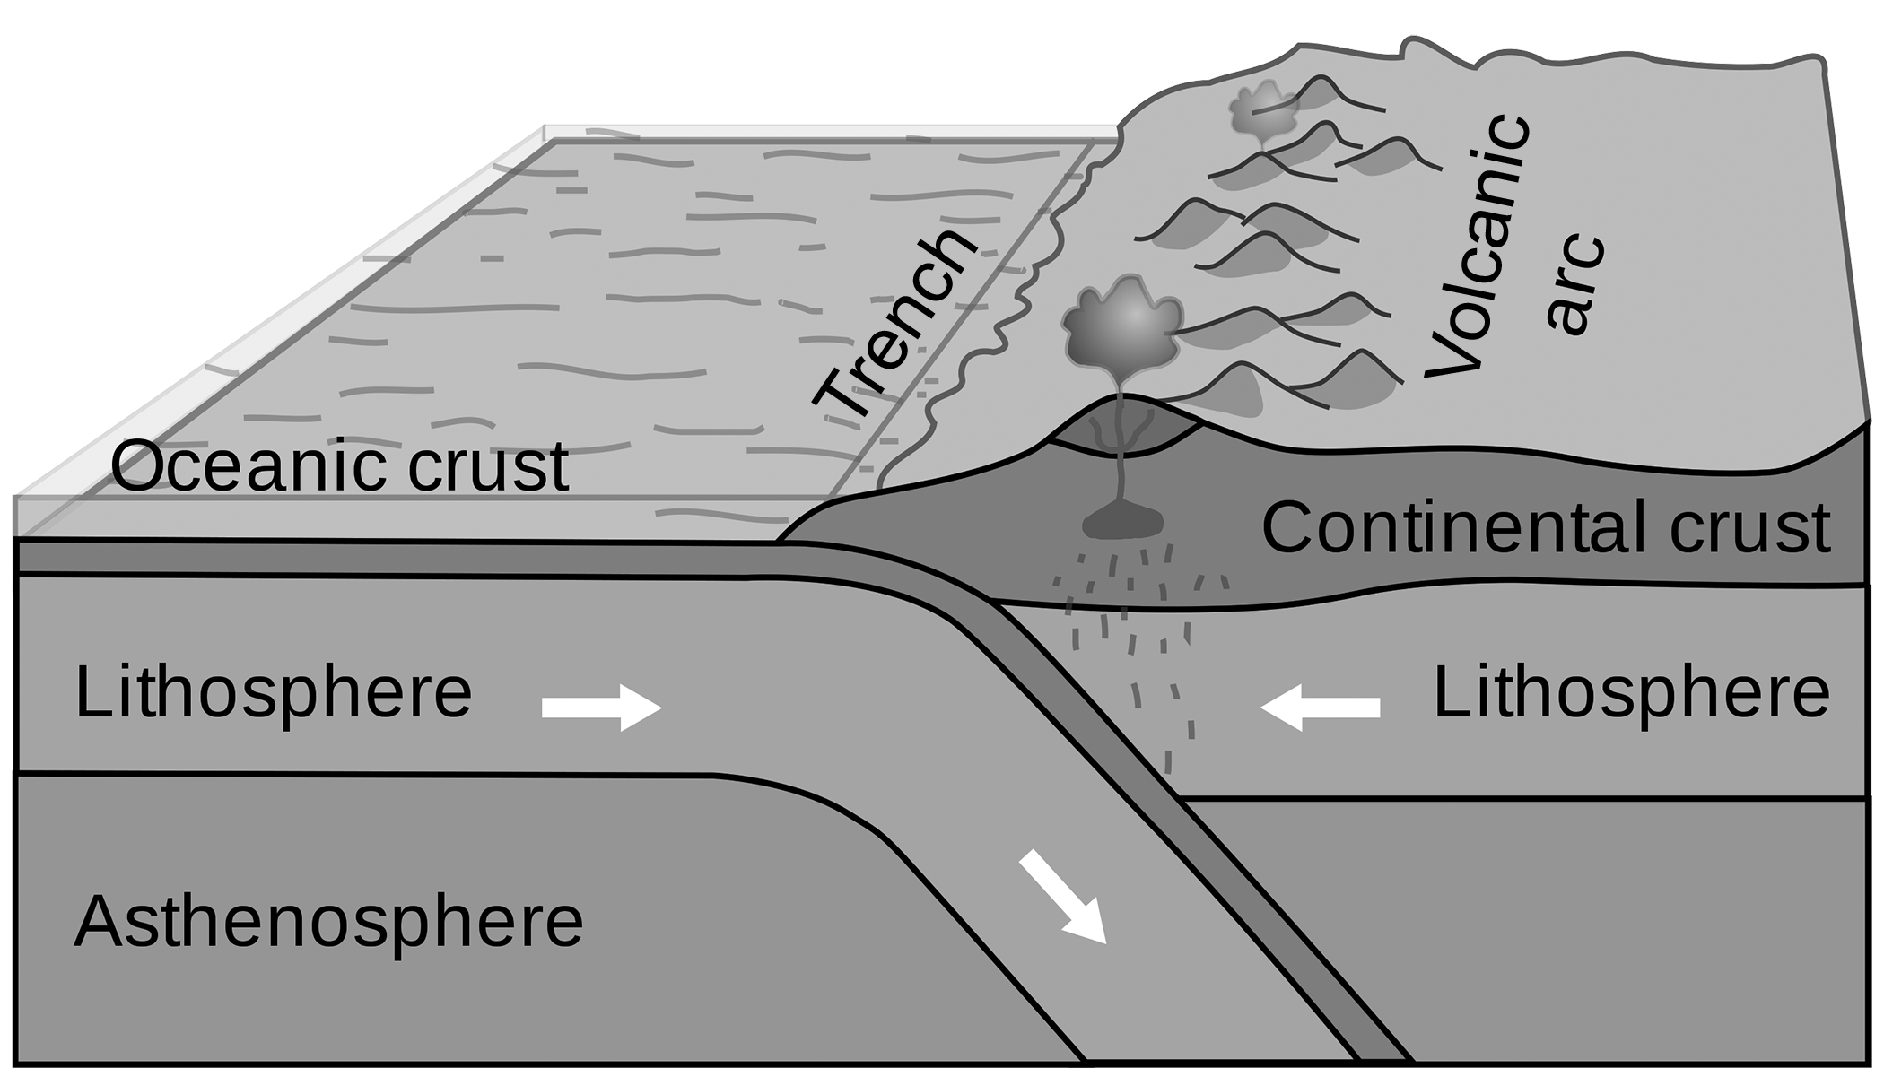
Plate Boundaries
The younger of the two plates will ride over the edge of the older plate because the former is less dense. The heavier plate eventually bends and plunges steeply through the asthenosphere and descends into the earth, creating a trench that can be as much as 100 kilometers wide, more than a thousand kilometers long, and several kilometers deep.
Booyabazooka, Public Domain, via Wikimedia commons

Slide 5
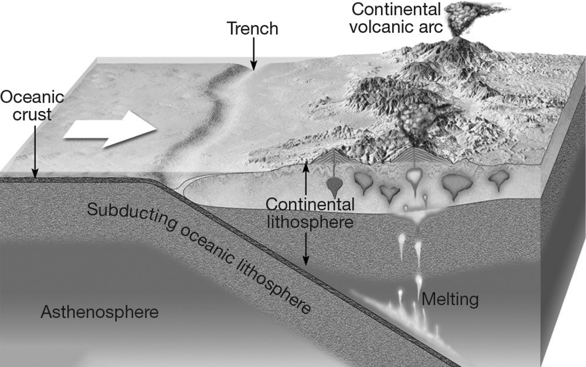
Plate Boundaries
Subduction zones are the regions where a portion of the tectonic plates are diving beneath other plates into Earth’s interior. These zones are defined by deep oceanic trenches, large earthquakes that extend from the trenches landward, and lines of volcanoes parallel to the trenches.
pmlbird, CC BY 2.0, flickr.com

Slide 6
Plate Boundaries
The Wadati-Benioff Zone is an example of a subduction zone. Earthquakes in this area may extend down to depths of 100 kilometers before the subducting plate heats up and loses its ability to deform in a brittle fashion
General examples of convergent boundaries include the boundary between the Eurasian Plate and the Indian Plate at the Himalayas and the boundary between the Nazca Plate and the South American Plate along the west coast of South America.

Slide 7
Plate Boundaries
There are three types of convergent boundaries: oceanic-oceanic, oceanic-continental, and continental-continental convergence.
Oceanic-oceanic convergence occurs when two oceanic plates meet and one oceanic plate is pushed underneath the other. During the process of subduction, the subducting plate descends into the mantle. Due to extreme temperature, the plate is heated, causing it to melt and turn into magma. As magma is less dense compared to the surrounding rocks, it rises on the seafloor through eruptions, forming arcs of volcanic islands, such as the Japanese islands, the Aleutian Islands, the Caribbean islands, and the Philippine islands.

Slide 8
Plate Boundaries
Oceanic-continental Convergence occurs when an oceanic plate pushes into and moves underneath a continental plate. The continental plate that overrides the oceanic plate lifts up to create mountain ranges. As the oceanic plate sinks, it glides into the newly formed trench, and smaller pieces break off. These small pieces are locked in their place for a long period of time before they produce sudden movements and earthquakes. Some of the landforms created by the convergence of the ocean and continental crusts are the Andes Mountains in western South America and the Cascade Range in western North America.

Slide 9
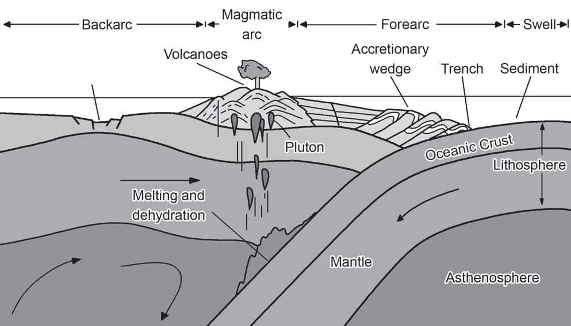
Plate Boundaries
Continental-continental convergence occurs when two continents meet head on. Since continental crusts are too light to slide down into a trench, neither plate is pushed underneath the other. This results in the formation of tall mountain ranges. The Himalayas, known as Earth’s highest mountain belt, is an example of a zone of mountains that rose when India collided with the Eurasian continent.

Slide 10
Plate Boundaries
Divergent Boundary
A divergent boundary is a zone where two lithospheric plates move apart from each other. This is also known as constructive plate boundary. This is characterized by long rift zones, normal faults, and basaltic volcanism. Slips on the faults cause divergent-boundary earthquakes.
The volcanic country of Iceland exemplifies the processes that occur along a divergent boundary. It splits along the Mid-Atlantic Ridge borders of North American and Eurasian Plates. As North America moves westward and Eurasia shifts eastward, a new crust is created on both sides of the boundary. As a crust adds mass to Iceland to both sides, a rift along the boundary is also carved out.

Slide 11
Plate Boundaries
The divergent boundary is marked by a mid-oceanic ridge. The ridge is composed entirely of basalt and is not deformed by folding but rather by extensional forces, resulting in normal faulting and basaltic igneous activity. New oceanic crust forms continually along the divergent boundary. Mid-oceanic ridges are nearly continuous features around the entire planet. These mid-oceanic ridges measure 10,000 kilometers, and assuming that they are not underneath bodies of water, the ridges would be visible from the moon.

Slide 12
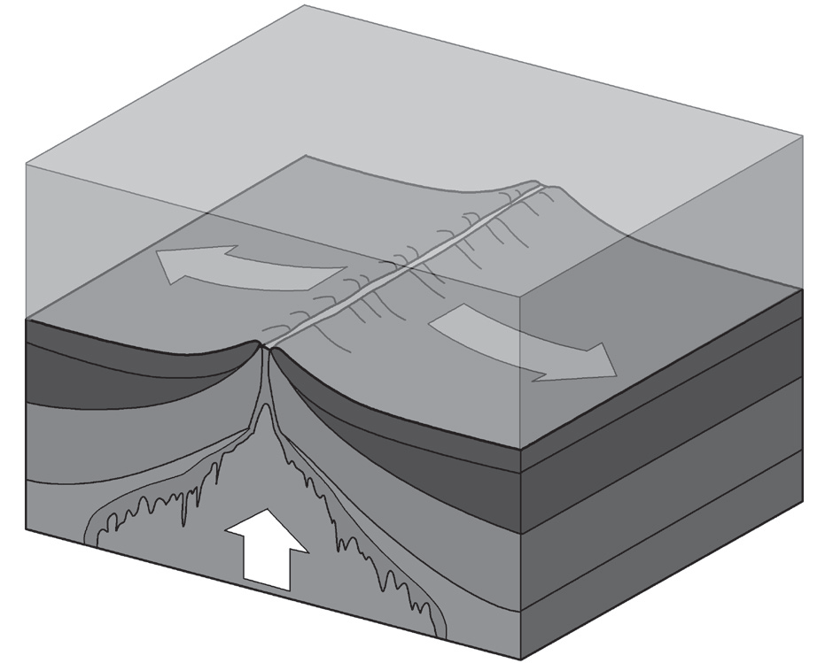
Plate Boundaries
The rate of spreading along the Mid-Atlantic ridges accounts for an average of 2.5 centimeters per year (25 kilometers per million year), a rate that may seem slow by human standards. However, because Earth has been existing for several billion years, seafloor spreading has caused the Atlantic Ocean to grow from a tiny inlet of water between Europe, Africa, and America into the second largest ocean in the world.

Slide 13
Plate Boundaries
Transform Fault Boundary
Transform fault boundary, or simply transform boundary, is a zone between two plates that slide horizontally past one another. It is also called conservative boundary because it neither creates nor destroys a crust.
Transform boundaries are generally vertical and parallel to the direction of movement. They are produced by shearing and are closely related to divergent plate boundaries on the ocean floor. When they occur on the seafloor, they form oceanic fracture zones. When on land, transform boundaries produce faults.

Slide 14
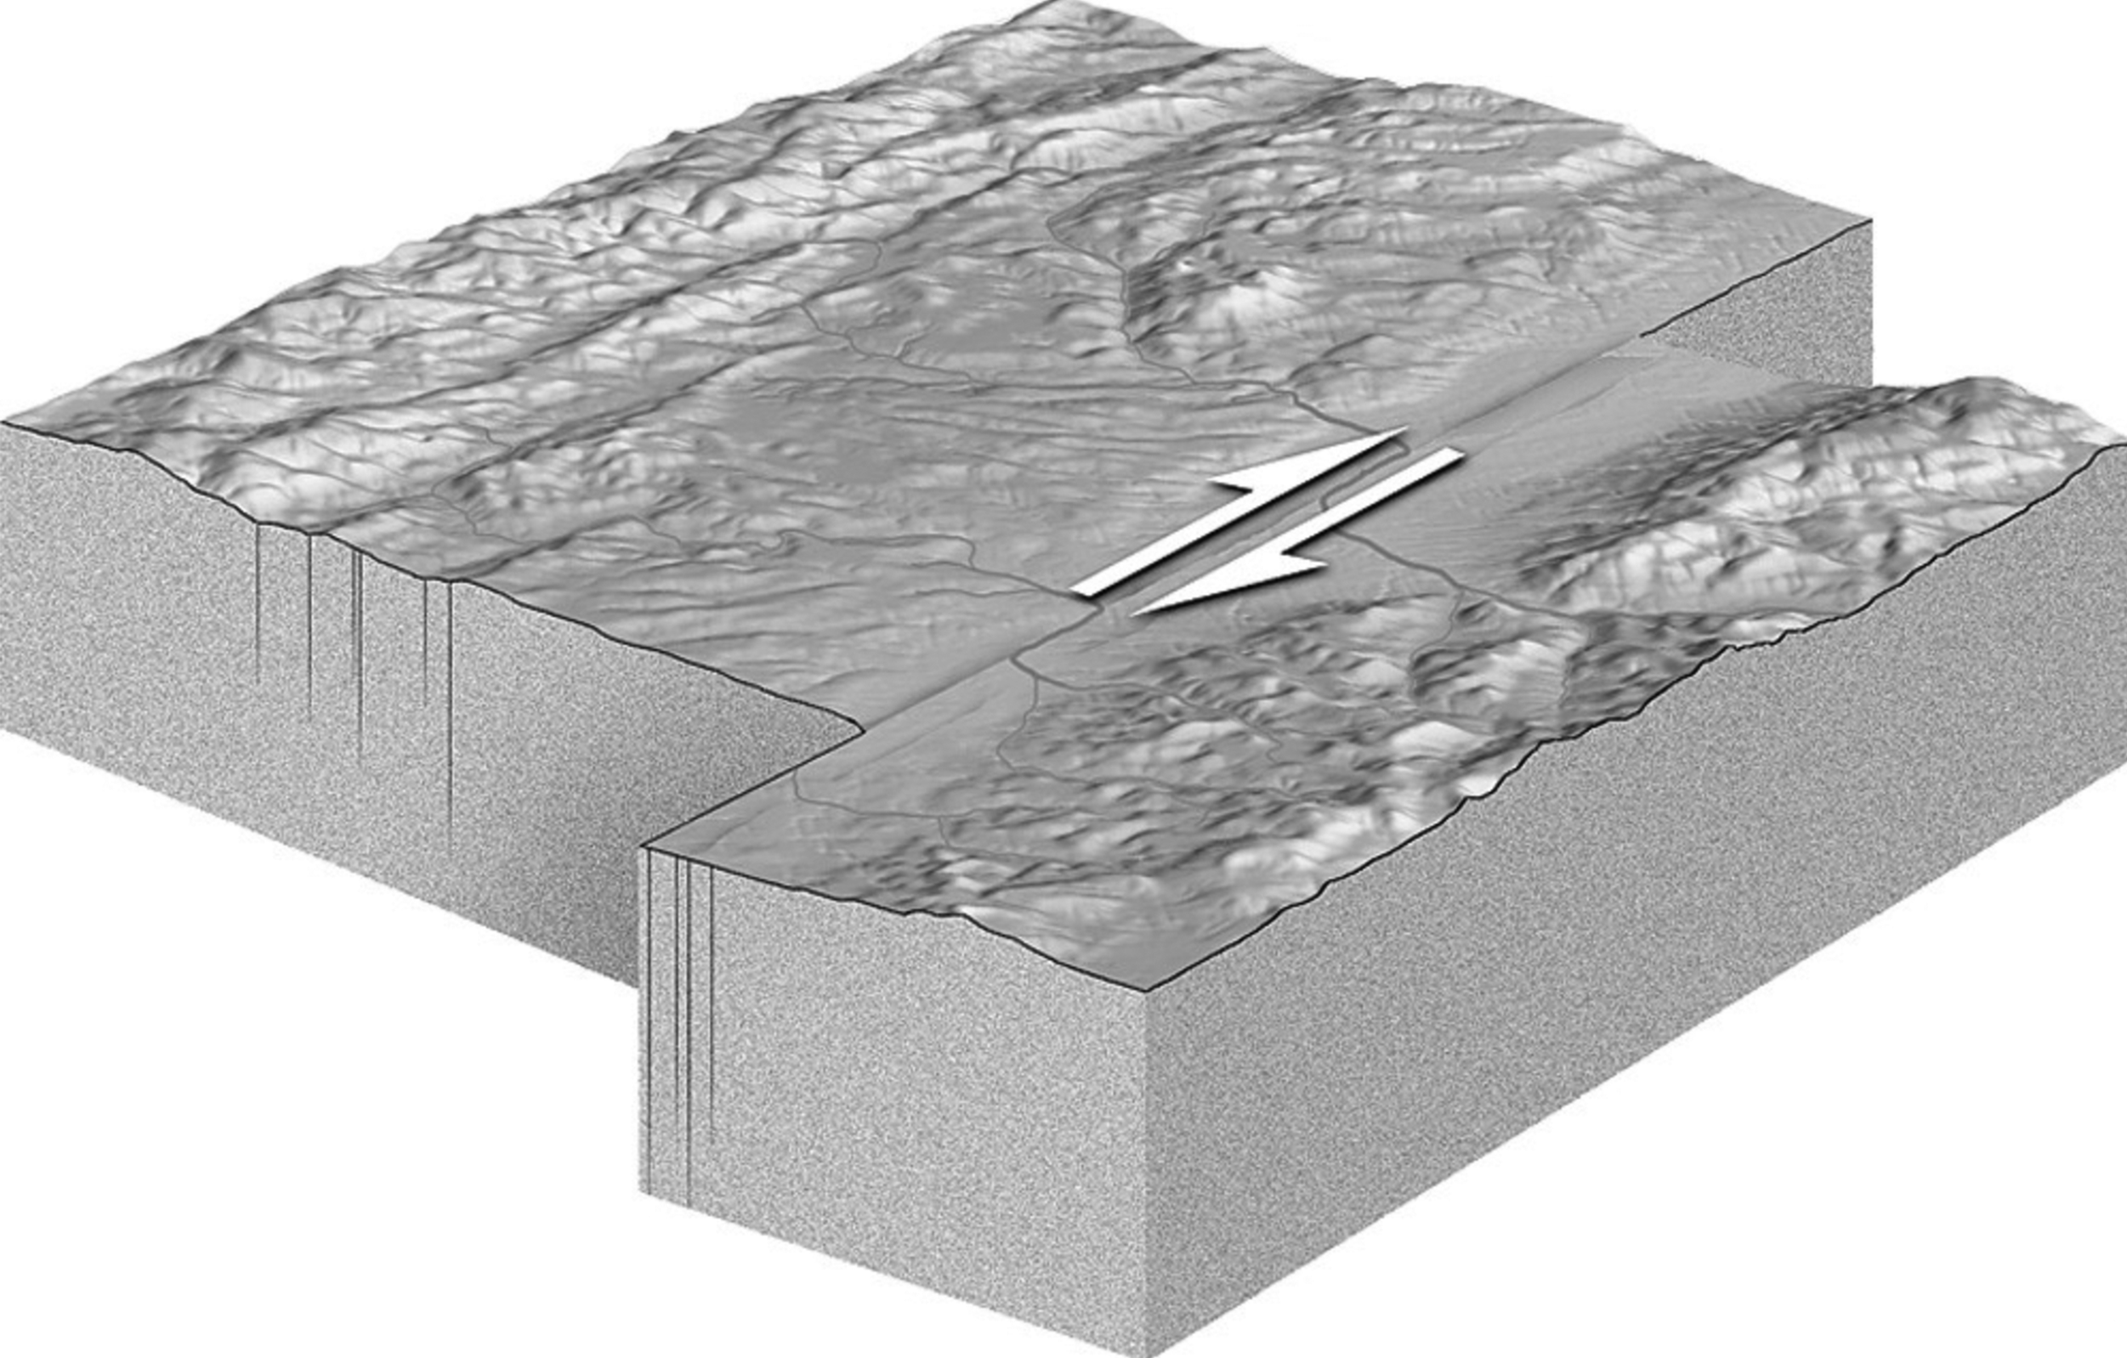
Plate Boundaries
Earthquakes occur only on the segment of a fracture zone that lies between two ridge segments. Both fracture and fault line connect off setting divergent zones. The San Andreas fault zone in California is a transform fault that connects two diverging
boundaries : the East Pacific Rise along the Pacific Ocean and South Punta Gorda in Florida.

Slide 15
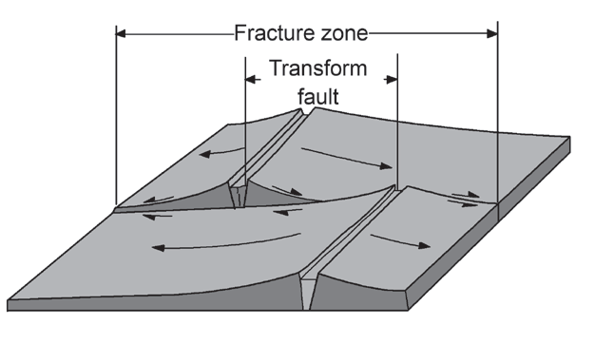
Plate Boundaries
Transform faults can connect convergent and divergent plate boundaries in three ways.
Ridge-Ridge Transform Fault Boundary |  | • connects two segments of a divergent plate boundary • by far the most abundant • fault cuts through the entire lithosphere • active displacement occurs only between the ridge segments • plate movements are in opposite directions between the ridge crests • sustains the formidable shearing movement Example: Dead Sea transform system

Slide 16
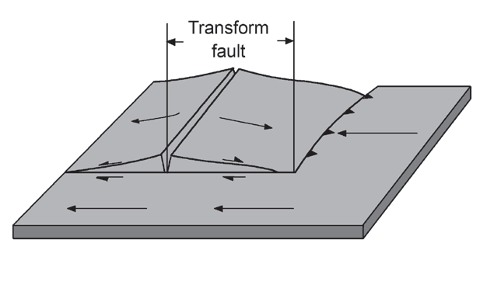
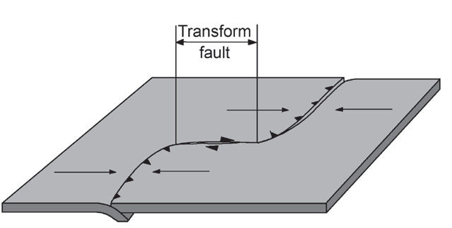
Plate Boundaries
Ridge-Trench Transform Fault |  | • connects a ridge and a trench • much less common • longest transform faults are all of this kind • forms an important connection between spreading and converging plates Example: Queen Charlotte Island Fault off the western coast of Canada
Trench-Trench Transform Fault |  | • a couple of trenches at two different convergent plate boundaries • rare Example: Alpine Fault in New Zealand

Slide 17
Plate Boundaries
Is it possible for more than two tectonic plates to meet at one point? The answer is yes. The point at which three plate boundaries meet is called a triple junction. At this boundary, one of three types ridge, trench, or transform is involved. There are approximately 50 tectonic plates with about 100 triple junctions among them. At any boundary between two plates, they may spread apart and produce a mid-oceanic ridge, push each other and create deep-sea trenches, or slide sideways and form transform faults.

Slide 18
Plate Boundaries
Activity
Directions: Match Column A with Column B. Write the letter of the correct answer in the space.
Column A
Column B
A. convergent
B. subduction zone
C. oceanic crust
D. transform fault
E. divergent
F. boundary
_____1. one lithospheric plate plunging under another plate
_____2. boundary marked by deep-ocean trenches and volcanic arcs
_____3. breaks between two tectonic plates
_____4. boundary marked by mid-ocean ridges
_____5. boundary marked by large faults at which one plate slides horizontally past another

Slide 19
Plate Boundaries
Answer Key
B
_____1. one lithospheric plate plunging under another plate
_____2. boundary marked by deep-ocean trenches and volcanic arcs
_____3. breaks between two tectonic plates
_____4. boundary marked by mid-ocean ridges
_____5. boundary marked by large faults at which one plate slides horizontally past another
A
F
E
D

