Slide 1
Earth’s Internal Structure and Active Volcanoes

Slide 2
Earth’s Internal Structure and Active Volcanoes
Many of the processes on Earth’s surface originate from what is happening inside it. Earth is about 12,756 km in diameter, with its internal structure mainly composed of three parts: the crust, mantle, and core.
The crust is the outer layer of Earth that is between 0–70 kilometers thick. It is made up of tectonic plates that are in constant motion. This is the solid layer where we live. The two types of crust are the continental crust and the oceanic crust. Continental crust carries land and is less dense than oceanic crust. On the other hand, oceanic crust carries water.

Slide 3
Earth’s Internal Structure and Active Volcanoes
The mantle is the thickest layer of Earth, approximately 2,900 kilometers deep. It is mostly composed of iron, magnesium, and silicon. In addition, the mantle is dense, hot, and semisolid. The mantle is composed of two layers: the lithosphere and the asthenosphere. The lithosphere is located at the uppermost part of the mantle and is rigid in structure. Beneath the lithosphere is the asthenosphere, which is flowy but still solid in nature.

Slide 4
Earth’s Internal Structure and Active Volcanoes
The heat from the core is transferred to the base of the mantle. The temperature difference between the lower and upper mantle requires heat transfer to occur. The warmer mantle material near the core moves up as it gets less dense. As it rises and moves away from the core, the material cools and is pushed aside by the rising material from the lower mantle. Cooler mantle material in the upper mantle is continuously pushed until it slowly sinks back to the lower mantle and will be heated again. You learned in the previous module that this process is called mantle convection and may provide the force for plate movements. Tectonic plates move away from each other where mantle convection currents rise up. Ridges are also formed where mantle convection currents move down.

Slide 5
Earth’s Internal Structure and Active Volcanoes
The core is divided into the outer and inner cores. The outer core is a layer made up of liquid iron and nickel, which surround the inner core. The outer core remains in the liquid state due to the radioactive decay of the elements uranium and thorium. The convection current created by the melting of iron and nickel creates electric currents and generates the magnetic field of Earth.
The inner core has a ball-like structure and is located at the center of Earth. The hottest part of the inner core has a temperature reaching up to 5,500°C. The inner core spins faster than Earth’s rotation on its axis.

Slide 6
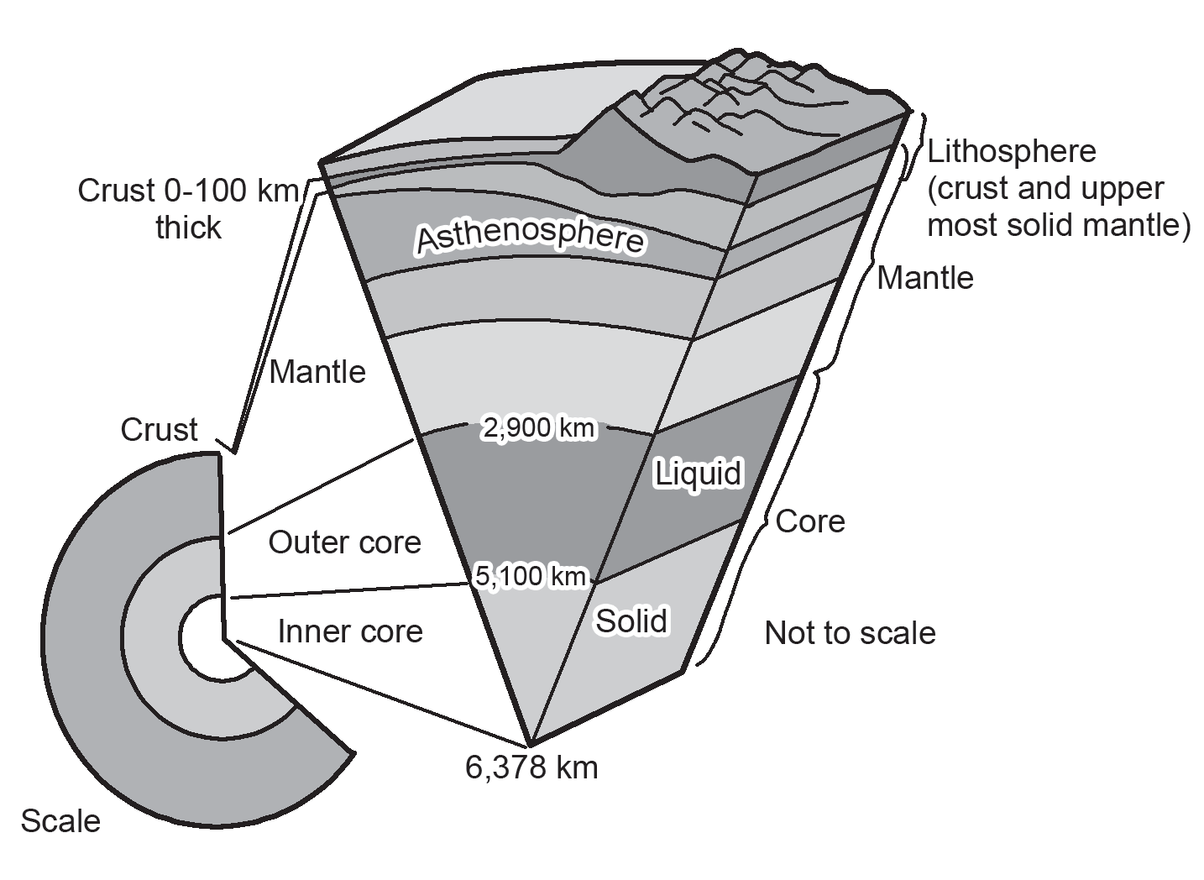
Earth’s Internal Structure and Active Volcanoes
Most landforms are the results of geologic processes in Earth’s structure. These geological formations are formed from the movement of plates, the uplift or subsidence of these plates, or by the movement of magma to the surface of Earth.

Slide 7
Earth’s Internal Structure and Active Volcanoes
Mountains and mountain ranges are usually formed by the movement of plates that takes place in millions of years. Fold mountains are formed when two plates collide and cause Earth’s crust to fold and crumple. An example of this is the Himalayan mountain range that was formed from the collision of the Eurasian Plate and Indian Plate about 50 million years ago and is continuing up to the present.
Mountains can also be formed along faults where large blocks of rocks are forced up and some are forced down. These are called fault-block mountains. The Sierra Nevada mountains are a good example of this. Volcanoes are formed when magma, the molten rock from the mantle, comes out to Earth’s surface. This then solidifies and forms the volcano.

Slide 8
Earth’s Internal Structure and Active Volcanoes
After millions of years, molten magma can come out from this channel or through other openings. The process by which magma comes out of the surface is also driven by mantle convection. As the plates move away from each other, hot molten magma rises from this ridge. Volcanic eruptions are driven by the expulsion of magma from these ridges.
Active volcanoes are not distributed equally around the world. Most active volcanoes are found near plate boundaries. About 75% of all volcanoes in the world are found in the Pacific Ring of Fire. Along this area, plates collide and form subduction zones, which melt the subducted rock and become magma.

Slide 9
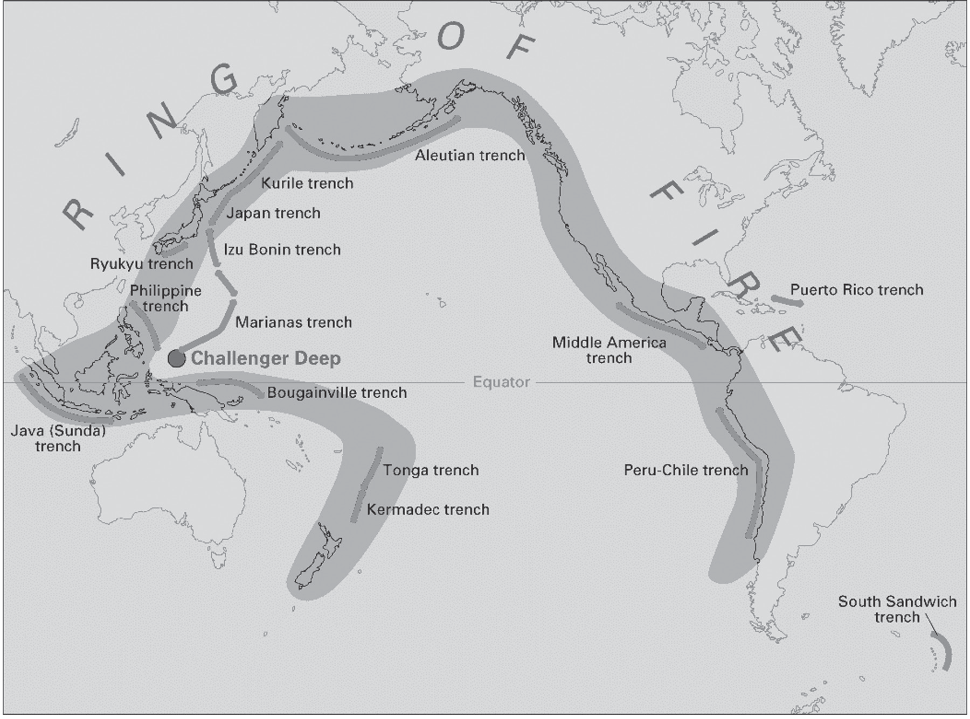
Earth’s Internal Structure and Active Volcanoes
The magma formed will be eventually discharged to Earth’s surface through vents. Mt. Fuji, one of the symbols of Japan, is an active volcano located along the Pacific Ring of Fire. Mt. Fuji was formed by the collision and activity of three plates: Amurian plate (associated with the Eurasian tectonic plate), the Okhotsk plate (associated with the North American plate), and the Filipino plate.

Slide 10
Earth’s Internal Structure and Active Volcanoes
Activity
Directions: Complete the given statements by choosing from the options inside the box.
magma plates Eurasian Indian
geologic processes
1. Most landforms are the results of ______________________ in Earth’s structure.
2. These geological formations are formed from the movement of _________.
3-4 The Himalayan mountain range that was formed from the collision of the _________ Plate and ________ Plate
5. Volcanoes are formed when _________, the molten rock from the mantle, comes out to Earth's surface.

Slide 11
Earth’s Internal Structure and Active Volcanoes
Answer Key
1. Most landforms are the results of __________________ in Earth’s structure.
2. These geological formations are formed from the movement of ______.
3-4 The Himalayan mountain range that was formed from the collision of the _________ Plate and ______ Plate
5. Volcanoes are formed when _______, the molten rock from the mantle, comes out to Earth's surface.
geologic processes
plates
Eurasian
Indian
magma

