Slide 1
Earthquake Epicenters

Slide 2
Earthquake Epicenters
An earthquake is described as the shaking of the ground. However, the cause of an earthquake can be attributed to the processes happening inside Earth. The most common type of earthquake is the tectonic earthquake.
Tectonic earthquakes happen as a result of the movement of tectonic plates. When plates move away or toward each other, some areas get stuck through time. In these areas, pressure builds up, and when the crusts finally move past each other, the crusts break. In some cases, the crust is displaced, and the force from the built-up pressure is released. This force is measured as seismic waves and recorded as the earthquake. About 90% of the recorded earthquakes around the world happen in plate boundaries, specifically in the Pacific Ring of Fire. Another type of earthquake is the volcanic earthquake, which is caused by a volcanic activity like eruption.

Slide 3
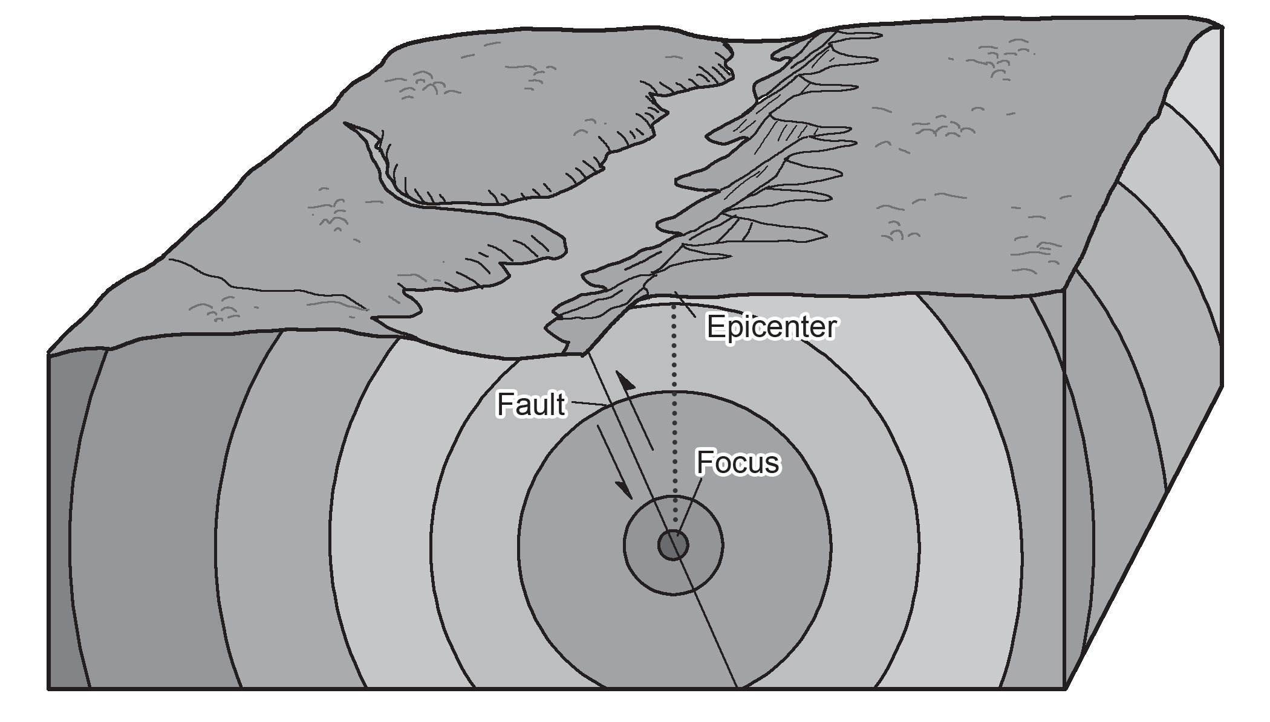
Earthquake Epicenters
The exact location where the earthquake starts is the hypocenter, also called as focus. This is below Earth’s surface. The location directly above the hypocenter is called the epicenter. The epicenter is on the surface of Earth.

Slide 4
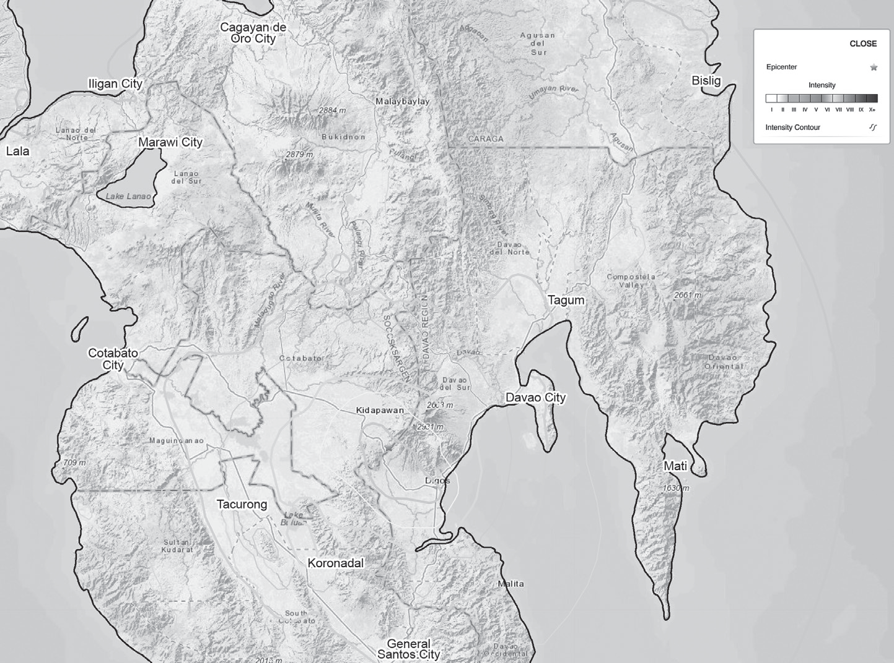
Earthquake Epicenters
The epicenter has a direct effect on the damage caused by earthquakes. The image on the next page shows that the highest intensity (ground shaking) is felt around the epicenter and gradually decreases away from the epicenter. This is the reason it is advisable to build infrastructures away from active faults as pressure may build up in these areas and the possibility of an earthquake is high.

Slide 5
Earthquake Epicenters
TAKEAWAYS
• Most earthquakes occur at the plate boundaries.
• Epicenter is the point directly above where an earthquake starts to occur.

Slide 6
Earthquake Epicenters
Activity
Directions: Identify which of these statements are TRUE or FALSE. Write your answers in the blanks provided.
_____ 1. The most common type of earthquake is the tectonic earthquake.
_____ 2. All earthquakes are volcanic in origin.
_____ 3. The epicenter is the location where an earthquake starts.
_____ 4. The Philippines is not located in the Pacific Ring of Fire.
_____ 5. The area closest to the epicenter has the greater earthquake caused damages.

Slide 7
Earthquake Epicenters
Answer Key
_____ 1. The most common type of earthquake is the tectonic earthquake.
_____ 2. All earthquakes are volcanic in origin.
_____ 3. The epicenter is the location where an earthquake starts.
_____ 4. The Philippines is not located in the Pacific Ring of Fire.
_____ 5. The area closest to the epicenter has the greater earthquake caused damages.
True
False
False
False
True

