Slide 1
Disaster Risks: Earthquakes, Tsunamis, and Volcanic Eruptions

Slide 2
Disaster Risks: Earthquakes, Tsunamis, and Volcanic Eruptions
A disaster is a sudden event that negatively affects lives, properties, livelihood, or industries that results in permanent changes to society, ecosystems, and the environment. Based on its origin, a disaster can be natural or man-made. Natural disasters, which can happen at any time, are catastrophic events resulting from natural processes of the earth, while man-made disasters are caused by human interference.
Risk is defined as the chance or the probability that a person will be harmed or will experience an adverse health effect if exposed to a hazard. It may also apply to any situation with property and equipment loss and harmful outcomes in the environment.

Slide 3
Disaster Risks: Earthquakes, Tsunamis, and Volcanic Eruptions
Assessing risks is dependent on three factors: hazards, exposure, and vulnerability. Hazard pertains to any dangerous phenomenon, such as an earthquake, a tsunami, or a volcanic eruption, that may cause the loss of lives and properties, environmental damages, and/or economic disruptions. It is often used interchangeably with harm and risk. However, this should not be the case. To point out clearly, the hazard is the source or cause of risk, harm is the outcome of disasters, and risk is the potentiality, probability, or likelihood of a disaster happening.
Exposure is the presence of people, properties, and other elements subjected to a potential loss in the hazard zone. A given community, for example, can either be highly prone to disasters or is safeguarded from these, depending on its exposure to the hazards present in the area where the community lies.

Slide 4
Disaster Risks: Earthquakes, Tsunamis, and Volcanic Eruptions
Vulnerability is the susceptibility of people and properties to the damaging effects of a hazard. It is determined by physical, social, economic, and/or environmental factors. Vulnerability and exposure determine the potentiality of the risk. In other words, the degree to which a hazard can become destructive depends on how exposed a given area is and how vulnerable it is to the hazard.
Natural disasters, like earthquakes, tsunamis, and volcanic eruptions, have many consequences that can be fatal to humans, destructive to properties, and harmful to the environment. Powerful earthquakes can make houses and buildings collapse. Tsunamis are powerful waves in the ocean that can be devastating when they come ashore. At worst, a powerful volcanic eruption can change the climate of the whole globe.

Slide 5
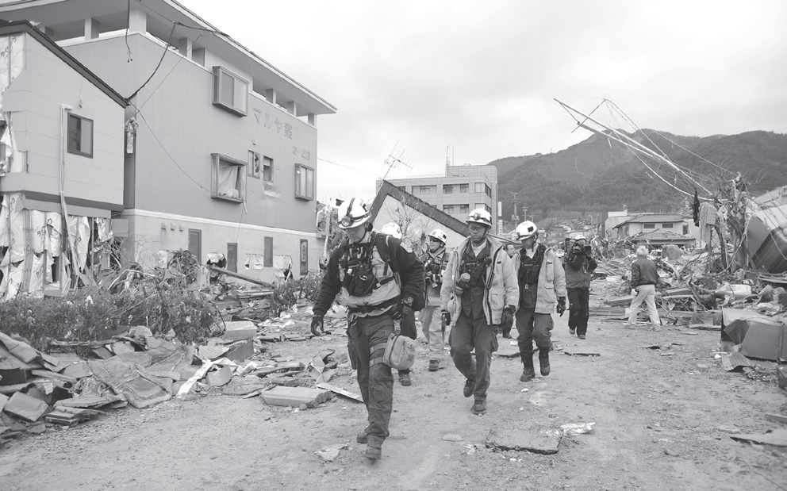
Disaster Risks: Earthquakes, Tsunamis, and Volcanic Eruptions
Earthquakes occur due to the interaction of tectonic plates. As plates push or move away from each other or slide past one another, their movements generate large amounts of energy that make the ground shake. This sudden movement or shaking of the ground is known as an earthquake.
DVIDSHUB, CC BY 2.0, via Wikimedia commons

Slide 6
Disaster Risks: Earthquakes, Tsunamis, and Volcanic Eruptions
The following are some earthquake hazards
Ground shaking is the primary cause of destruction during an earthquake. It may cause power lines to break; pipelines to rupture; and buildings, roads, bridges, and other structures to collapse. It is a direct hazard of earthquakes and can cause secondary hazards, such as tsunamis, landslides, fires, destabilized cliffs and steep slopes that cause landslides, and rockfalls.
Subsidence or lowering of the ground surface often occurs during earthquakes. This may be due to the downward vertical displacement on one side of a fault and can sometimes affect a large land area. Coastal areas can become permanently flooded as a result.

Slide 7
Disaster Risks: Earthquakes, Tsunamis, and Volcanic Eruptions
Liquefaction occurs when waterlogged sediments are agitated by seismic shaking. This separates the grains from each other, reducing their load-bearing capacity. Liquefaction can cause the sinking or tilting of the structure above it.
At least one person was killed, and 43 persons were injured after a magnitude 6.6 earthquake shook central Philippines. It also brought damage to buildings and roads.
The shallow quake struck southeast of Masbate Island in the Bicol region at 8:03 a.m. (00:03 GMT) on Tuesday, the US Geological Survey said.
Sand boil is a craterlike effect of liquefaction where liquid sand and excess water flows toward the surface.
Seiches are standing waves set up on rivers, ponds, and lakes when seismic waves pass through the area.

Slide 8
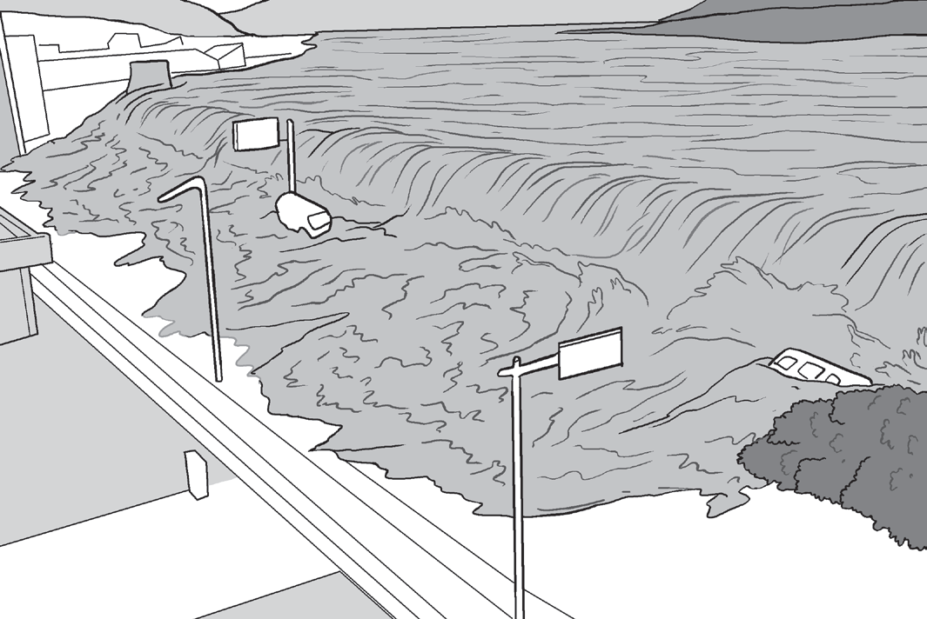
Disaster Risks: Earthquakes, Tsunamis, and Volcanic Eruptions
A Tsunami Overflowing Seawalls
Tsunami is a Japanese term used to describe seismic sea waves that are generated when an earthquake’s focus is undersea. As large areas of the ocean floor rise or fall suddenly during an earthquake, the large volume of water is displaced, causing the sea to recede and creating large waves.
A tsunami’s height and impact to a specific coastal location are influenced by the local bathymetry and topography and the direction from which the tsunami arrives.
Did You Know?
In most cases, the first in the series of waves is not the biggest. A tsunami may start small, relatively speaking, and develop over time. People have been killed most often by subsequent waves, coming hours after the “start of the tsunami.”

Slide 9
Disaster Risks: Earthquakes, Tsunamis, and Volcanic Eruptions
Did You Know?
In most cases, the first in the series of waves is not the biggest. A tsunami may start small, relatively speaking, and develop over time. People have been killed most often by subsequent waves, coming hours after the “start of the tsunami.”
Low-lying tsunami areas, such as beaches, bays, lagoons, harbors, river mouths, and places along rivers and streams leading to the ocean, are the most vulnerable.
Large tsunamis, striking with tremendous force, are a significant threat to human health, coastal properties and infrastructures, coastal resources, and even national economies.

Slide 10
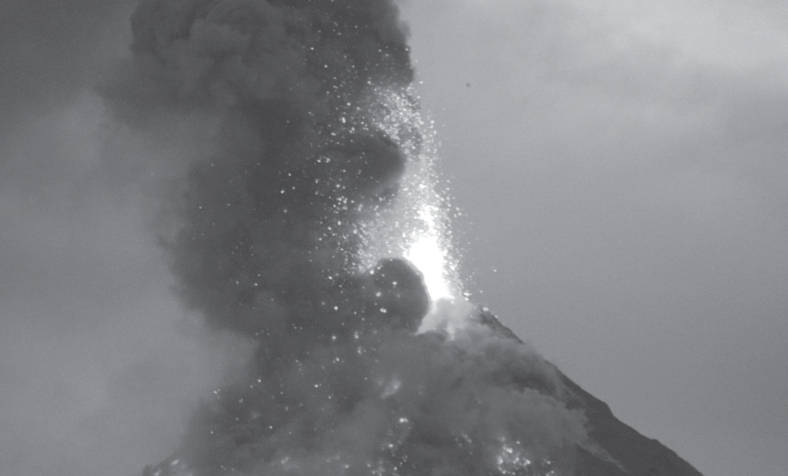
Disaster Risks: Earthquakes, Tsunamis, and Volcanic Eruptions
Volcanic eruptions occur when volcanoes spew hot, dangerous gases, ash, lava, and rocks that are powerfully destructive.
A Violent Volcanic Eruption
The following are the hazards associated with volcanic eruptions
Lava or molten rock can erupt as fire fountains or lava flows (when it is runny) or as steep-sided domes (when it is viscous). Lava may destroy buildings and infrastructures, but it moves relatively slow so it is rarely a direct threat to people.
Darkimages08, CC BY-SA 4.0, via Wikimedia commons

Slide 11
Disaster Risks: Earthquakes, Tsunamis, and Volcanic Eruptions
Earthquake and Volcanic Hazards
• Earthquakes and volcanoes cause damages not only to humans and structures but to the environment and wildlife as well.
• Earthquakes can cause damages by shaking, tsunamis, and landslides.
• Volcanoes can cause damages by ash flows, release of gases, mudflows,
lava flows, and landslides.
Pyroclastic flows are hot avalanches of rock, ash, and gas that travel down on volcano slopes at high speeds. These pyroclastic flows may be very dangerous if you are close to a
volcano.
Phreatic explosions are explosions caused by the interaction of water with hot rock or magma (lava).

Slide 12
Disaster Risks: Earthquakes, Tsunamis, and Volcanic Eruptions
On January 12, 2020, the Taal Volcano in the Philippines awoke from 43 years of being quiet and began to spew gases, ash, and lava into the air. In the weeks that followed, the eruption dropped a layer of unusually wet, heavy ash on the surrounding landscape, withering vegetation and turning the lush fields and forests of the volcano island to a ghostly gray.
Lahars are hot or cold mixtures of water and volcanic debris that are formed when volcanic materials interact with water, ice, snow, or loose wet sediments. Lahars are most dangerous if you are close to a volcano, but large lahars may rapidly travel tens of kilometers from a volcano to river valleys, which can pose a threat to people and infrastructures far beyond the volcano’s slopes.

Slide 13
Disaster Risks: Earthquakes, Tsunamis, and Volcanic Eruptions
5. Volcanic gases bubble out of lava or escape through soil or vents in the ground. The most common volcanic gases are water vapor, carbon dioxide, sulfur dioxide, hydrogen, hydrogen sulfide, and carbon monoxide. Some of these gases are irritating and poisonous or may cause breathing problems. Also, the release of sulfur dioxide may cause acid rain to form.

Slide 14
Disaster Risks: Earthquakes, Tsunamis, and Volcanic Eruptions
Activity
Directions: Identify whether the following hazards are associated with earthquakes, tsunamis, or volcanic eruptions. Write your answer in the blank.
1. large tsunami – __________
2. sand boil – __________
3. seiches – __________
4. geological disaster – __________
5. lahar – __________

Slide 15
Disaster Risks: Earthquakes, Tsunamis, and Volcanic Eruptions
Answer Key
1. large tsunami – _________
2. sand boil – ____________
3. seiches – ____________
4. geological disaster – _________________
5. lahar – ___________
tsunamis
earthquakes
earthquakes
volcanic eruptions
earthquakes

