Slide 1
Disaster Preparedness: Earthquakes, Tsunamis, and Volcanic Eruptions

Slide 2
Disaster Preparedness: Earthquakes, Tsunamis, and Volcanic
Disaster preparedness refers to measures taken to prepare for and reduce the effects of disasters, that is, to predict and, when possible, prevent disasters, mitigate their impact on vulnerable populations, and respond to and effectively cope with their consequences.
Preparing your family for a possible earthquake, volcanic eruption, and tsunami not only will help protect your health and properties from volcanic ashes, strong waves, and ground shaking, but may also become the difference between life and death.

Slide 3
Disaster Preparedness: Earthquakes, Tsunamis, and Volcanic
Preparing a plan of approach is vital, as is educating everyone in your family or household to ensure their safety and well-being when disasters happen. The given table presents the things to do before, during, and after the disaster.
Earthquakes | Tsunamis | Volcanic Eruptions
Before
Practice your earthquake drill: DROP, COVER, and HOLD. Talk with your family and prepare an emergency plan. Identify the safe places close to your home or school. | Know if your local area could be struck by a tsunami. Talk with your family and prepare an emergency plan. Identify the safe places close to your home and school. It should be at least one kilometer inland or 35 meters above sea level. | Know where active volcanoes are and whether they are likely to affect you. Have an evacuation plan on where to go and how to get there.

Slide 4
Disaster Preparedness: Earthquakes, Tsunamis, and Volcanic
During
DROP, COVER, and HOLD. Stay where you are until the shaking stops. Do not attempt to run outside. | Leave the area immediately if you are on the beach or near a river when a strong earthquake occurs. Move quickly but safely. Do not go to a river or beach to watch the waves if a warning has been issued. | Stay indoors and keep the windows and doors shut. If outdoors, find shelter. Listen to the radio for instructions. If told to leave, cover your face and mouth and take your getaway items.

Slide 5
Disaster Preparedness: Earthquakes, Tsunamis, and Volcanic
After
• Listen to and follow instructions from adults or the radio. • If you can, help others who are in need. • Watch out for possible dangers or hazards. Stay calm. • Remember that there may be some aftershocks. | • Stay calm. • Listen to and follow instructions from adults or the radio. • If you can, help others who are in need. | • If you are in a safe place, stay put. • Listen to the radio for information. • Return home only when you are told.

Slide 6
Disaster Preparedness: Earthquakes, Tsunamis, and Volcanic
What is the importance of preparing for disasters?
Disaster can happen at any time, often with little to no warning. Mass destruction can leave you cut off from the outside world for days. Emergency rescuers will soon be there to help following a disaster, but it may take time before they can get to you.
You need to be prepared. Being ready for any disaster is important to surviving and recovering from a disaster. You are now aware of the possible risks and things to do before, during, and after earthquakes, volcanic eruptions, and tsunamis. All these concepts and ideas may help you during these calamitous events.

Slide 7
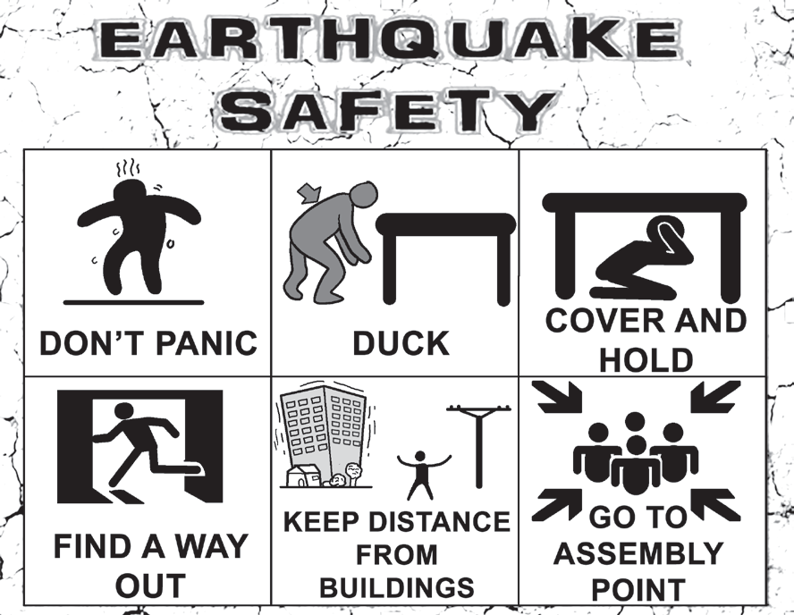
Disaster Preparedness: Earthquakes, Tsunamis, and Volcanic
Duck down to the floor, take cover under a sturdy table or desk, and hold on until the shaking stops. Remember: Avoid danger spots near windows, hanging objects, mirrors, or tall furniture. If you take cover under a sturdy piece of furniture, hold on to it and be prepared to move with it.

Slide 8
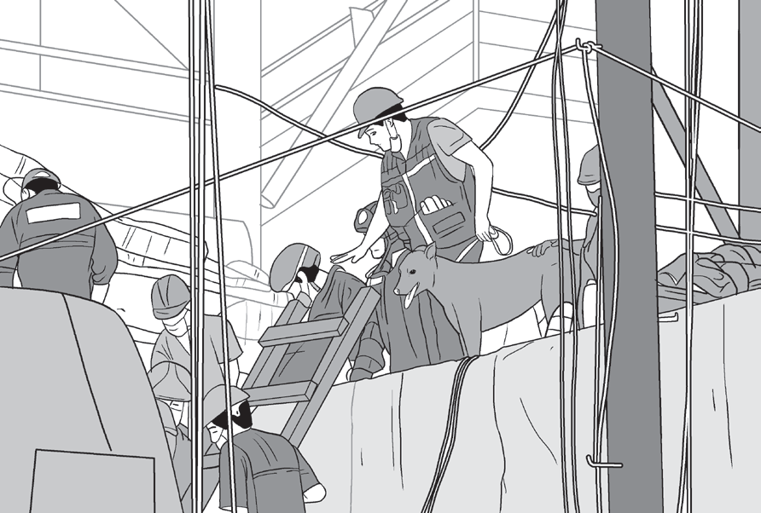
Disaster Preparedness: Earthquakes, Tsunamis, and Volcanic
On April 22, 2019, a 6.1-magnitude earthquake struck the island of Luzon in the Philippines, leaving at least 18 dead and 3 missing and injuring at least 256 others. Despite the fact that the epicenter was in Zambales, most of the damage to infrastructure occurred in the neighboring province of Pampanga, which suffered damage to 29 buildings and structures.

Slide 9
Disaster Preparedness: Earthquakes, Tsunamis, and Volcanic
Activity
Directions: Unscramble the words below to unlock the things that you need to prepare for earthquakes, tsunamis, or volcanic eruptions. Write your answers in the blanks.
1. E L C L P N E O H – ______________
2. I R F S T D I A K T I – _______________
3. D O F O – ________
4. D O I R A – ________
5. F A L H S G H T L I – _____________

Slide 10
Disaster Preparedness: Earthquakes, Tsunamis, and Volcanic
Answer Key
1. E L C L P N E O H – ______________
2. I R F S T D I A K T I – _______________
3. D O F O – ________
4. D O I R A – ________
5. F A L H S G H T L I – _____________
CELLPHONE
FIRST AID KIT
FOOD
RADIO
FLASHLIGHT

