Slide 1
Linear Momentum and Its Conservation

Slide 2


Linear Momentum and Its Conservation
The concept of momentum may not be entirely new to you. For example, in a basketball game, you have probably heard the commentators saying that a player has the momentum when he/she is doing very well in the game. In Physics, momentum is a measure of the quantity of motion of an object.
Specifically, linear momentum is a measure of the difficulty encountered in bringing an object to rest. The greater the object’s mass and velocity, the greater is its momentum. Since velocity is a vector quantity, momentum is also a vector. The direction of an object’s momentum is the same as the direction of its velocity. The unit of momentum is kg ⋅ m/s.
Recall that when a body is acted upon by a resultant force, the body is accelerated in accordance with Newton’s second law of motion. That is,
Substitute the formula of acceleration,
in the equation of
force from Newton’s second law, ΣF = m⋅ a.

Slide 3

Linear Momentum and Its Conservation
Cross multiply force and time to isolate mass and velocity on the other side of the equation.
Notice that the right side of the equation equals the change in an object’s momentum, while the left side is the cause of this change, which is called impulse or the product of the force acting on the object and the time of momentum change. Impulse is the change in the body’s momentum through a combination of changes in its mass or velocity.
Consider the time elapsed to be “t” and expand the change in velocity, Δv into Δv = Vf Vi . Then, substitute these values to the equation.
ΣF ⋅ t = m (vf - Vi)
ΣF ⋅ t = mvf - mvi
Rearranging the equation produces the equation for the impulse–momentum theorem.

Slide 4


Linear Momentum and Its Conservation
The above impulse–momentum theorem tells us that when a net force ΣF acts on a body, the impulse is equal to the change in momentum of the body. This theorem helps to interpret a variety of real-life examples, such as impulses occurring in athletics, car collisions, and even that of space rockets. To further understand the principles, study the example below.
Example: What is the average braking force necessary to stop a 900.0 kg motorbike traveling with a constant velocity of 10.0 m/s for 20.0 s?
Given: m = 900.0 kg; t = 20.0 s vi = 10.0 m/s; vf = 0 m/s | Unknown: F | Equation:
Solution: Substituting the given values to the equation and solving for the unknown:

Slide 5
Linear Momentum and Its Conservation
The above example suggests that a change in momentum may be achieved by some combination of force and time. A large force acting for a short time or a small force acting for a long time may bring about the same change in momentum.
When the driver of a moving car lightly steps on the brakes, he/she brings the car to a gentle stop. However, if he/she slams on the brakes, he/she lets the car stop immediately. In the latter scenario, the driver experiences a greater force due to the change in momentum that can cause injuries. These injuries include fractures, broken bones, head bumps, whiplash, traumatic brain injuries, spinal cord injuries, back injuries, internal injuries, and other more serious injuries.

Slide 6
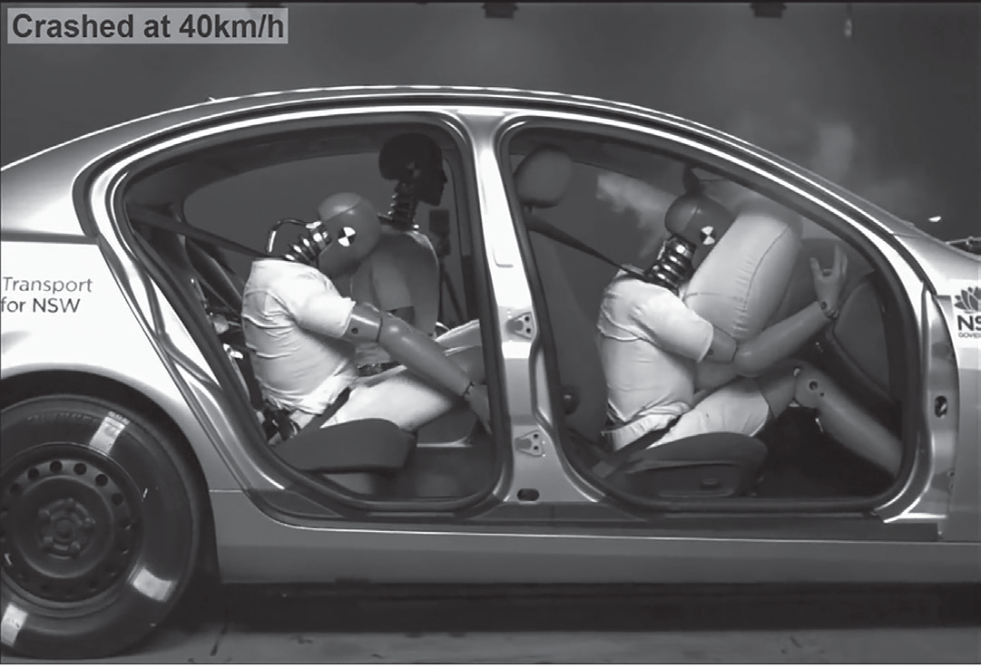
Linear Momentum and Its Conservation
Figure shows a test car to check the effectiveness of safety features in vehicles and compare the reduction of injuries caused by collisions. These safety features, namely, seat belt, airbag, padded dashboard, child restraints, and even crumple zones, absorb energy from the impact. They reduce the force involved and increase the time elapsed with the body’s change in momentum. In doing so, vehicular crash-related injuries or loss of life are prevented.

Slide 7


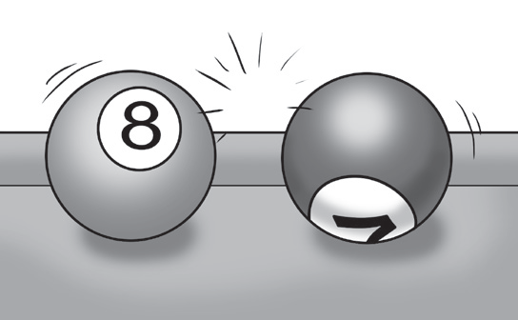
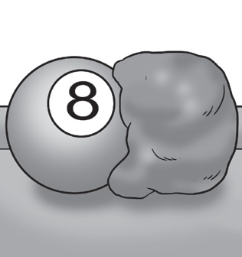
Linear Momentum and Its Conservation
Conservation of Momentum
When two objects collide, there are short-term forces that act on them upon contact. These forces may cause the objects to separate or to stick together. Figure shows two billiard balls before, during, and after they collide.
Before the collision, the first ball’s velocity is V1B. Following the collision, its velocity becomes V1A. Then, its change in momentum This change in momentum is caused by the force of the second ball on the first ball, which we assume constant and lasts for time t. Thus, we can summarize for the first ball that Similarly, the momentum of the second ball is changed due to the force of the first ball on the second ball.

Slide 8
Linear Momentum and Its Conservation
Hence, for the second ball, we obtain F(1 on 2).t = m2V2A – m2V2B. Combining these two equations, we find that:
F( 2on 1). t + F (1 on 2). t = (m1v1A – m1v1B) + (m2v2A – m2v2B)
(F( 2 on 1) + F(1 on 2)). t = (m1v1A – m1v1B) + (m2v2A – m2v2B)
0 = (m1v1A – m1v1B) + (m2v2A – m2v2B)
M1v1B + m2v2B = m1v1A + m2v2A
Combined equation
By Newton’s third law of motion, the forces are equal in magnitude but oppositely directed; hence, the sum is zero.
Simplifying the equation and transposing negative terms to the other side of the equation.

Slide 9
Linear Momentum and Its Conservation
The sum of the terms, m1v1B + m2v2B, is the total momentum before the collision (ρBC) for both objects. The sum of those on the right side, m1v1A + m2 v2A, is the total momentum after the collision (ρBC) for both objects. Although the momentum of each ball may change during the collision, the total momentum of the system is constant.
When the sum of the external forces acting on a system of objects is zero, the vector sum of the momentum of these objects is constant, both in magnitude and direction. This principle of the conservation of momentum is formulated for two objects:
ρBC = ρAc
m1v1B + m2v2B = m1V1A + m2v2A

Slide 10
Linear Momentum and Its Conservation
To point out the principles clearly, study how the different equations above are used in solving the sample problem below.
Example: A 6 kg object traveling at 12 m/s east collides head-on with a 4 kg object traveling at 4 m/s west. Determine the velocity after the collision of the first object if the second object moves with a final velocity of 5 m/s east. Assume that the collisions occur in an isolated system.
Given: m1 = 6 kg; V1B = 12 m/s; m2 = 4 kg; v2B = - 4 m/s; v2A = 5 m/s | Unknown: V1A= ? | Equations: ρBC = ρAc m1v1B + m2v2B = m1V1A + m2v2A

Slide 11






Linear Momentum and Its Conservation
Solution: Substituting the given values to the equation and solving for the unknown m1v1B + m2v2B = m1V1A + m2v2A
`
Thus, the velocity after the collision of the first object is 6 m/s, east.

Slide 12

Linear Momentum and Its Conservation
In every collision or interaction, momentum is conserved. That is, the total momentum before the collision is equal to the total momentum after the collision. Energy is also conserved in the collision, but this energy may be transformed into other forms. In most of the collisions, the total kinetic energy never increases and usually decreases as a result of the collision. From kinetic energy considerations, the momentum equation on the previous page becomes:
Collisions in which the kinetic energy is conserved are said to be elastic, such as the two athletes in Figure 7B who separate after the collision. All other collisions in which the total kinetic energy after colliding is less than before collision are inelastic or perfectly inelastic. Figure 7A shows that they stick together and move as one unit after the collision.

Slide 13
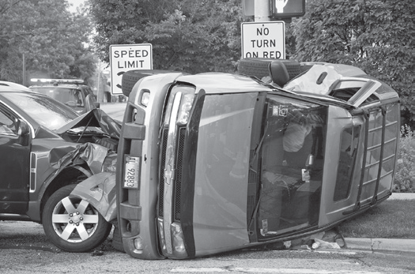

Linear Momentum and Its Conservation
Collisions in which the kinetic energy is conserved are said to be elastic, such as the two athletes in Figure 7B who separate after the collision. All other collisions in which the total kinetic energy after colliding is less than before collision are inelastic or perfectly inelastic. Figure 7A shows that they stick together and move as one unit after the collision.
Figure 7: (A) In inelastic collision, the cars get entangled and are deformed after the collision and in (B) elastic collision, after colliding, these athletes separate and maintain their form.
Charles Edward Miller from Chicago, United States, CC BY-SA 2.0, via Wikimedia Commons
CC0 Public Domain via Picryl
Example: For each scenario, determine the total kinetic energy of the system before and after the collision, and identify the collision as being elastic, inelastic, or perfectly inelastic.

Slide 14
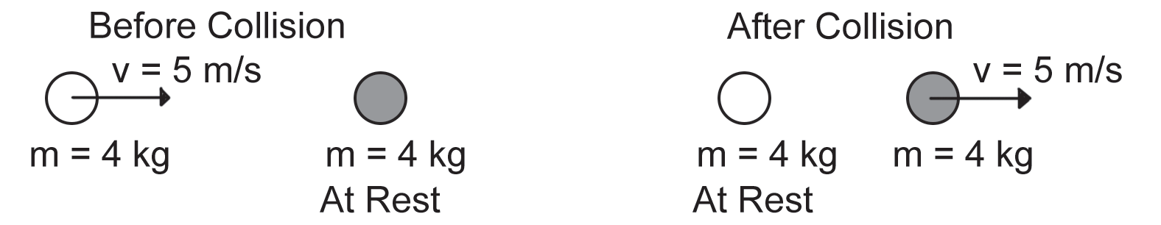
Linear Momentum and Its Conservation
1.
The system’s kinetic energy is conserved in this collision. That is, the total kinetic energy is the same before the collision as after the collision. This scenario is the critical requirement for elastic collision.

Slide 15
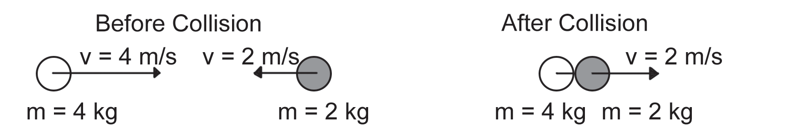


Linear Momentum and Its Conservation
2.
Therefore, the system’s kinetic energy is not conserved in this collision. That is, the total kinetic energy is not the same before the collision as after the collision. The critical requirement for a collision to be perfectly inelastic is that the colliding objects move as a single unit with the same velocity after the collision. These objects do stick together after the collision and move as a single unit at the same velocity. Thus, the collision is perfectly inelastic.

Slide 16
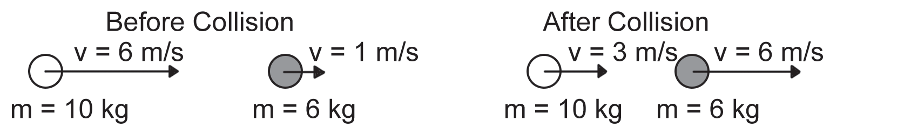


Linear Momentum and Its Conservation
3.
Therefore, the system’s kinetic energy is not conserved in this collision. That is, the total kinetic energy is different before and after the collision occurs. Thus, the collision does not meet the criterion for a perfectly elastic collision. The objects do not stick together after the collision. Thus, the collision is inelastic.

Slide 17
Linear Momentum and Its Conservation
Activity
Directions: ‪Choose the letter of the correct answer.
For numbers 1-4, choose from the following options:
A. Kinetic energy is lost in the system.
B. Momentum and kinetic energy are both conserved.
C. Neither momentum nor kinetic energy is necessarily conserved.
D. Momentum is conserved; kinetic energy is not necessarily conserved.
____ 1. Two gliders collide on a horizontal frictionless air track. Which of the above statements must be true regardless of whether the collision is elastic or inelastic?
____ 2. Two gliders collide on a frictionless horizontal air track. If the collision is elastic, which of the above statements must be TRUE?

Slide 18
Linear Momentum and Its Conservation
____ 3. Two gliders collide on a horizontal frictionless air track. If the collision is inelastic, which of the above statements must be TRUE?
____ 4. Two railed cars are rolling toward one another on a frictionless horizontal track. The two cars have the same mass and are moving at the same speed. Which of the above statements is TRUE?
____ 5. In which type of car collision below does the conservation of kinetic energy take place?
A. elastic collision
B. perfectly inelastic collision
C. inelastic collision
D. all of these

Slide 19
Linear Momentum and Its Conservation
Answer Key
____ 1. Two gliders collide on a horizontal frictionless air track. Which of the above statements must be true regardless of whether the collision is elastic or inelastic?
____ 2. Two gliders collide on a frictionless horizontal air track. If the collision is elastic, which of the above statements must be TRUE?
____ 3. Two gliders collide on a horizontal frictionless air track. If the collision is inelastic, which of the above statements must be TRUE?
____ 4. Two railed cars are rolling toward one another on a frictionless horizontal track. The two cars have the same mass and are moving at the same speed. Which of the above statements is TRUE?
____ 5. In which type of car collision below does the conservation of kinetic energy take place?
D
B
A
D
A

