Slide 1
Mechanical Energy

Slide 2
Mechanical Energy
There are two main types of mechanical energy: kinetic energy and potential energy.
Kinetic energy
Is the energy possessed by an object by virtue of its motion. For instance, a car in motion possesses kinetic energy whose amount depends on the car’s mass and speed. Mathematically, the energy of a moving object is computed as:
KE = ½ mv²
where KE is the kinetic energy, m is the mass of the object, and v is the velocity.

Slide 3
Mechanical Energy
Potential energy
Is the energy possessed by an object because of its position. For example, a pile of books on the top of the table has more ability to do work than the same pile placed at ground level. Thus, potential energy depends on the height of an object relative to a reference point. Mathematically, the gravitational potential energy stored in an object is given by the equation:
PE = mgh
Where PE is the gravitational potential energy, m is the mass of the object, h is the vertical distance or height, and g is the acceleration due to gravity which has a value of 9.8 m/s2.

Slide 4
Mechanical Energy
Mechanical energy
EM, is the sum of the potential energy and the kinetic energy of a system. Its unit is joule (J), and is defined by the equation:
EM = KE + PE = ½ mv² + mgh

Slide 5
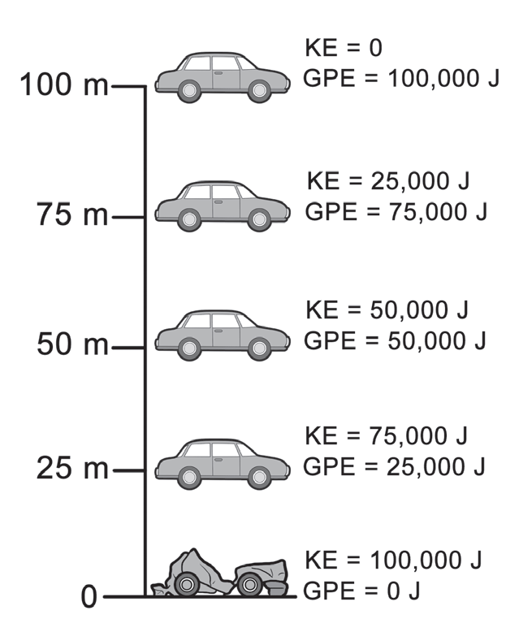
Mechanical Energy
To understand in a better way, consider a car with a gravitational potential energy of 100,000 J as it falls down a cliff of 100 m. Notice what happens to the potential, kinetic, and mechanical energies of the system in every 25 m intervals.
Figure shows the gravitational potential and kinetic energies of the car. Observe that the total energy is still 100,000 J for each interval. This shows that the energy is converted from potential into kinetic for the whole 100 m drop. With each drop, the velocity of the car, which is proportional to the car’s kinetic energy, also becomes greater.

Slide 6
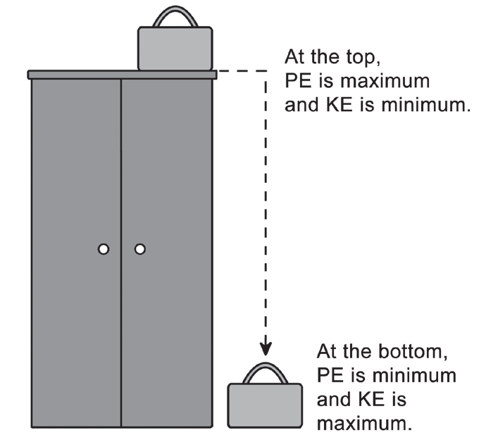
Mechanical Energy
Example:
A 1.5 kg suitcase rests at the top of a cabinet whose height is 2 m. What is the mechanical energy of the suitcase at the top and at the bottom of the cabinet?
Given : m = 1.5 kg; htop = 2 m; hbottom = 0 m
g = 9.8 m/s²; vtop = 0 m/s (suitcase is at rest.)
Unknown: Mechanical energy, EM
At the top and at the bottom of the cabinet
Equation: EM = KE + PE

Slide 7



Mechanical Energy
Solving for the potential energy at the top and at the bottom of the cabinet: Due to its position, the PE at the top of the cabinet is maximum: At the bottom of the cabinet, the PE of the suitcase is minimum: | Solving for the kinetic energy at the top and at the bottom of the cabinet: Since the suitcase rests at the top of the cabinet, the KE at the top is zero: Since the suitcase will be descending downward with a greater speed, the PE will be converted into KE at the bottom of the cabinet:
PEbottom = mghbottom
KEbottom = PEtop = 29 J

Slide 8
Mechanical Energy
The mechanical energy at the top and at the bottom of the cabinet is constant: EM = KEtop + PEtop = 0J + 29 J EM = KEbottom + PEbottom = 29 J + 0J = 29 J
Energy Transformations
The conversion or transformation of energy is a process that involves energy changes from one form to another. The following human activities and natural landscapes are some examples of energy transformation.

Slide 9
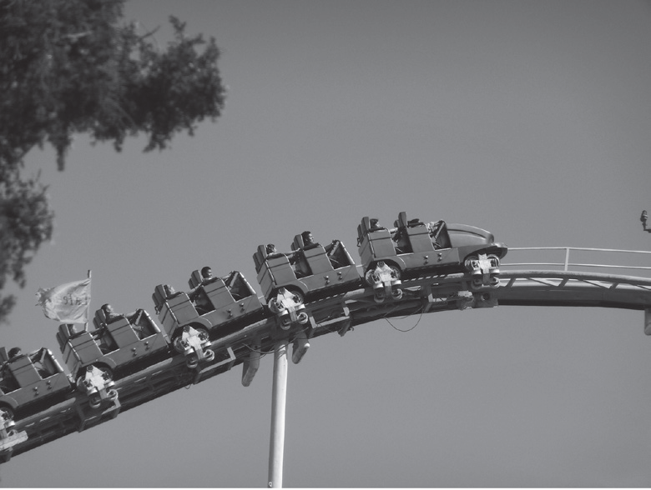
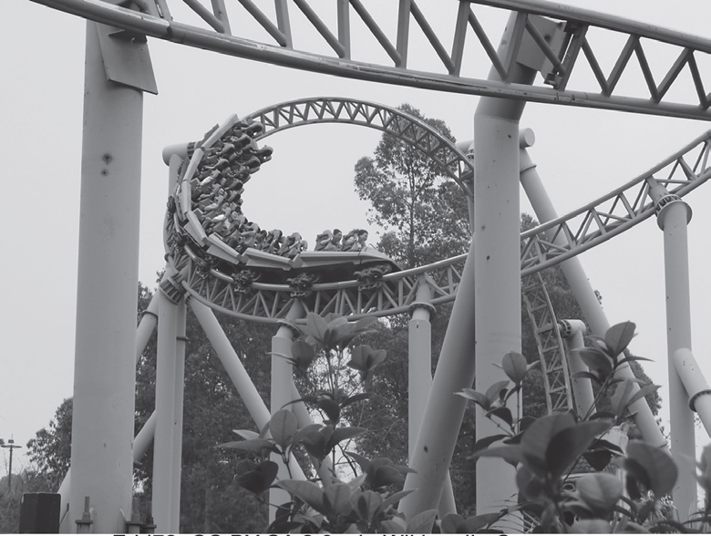
Mechanical Energy
In an amusement ride, such as a roller coaster shown in Figure below, the carts are pulled up to the top of a hill. At this level, the carts possess the maximum potential energy. As they move down along the track, their energy is converted into kinetic energy. The carts move up and down the hill due to the interchange between potential and kinetic energies.
(Left) As the carts are pulled up along the track, the carts’ potential energy is greatest in this elevated position. (Right) As the carts move along the track, the potential energy is converted into kinetic energy.
Rodrigo SanSs, CC BY-SA 3.0, via Wikimedia Commons
Edd72, CC BY-SA 2.0, via Wikimedia Commons

Slide 10
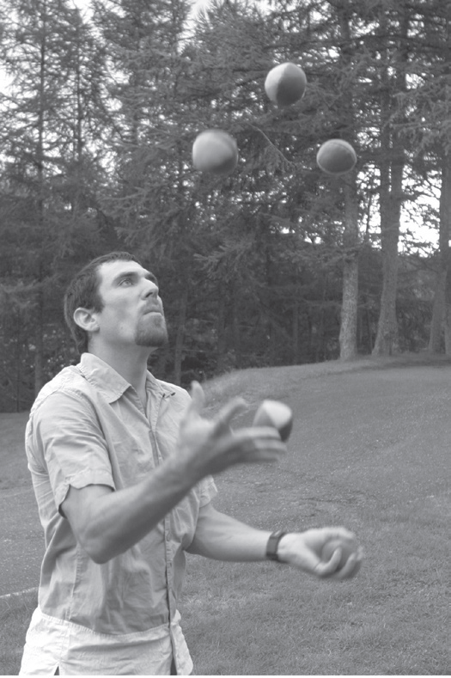
Mechanical Energy
Any object that rises or falls experiences a change in its kinetic and gravitational potential energies. Look at the balls in Figure. When the balls are tossed in the air, they possess kinetic energy. Each time that a ball rises, it slows down, and its kinetic energy decreases. But with every throw, the ball’s height increases, and hence, its gravitational potential energy increases. At the highest point in each ball’s path, it stops moving. At this point, it no longer possesses kinetic energy, but it possesses potential energy. As the balls fall, the entire energy conversion is reversed kinetic energy increases while potential energy decreases.

Slide 11
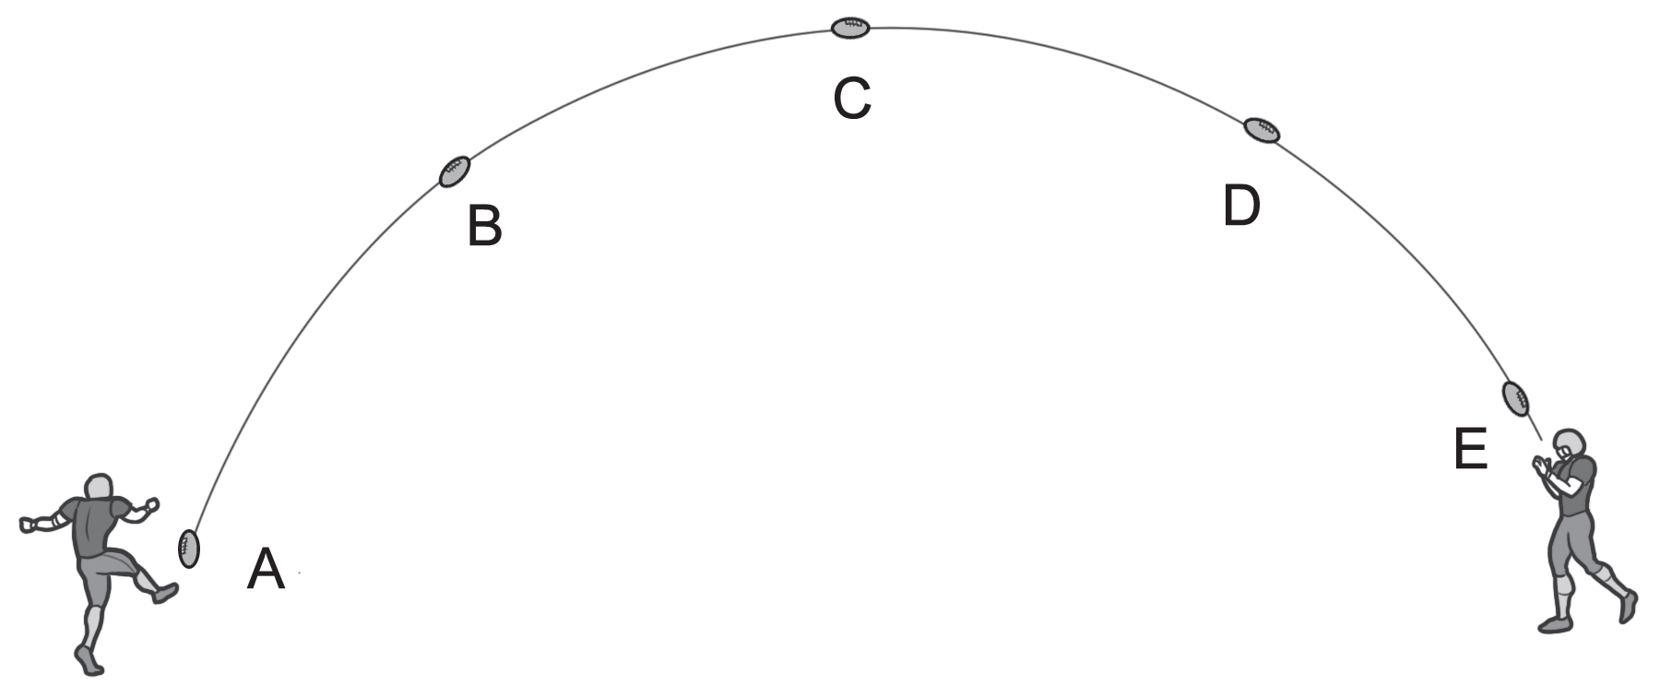
Mechanical Energy
Another example of this conversion happens in sports, like football. From Figure, at point A, the football’s potential energy is minimum, but then, when it is kicked, the ball is given a maximum kinetic energy. At point B, as the ball ascends, the kinetic energy is decreased while the potential energy is increased. At the highest point which is at point C, the kinetic energy is minimum and the potential energy is at its maximum. At point D, the ball descends, and the potential energy decreases while the kinetic energy increases. Last, at point E, as the receiver catches the ball, the potential energy is minimum, and the kinetic energy becomes maximum once again.

Slide 12
Mechanical Energy
The conversion between potential and kinetic energies on a large scale is illustrated in nature by waterfalls. The water at the top of the falls has gravitational potential energy because it is higher than at the bottom of the falls. But as the water falls, its height decreases and so it loses potential energy. At the same time, its kinetic energy increases because its velocity increases. Thus, potential energy is converted into kinetic energy.

Slide 13
Mechanical Energy
Activity
Directions: Read and Analyze each question carefully. Give the letter of the correct answer.
For items 1-2, refer to the situation below:
Ben sits on a sled, with a total mass of 60 kg, and slides down a 100 m long hill on a 30° incline. His velocity as he speeds down from the top of the hill is 10 m/s.
1. What is the potential energy at the top of the hill?
A. 18,200 J C. 21,800 J
B. 19,000 J D. 29,400 J
2. What is the kinetic energy at the bottom of the hill?
A. 19,500 J C. 32,400 J
B. 29,840 J D. 36,000 J

Slide 14
Mechanical Energy
3. Which energy is possessed by a snowboarder who sits at the top of a hill?
A. kinetic energy C. potential energy
B. sound energy D. electrical energy
4. A jack-in-the-box has energy stored in its compressed spring. When the box is opened and the spring is released, into what form of energy is the stored energy transformed?
A. kinetic energy C. mechanical energy
B. potential energy D. gravitational energy
5. An object is lifted to some height and then dropped. During the drop, which of the following is increased? Neglect air resistance.
A. kinetic energy C. kinetic energy and total mechanical energy
B. gravitational potential energy D. kinetic energy and gravitational potential energy

Slide 15
Mechanical Energy
Answer Key
1. What is the potential energy at the top of the hill?
A. 18,200 J C. 21,800 J
B. 19,000 J D. 29,400 J
2. What is the kinetic energy at the bottom of the hill?
A. 19,500 J C. 32,400 J
B. 29,840 J D. 36,000 J
3. Which energy is possessed by a snowboarder who sits at the top of a hill?
A. kinetic energy C. potential energy
B. sound energy D. electrical energy

Slide 16
Mechanical Energy
4. A jack-in-the-box has energy stored in its compressed spring. When the box is opened and the spring is released, into what form of energy is the stored energy transformed?
A. kinetic energy C. mechanical energy
B. potential energy D. gravitational energy
5. An object is lifted to some height and then dropped. During the drop, which of the following is increased? Neglect air resistance.
A. kinetic energy C. kinetic energy and total mechanical energy
B. gravitational potential energy D. kinetic energy and gravitational potential energy

