Slide 1
Applications of the Law of Conservation of Mechanical Energy

Slide 2



Applications of the Law of Conservation of Mechanical Energy
The law of conservation of energy states that energy is transformed from one form to another; energy is neither created nor destroyed, and thus, energy exists in one form or another. Meanwhile, the law of conservation of mechanical energy states that the total mechanical energy of an object is constant for a conservative system, which means that it does not contain any frictional forces.
Mathematically, this is expressed using the following equations:
EMi = EMf | where is the initial mechanical energy and is the final mechanical energy in the system; also note that EM = KE + PE.

Slide 3

Applications of the Law of Conservation of Mechanical Energy
KEi + GPEi + EPEi = Kef + GPEf + EPEf | where KEi is the initial kinetic energy, GPEi is the initial gravitational potential energy, and EPEi is the initial elastic potential energy. Also, KEf is the final kinetic energy, GPEf is the final gravitational potential energy, and EPEf is the final elastic potential energy.
 | where m is the mass of the object in kilograms (kg), g is the acceleration due to gravity in meter-per-second-square (m/s²), h is the height in meters (m), v is velocity in meter-per-second (m/s), and x is the length of compression of the object in meters (m). The subscripts, i and f, denote the initial and final values for the entire system. The energy in the system is given in the unit J for joules.

Slide 4
Applications of the Law of Conservation of Mechanical Energy
To solve problems regarding the conservation of mechanical energy, it is important to identify two different positions of the object and recognize the types of energy present in each of the positions. The reference points used while computing for the potential energies must be consistent all throughout the solution of the problem.
Examples:
1. During a flood, a tree trunk with a mass of 100 kg falls down a waterfall that is 5 m high. If air resistance is ignored, find the tree trunk’s (a) potential energy at the top of the waterfall, (b) kinetic energy at the bottom of the waterfall, and (c) velocity as it falls to the bottom of the waterfall.

Slide 5
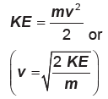



Applications of the Law of Conservation of Mechanical Energy
Given: m = 100 kg h = 5 m | Unknown : a) PE b) KE c) v | Equations: PE = mgh KETotal = PETotal
Solution: Substituting the given values in the equations and solving for the unknown:

Slide 6
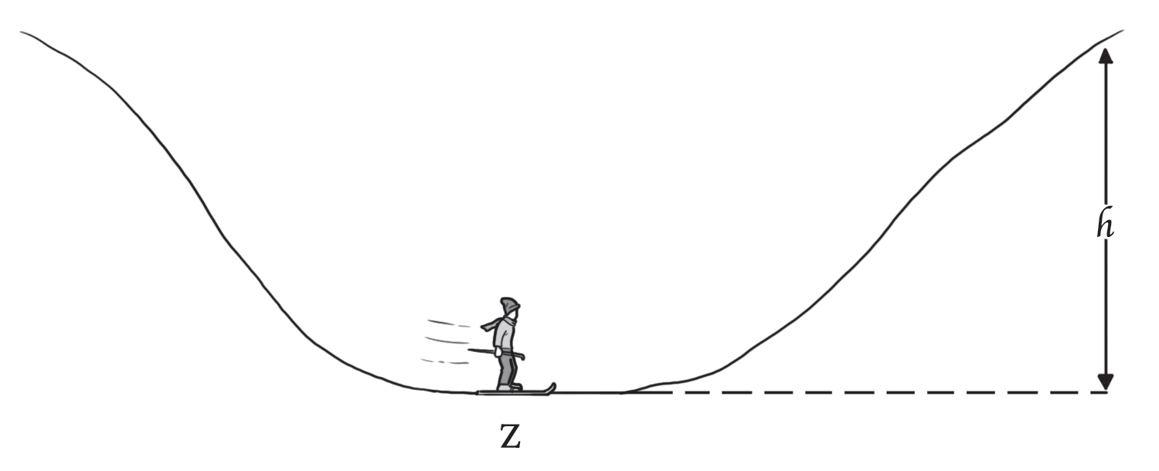


Applications of the Law of Conservation of Mechanical Energy
2. Bianca whose mass is 85 kg, skis down the hill, passing point Z with a kinetic energy of 9,700 J. If friction is ignored, to what maximum height, h, can Bianca ski?
Given: m = 85 kg KE = 9,700 J | Unknown: hmax | Equations: KETotal = PETotal
Solution: Substituting the given values in the equations and solving for the unknown: KETotal = PETotal = 9,700 J

Slide 7
Applications of the Law of Conservation of Mechanical Energy
Applications of the Law of Conservation of Mechanical Energy
1. Why do we often feel warm after rubbing our hands? This involves conservation of mechanical energy.
The mechanical energy supplied by our muscles helps us to move our hands back and forth against each other. The motion of the hands is opposed by the frictional force. The mechanical energy from our muscles gets converted into the form of heat. This makes us feel warm.
2. The operation of hydropower plants illustrates the law of conservation of mechanical energy. Hydropower plants convert the potential energy of water into electrical energy which is used for commercial and household use. More specifically, the potential energy of water is converted into kinetic energy as water starts to fall from a dam. A turbine converts the mechanical energy of falling water into mechanical energy. Then, a generator converts the mechanical energy from the turbine into electrical energy.

Slide 8
Applications of the Law of Conservation of Mechanical Energy
Activity
Directions: Read and answer each item carefully. Give the letter of the correct answer.
1. A 14,300 kg airplane is flying at an altitude of 497 m at a speed of 214 km/h. What is the airplane’s total mechanical energy?
A. 8.20 × 10⁷ J C. 2.67 × 10⁸ J
B. 9.49 × 10⁷ J D. 1.45 × 10⁸ J
2. What is the total mechanical energy for a ball of mass 0.15 kg which has a kinetic energy of 20 J and is 2 m above the ground?
A. 22 J C. 25 J
B. 23 J D. 26 J

Slide 9
Applications of the Law of Conservation of Mechanical Energy
3. Ignoring friction, what is the maximum velocity reached by a 56 kg skier as he/she skis from the top to the bottom of a 6.50 m slope?
A. 9.6 m/s C. 12.7 m/s
B. 11.3 m/s D. 13.1 m/s
4. Leo sits on a slide at the top of a 23.7 m tall hill. If Leo and the slide have a total mass of 37.3 kg, how fast will they be going when they reach the bottom of the hill, assuming there is no friction between the slide and the ground?
A. 12.70 m/s C. 19.3 m/s
B. 18.50 m/s D. 21.6 m/s

Slide 10
Applications of the Law of Conservation of Mechanical Energy
Answer Key
1. A 14,300 kg airplane is flying at an altitude of 497 m at a speed of 214 km/h. What is the airplane’s total mechanical energy?
A. 8.20 × 10⁷ J C. 2.67 × 10⁸ J
B. 9.49 × 10⁷ J D. 1.45 × 10⁸ J
2. What is the total mechanical energy for a ball of mass 0.15 kg which has a kinetic energy of 20 J and is 2 m above the ground?
A. 22 J C. 25 J
B. 23 J D. 26 J

Slide 11
Applications of the Law of Conservation of Mechanical Energy
3. Ignoring friction, what is the maximum velocity reached by a 56 kg skier as he/she skis from the top to the bottom of a 6.50 m slope?
A. 9.6 m/s C. 12.7 m/s
B. 11.3 m/s D. 13.1 m/s
4. Leo sits on a slide at the top of a 23.7 m tall hill. If Leo and the slide have a total mass of 37.3 kg, how fast will they be going when they reach the bottom of the hill, assuming there is no friction between the slide and the ground?
A. 12.70 m/s C. 19.3 m/s
B. 18.50 m/s D. 21.6 m/s

