Slide 1
Series and Parallel Circuits

Slide 2
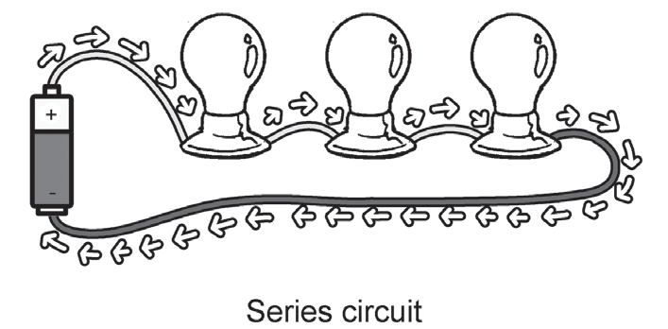
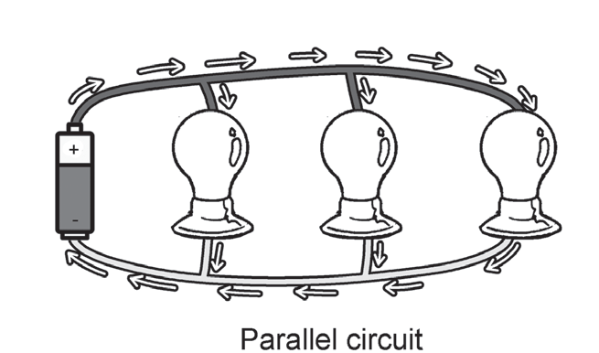
Series and Parallel Circuits
Series and Parallel Circuits
There are two basic ways to connect two or more electrical devices in a circuit with a single energy source. These connections can be in series or parallel.
In a series circuit, the electricity flows in only one path.The electrical devices are connected by wires through which the electric current from the energy source flows in a single direction. If one of the loads is busted, the rest of the loads connected in the series circuit will not work. It is because the flow of electricity is interrupted by the busted electrical device. Replacing the busted electrical device will complete the circuit again, allowing the rest of the devices to work too.
In a parallel circuit, the electric current flows in multiple paths. The electrical devices are connected by wires through which the electricity flows in multiple directions. This is the reason why even if one of the electrical devices is turned off or busted, the rest will still work as the flow of electricity is not interrupted.

Slide 3
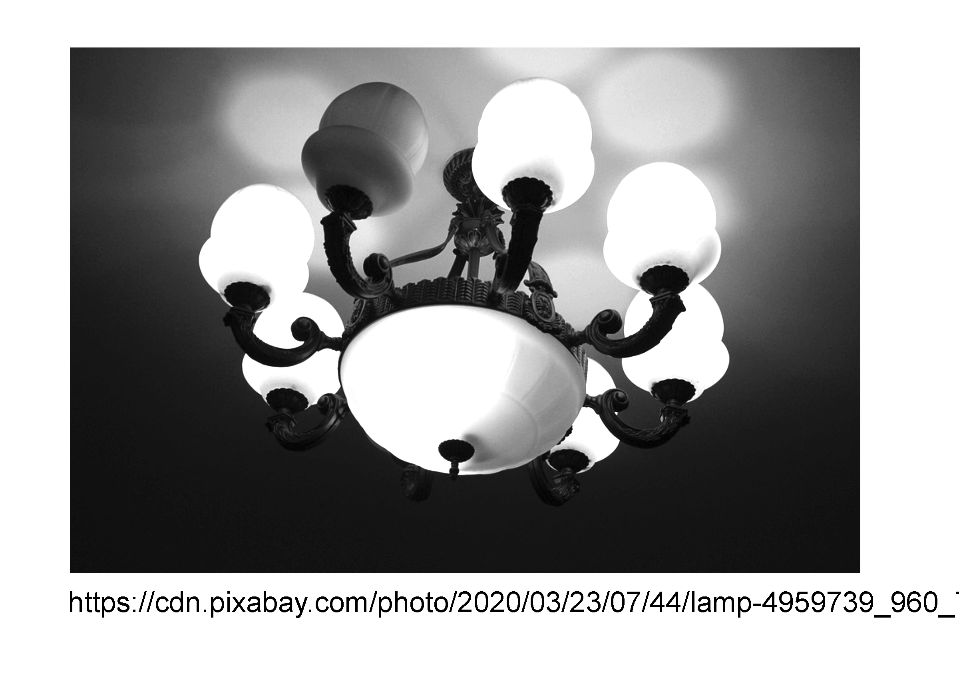
Series and Parallel Circuits
Applications of Series and Parallel Circuits
The type of circuit that is used in a certain electrical device depends on its purpose. For instance, a conventional ceiling lamp uses a series circuit to ensure the same amount of brightness for each bulb present in it. Since the electric current in a series circuit passes in one direction, it is equally distributed in each bulb.
Conventional ceiling lamps often use series circuit to ensure the equal brightness of each bulb in it.

Slide 4
Series and Parallel Circuits
However, the downside of this kind of connection is that if one bulb gets busted, the rest of the bulbs in the ceiling lamp will not light up too. In some refrigerators, a series circuit is applied to their wirings, to ensure that the electric current will flow in one path only.
Most lighting systems at home use parallel circuits. It is more cost-efficient because even if you turn off the lights that are not in use, the others will still work. This allows people to conserve electricity. Parallel circuits are also used in more complex appliances as they lessen the chances of short circuits.

Slide 5
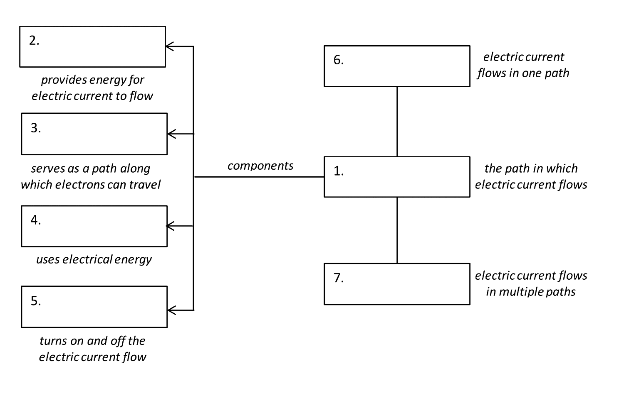
Series and Parallel Circuits
Direction. Copy and complete this concept map.

Slide 6
Series and Parallel Circuits
Answer Key:
1. Circuit
2. Battery
3. Conductor/Conducting wire
4. Load
5. Switch
6. Series circuit
7. Parallel circuit

