Slide 1
Expressing a Ratio as a Fraction and Vice Versa

Slide 2

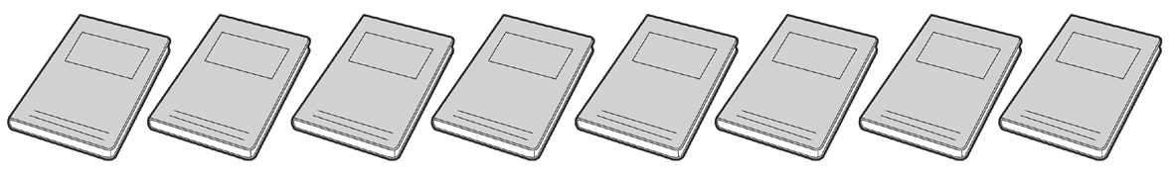
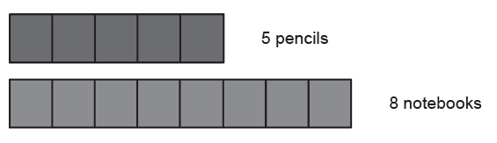
Expressing a Ratio as a Fraction and Vice Versa
Ratio
A ratio is a comparison of two quantities. It can be expressed in a phrase, colon, and fractional form.
For example, you have 5 pencils and 8 notebooks.

Slide 3
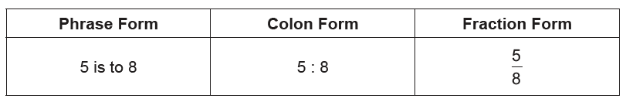
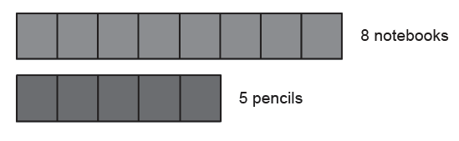
Expressing a Ratio as a Fraction and Vice Versa
Cont.
The ratio of 5 pencils to 8 notebooks can be expressed using the following:
Remember that it is very important to know which object is mentioned first. When the ratio of notebooks to pencils is asked, it would be expressed differently.

Slide 4
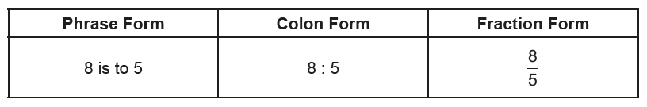
Expressing a Ratio as a Fraction and Vice Versa
Cont.
The ratio of 8 notebooks to 5 pencils can be expressed by the following:

Slide 5
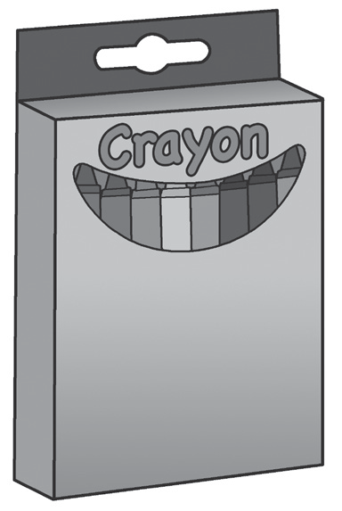

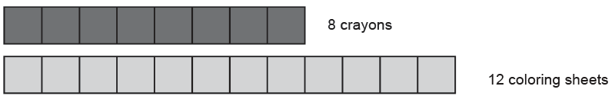
Expressing a Ratio as a Fraction and Vice Versa
Reducing a Ratio to Its Lowest Terms
A ratio may be expressed in simplest form or lowest terms. To simplify a ratio, divide the terms by the GCF.
For example, you want to determine the simplest ratio for the number of your crayons to the number of your coloring sheets.
You have 8 pieces of crayons and 12 coloring sheets.

