Slide 1
Finding the Missing Term in a Proportion

Slide 2



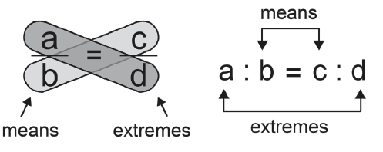
Finding the Missing Term in a Proportion
Proportion
A proportion is an equation stating that two ratios are equal.
In the proportion , a and d are called the extremes, and b and c are called the means.
In colon form, the proportion is expressed as a : b = c : d.
In any proportion, the product of the extremes is equal to the product of the means. So, in

Slide 3
Finding the Missing Term in a Proportion
Example 1: Determine if the equation 4 : 6 = 16 : 24 forms a proportion.
Solution:
4 : 6 and 16 : 24
If this equation forms a proportion, then the product of 4 and 24 must be equal to the product of 6 and 16.
4 x 24 = 6 x 16
96 = 96
Therefore, 4 : 6 = 16 : 24 is a proportion. In this proportion, the extremes are
4 and 24, whereas the means are 6 and 16.

Slide 4


Finding the Missing Term in a Proportion
Cont.
You may also check if it is a proportion by getting the cross products of the fractions. If the products are the same, then it is a proportion. 4 : 6 = 16 : 24 is = in fraction form.
Get the cross product.
Because the cross products are equal, 4 : 6 = 16 : 24 is a proportion.

Slide 5
Finding the Missing Term in a Proportion
Example 2: Determine if the equation 3 : 8 and 8 : 24 forms a proportion.
Solution:
If this equation forms a proportion, then the product of 3 and 24 must be equal to the product of 8 and 8.
3 x 24 = 8 x 8
72 ≠ 64
Therefore, 3 : 8 = 8 : 24 is NOT a proportion.

Slide 6


Finding the Missing Term in a Proportion
You may also check if it is a proportion by getting the cross products of the
fractions. If the products are the same, then it is a proportion.
3 : 8 = 8 : 24 is in fraction form.
Get the cross product.
Because the cross products are not equal, the given equation is not a proportion.

Slide 7

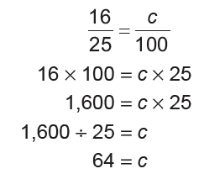
Finding the Missing Term in a Proportion
Finding a Missing Term in a Proportion
The process of finding the missing term in a proportion is solving a proportion.
A way or method to find the missing term in a proportion is to express the ratio in fraction form. Then, get the cross products of the fractions.
Example 1: Find the missing number in the proportion
Solution:
Determine the cross products and equate.
So, the missing number is 64.

Slide 8

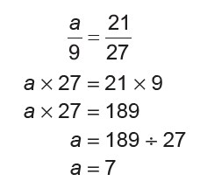
Finding the Missing Term in a Proportion
Example 2: Find the missing number in the proportion .
Solution:
Determine the cross products and equate.
The missing number is 7.

Slide 9
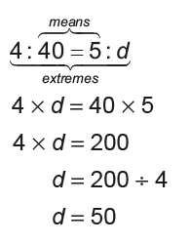
Finding the Missing Term in a Proportion
Example 3: Find the missing number in the proportion 4 : 40 = 5 : d.
Solution:
The missing number is 50.

Slide 10
Finding the Missing Term in a Proportion
KEY TAKEAWAYS
• A proportion is an equation stating that two ratios are equal.
• In any proportion a : b = c : d, a and d are called the extremes, whereas b and c are called the means.
• The product of the extremes equals the product of the means. If a : b = c : d then, a x d = b x c.
• The process of finding the missing term in a proportion is solving a proportion. A way or method to find the missing term in a proportion is to express the ratio in fraction form. Then, get the cross products of the fractions.

Slide 11
Finding the Missing Term in a Proportion
Find the missing term in the given proportions.
1. 3 : 45 = ___: 225
Answer: 15
2. 25 : ___ = 15 : 30
Answer: 50
3. ___ : 45 = 6 : 90
Answer: 3
4. 5 : 12 = ___ : 120
Answer: 50

