Slide 1
Solving Problems Involving Direct Proportion

Slide 2
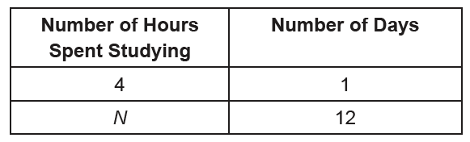
Solving Problems Involving Direct Proportion
Direct Proportion
In a direct proportion, an increase in one quantity causes an increase in the other quantity. Likewise, a decrease in one causes a decrease in the other as well.
Problem 1: If you spend 4 hours a day studying, how many hours will you spend studying for 12 days?
Solution:
Let us use a table to illustrate the situation in the problem.

Slide 3

Solving Problems Involving Direct Proportion
From the quantities in the table, you can obtain the proportion below:
Solving the proportion,
4 x 12 = N x 1
48 = N
Therefore, 48 h will be spent studying for 12 days.

Slide 4
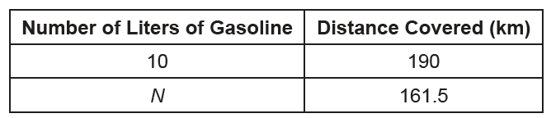
Solving Problems Involving Direct Proportion
Problem 2: A car uses 10 liters of gasoline to travel a distance of 190 kilometers.
At this rate, how many liters of gasoline will the car consume for a distance of 161.5 kilometers?
Solution:
The situation in the problem illustrates a direct proportion because the decrease
in the distance would mean a decrease in the number of liters of gasoline consumed.

Slide 5

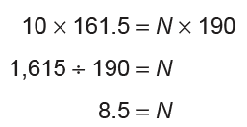
Solving Problems Involving Direct Proportion
Cont.
From the quantities in the table, you can obtain the proportion below:
or 10 : N = 190 : 161.5
Solving the proportion,
This means that the car will consume 8.5 L for a distance of 161.5 km.

Slide 6
Solving Problems Involving Direct Proportion
Answer the following problems
1. A car uses 10 liters of gasoline for a distance of 100 kilometers. At this rate, how
many liters of gasoline will the car consume for a distance of 340 kilometers?
Answer: 10 : 100 = 34 : 340, 34 liters of gasoline
2. A man can burn approximately 200 calories by walking up and down the stairs
for about 10 minutes. About how long will it take him to burn 900 calories?
Answer: 200 : 10 = 900 : 45, 45 minutes

