Slide 1
Solving Problems Involving Inverse Proportion

Slide 2
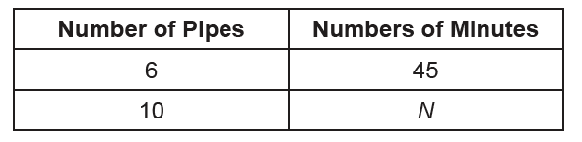
Solving Problems Involving Inverse Proportion
Inverse proportion
• In an inverse proportion, an increase in one quantity causes a decrease in another quantity. Likewise, a decrease in one quantity causes an increase in another quantity.
• An inverse proportion is of the form: more quantity : less quantity = more time : less time
Problem 1: Six pipes can fill a tank for 45 minutes. At the same rate, how long will it take 10 pipes to fill the tank?
Solution:
You can use a table to illustrate the situation in the problem.

Slide 3

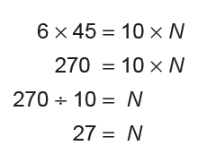
Solving Problems Involving Inverse Proportion
The relationship between the number of open pipes and the time it will take them to fill the tank describes an inverse proportion. Thus, the proportion must be set as:
fewer pipes : more pipes = less time : more time
= N or 6 : 45 = 10 : N
Solving the proportion,
So, 10 pipes will only take 27 min to fill the tank.

Slide 4
Solving Problems Involving Inverse Proportion
Problem 2: In a poultry farm with 56 hens, a supply of feeds can last for 18 days. If the owner added 16 more hens, how long will this supply last?
Solution:
The situation in the problem manifests that as the number of hens increases, the
supply of feeds is consumed faster. This is an inverse proportion.

Slide 5
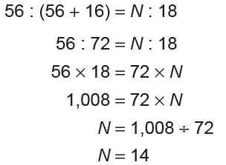
Solving Problems Involving Inverse Proportion
Thus, the proportion must be set as:
fewer hens : more hens = fewer days : more days
The supply of feeds will only last for 14 days.

Slide 6
Solving Problems Involving Inverse Proportion
KEY TAKEAWAYS
• In an inverse proportion, an increase in one quantity causes a decrease in another quantity. Likewise, a decrease in one quantity causes an increase in another quantity.
• An inverse proportion is of the form:more quantity : less quantity = more time : less time

Slide 7
Solving Problems Involving Inverse Proportion
Solve the following problems.
1. If 20 persons can consume a certain amount of food in 3 months, in how many
months can 40 persons consume the same amount of food?
Answer: 20 : 3 = 40 : N, (N = 1.5 months)
2. If 8 men can clean a wall in 40 hours, find the number of men required to clean
the wall in 80 hours?
Answer: 8 : 40 = N : 80, (N = 4)

