Slide 1
Solving Problems Involving Partitive Proportion

Slide 2
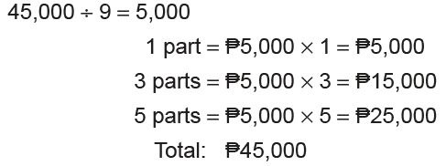
Solving Problems Involving Partitive Proportion
• In a partitive proportion, the whole is divided into parts according to the given ratios.
• The sum is partitioned to different parts.
Problem 1: How much will each winner receive from the pot amounting to ₱45,000 if the cash prize should be divided in the ratio of 1 : 3 : 5?
Solution: 1 : 3 : 5 1 + 3 + 5 = 9
So, the winners will get the amount of ₱5,000, ₱15,000, and ₱25,000.

Slide 3
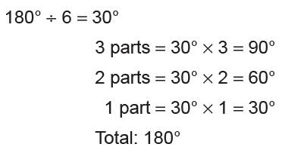
Solving Problems Involving Partitive Proportion
Problem 2: The angles of a triangle are in the ratio 3 : 2 : 1. What are the measurements
of the angles?
Solution: 3 : 2 : 1 3 + 2 + 1 = 6
The sum of the angles of a triangle is 180°.
The triangle has the angle measurements of 90°, 60°, and 30°.

Slide 4
Solving Problems Involving Partitive Proportion
Answer the following problems in your notebook.
1. Rica, Rose, and Ronalyn shared 486 marbles in the ratio 2 : 3 : 4. How many did each person receive?
Answer: Rica – 108, Rose – 162, Ronalyn - 216
2. Four businessmen will share a profit of ₱500,000 in the ratio of 2 : 2 : 3 : 3. How much will be the largest amount received?
Answer: ₱150,000

