Slide 1


Proportion

Slide 2
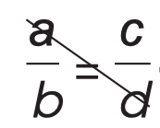

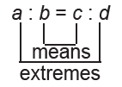
Proportion
PROPORTION
Ratio refers to the comparison of two quantities of the same kind. It is a number that expresses one quantity as a fraction of the other. It can be written with the use of a colon, “:,” such as a : b or can also be expressed in fraction form such as a:b.
For example, if you want to write the ratio of 3 and 4, you can write this as 3 : 4 or 3/4.
Proportion is an equation or statement that shows that two ratios are equal. That is, if the ratio a : b is equal to the ratio c : d, then a, b, c, and d are said to be in proportion. It can be written in fraction form or using the symbol “:.” See the examples below.
a
c
=
; wherein b ≠ 0 and d ≠ 0
b
d
or
a : b = c : d; wherein b ≠ 0 and d ≠ 0
For the example of proportion in fraction form, the extremes are the values that are hit when you draw a diagonal line from top left to bottom right, Therefore, the extremes are a and d. On the other hand, the means are the values that are hit when you draw a diagonal line from bottom left to top right, These values are b and c.
In the example that uses the symbol “:,” the extremes are the values represented by the outermost values, which are a and d, while the means are represented by the innermost values, which are b and c.
For instance, in the proportion
5 : 11 = 13 : 9, 11 and 13 are the means,
And 5 and 9 are the extremes.
Rex Curriculum Resource
WWW.REX.COM.PH

Slide 3
Proportion
Example 1:
Example 1: Show that 7 : 21 = 12 : 36 is a proportion.
To show that the 7 : 21 = 12 : 36 is a proportion, express them in fraction form.
Then, simplify both fractions and check if they are equal. The fraction 7/21 simplifies to 1/3, while the fraction 12/36
also simplifies to 1/3. The two ratios are equal because they are both equal to 1/3.
Thus, 7 : 21 = 12 : 36 is a proportion. It is your time to check if the following ratios show a proportion or not.
7
?
12
21
=
36
Rex Curriculum Resource
WWW.REX.COM.PH

Slide 4
Activity:
Try It 1
Write P if the ratio is a proportion. Otherwise, write NP. Write your answers on a
separate sheet of paper.
1. 3 : 33 and 4 : 44 3. 64 : 24 and 3 : 8
2. 3/7 and 9 : 42 4. 49 : 14 and 7/2
Rex Curriculum Resource
WWW.REX.COM.PH

Slide 5
Activity: ANSWER SHEET
Try It 1
Write P if the ratio is a proportion. Otherwise, write NP. Write your answers on a
separate sheet of paper.
1. 3 : 33 and 4 : 44 3. 64 : 24 and 3 : 8
2. 3/7 and 9 : 42 4. 49 : 14 and 7/2
ANSWERS:
1. P 3. NP
2. NP 4. P
Rex Curriculum Resource
WWW.REX.COM.PH

Slide 6
Proportion
When you were in Grade 7, you learned one of these properties, which states that the product of the means is equal to the product of the extremes. That is, in the proportion a/b = c/d where b ≠ 0 and d ≠ 0, ad = bc.
To illustrate, suppose that a = 2, b = 4, c = 3, and d = 6, then we have 2/4 = 3/6. Multiplying the means, we have (4)(3) = 12, and multiplying the extremes, we have (2)(6) = 12. As we can see, the product of the means is equal to the product of the extremes. That is, ad = bc = 12.
Now, let us study the other properties. Consider the proportion a/b = c/d, wherein b ≠ 0 and d ≠ 0, the following properties can be derived.
1. One property can be derived by multiplying both sides of the equation by b/c. Applying the Multiplication Property of Equality (MPE) and cancellation of common terms (as shown below), you can simplify the result to a/c = b/d.
a/b * b/c = c/d * b/c
a/c = b/d
To show this property, let us consider the proportion 2/4 = 3/6. Multiplying this proportion by 4/3, we have
2/4 * 4/3 = 3/6 * 4/3
8/12 = 12/18.
Simplifying both ratios, we have
2/3 = 2/3.
Rex Curriculum Resource
WWW.REX.COM.PH

Slide 7
Proportion
2. Another property can be derived by multiplying both sides of the equation by d/a. Applying the Multiplication Property of Equality (MPE) and cancellation of common terms (as shown below), you can simplify the result to
a/c = b/d.
a/b * d/a = c/d * d/a
d/b = c/a
To show this property, let us consider the proportion 2/4 = 3/6. Multiplying this proportion by 6/2, we have
2/4 * 6/2 = 3/6 * 6/2
12/8 = 18/12.
Simplifying both ratios, we have
3/2 = 3/2.
Rex Curriculum Resource
WWW.REX.COM.PH

Slide 8
Proportion
3. The third property can be derived by getting the reciprocal of both ratios. That is,
1 / (a/b) = 1 / (c/d)
To show this property, let us consider the proportion 2/4 = 3/6. Getting the reciprocal, we have
1 / (2/4) = 1 / (3/6)
4/2 = 6/3.
Simplifying both ratios, we have
2 = 2.
Rex Curriculum Resource
WWW.REX.COM.PH

Slide 9
Proportion
4. The next property can be derived by multiplying both sides of the equation by bd. When you apply the Multiplication Property of Equality (MPE) and cancellation of the common terms (as shown below), you will get ad = bc.
a/b = c/d
(a/b) * bd = (c/d) * bd
ad = bc
To show this property, let us consider the proportion 2/4 = 3/6, then a = 2, b = 4, c = 3, and d = 6. Applying the property, we have
(2/4) * 6 = (3/6) * 4
12 = 12
Rex Curriculum Resource
WWW.REX.COM.PH

Slide 10
Proportion
5. Another property can be derived by adding 1 to both sides of the equation. When you apply the Addition Property of Equality (APE) (as shown below), you will get
a/b + 1 = c/d + 1
(a/b) + 1 = (c/d) + 1
To show this property, let us consider the proportion 2/4 = 3/6. Adding 1 to both sides, we have (2/4) + 1 = (3/6) + 1
(2+4) + 1 = (3/6) + 1
(6/4) = (9/6)
Simplifying both sides, we have
3/2 = 3/2.
ᵃ ᵇ⁄
Rex Curriculum Resource
WWW.REX.COM.PH

Slide 11

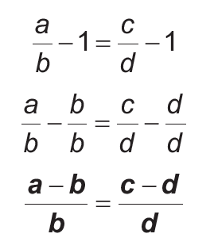




Proportion
6. The last property can be derived by subtracting 1 from both sides of the equation. When you apply the Subtraction Property of Equality (SPE) (as shown below), you will get
To show this property, let us consider the proportion Subtracting 1 from both sides, we have
Simplifying both ratios, we have
We need to understand these properties so that we can apply them in solving problems and equations that involve proportions. Also, in solving equations involving proportions, cross multiplication can be used just like in the following examples on the next slides..
Rex Curriculum Resource
WWW.REX.COM.PH

Slide 12
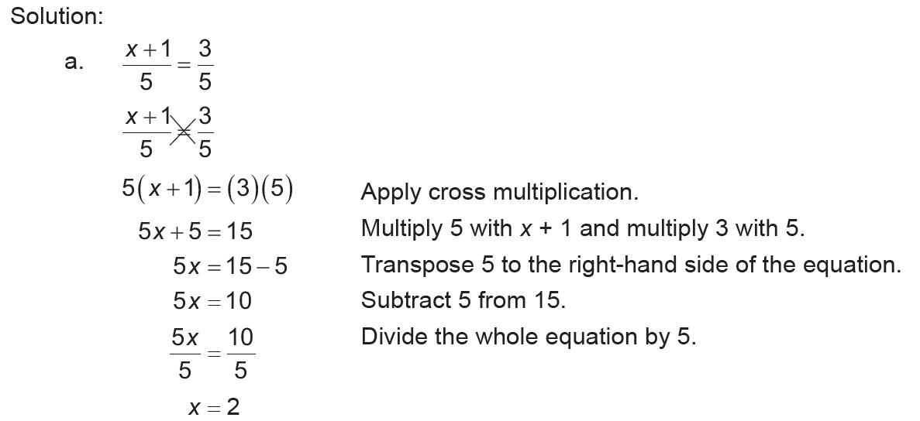
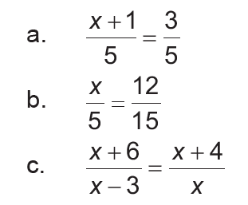
Proportion
Example 2:
Solve for x in each proportion.
Rex Curriculum Resource
WWW.REX.COM.PH

Slide 13
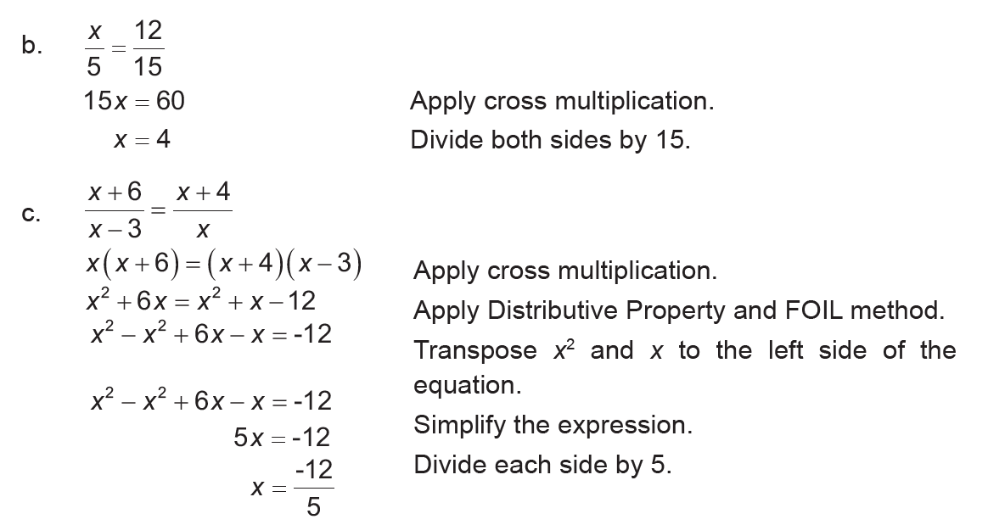
Proportion
Example 2:
Solve for x in each proportion.
Rex Curriculum Resource
WWW.REX.COM.PH

Slide 14
Activity:
Try It 2
Solve for the value of x in each proportion.
x
15
x +
_x001f_
5
x +
_x001f_
3
1.
=
2.
=
4
20
x +
2
_x001e_
x
_x001f_
Rex Curriculum Resource
WWW.REX.COM.PH

Slide 15
Activity: ANSWER SHEET
Try It 2
Solve for the value of x in each proportion.
x
15
x +
_x001f_
5
x +
_x001f_
3
1.
=
2.
=
4
20
x +
2
_x001e_
x
_x001f_
ANSWER:
Try It 2
1. x = 3
2. no solution
Rex Curriculum Resource
WWW.REX.COM.PH

Slide 16
Proportion
Example 3:
Example 3: In a certain regular polygon, the measures of an interior angle and an exterior angle are in the ratio of 5 : 1. Name the type of polygon.
Solution:
To determine the type of polygon, we need to know the number of sides this polygon has. Since the problem provides the ratio of the measures of an interior angle and an exterior angle, let's explore the relationship between the two.
In any polygon, an interior angle and an exterior angle are supplementary. So, if x represents the measure of an interior angle, the measure of its corresponding exterior angle is 180° – x.
Hence, we have the proportion:
5/1 = x / (180° - x)
Cross-multiplying:
5(180° - x) = 1 * x
900 - 5x = x
900 = 6x
Dividing by 6:
150 = x
Now, the measure of the exterior angle is 180° – 150° = 30°. Remember that, in geometry, the exterior angle of a regular polygon is equal to 360° / n, where n is the number of sides. Thus, solving for the number of sides, we have:
360° / n = 30°
Cross-multiplying:
360° = 30° * n
Dividing by 30°:
n = 12
Therefore, the regular polygon is a regular dodecagon.
Rex Curriculum Resource
WWW.REX.COM.PH

Slide 17
Activity:
Try It 3
In a certain In a certain regular polygon, the measures of an interior angle and an exterior angle are in the ratio 3 : 2.
Name the type of polygon.
Rex Curriculum Resource
WWW.REX.COM.PH

Slide 18
Activity: ANSWER SHEET
Try It 3
In a certain In a certain regular polygon, the measures of an interior angle and an exterior angle are in the ratio 3 : 2.
Name the type of polygon.
ANSWER:
Pentagon
Rex Curriculum Resource
WWW.REX.COM.PH

Slide 19
Proportion
Example 4:
Find the fourth term in a proportion if the first three terms are 12, 17, and 36.
Solution:
Let x be the fourth term of the proportion. So,
12 / 17 = 36 / x
Solve for x.
Cross-multiplying:
12x = 17 * 36
12x = 612
Divide both sides by 12:
x = 51
Therefore, the fourth term in the proportion is 51.
Rex Curriculum Resource
WWW.REX.COM.PH

Slide 20
Activity:
Try It 4
Find the fourth term in a proportion if the first three terms are 18, 35, and 72.
Rex Curriculum Resource
WWW.REX.COM.PH

Slide 21
Activity: ANSWER SHEET
Try It 4
Find the fourth term in a proportion if the first three terms are 18, 35, and 72.
ANSWER:
x = 140
Rex Curriculum Resource
WWW.REX.COM.PH

Slide 22
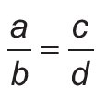
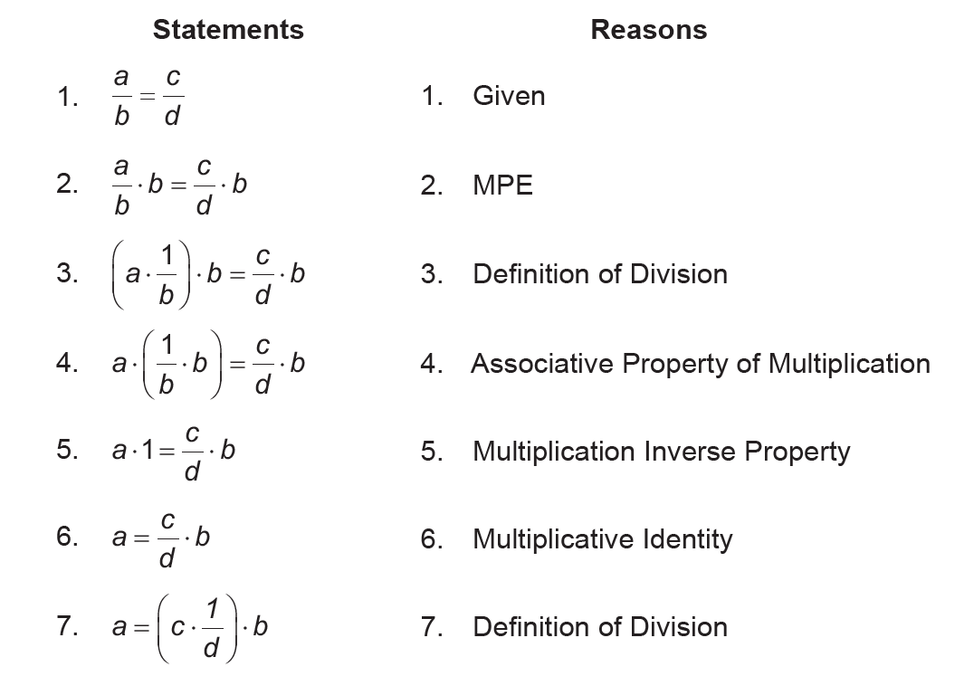
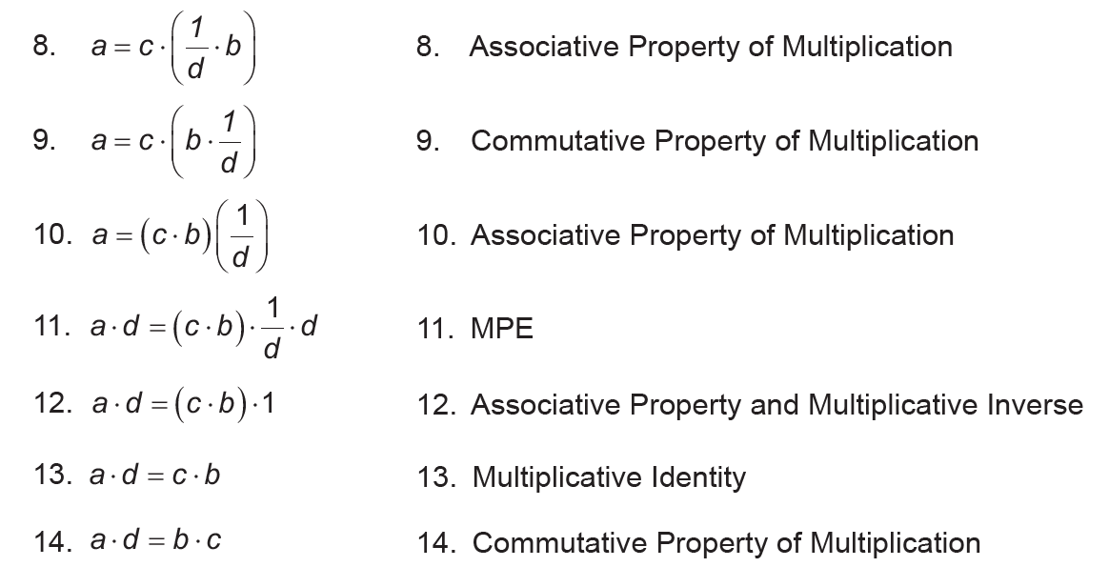
Proportion
Example 5:
Prove that = is equal to ad = bc.
Proof:
Rex Curriculum Resource
WWW.REX.COM.PH

Slide 23
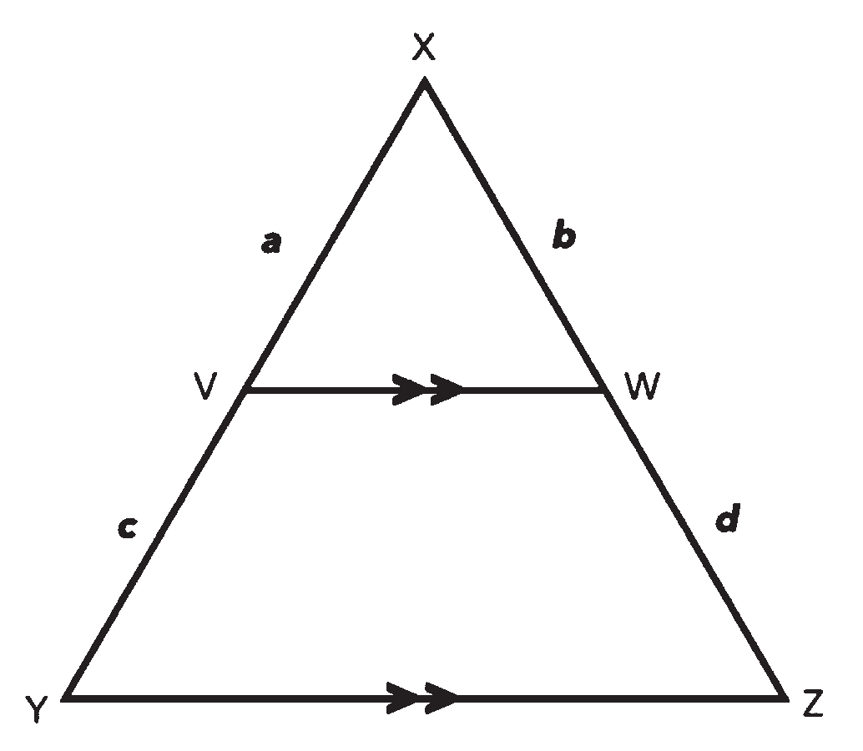
Proportion
Example 5:
The Fundamental Theorem of Proportionality states that, “If a line is drawn parallel to one side of a triangle to intersect the other two sides in distinct points, the other two sides are divided in the same ratio.”
In the following figure, we can see that side VW is parallel to side YZ of ΔXYZ. The Fundamental Theorem of Proportionality states that a : c = b : d, which is the same as XV : VY = XW : XW.
Rex Curriculum Resource
WWW.REX.COM.PH

Slide 24
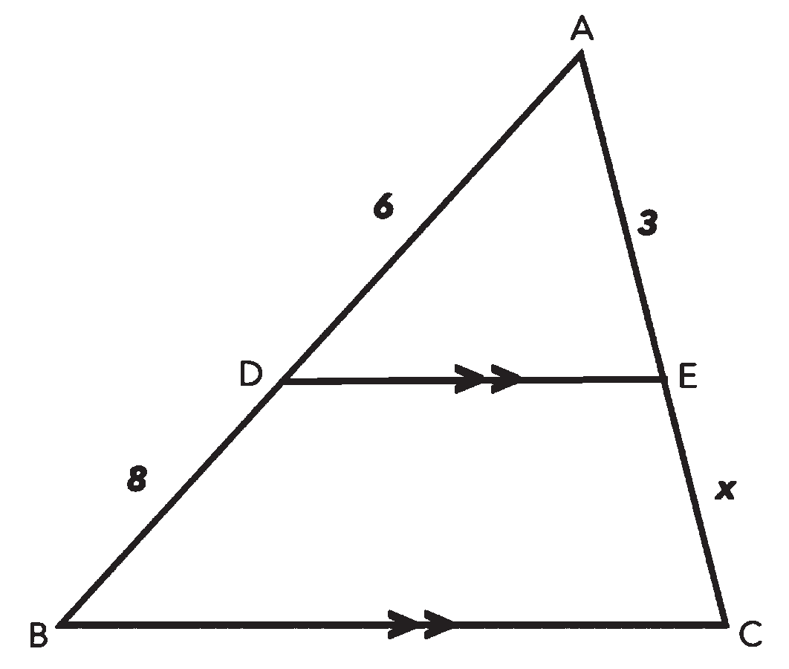
Proportion
Example 6:
Solve for the value of x in the given triangle below.
Using the Fundamental Theorem of Proportionality, we can say that AD :DB = AE : EC . Thus, taking the measurement of these sides, we have the proportion 6:8 = 3:x.
From here, we can solve for the value of x.
Cross-multiply:
6x = 3 * 8
Simplify the right-hand side of the equation:
6x = 24
Divide both sides of the equation by 6:
X = 24 / 6
Therefore, the value of x is 4.
Rex Curriculum Resource
WWW.REX.COM.PH

Slide 25
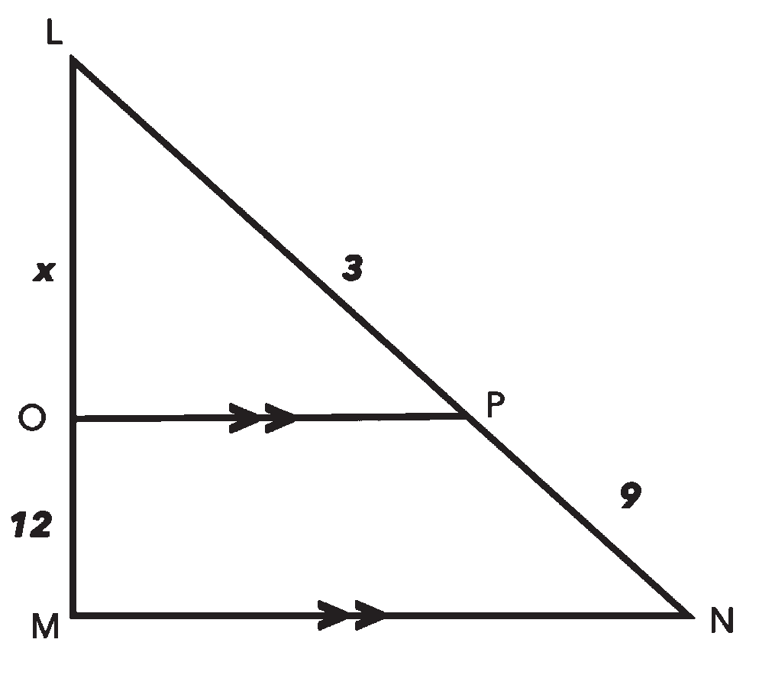
Activity:
Try It 5
Find the value of x in the given triangle below.
Rex Curriculum Resource
WWW.REX.COM.PH

Slide 26
Activity: ANSWER SHEET
Try It 5
Find the value of x in the given triangle below.
ANSWER
Try It 5
x = 12
Rex Curriculum Resource
WWW.REX.COM.PH

Slide 27
Proportion
Example 6:
The amount of medication that should be administered to children is based on the ratio of the child’s weight to that of an average adult. The average adult’s weight of 70 kilograms is often used. If an adult dose of a medication is 20 milligrams, how much should a 14-kilogram child take for his/her medication?
adult weight
child weight
adult dose of medication
=
child dose of medication
70 kg
14 kg
=
20 mg
x mg
70x
=
280
x
=
4 mg
Rex Curriculum Resource
WWW.REX.COM.PH

Slide 28
Activity:
Try It 6
The amount of medication that should be administered to children is based on the ratio of the child’s weight to that of an average adult. The average adult weight of 70 kilograms is often used. If an adult dose of a medication is 20 milligrams, how
much should a 10.5-kilogram child take for his/her medication?
Rex Curriculum Resource
WWW.REX.COM.PH

Slide 29
Activity: ANSWER SHEET
Try It 6
The amount of medication that should be administered to children is based on the ratio of the child’s weight to that of an average adult. The average adult weight of 70 kilograms is often used. If an adult dose of a medication is 20 milligrams, how
much should a 10.5-kilogram child take for his/her medication?
ANSWER:
Try It 6
A 10.5-kg child should take 3 mg for his/her medication.
Rex Curriculum Resource
WWW.REX.COM.PH

Slide 30
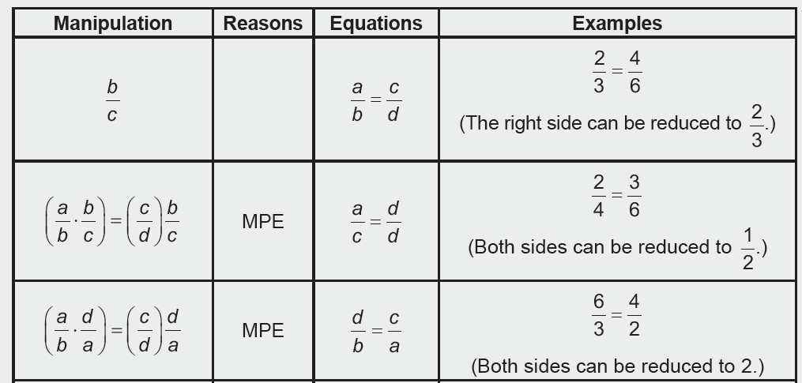
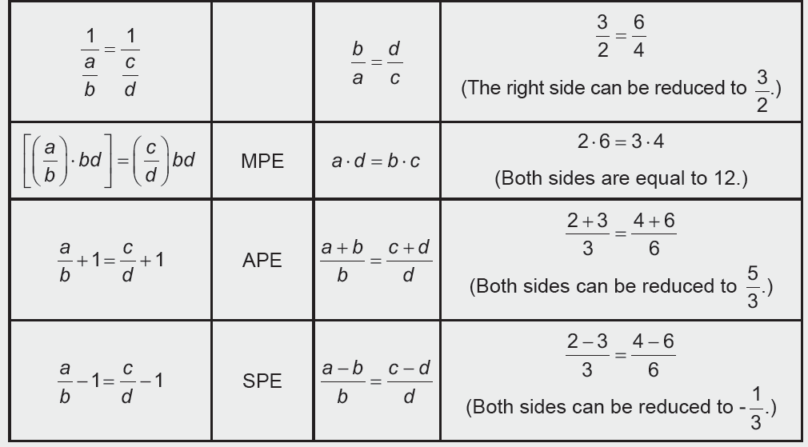
KEY TAKEAWAYS
Using the same proportion a/b = c/d, provided that no term is zero, the following equations can be derived. These equations are also properties of a proportion.
Rex Curriculum Resource
WWW.REX.COM.PH

Slide 31


