Slide 1


Conversion of Decimals, Fractions, and Percents

Slide 2
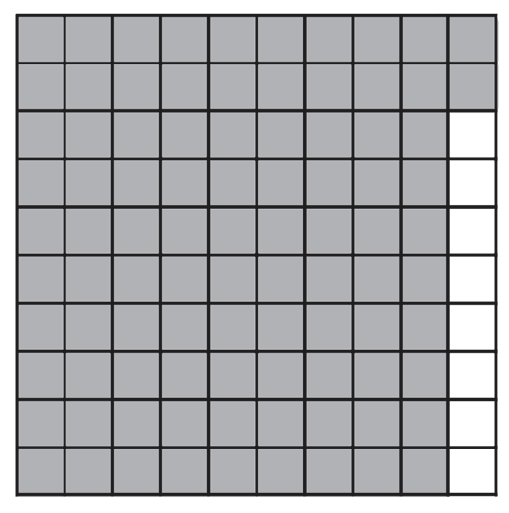
The concept of percent can be applied to your activities in school. Take a look at the given situation.
Nathan scored 92 out of 100 items in his Mathematics test. What percent of the total number of items was he able to answer correctly? What does this result show about Nathan’s performance in math?
The given model represents the score of Nathan in his mathematics test.
92 out of 100
Looking at the model, 92 of 100 can be represented as 92%. Thus, we can say that:
92 out of 100 or 92/100 is equal to 92%
This result shows that Nathan is performing well in Math.
Notice that it became easy for us to interpret Nathan’s performance in Math because we were able to convert it to percent.
The succeeding lesson will allow us to explore more on converting fractions and decimal numbers to percent and vice versa.
Rex Curriculum Resource
WWW.REX.COM.PH

Slide 3
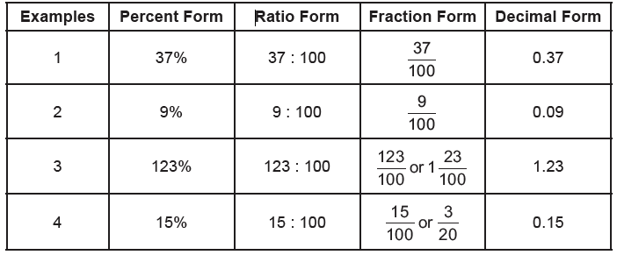
Remember, percent is a ratio that compares a number to 100. It is similar to a fraction whose denominator is 100. As a fraction, the percent symbol (%) takes the place of hundredths. Study the given examples.
Rex Curriculum Resource
WWW.REX.COM.PH

Slide 4
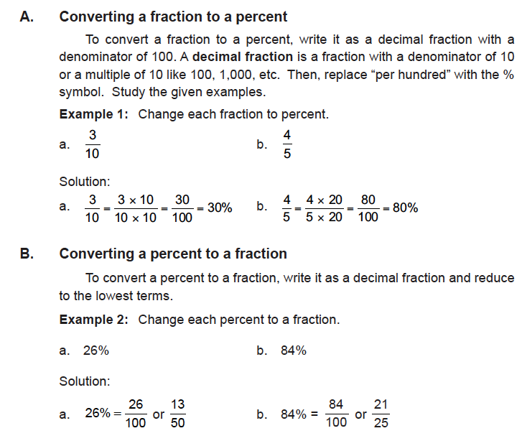
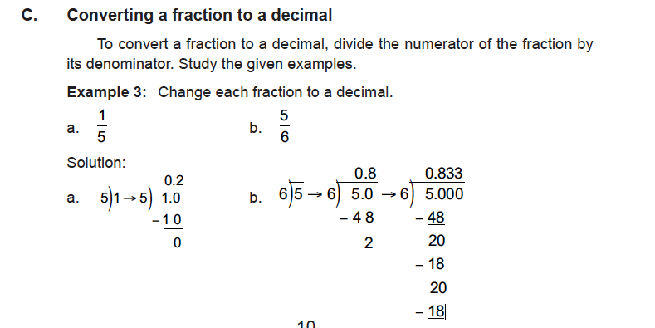

Rex Curriculum Resource
WWW.REX.COM.PH

Slide 5
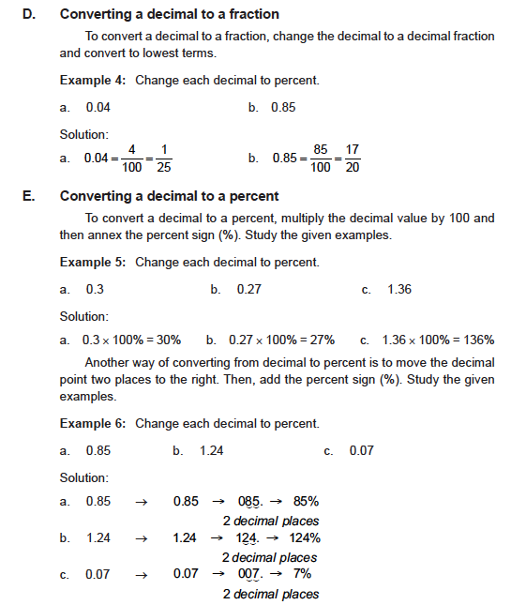
KEY TAKEAWAYS
• To convert a fraction to a percent, write it as a decimal fraction with a
denominator of 100. Then, replace “per hundred” with the % symbol.
• To convert a percent to a fraction, write it as a decimal fraction and reduce to lowest terms.
• To convert a fraction to a decimal, divide the numerator of the fraction by its denominator.
• To convert a decimal to a fraction, change the decimal to a decimal fraction and reduce to lowest terms.
• To convert a decimal to percent, multiply the decimal value by 100 and then annex the percent sign (%).
Rex Curriculum Resource
WWW.REX.COM.PH

Slide 6
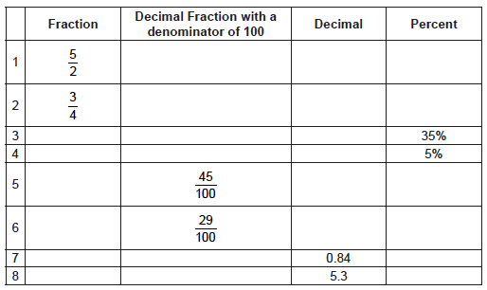
Activity:
Convert the following quantities into the indicated form.
Rex Curriculum Resource
WWW.REX.COM.PH

Slide 7


