Slide 1


Relationship of Decimals, Fractions, and Percents

Slide 2
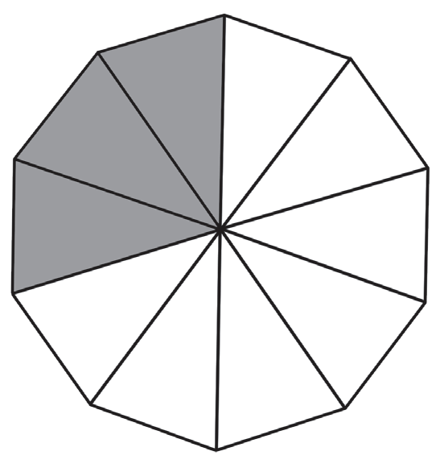
Look at the figure on the right.
In how many equal parts has the whole been divided?
What part of the shape is shaded? How do you
represent this as a percent?
What part of the whole is unshaded? What percent
of the whole is this?
These questions will be answered as you go about
the succeeding lesson. Have Fun!
Rex Curriculum Resource
WWW.REX.COM.PH

Slide 3
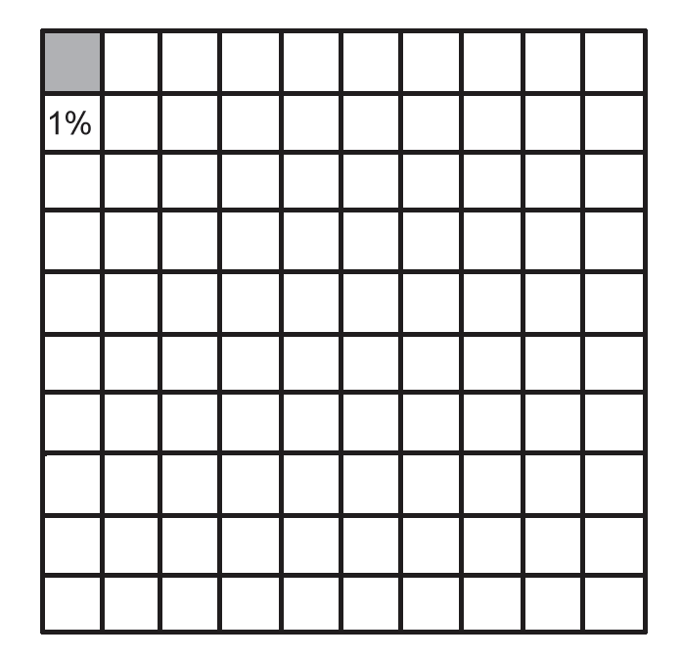
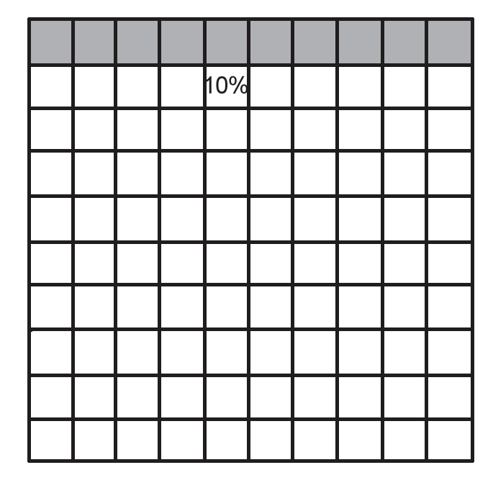
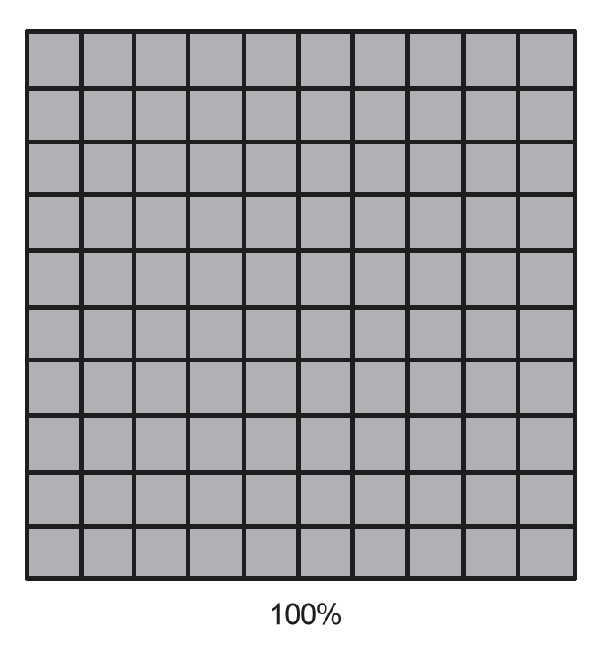
A percent is a ratio that compares a number to 100. The word “percent” is from the Latin phrase per centum. It means “per hundred” or “out of 100.” The symbol used for percent is %.
You can also use a part-whole model to represent percent. In this model, the whole is taken as the base (100%). When a whole is divided into 100 equal parts, then each part is 1/100 of the whole or 1% of the whole. Look at the models for 1%, 10%, and 100%.
Each big square consists of 100 equal parts. Count the shaded squares in each model to get their percent forms.
For example, the model for 10% shows that 10 parts are shaded out of 100 parts.
Rex Curriculum Resource
WWW.REX.COM.PH

Slide 4
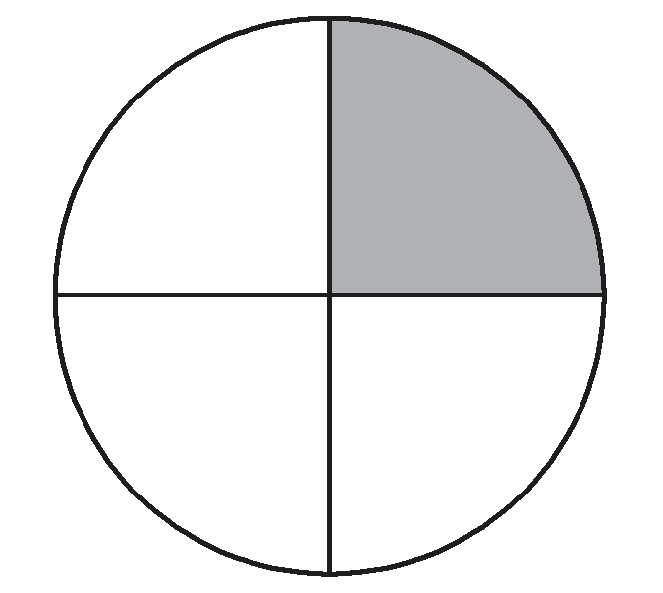
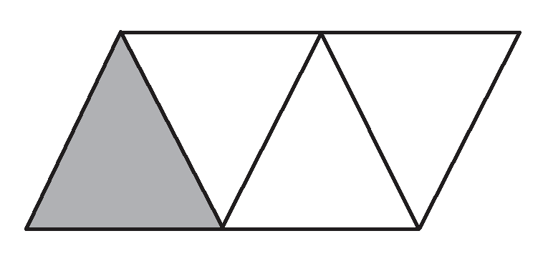
You can also use regional models and other shapes to show 25%. Remember that 25% is equivalent to the decimal fraction
25/100 or ¼.
Thus, the shaded parts in the following models represent 25%. How do you find the percent form for the unshaded parts of each model?
1/ 4 or 0.25 or 25%
Rex Curriculum Resource
WWW.REX.COM.PH

Slide 5
KEY TAKEAWAYS
• A percent is a ratio that compares a number to 100. It means “per hundred” or “out of 100.” The symbol for percent is %.
• The symbol % replaces the phrase “per hundred” in a ratio and the denominator 100 or hundredths in a fraction.
• You can visualize decimals, fractions, and percents using 100’s grid, bar, number line, or part-whole models.
Rex Curriculum Resource
WWW.REX.COM.PH

Slide 6
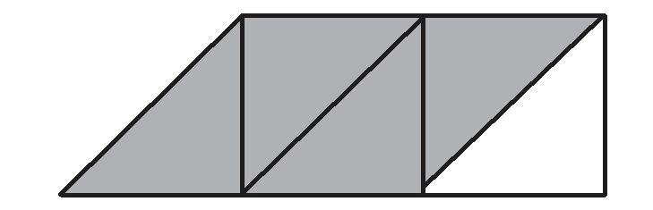
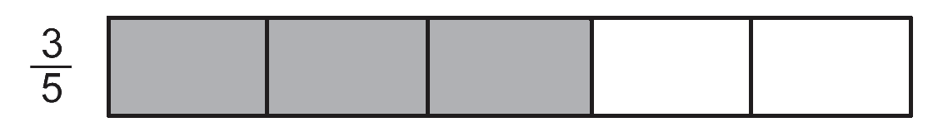
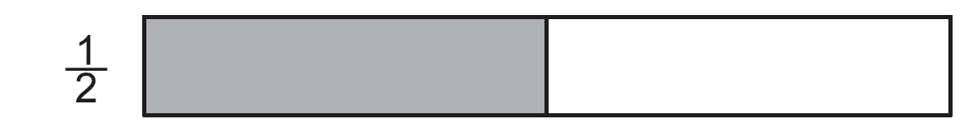
Activity:
Answer the following questions
1. How many parts will you shade in a square consisting of 100 equal parts to show 35%?
2. What is the percent form of the shaded part in the given figure below?
You can also use bar models to show fractions and percent. Look at the shaded regions in the given pictures. Figure A is divided into 5 equal parts. Three parts of Figure A are shaded. Thus, the shaded parts of Figure A show 3/5 or 60%. Can you give the percent form for the shaded part in Figure B?
Figure A Figure B
Rex Curriculum Resource
WWW.REX.COM.PH

Slide 7
Activity: ANSWER KEY
Answer the following questions
1. How many parts will you shade in a square consisting of 100 equal parts to show 35%?
2. What is the percent form of the shaded part in the given figure below?
You can also use bar models to show fractions and percent. Look at the shaded regions in the given pictures. Figure A is divided into 5 equal parts. Three parts of Figure A are shaded. Thus, the shaded parts of Figure A show 3/5 or 60%. Can you give the percent form for the shaded part in Figure B?
Figure A Figure B
ANSWERS
1. 35
2. 80%
Rex Curriculum Resource
WWW.REX.COM.PH

Slide 8


