Slide 1


Finding Percentage

Slide 2
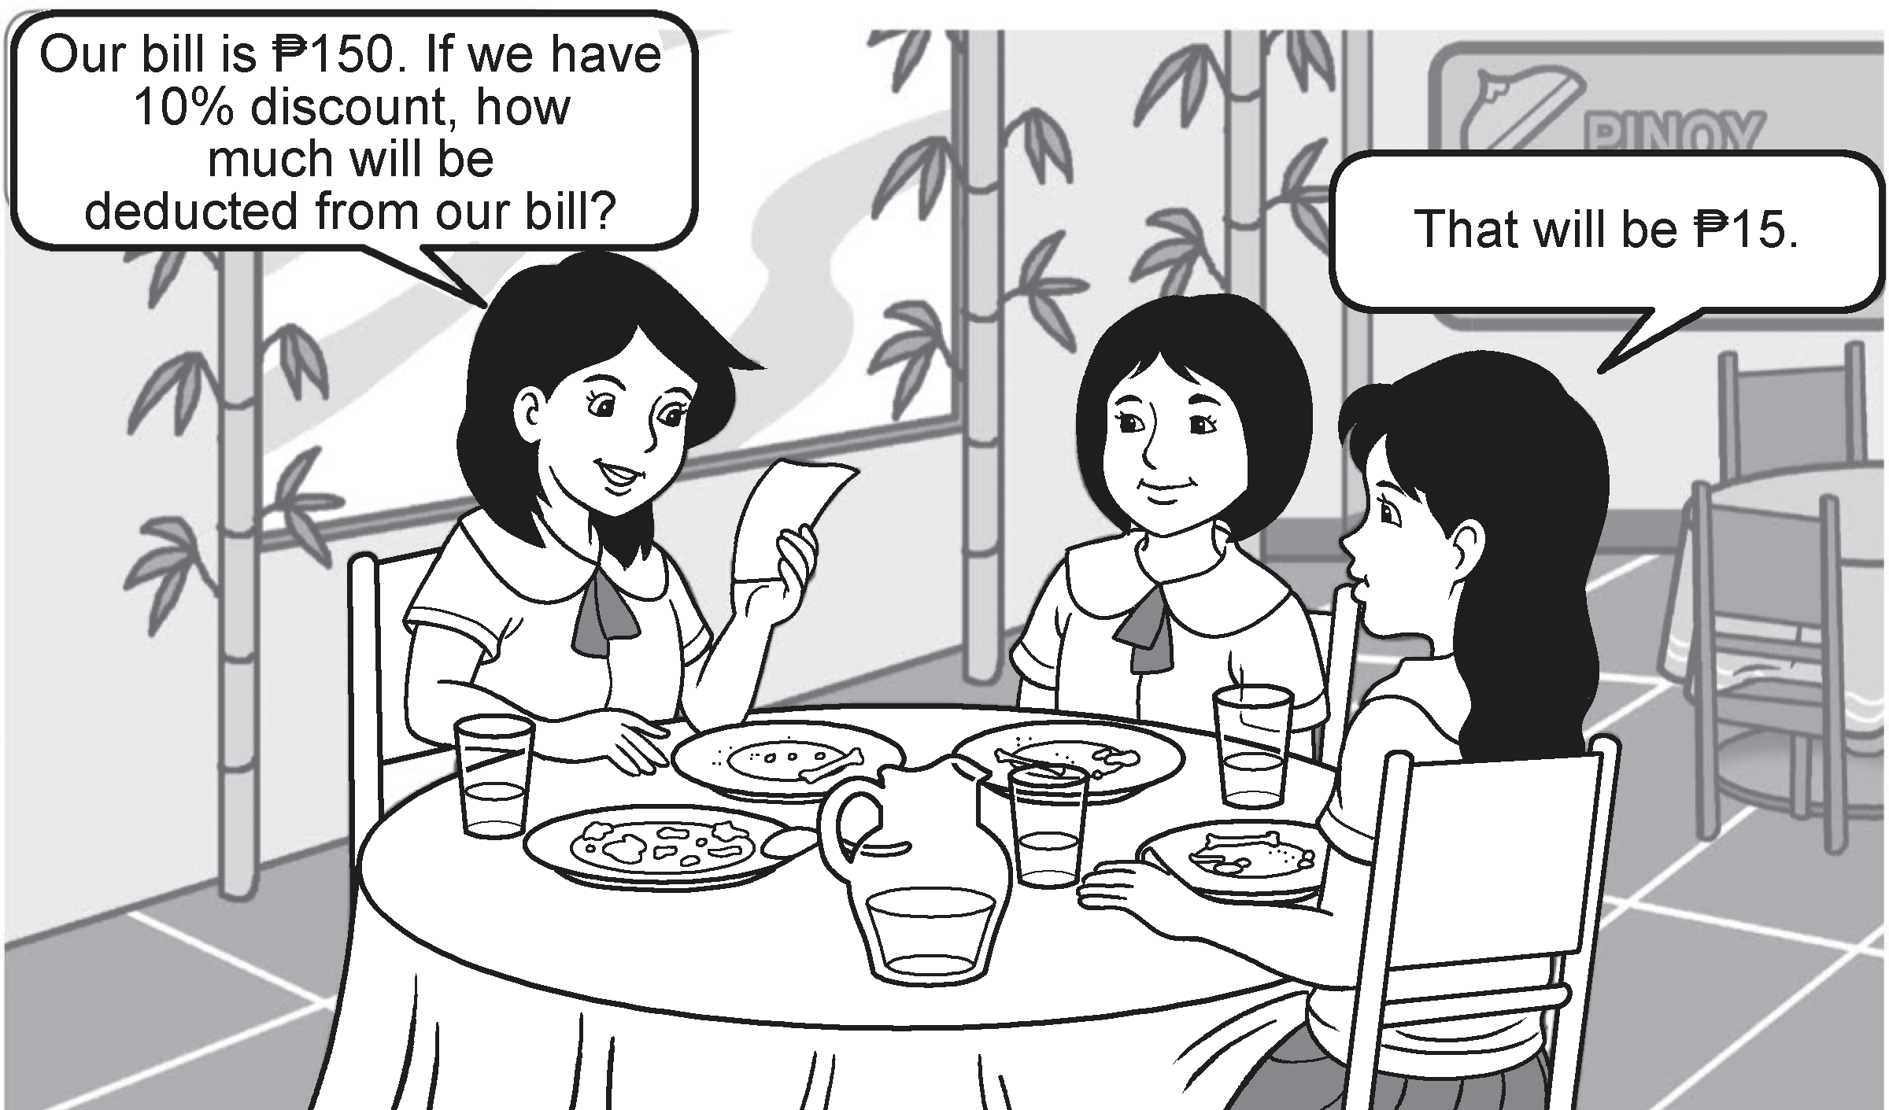
Lilay, Jeng, and Weng took their snacks at their school’s cafeteria. Study their conversation below.
Is the answer correct? How do you compute the answer? Let us find out by
studying this lesson.
Rex Curriculum Resource
WWW.REX.COM.PH

Slide 3
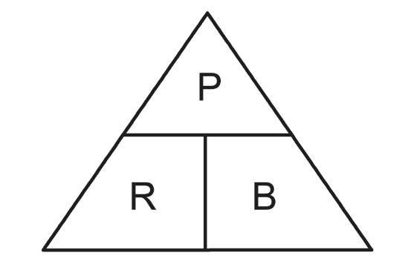
Percentages are used frequently in everyday life. People use them to compute discounts in a sale, commissions in sales, interests in bank deposits, grades in exams, and so on. Let us check how to solve the unknown in these problems
Example 1: What is 20% of 60?
Solution: The unknown in the problem is the percentage. To get the answer, multiply the base and rate. To solve this, we can use the
Teehan’s triangle.
Here is how:
The set of three formulas for percentage, rate, and base can be placed in the Teehan’s triangle.
If the percentage is unknown, P = Rate × Base
If the rate is unknown, R = (Percent ÷ Base) × 100.
The answer here will be multiplied by 100 to convert it to percentage form (%).
If the base is unknown, B = Percentage ÷ Rate. To facilitate the computation in this formula, the rate should be in decimal or fraction form.
Then,
R B P
20% of 60 = n
20% of 60 = 0.20 × 60 or 12
So, the percentage is 12.
Rex Curriculum Resource
WWW.REX.COM.PH

Slide 4
Example 2: To answer the problem in slide 2, the original amount is the base, while the rate is 10%. So, the unknown is the percentage.
Getting the answer is easy. All you need to do is to multiply the base and the rate.
Here is how:
Percentage = Base × Rate
= ₱150 × 10%
= ₱150 × 0.1 Change 10% to decimal form and multiply it with 150.
= ₱15
So, the deduction is ₱15.
Example 3: Mr. Reyes borrowed ₱20,000.00 from a bank payable for one year. If the interest rate is 6%, how much interest will he pay?
Solution: The unknown in the problem is the percentage. To get the answer, multiply the base and rate.
Here is how:
6% of ₱20,000 = 0.06 × 20,000 or 1,200
So, the interest is ₱1,200.
Example 4: Jun receives a 5% commission on all his sales. What is his commission if his total sales is ₱40,000?
Solution: To get the answer, multiply the base and rate. Here is how:
5% of ₱40,000 = 0.05 × 40,000 or 2,000
So, his commission is ₱2,000.
Rex Curriculum Resource
WWW.REX.COM.PH

Slide 5
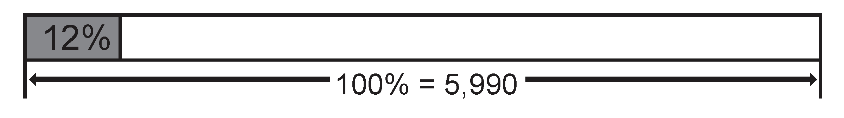
Did you know that you have to pay a 12% sales tax or value-added tax (VAT) every time you purchase your groceries? In the Philippines, the VAT rate is 12%. It is a form of sales tax on a consumption added on the sale, barter, or exchange of goods. Study the given examples to know more about VAT or sales tax.
Example 5: Riza bought a cell phone that cost ₱5,990, exclusive of tax. How much
would she pay for the VAT?
Solution: The base is 5,990 and the percent rate is 12%. The unknown is the percentage. Let’s visualize the scenario in order to solve the problem.
The percentage or VAT is 12% of the base, which is 5,990. So, the VAT is ₱718.80.
VAT = 12% of ₱5,990 = 0.12 × 5,990 or 718.80
So Riza should pay ₱718.50 for the sales tax or VAT.
Rex Curriculum Resource
WWW.REX.COM.PH

Slide 6
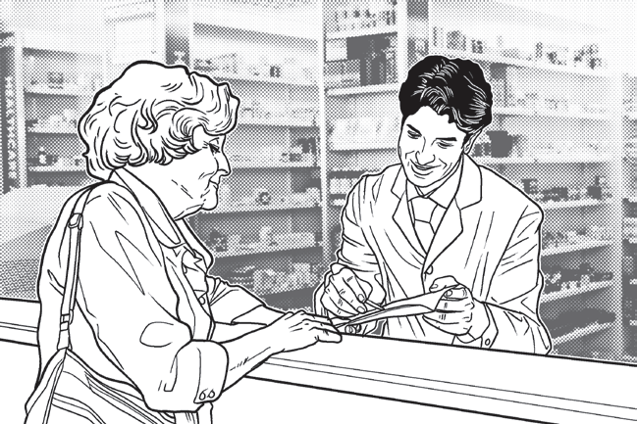
Did you know that senior citizens in the Philippines, aged 60 years old and above, are entitled
to a 20% senior citizen discount and are exempted from the VAT on applicable goods and services?
Example 6: Uncle Andie, a senior citizen, bought his medicines from a nearby drugstore. How much discount did he get if the total selling price is ₱2,000?
Solution: Uncle Andie is exempted from paying VAT. As such, you need to deduct the amount of VAT from the selling price of the medicine. Here is how:
₱2,000 = Tax (12%) + Original Price (100%)
₱2,000 = 112% (Original Price)
Original Price = ₱2,000 ÷ 112%
Original Price = ₱1,785.71
To compute for the tax, get the difference of the selling price and original price. That is
₱2,000 − ₱ 1,785.71 = ₱214.29
To get the 20% additional discount for the senior citizen, simply multiply the original price and discount.
Senior Citizen Discount = ₱1,785.71 × 0.20
Senior Citizen Discount = ₱357.14
And to finally solve for the total discount, just add the senior citizen discount and VAT. That is
₱214.29 + ₱357.14 = ₱571.43
Therefore, Uncle Andie will get a discount of ₱571.43.
Rex Curriculum Resource
WWW.REX.COM.PH

Slide 7
KEY TAKEAWAYS
• The percentage (or amount) is the part that you are comparing with the base.
• To find the percentage of a number, multiply the base and the rate.
Rex Curriculum Resource
WWW.REX.COM.PH

Slide 8
Activity:
Read each item carefully. Then, solve for the unknown in the problem.
1. What is 40% of 160?
2. Sophie got 90% in a 50-item test in Math. How many items did she answer correctly?
3. Ana bought a 2-kilogram pack of powdered milk. How much will she pay for the sales tax or VAT if it costs ₱530?
Rex Curriculum Resource
WWW.REX.COM.PH

Slide 9
Activity: ANSWER KEY
Read each item carefully. Then, solve for the unknown in the problem.
1. What is 40% of 160?
2. Sophie got 90% in a 50-item test in Math. How many items did she answer correctly?
3. Ana bought a 2-kilogram pack of powdered milk. How much will she pay for the sales tax or VAT if it costs ₱530?
ANSWER KEY
1. 64
2. 45
3. ₱63.60
Rex Curriculum Resource
WWW.REX.COM.PH

Slide 10


