Slide 1
Finding the Percentage, Base, or Rate

Slide 2

Finding the Percentage, Base, or Rate
What are percentages and what are the formulas you need to use? These are what you will learn in this discussion.
Rate
The rate is the number of hundredths taken. The percent sign (%) is affixed to the rate. The rate is the decimal equivalent of a percent.
Base
Base is the whole in which the rate operates.
Percentage
Percentage is the answer obtained when you multiply a number by a percent.
Percentage is the part of the base that is determined by the rate.

Slide 3
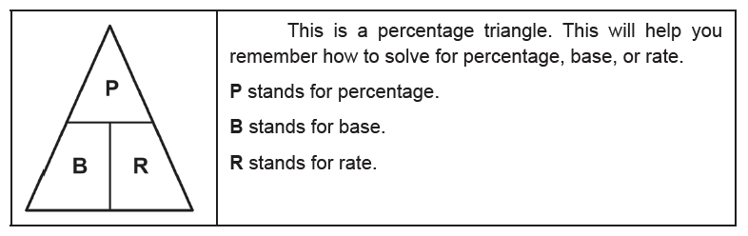
Finding the Percentage, Base, or Rate
Cont.

Slide 4
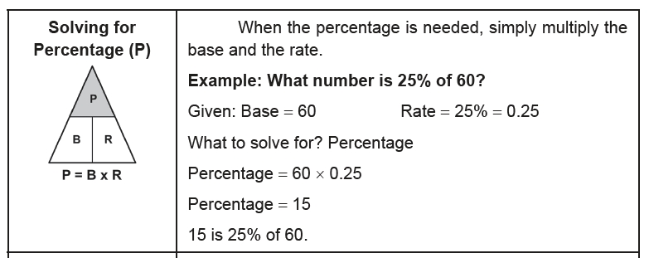
Finding the Percentage, Base, or Rate
Cont.
Below are the formulas you need to solve for percentage, base, or rate.

Slide 5
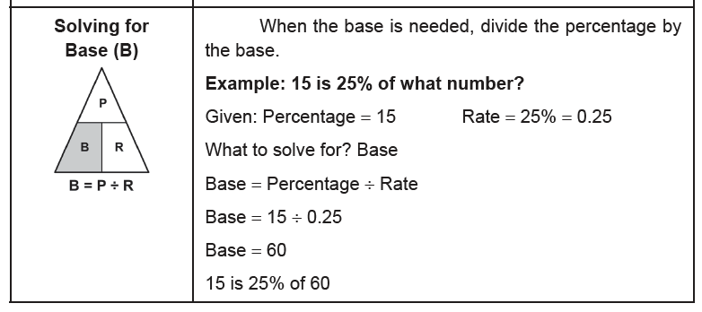
Finding the Percentage, Base, or Rate
Cont.

Slide 6
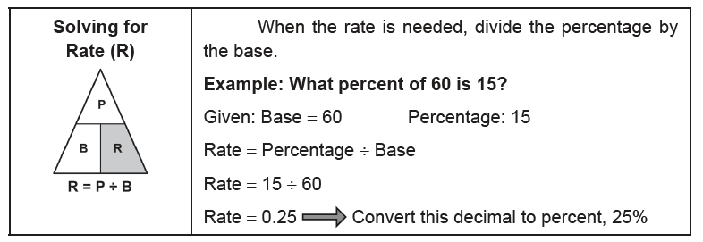
Finding the Percentage, Base, or Rate
Cont.

Slide 7
Finding the Percentage, Base, or Rate
Example 1: What number is 6% of 30?
Identify what is needed in the problem.
It is a part of 30 that is asked, so it is the percentage that is needed.
Use the formula: P = B × R
Given: Base = 30 Rate = 6% = 0.06
P = 30 × 0.06
P = 1.8
Answer: 1.8 is 6% of 30.

Slide 8
Finding the Percentage, Base, or Rate
Example 2: What percent of 40 is 8?
Identify what is needed in the problem.
It is the rate that is needed.
Use the formula: R = P ÷ B
Given: Base = 40 Percentage = 8
R = 8 ÷ 40
R = 0.2 Convert this percent, 20%
Answer: 8 is 20% of 40.

Slide 9
Finding the Percentage, Base, or Rate
Example 3: 300 is 75% of what number?
Identify what is needed in the problem.
The base is needed.
Use the formula: B = P ÷ R
Given: Percentage = 300 Rate = 75% = 0.75
B = 300 ÷ 0.75
B = 400
Answer: 300 is 75% of 400.

Slide 10
Finding the Percentage, Base, or Rate
Complete the following. Answers
1. What percent of 50 is 5? R = 10% B = 50 P = 5
2. 30 is what percent of 240? R = 12.5% B = 240 P = 30
3. What is 28.5% of 600? R = 28.5% B = 600 P = 171

