Slide 1
Electromagnets

Slide 2
Electromagnets
What Is an Electromagnet?
In 1820, Danish physicist Hans Christian Oersted discovered that the electric current in a wire diverts a magnetized compass needle, which led to the formulation of the electromagnetic theory. While lecturing before a class, Oersted accidentally pushed a magnetic compass under a wire connected to a battery.
7
He noticed that instead of pointing north, the compass needle swung at right angles to the wire. This happened only when the current was on. Oersted found out that electricity had a magnetic influence as the current-carrying wire had a magnetic field around it.

Slide 3
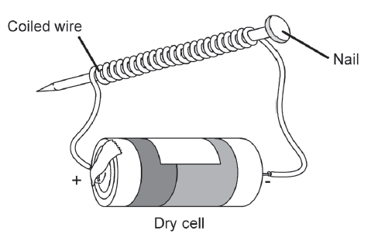
Electromagnets
An electromagnet runs on electricity (provided by the dry cell in the activity). It is a piece of soft metal iron that is magnetized by passing the electric current through a coil of wire wrapped around the metal. It becomes magnetized when the electric current is present and demagnetized when the electricity is turned off.

Slide 4
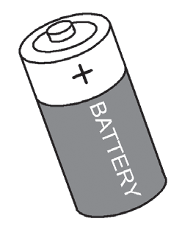
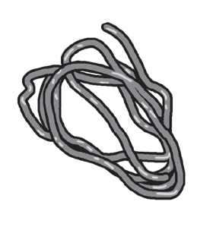
Electromagnets
Components of an Electromagnet
The source is from where the electricity comes. It is where the current or electricity starts to flow. the battery is the source of electricity or charges moving through the wire.
The wire allows the electricity to flow from the source to the core (nail). It is also called a path. The path is all the parts of the circuit through which the current flows. It is the pathway of flowing electricity and is made of conducting materials called conductors. These are materials that conduct electricity and allow it to pass through.

Slide 5
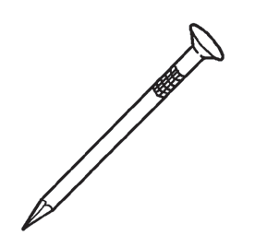
Electromagnets
The nail serves as the core of the electromagnet. When electricity flows from the source, the nail becomes a temporary magnet. Temporary magnets lose all or most of their magnetic properties after a short time. Once the wire is disconnected from the source, the nail will lose its magnetic properties.

Slide 6
Electromagnets
Factors that Affect the Strength of Electromagnets
Electromagnets can increase their strength with a little modification.
As electromagnets work by sending an electrical signal through the coiled wire, more of this can be used to create a bigger coil. The strength of the current sent through the wire can also be increased, which can also improve the efficiency of the magnet.
Wrapping the metal coils around an iron core is also a way to increase the strength of electromagnets.
The strength of electromagnets is also increased by raising the voltage of the dry cell, which is done by adding more of these sources connected to the wire.

Slide 7
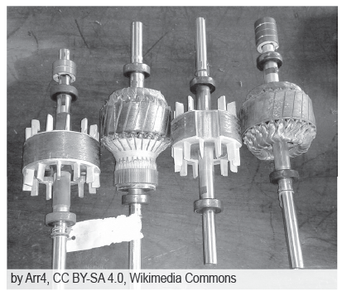
Electromagnets
Uses of Electromagnets
Electromagnets are used every day. These devices are useful for domestic, industrial, commercial, communication, transportation, and medical purposes.
One of the most important uses of electromagnets is that they help in running electric motors. An electric motor is a device that converts electrical energy into mechanical energy. Electric motors run refrigerators, vacuum cleaners, washing machines, blenders, drills, and many others.

Slide 8
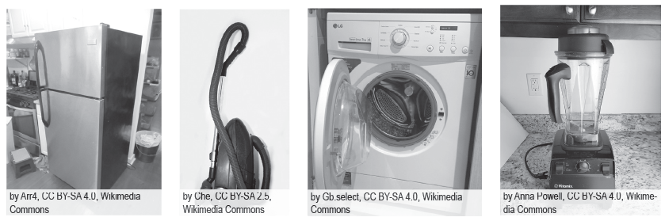
Electromagnets
Some appliances run by electric motors
Aside from these useful things, the electromagnets of speakers transform signals into sounds by making them vibrate. In the picture tubes of television (TV) sets or computer monitors (old models), an electromagnet, called a deflection yoke,helps form images on the screen.

Slide 9
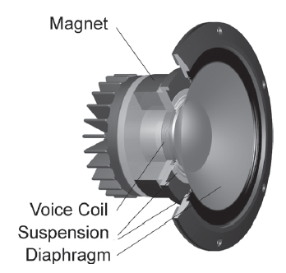
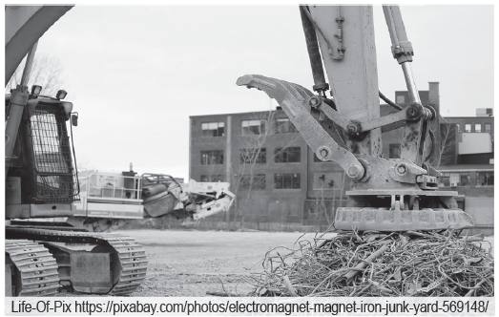
Electromagnets
In different industries and businesses, magnets are commonly used in electromagnet-powered devices, such as cutters, fax machines, computers, and cranes. Powerful cranes use electromagnets to move scrap iron and steel to separate metals for recycling.
An electromagnet inside a speaker’s system
An electromagnet crane

Slide 10
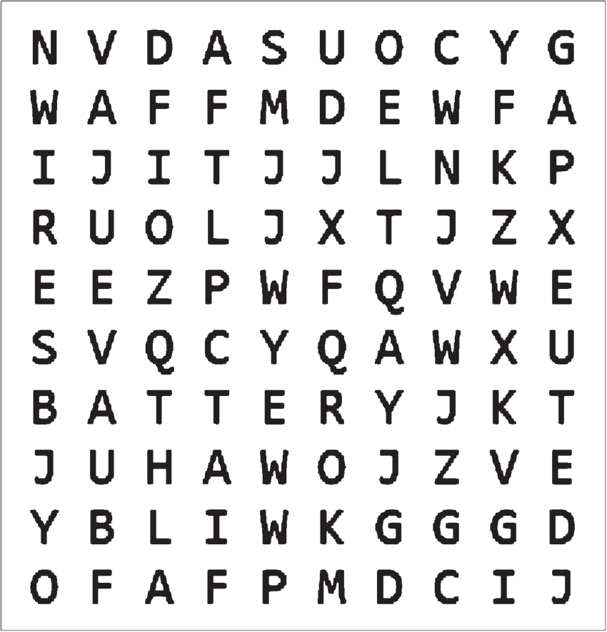
Electromagnets
Activity
Directions: Find and give the components of an electromagnet.
Components of an electromagnet

Slide 11
Electromagnets
Answer Key
Components of an electromagnet
Nail
Wire
Battery

