Slide 1
The Sun and the Planets

Slide 2
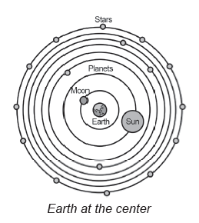
The Sun and the Planets
Some of the theories on the solar system according to early astronomers, such as Claudius Ptolemy.
Geocentric Model (Earth-centered Model)
The geocentric model was formulated by a Greek philosopher named Claudius Ptolemy. He proposed that the planets, the Sun, and the Moon moved in perfect circles around Earth. He imagined that the planets go occasionally in small circles and then return to their orbits. This theory tried to explain the retrograde motion of some planets. Retrograde motion refers to the east to west rotation of the planet, whereas prograde motion is the west to east rotation of the planet.

Slide 3
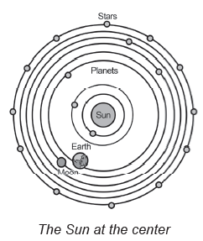
The Sun and the Planets
Heliocentric Model (Sun-centered Model)
The word heliocentric is derived from the word helios, which means Sun, and kéntron, which means center. Literally, heliocentric means Sun-centered.
In AD 500, a Greek philosopher named Philolaus stated that Earth was moving around the central fire (Sun) in a west to east direction. Later, a Greek astronomer in the person of Aristarchus thought that Earth rotates and moves in an orbit around the Sun like the other planets. This theory, however, was not immediately accepted by the learned men during their time since they were not able to prove it.

Slide 4
The Sun and the Planets
In 1543, a Polish astronomer named Nicolaus Copernicus formulated a theory that states that it is the Sun, and not Earth, which is at the center of the solar system. He proposed that the planets, including Earth, revolve around the Sun and that the closest planet to the Sun is Mercury, followed by Venus, Earth, Mars, Jupiter, and Saturn. Other planets were not yet discovered during that time. This theory then led to the formulation of the Sun-centered Copernican model. After hundreds of years, this theory was then universally accepted.
Modern astronomers, such as Tycho Brahe and Johannes Kepler, contributed much to improve the heliocentric model of the solar system. Through their mathematical computations, observations, and records of the positions of the stars, moon, and planets, they discovered that all planets revolve around the Sun in elliptical orbits. This is in contrast to the geocentric model, which demonstrates that the orbits are perfect circles rather than elliptical.

Slide 5
The Sun and the Planets
The study of the solar system was improved further through the invention of the telescope. With the invention of this device, scientists are now able to have greater precision in terms of studying heavenly bodies. Among the astronomers to use the telescope is Italian astronomer and physicist Galileo Galilei. He was able to discover the moons of Jupiter by using his homemade telescope.
Astrology is a pseudoscience that tells the supposed influence of stars and planets on human activities and events by their positions and aspects. Being a pseudoscience, astrology is not an actual scientific study. It is way different from the scientific study of heavenly bodies, that is, astronomy.

Slide 6
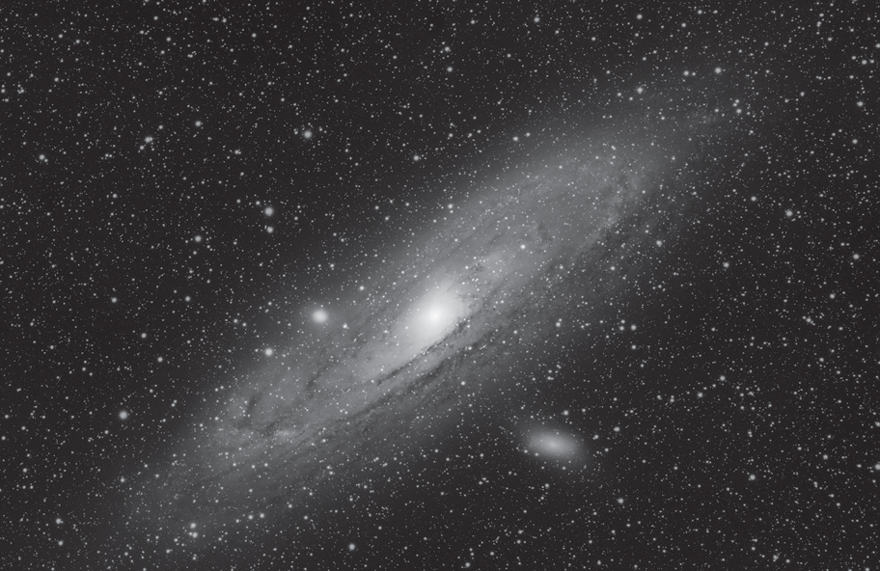
The Sun and the Planets
The solar system is only a speck in
the Milky Way.
The Solar System The solar system is like a big family. It consists of the Sun and everything revolving around it. This includes the eight planets and their moons, comets, asteroids, and meteors.
The solar system belongs to a larger group system of stars and other objects called the Milky Way galaxy. The Milky Way is only one of the billions of galaxies that makes up the whole universe.
Public Domain via Piqsels.com

Slide 7
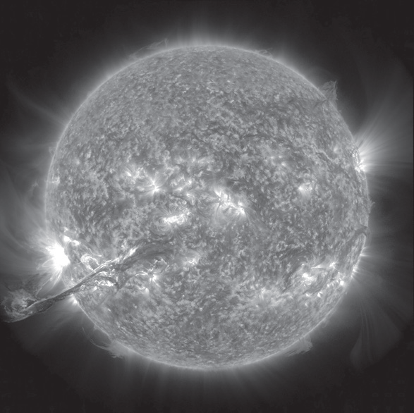
The Sun and the Planets
The Solar System and Its Members
The Sun as seen from space
A. The Sun
The Sun is a huge ball of extremely hot gases, mostly hydrogen and helium. It is the center of the solar system. The Sun’s diameter is about 1,390,000 kilometers or about 109 times the diameter of Earth. Its temperature is 15,000,000°C at the center and 5,000°C at the surface.
The Sun is a yellow dwarf star, but it is considered the largest object in the solar system. Its gravity holds everything, from the biggest planets to the tiniest debris in its orbit.
NASA/GSFC/SDO (CC BY 2.0) via Flicker.com

Slide 8
The Sun and the Planets
B. The Planets
Studying the planets began long ago when the early astronomers noticed that five “stars” (the only planets they could see without a telescope) were brighter than the others. As these five “stars” seemed to move in relation to other stars, the Greeks called them planēt, which means “to wander.”
The general characteristics of the planets are massive and spherical, have an atmosphere, revolve around the Sun, shine by reflected light, and do not have light of their own.
There are eight known planets in the solar system. They are grouped into two: the terrestrial planets (inner planets), which include Mercury, Venus, Earth, and Mars; and the gas giants (outer planets/Jovian planets), which include Jupiter, Saturn, Uranus, and Neptune.

Slide 9
The Sun and the Planets
The Terrestrial Planets
Mercury, Venus, Earth, and Mars are terrestrial planets because they are solid,
rocklike, and dense.
A. Mercury: The Innermost Planet
  Mercury is the closest planet to the Sun. It is so close to the Sun that its glare made it nearly impossible to see its surface from Earth.
  Mercury is the smallest planet in the solar system—only slightly larger than Earth’s moon.
  No moon accompanies Mercury. It revolves quickly (88 days) but rotates slowly (179 days); thus, a night on Mercury lasts for about 3 months followed by 3 months of daylight.
  Trivia: Mercury has been known since ancient times because it can be seen without using advanced telescopes. The planet has been visited by two spacecraft: Mariner 10 and MESSENGER.

Slide 10
The Sun and the Planets
B. Venus: Earth’s Twin Planet
  Venus is the second planet from the Sun.
  Venus is considered the twin planet of Earth due to its similarity with size and mass to that of Earth.
  Venus is the second-brightest object in the night sky next to the moon the moon. It is often called the “morning star” when it is in the west at sunset.
  Venus is known as the hottest planet due to its atmosphere. Venus’ surface reaches to a temperature of about 475°C because its thick atmosphere prevents excess sunlight to escape the planet. Its very thick atmosphere is composed mostly of carbon dioxide (97%). This environment makes it impossible for life to exist on Venus.
  Like Mercury, Venus has no moons.
  Trivia: One day on Venus lasts 243 Earth days because Venus spins backward, with the Sun rising in the west and setting in the east.

Slide 11
The Sun and the Planets
C. Earth: Our Home Planet
  Earth is the third planet from the Sun.
  Earth is the only planet in the solar system where life is known to exist.
  Earth has abundant liquid water and supports life.
  Earth has an atmosphere that supports and protects life. The gaseous form of water, water vapor, is held in the atmosphere. Over millions of years ago, oxygen has been added to this atmosphere. As a result of these conditions, Earth can support life.
  Earth has one natural satellite, the Moon.
  Trivia: More than 70% of the Earth’s surface is covered by water, which absorbs most of the carbon dioxide from the atmosphere. The rest is land, mostly in the form of continents.

Slide 12

The Sun and the Planets
D. Mars: The Red Planet
  Mars is the fourth planet from the Sun.
  Mars is known as the Red Planet. The surface of Mars appears reddish-yellow due to the iron oxide in the soil and dust that cover most of the planet.
  Mars has a thin atmosphere composed mostly of carbon dioxide, but it has small amounts of nitrogen and oxygen.
  Mars has water in its atmosphere, about as much as Earth’s atmosphere, which is enough to condense and form clouds and fog.
• Mars has two irregularly shaped moons, Phobos and Deimos.
• Trivia: Mars is the home to the largest volcano (Olympus Mons) and the largest canyon (Valles Marineris) in the entire solar system.

Slide 13
The Sun and the Planets
The Gas Giants
Can you name the next set of planets? These planets are collectively known as the gas giants. They are called gas giants because they are composed mainly of gases, such as hydrogen and helium.
A. Jupiter: The Most Giant
  Jupiter is the fifth planet from the Sun.
  Jupiter is the largest planet in the solar system. It is more than 11 times the size of Earth. Its mass is 300 times heavier than Earth’s.
  Jupiter has a permanent storm known as the Great Red Spot.
  Jupiter rotates much faster than any other planet, completing one rotation in slightly less than 10 hours, which is the reason why its poles are flattened.
  Jupiter has 63 moons (as of February 2004): four large moons (Io, Europa, Ganymede, and Callisto) and at least 59 smaller moons.
  Trivia: Eleven Earths could fi t across Jupiter’s equator. If Earth were the size of a grape, Jupiter would be the size of a basketball.

Slide 14
The Sun and the Planets
B. Saturn: The Ringed Planet
  Saturn is the sixth planet from the Sun and the second largest planet in the solar system.
  Saturn has a complex ring system held in place by its gravitational pull. The rings consist of particles of ice and rock, varying in size from dust to boulders.
  Saturn has 31 moons, and the largest is Titan. Titan, larger than planet Mercury, has an atmosphere that is composed of nitrogen, argon, and methane.
  Trivia: Few space missions have visited Saturn: Pioneer 11 and Voyagers 1 and 2 flew by, and Cassini orbited Saturn 294 times from 2004 to 2017.

Slide 15
The Sun and the Planets
C. Uranus: The “Sideways Planet”
  Uranus is the seventh planet from the Sun and the third largest in the solar system.
  Uranus is known as the “sideways planet” because it rotates on its “side.” Its axis of rotation is parallel to its orbit.
  Uranus has an atmosphere that is composed of hydrogen, helium, and methane. Methane gives the planet its bluish-green color.
  Uranus has at least 21 moons; the largest is Titania, which has several craters and deep valleys.
  Trivia: Uranus is the first planet found with the aid of a telescope. The planet was discovered in 1781 by German-born British astronomer William Herschel, although he originally thought it was either a comet or a star.

Slide 16
The Sun and the Planets
D. Neptune: The Farthest Planet
  Neptune is the eighth planet, farthest from the Sun, and the fourth largest in diameter.
  Neptune has an atmosphere made of methane gas. This gas gives the planet a distinctive bluish-green color.
  Neptune has a dark-colored storm called the Great Dark Spot, which is similar to the Great Red Spot on Jupiter.
  Neptune has 11 moons and several rings. The largest of the moons is Triton, which has a thin atmosphere mostly made of nitrogen. Trivia: Neptune’s winds are the fastest known in any planet, with speed of winds approaching 2,100 kilometers per hour.

Slide 17
The Sun and the Planets
Characteristics of Planets
Planet | Period of Revolution | Period of Rotation | Distance from the Sun | Estimated Radius (Size)
Mercury | 88 days | 58.6461 days | 57 million km | 2,440 km
Venus | 225 days | 243.16 days | 107 million km | 6,052 km
Earth | 365 ½ days | 23 hours 56 min | 107 million km | 6,371 km
Mars | 687 days | 24 hours 37 min | 229 million km | 3,390 km
Jupiter | 11.86 years | 9 hours 55 min | 778 million km | 69,911 km
Saturn | 29.5 years | 10 hours 13 min | 1,429 million km | 58,232 km
Uranus | 84 years | 17.2 hours | 2,871 million km | 25,362 km
Neptune | 164.8 years | 16 hours 17 min | 4,496 million km | 24,622 km

Slide 18
The Sun and the Planets
Remember This!
Here is an easier way of remembering the planets, starting from the one closest to the Sun.
My Very Eager Mother Just Served Us Noodles:
Mercury, Venus, Earth, Mars, Jupiter, Saturn, Uranus, Neptune

Slide 19
The Sun and the Planets
Activity
Directions: Analyze and complete the given statements by choosing from the options inside the box.
solar system
atmosphere
terrestrial
Venus
life
1. The ___________________ is composed of the Sun and all the natural objects traveling around it.
2. ___________________ is a planet with a longer rotation period than its revolution period.
3. Mercury, Venus, Earth, and Mars are the inner or _________________ planets.
4. Venus is the hottest planet due to its thick ______________________.
5. Earth is the only known planet in the solar system that can support ____________________.

Slide 20
The Sun and the Planets
Answer Key
1. The ___________________ is composed of the Sun and all the natural objects traveling around it.
2. ___________________ is a planet with a longer rotation period than its revolution period.
3. Mercury, Venus, Earth, and Mars are the inner or _________________ planets.
4. Venus is the hottest planet due to its thick ______________________.
5. Earth is the only known planet in the solar system that can support ____________________.
Solar System
Venus
terrestrial
atmosphere
life

