Slide 1
Other Members of the Solar System

Slide 2
Other Members of the Solar System
Aside from the eight planets, other members of the solar system, including the asteroids, comets, and meteors, revolve around the Sun.
Asteroids
- are made up of small chunks of irregularly shaped rocks and iron that are believed to have been
the leftover of the formation of the solar system about 4.6 billion years ago.
- also called minor planets or planetoids by scientists because they are more like planets and moons
- asteroids are classified according to their size. There are about 200 asteroids that have been discovered that are larger than 100 kilometers in diameter
Scientists estimated that there are more than 750,000 asteroids found between the 350 million miles of space between Mars and Jupiter, known as the asteroid belt.

Slide 3
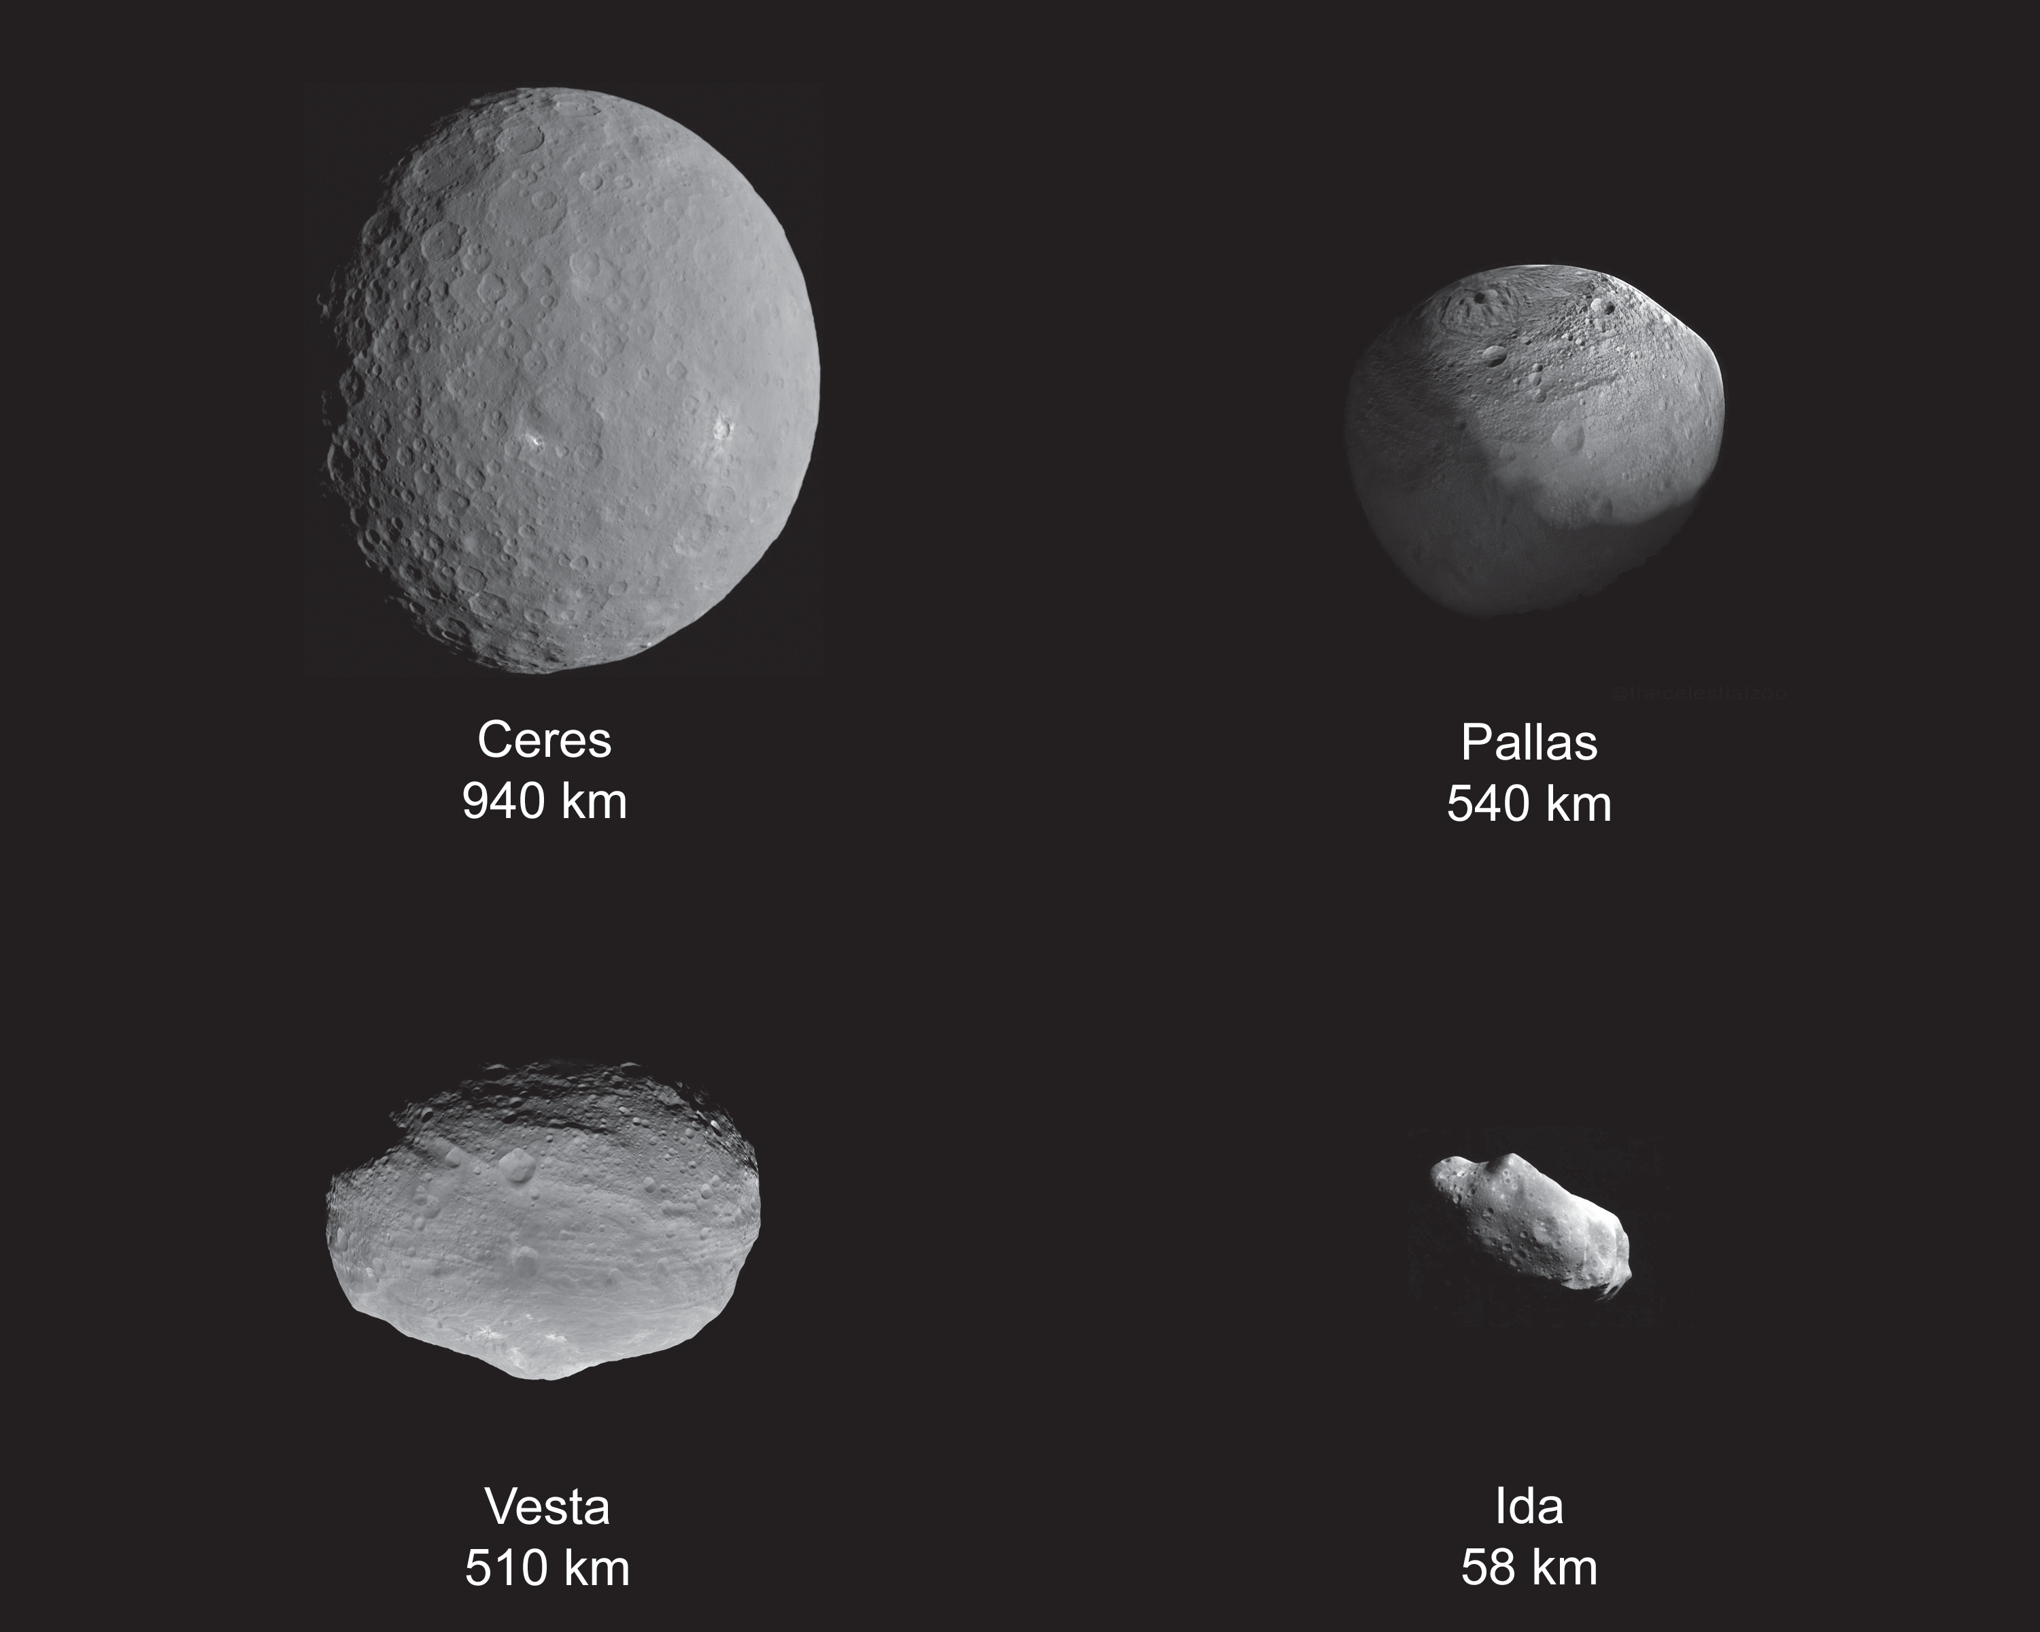
Other Members of the Solar System
Some of the known asteroids are as follows:
• Ceres is so far the largest one with a diameter of 940 km. It is the first to have been discovered. It was found by Italian astronomer Giuseppe Piazzi on January 1, 1801. In 2006, along with Pluto, Eris, Makemake, and Haumea, Ceres was given the dwarf planet status.
• Pallas is second to the largest, with a diameter of 540 km.
• Vesta is next to Pallas with 510-km diameter.
• Ida is about 58- km wide.
• 1991 BA is one of the smallest asteroids, measuring less than 1 km.

Slide 4
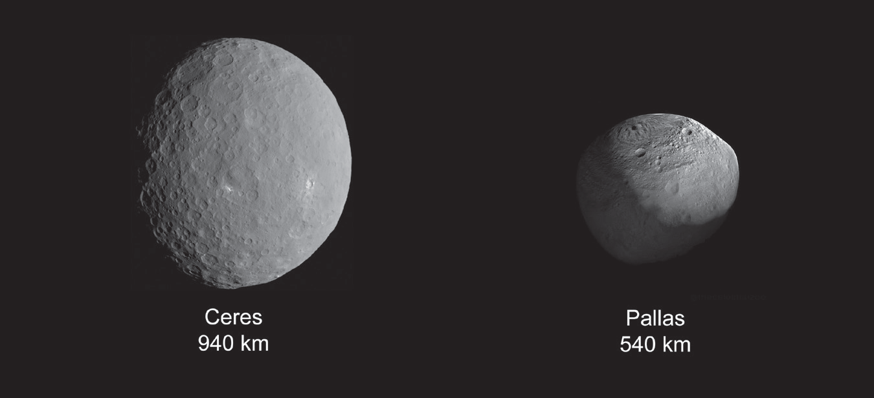
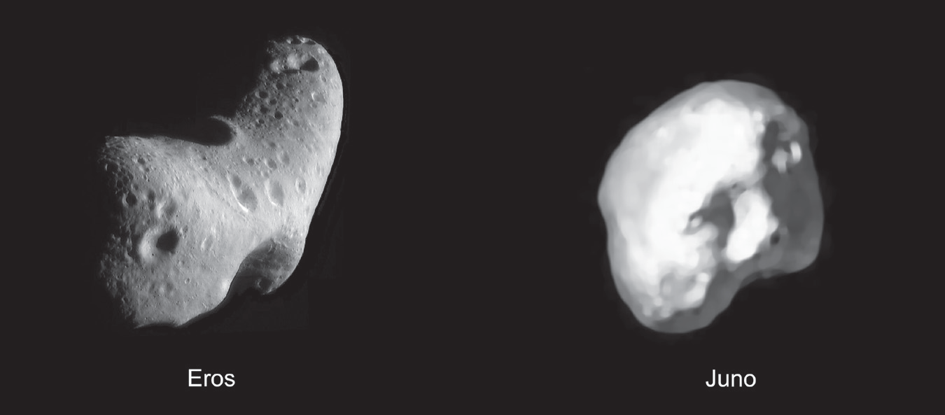
Other Members of the Solar System
Some asteroids are grouped based on their color and composition:
The C-type asteroids or carbonaceous asteroids are grayish in color and the most common. About 75% of the asteroids fall in this category, and they inhabit the main belt.
Examples of these are Ceres and Pallas.
The S-type asteroids or siliceous asteroids are made up of iron and magnesium silicate. There are about 17% of this type of asteroids dominating the inner asteroid belt.
Examples of these are Eros and Juno.

Slide 5
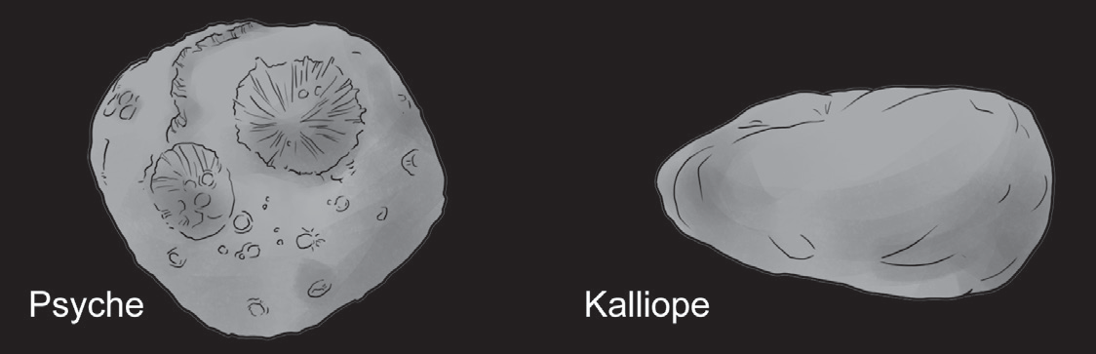
Other Members of the Solar System
The M-type asteroids or metallic asteroids are rich in metallic substances such as nickel and iron. They inhabit the middle region of the main belt. Examples of these are Psyche and Kalliope.

Slide 6
Other Members of the Solar System
The asteroids can be classified based on their position:
The Aten asteroids lie outside the asteroid belt, near the orbit of Mars. These include Ceres, Pallas, Juno, and Vesta.
The Apollo asteroids lie near Earth, which sometimes cross Earth’s orbit. Some examples of these are Icarus that has reached Earth at about 6 million km, Geographos that has reached Earth at about 5 million km, and Eros that has reached Earth at about
2.67 million km.
The Trojan asteroids are known to dwell along Jupiter’s orbital path and lie within the asteroid belts. The asteroids Hector, Diomedes, Agamemnon, Petrocius, and other asteroids within this region circle the Sun for 12 years.

Slide 7
Other Members of the Solar System
Comets
Comets are known for their structure. Theoretically, they originated from a dense shell of material surrounding the Oort cloud, the outer edge of the solar system that is about a trillion miles away from the Sun. Comets have a cloudy appearance, and they contain these three basic parts :
The nucleus is believed to be solid, containing a chunk of dust, ice or frozen gases, water vapor, and other materials.
The cloud-like coma surrounds the nucleus and is composed of gas and small bits of rocks and dust.
The tail is made of gas or dust particles or both. A comet has a tail when it is near the Sun due to the melting of icy constituents and dust blown away by the solar wind, making it very bright and causing it to form its tail. However, when it goes away from the Sun, its tail disappears.

Slide 8
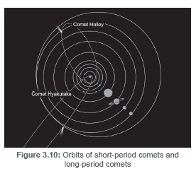
Other Members of the Solar System
Comets are grouped according to their order of appearance:
Short-period comets (periodic comets) are those with an orbital period of less than 200 years. One example of a short-period comet is Halley’s Comet. Edmund Halley predicted it to appear every 75 to 76 years. Another example is the Tempel–Tuttle Comet that takes 33 years to orbit the Sun .
Long-period comets have an orbital period of more than 200 years. Hale–Bopp comet takes about 2,534 years to orbit the Sun . Another example is the Hyakutake comet that has an orbital period of 113,782 years.

Slide 9
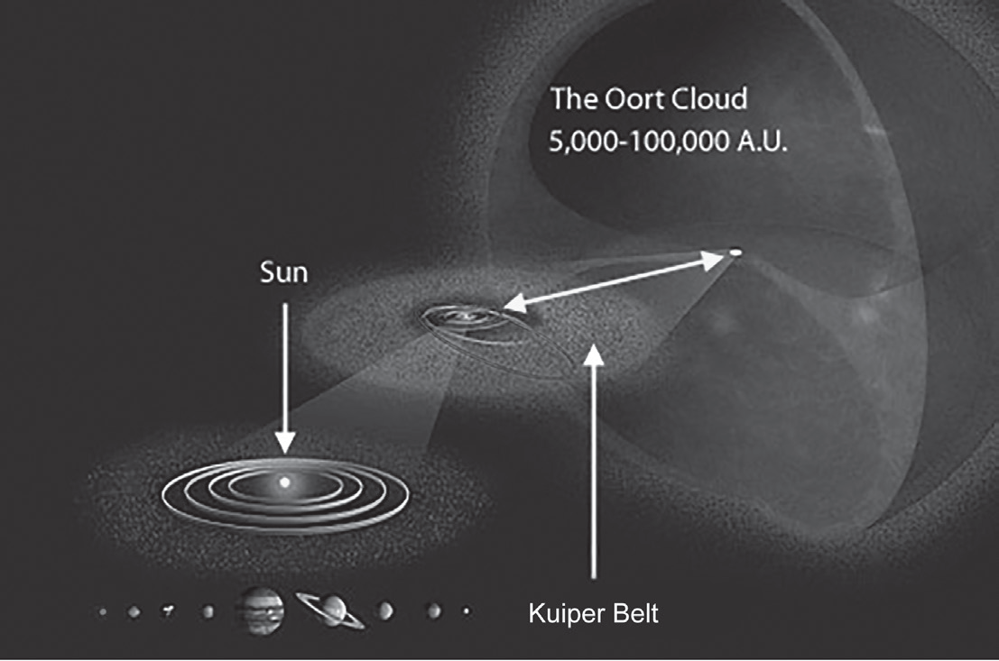
Other Members of the Solar System
Kuiper Belt and Oort Cloud
The Kuiper belt is believed to be the origin of the short-period comets. The objects coming from this region are found orbiting the Sun from beyond Neptune and Pluto. The Oort cloud is a theoretical gathering of rocks in spherical motion at the outer edge of the solar system.
Accordingly, this region is where long period
comets form.

Slide 10
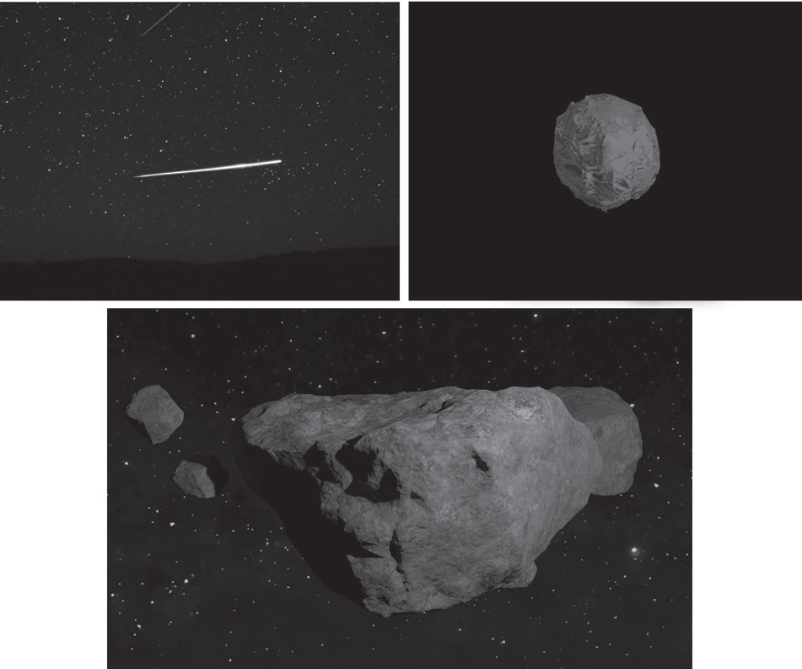
Other Members of the Solar System
Meteors
If you have seen a flash of light zooming so fast through the darkness of the sky and disappearing in the blink of an eye, you might probably be one of the lucky ones who have witnessed a “falling or shooting star.” The bright streaks of light that dart the night sky are what we call meteors.
A meteoroid is believed to be a fragment of an asteroid or remnant of a comet, and some say it is a space debris made of stony metallic rocks. They sometimes strike Earth’s atmosphere when they are pulled by Earth’s gravity as they pass 55 miles from Earth. A meteoroid that enters Earth’s atmosphere is known as a meteor.
When the remains of the meteoroids reach Earth’s surface, they are called meteorites.

Slide 11
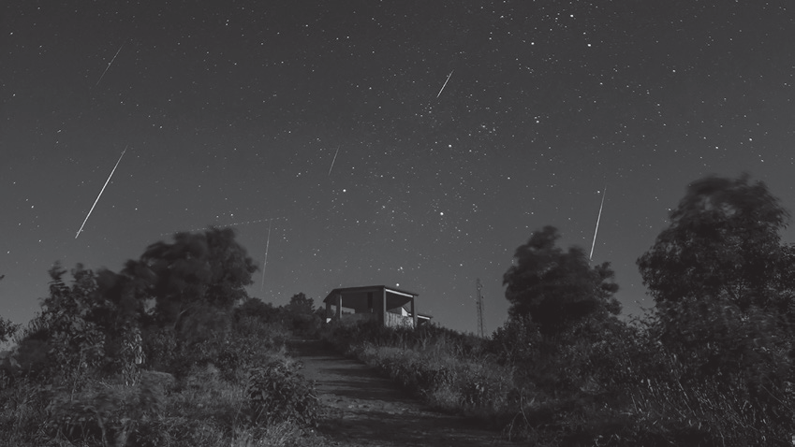
Other Members of the Solar System
Meteor showers are visible when Earth encounters groups of meteors moving together. These are produced when Earth passes through a trajectory of comet debris.
Meteor showers are thought to be the interaction between the planet and streams of debris ejected from the comet along its orbit. Halley’s Comet has been identified with the meteor shower known as Eta Aquarid, which can be seen every year in early May. Some meteor showers are seen in the mid-month of August when Earth crosses the path of
comets.

Slide 12
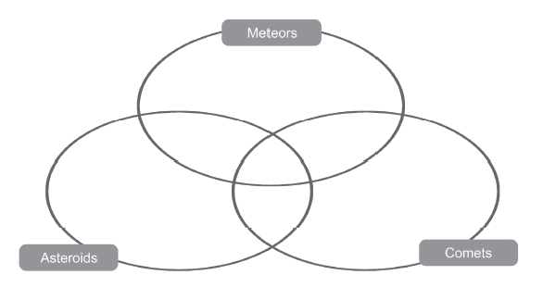
Other Members of the Solar System
Activity:
Directions: Complete the Venn diagram using the characteristics of comets, asteroids, and meteors listed below. Write your answers in the appropriate location within the diagram.
Progress across the sky very slowly | Most have slightly elliptical orbits | Mostly made of ice, rock, and compounds with hydrogen and carbon
Remains of the formation of the solar system | Also known as shooting stars | Meteor showers
Rocky composition | Most burn up as they enterEarth’s atmosphere | Tail always points away from the Sun
Orbit the Sun in highly elliptical orbits | Most are fragments of large asteroids | Mostly made of rocks and metals
Can be found mostly in the asteroid belt | Streak across the sky very fast | Found in outer regions of the solar system

Slide 13
Other Members of the Solar System
Answer Key:
Meteors | Comets | Asteroids
Also known as shooting stars Streak across the sky very fast Most burn up as they enter Earth’s atmosphere | Tail always points away from the Sun Mostly made of ice, rock, and compounds with hydrogen and carbon Found in outer regions of the solar system Orbit the Sun in highly elliptical orbits | Can be found mostly in the asteroid belt Mostly made of rocks and metals Most have slightly elliptical orbits
Meteors and Asteroids | Meteors and Comets | Comets and Asteroids
Most are fragments of large asteroids | Meteor showers | Progress across the sky very slowly
Comets, Meteors, and Asteroids
Remains of the formation of the solar system Rocky composition

