Slide 1
Introduction to Thermodynamics

Slide 2
Introduction to Thermodynamics
Internal energy
Is the sum of all the potential and kinetic energies of the particles of an object or a system.
Thermal energy
Thermal energy refers to the energy contained within a system that is responsible for its temperature, while heat is the flow of thermal energy.

Slide 3
Introduction to Thermodynamics
Consider a certain amount of hot water. The component water molecules possess both kinetic and potential energies; the sum of these is the internal energy of the hot water. Since the hot water has higher temperature than the surrounding air, some of the water’s internal energy which is now called thermal energy is transferred to the air as heat. When heat is absorbed by the surrounding air, the air gains thermal energy. This also results in the increase in the air’s internal energy.
Thermodynamics
Is the study of heat and its transformation into mechanical work. It was derived from the Greek words thermé, meaning “heat,” and dynamikos meaning “powerful.” It was developed in mid-1800s, before the atomic and molecular natures of matter were understood.

Slide 4
Introduction to Thermodynamics
Relating Heat and Work
The relationship between heat and work was demonstrated by Count Rumford in his cannon-boring experiments. Through these experiments, he revealed that the mechanical friction produced heat which deformed the tools he used in drilling cannon holes. According to him, work was equivalent to a given amount of heat.

Slide 5
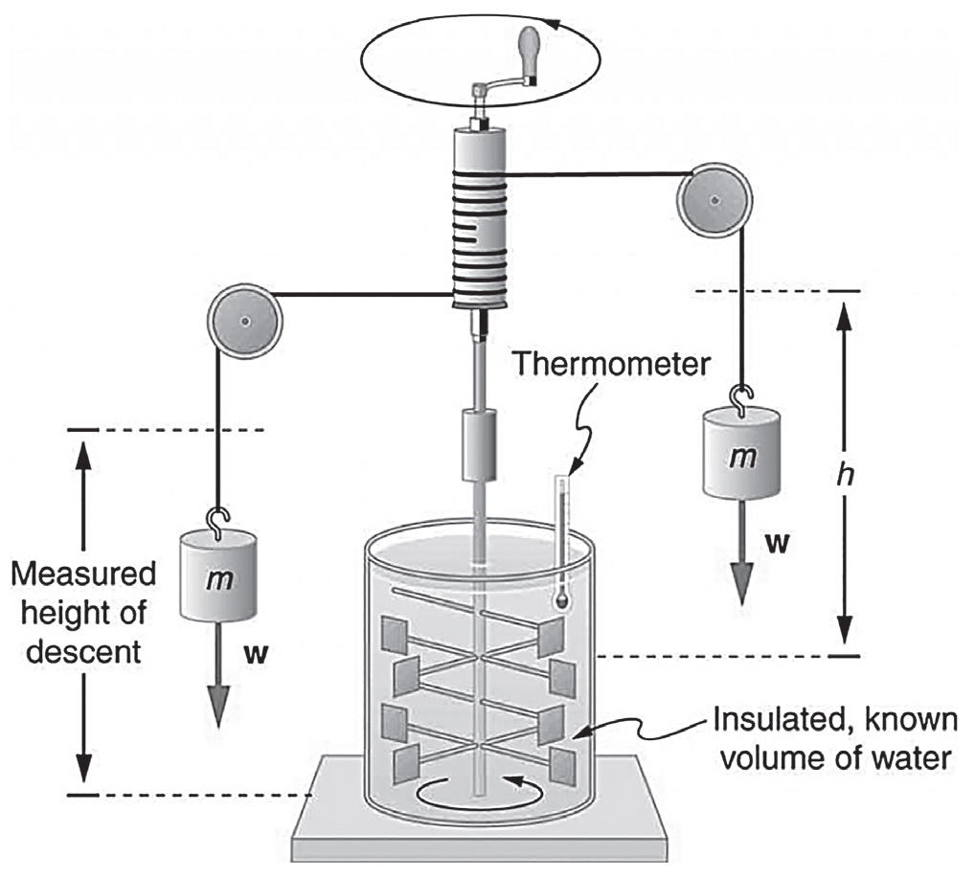
Introduction to Thermodynamics
Rumford’s observation was supported by James Prescott Joule who became interested in the mechanical equivalent of heat. Joule set up the paddle-wheel apparatus as shown in illustration below. The crank was turned such that the weights fell. As they dropped, the wires to which they were attached made the shaft and the paddles turn. The friction produced from the paddling warmed and raised the temperature of the water. Almost all the work done on the apparatus was transformed into heat. This concept of transforming work into heat or heat into work is known as the mechanical equivalent of heat.

Slide 6
Introduction to Thermodynamics
The First Law of Thermodynamics
Joule’s experiment highlighted that heat is another form of energy and that heat is related to work, and vice versa. This equivalent of heat and work is incorporated in the first law of thermodynamics. This law is based on the law of conservation of energy. According to this law, when work is done on a system, the energy used in doing the work is transformed into the internal energy of the system. Since the total internal energy of the system cannot be measured, what we can only define is the change of the internal energy when heat is added or removed from the system. This means that the change in internal energy is manifested as heat absorbed by the system, as indicated by the increase in temperature.

Slide 7
Introduction to Thermodynamics
The first law of thermodynamics can be stated as: the change in the internal energy is equal to the heat added to a system minus the work done by the system. Mathematically, this statement is expressed as
∆U = Q – W
where ΔU is the change in internal energy, Q is the heat added to the system, and W is the work done by the system. All quantities are usually expressed in joules (J).
The law implies that when heat is added on the system, the internal energy increases. Likewise, when heat is lost, the internal energy decreases. When work is done by the system, the internal energy decreases. But when work is done on the system, the internal energy increases.

Slide 8
Introduction to Thermodynamics
Sign Conventions for Work and Heat
Sign of the Physical Quantities | Thermodynamic Process | Change in Internal Energy
ΔQ > 0 | Energy added to the system as heat | Internal energy increases if W = 0.
ΔQ < 0 | Energy removed from the system as heat | Internal energy decreases if W = 0.
ΔQ = 0 | No transfer of energy as heat | No internal energy change if W = 0.
W > 0 | Work done by the system (expansion of gas) | Internal energy decreases if ΔQ = 0.
W < 0 | Work done on the system (compression of gas) | Internal energy increases if ΔQ = 0.
W = 0 | No work done | No internal energy change if ΔQ = 0.

Slide 9
Introduction to Thermodynamics
Examples:
1. In an experiment, 300 J heat is supplied to an ideal gas system. At the same time, 125 J of work is done on the ideal gas when it is compressed. How much is the increase in the internal energy of the gas?
Given: Q = 300 J (Heat is added to the system.)
W = –125 J (Work is done on the system.)
Unknown: ΔU
Solution:
ΔU = Q – W
ΔU = 300 J – (–125 J)
ΔU = 425 J
The internal energy is increased by 425 J.

Slide 10
Introduction to Thermodynamics
2. A gas is confined in a cylinder with movable piston. It is heated so that 2,000 J of work is added on the system. During the gas expansion, 1,350 J of work is done by the system. How much is the change in the internal energy of the gas? Did the internal energy increase or decrease?
Given: Q = 2,000 J (Heat is added to the system.)
W = 1,350 J (Work is done by the system.)
Unknown: ΔU
Solution:
ΔU = Q – W
ΔU = 2000 J – (–1350 J)
ΔU = 650 J
The internal energy of the system increased by 650 J.

Slide 11
Introduction to Thermodynamics
Activity
Directions: Read each statement carefully. Write T if the statement is correct or F if it is incorrect.
______ 1. Work is done by an expanding gas.
______ 2. Heat and temperature are the same thing.
______ 3. Heat is energy in transit due to the difference in temperatures.
______ 4. When work is done by the system, its internal energy increases.
______ 5. The first law of thermodynamics is based on the law of conservation of energy.

Slide 12
Introduction to Thermodynamics
Answer Key
______ 1. Work is done by an expanding gas.
______ 2. Heat and temperature are the same thing.
______ 3. Heat is energy in transit due to the difference in temperatures.
______ 4. When work is done by the system, its internal energy increases.
______ 5. The first law of thermodynamics is based on the law of conservation of energy.
T
F
T
F
T

