Slide 1
Heat Engines

Slide 2
Heat Engines
The second law of thermodynamics emphasizes the direction or flow of heat. It states that heat flows naturally from a hot object to a cold object. Another form of this law claims that as energy is transferred or transformed, greater portion of it is wasted. It also states that each isolated system has a natural tendency to degrade into a more disordered state. There are a variety of ways to state the second law of thermodynamics.

Slide 3
Heat Engines
The following are the major contributors to the development of this law:
Nicolas Léonard Sadi Carnot was a French physicist, a mechanical engineer, and a military scientist who is known as the “Father of Thermodynamics” because of his contributions to the development of the second law of thermodynamics. He used the concept of caloric (pertains to heat) to describe the law.
Rudolf Clausius was a German mathematical physicist who developed the Clausius statement: Heat generally cannot flow spontaneously from a material at a lower temperature to a material at a higher temperature.
William Thomson was a Scottish engineer, mathematician, and a physicist. He was popularly known as Lord Kelvin. According to him, it is impossible to convert heat completely in a cyclic process. This means that it is impossible to transform all the system’s energy into work without losing energy.

Slide 4
Heat Engines
Heat Engine
An important application of the second law of thermodynamics is the operation of a heat engine. A heat engine is any device that converts heat energy to mechanical energy. Some examples of this are gasoline engines and diesel engines, which can be found in cars and steam turbines that are used to generate electricity in power plants.

Slide 5
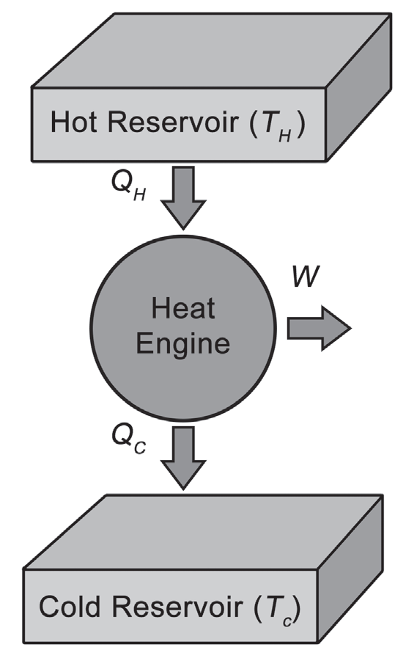
Heat Engines
A heat engine has the following components: the heat source (hot reservoir), the heat sink (cold reservoir), and the heat engine, which performs useful work. The engine takes the heat from the high temperature reservoir. The energy absorbed by the heat engine is used to perform useful work. However, not all the heat absorbed can be fully converted to useful work, making it impossible to convert heat completely to work in a cyclic process.
A cyclic process means that the process returns to its initial state or condition in its operation. Portion of the heat absorbed will be expelled as waste heat. This waste heat goes to the heat sink. The energy converted to useful mechanical work (W) is equal to the difference in heat input (QH) and heat output (QC). Mathematically, this can be expressed as:
W = QH – QC

Slide 6
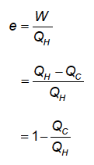
Heat Engines
Efficiency is one of the most important parameters for any heat engine. From the equation on the previous slide, we can understand why there is no 100% efficient engine. For example, cars, no matter how expensive or advanced they are, release a burned gas exhausting from their engines. Thus, heat is expelled to the environment. QC can never be zero and the efficiency is always less than 100%. The efficiency of an engine can be determined by taking the ratio between the work output, W, and the heat input, QH. On the other hand, the heat engine’s thermal efficiency, e, is described by the formula below:

Slide 7
Heat Engines
There are many kinds of engines. Some of these are the gasoline engine, the diesel engine, and the steam engine. If the burning of fuel happens outside the engine, then it is classified as an external combustion engine. However, if the fuel is burned inside the cylinder or turbine chamber, then the engine is called as an internal combustion engine.

Slide 8
Heat Engines
There are two types of internal combustion engines: the gasoline engine and the diesel engine.
Gasoline Engine
A gasoline engine is also called a “four-stroke engine” because the internal combustion process that takes place involves four steps. Each step is referred to as stroke. The first stroke is the intake stroke. During this step, the intake valve opens to allow air inside. The piston moves downward, which increases the space to allow the air fuel mixture to enter the combustion chamber.
The next step is the compression stroke, which involves the compression of the mixture. During this process, the intake valve is closed and the piston moves up the chamber to the top. This compresses the fuel air mixture. A spark plug provides the compressed fuel in the activation energy for combustion.

Slide 9
Heat Engines
After the compression stroke is the combustion of the fuel, which is known as the expansion stroke. As the fuel burns in the chamber, the heat released from the process increases the pressure, which forces the piston down and creates the power output.
The last step is the exhaust stroke. As the piston reaches the bottom, the exhaust valve opens and the remaining exhaust gas is pushed out by the piston as it moves back upward. The intake valve opens again, repeating the cycle.

Slide 10
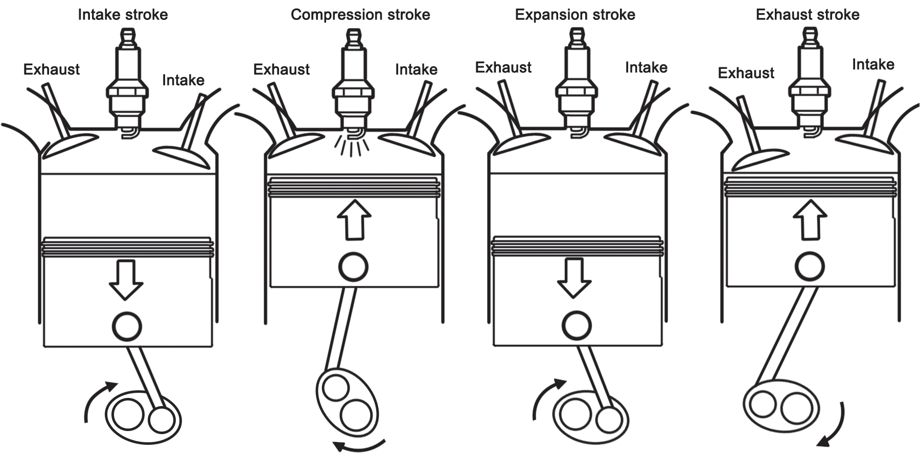
Heat Engines
The diesel engine works the same way as the gasoline engine. But the difference is that the diesel engine has no spark plug to ignite the fuel–air mixture, and the air is compressed to a sufficiently high temperature to ignite the diesel fuel.
A Gasoline Engine’s Four-Stroke Cycle

Slide 11
Heat Engines
Example
1. A gasoline engine burns the gasoline and produces 65 kJ of heat. Ten kJ of work was done by the engine. (a) How much energy is expelled outside? (b) What is the engine’s efficiency?
Given: QH = 65 kJ; W = 10.0 kJ
Unknown: (a) QC; (b) 𝘦
Solution:
(a) Solving for Qc:
W = QH – QC
QC = QH – W
QC = 65 kJ – 10.0 kJ
QC = 55 kJ
The amount of energy expelled is 55 kJ.

Slide 12
Heat Engines
(b) Solving for 𝘦
𝘦 =___________
QH
𝘦 = 65 kJ – 55 kJ
65 kJ
𝘦 = 0.15 % 𝘦 = 15 %
QH – QC
The efficiency is usually expressed in percentage (%) efficiency, which is calculated by multiplying the efficiency of the engine by 100. The answer shows that the engine is 15% efficient. This means that 85% of the energy is expelled as waste.

Slide 13
Heat Engines
2. A heat engine extracts 4,200 J of energy from the hot reservoir. It then transfers 2,100 J of energy to the cold reservoir. How much is the work done by the heat engine?
Given: QH = 4,200 J; QC = 2,100 J
Unknown : W
Solution:
W = QH – QC
W = 4,200 J - 2,100 J
W = 2,100 J
The amount of work done by the heat engine is 2,100 J.

Slide 14
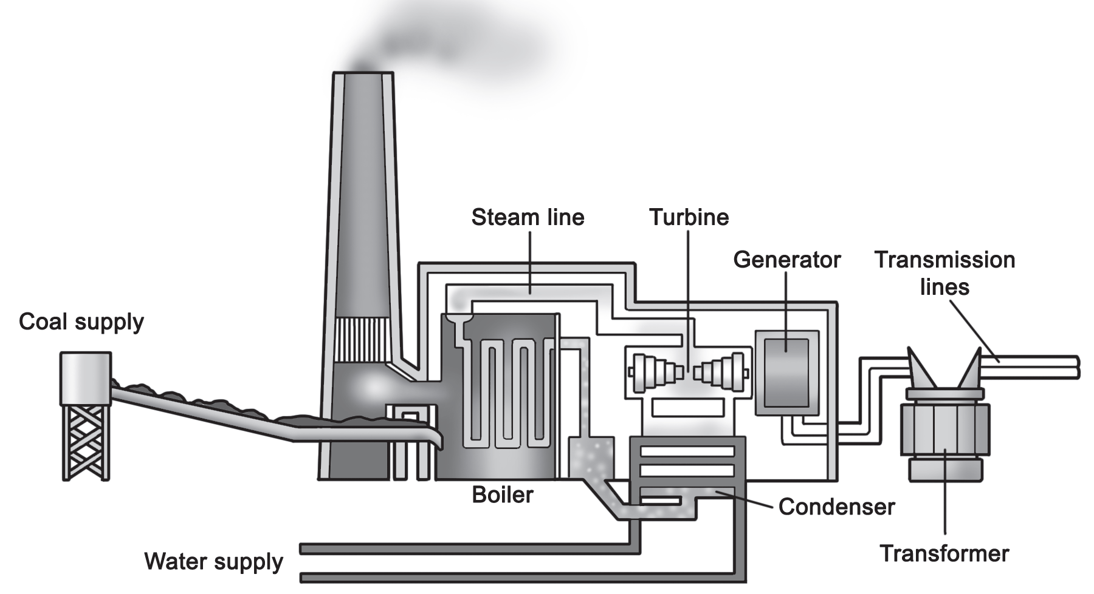
Heat Engines
Steam Engine
Steam engines are examples of external combustion engines. They consist mainly of a boiler, a steam chest, and a cylinder. The boiler holds the water which is heated by the burning fuel and then transformed into steam. The steam generated turn steam turbines in generators. The generator transforms the mechanical energy into electrical energy. Steam engines are utilized in electric power plants, like coal-fire, geothermal, and nuclear power plants.
Source: https://socratic.org/questions/how-does-coal-produce-energy

Slide 15
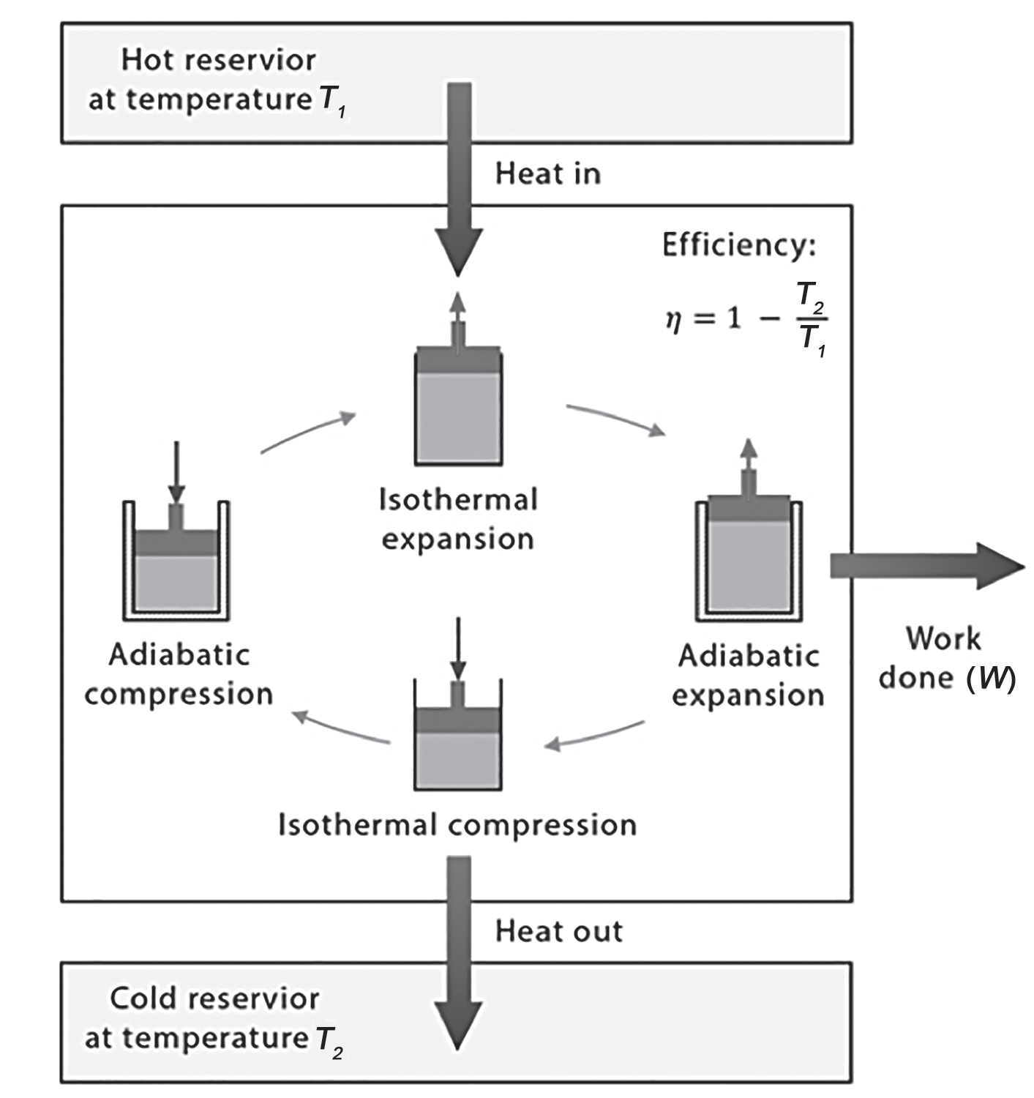
Heat Engines
Carnot Engine
Carnot engine. This engine consists of a cylinder filled with an ideal gas and a movable piston at one end.
Under ideal condition, the work done by the Carnot engine depends on the temperature difference between the hot and the cold temperature reservoir. Note that this engine is free from friction heat losses. As shown in illustration, during the Carnot cycle, an amount of heat Q is added to the gas which expands isothermally at a temperature TH.

Slide 16
Heat Engines
An isothermal process means that the process occurs at a constant temperature. Then, there is an adiabatic expansion of the gas, where there is no heat exchange to the surroundings, but the temperature drops to TC. After the adiabatic expansion, isothermal compression of the gas follows at TC. At this point, the heat is already expelled. Then, the gas is compressed adiabatically, back to its original state.
The following equation describes the efficiency of Carnot engine, which is also known as the ideal efficiency or Carnot efficiency:
TH - TC
Ideal Efficiency = _______
TC
where TH is the temperature of the high-temperature body and TC is the temperature of the cold-temperature body. Take note that the temperatures should be expressed in Kelvin (K) scale.

Slide 17
Heat Engines
Example
A gasoline engine burns the gasoline at 850 K and releases heat into the muffler at 490 K. What is the ideal efficiency of the engine?
Given: TH = 850 K; Tc = 490 K
Unknown: Ideal Efficiency
Solution:
Ideal Efficiency = ________ Ideal Efficiency = 0.42
TC
Ideal Efficiency = _____________ Ideal Efficiency = 42 %
850 K
TH - TC
850 K - 490 K

Slide 18
Heat Engines
Activity
Directions: Read and understand each question carefully. Write the letter of the correct answer.
Refer to the following choices:
A. Carnot engine C. diesel engine
B. gasoline engine D. steam engine
___ 1. an ideal engine
___ 2. used in electric power plants
___ 3. also known as a four-stroke engine
___ 4. needs a sufficiently higher temperature to ignite the fuel

Slide 19
Heat Engines
Answer Key
___ 1. an ideal engine
___ 2. used in electric power plants
___ 3. also known as a four-stroke engine
___ 4. needs a sufficiently higher temperature to ignite the fuel
A
D
B
C

