Slide 1
Energy Generation, Transmission, and Distribution

Slide 2
Energy Generation, Transmission, and Distribution
How Is Electricity Generated?
In each power plant, whether fossil-fueled or nuclear-powered, the following basic components are present: a heat source, turbine, generator, condenser, and pump. these components of a power plant, which facilitate energy transformations that ultimately generate electricity.
1. The heat source in the power plant provides heat to generate steam. The heat source can be the combustion of fossil fuels, nuclear fission, splitting of radioactive substances, or geothermal energy from the Earth’s interior, depending on the type of power plant. For turbines to work efficiently, heat must enter them at a high temperature and pressure as possible. Hydroelectric power plants and windmills do not require a heat source.

Slide 3
Energy Generation, Transmission, and Distribution
2. The turbine is an important device used to run generators. There are two kinds of turbines in power plants: steam and water turbines. The steam turbine uses the steam produced in the heat source to rotate its blades, while the water turbine uses the energy from flowing water.
3. The spinning turbines cause large magnets to turn within wire coils in the generator. An electric generator generates electricity, primarily by the movement of the loop of wire known as armature between the poles of the magnet.
4. The condenser turns the steam (gas) back to water (liquid) so that it can be returned to the heat source to be heated again.
5. Finally, the pump in power plants provides the force to circulate the water to the system.

Slide 4
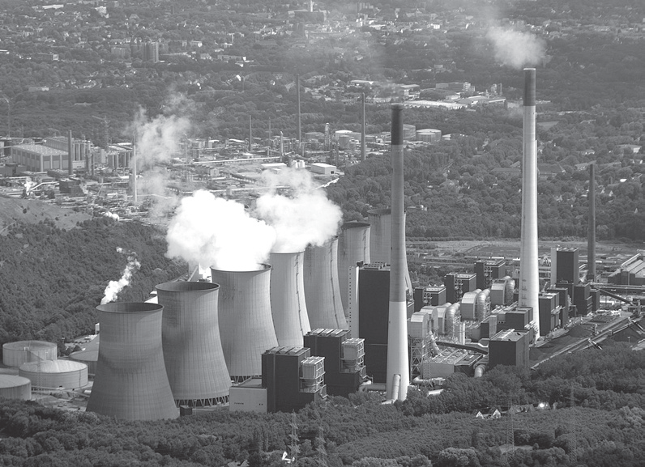
Energy Generation, Transmission, and Distribution
Types of Power Plants
Power Plant | Description
 | It is a thermal power station, which burns coal to generate electricity. The coal is usually pulverized and then burned in a pulverized coal-fired boiler. When coal is burned, the chemical energy is transformed into heat. The hot exhaust gases from the combustion reaction are used to heat water into steam, which travels through pipes at high pressure and spins a steam turbine, which in turn produces mechanical to electrical energy.
By Sebastian Schlüter, CC BY-SA 3.0, via Wikimedia commons
Coal-fire or fossil fuel power plant

Slide 5
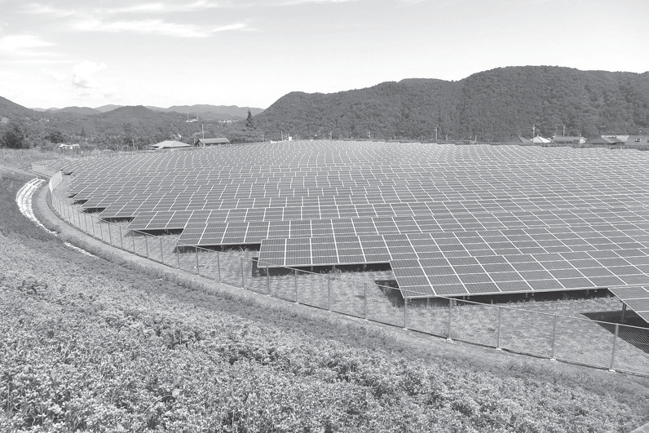
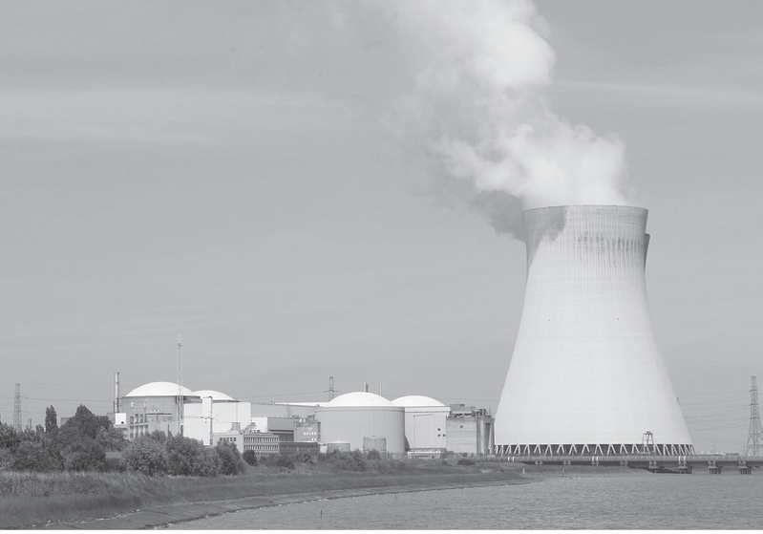
Energy Generation, Transmission, and Distribution
 | It is also called a solar farm or a photovoltaic power station. It is a large collection of solar panels that absorb energy from the Sun. A solar panel consists of photovoltaic (PV) cells, which convert light into electric current using the photovoltaic effect. Other solar farms make use of concentrating solar-thermal power (CSP) technologies, which can be used to generate electricity to power a turbine.
 | It is a thermal power station in which the heat source is a nuclear reactor. It uses heat produced during nuclear fission to turn water into steam, which turns the blades of a steam turbine. As the turbine blades turn, they drive generators that make electricity.
By Σ64 - Own work, CC BY 3.0, via Wikimedia commons
Solar power plant
By Sally V - Own work, CC BY-SA 4.0, via Wikimedia commons
Nuclear power plant

Slide 6
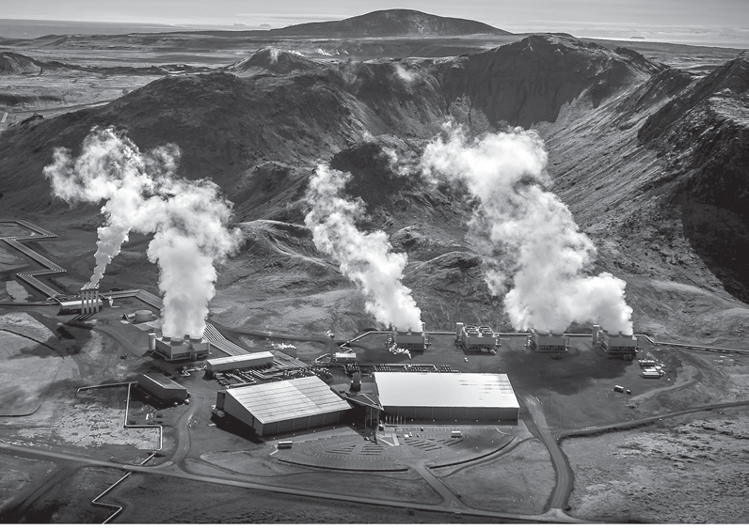
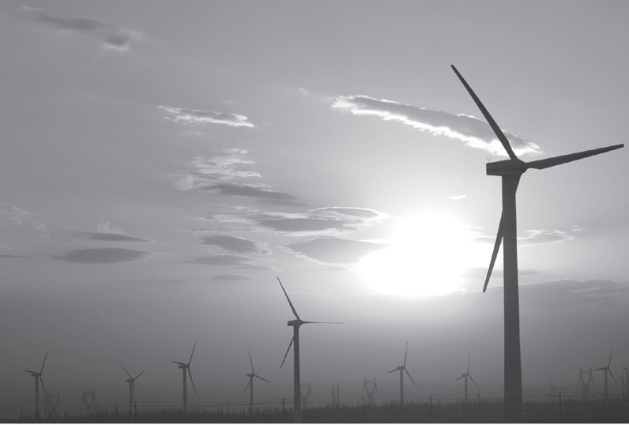
Energy Generation, Transmission, and Distribution
 | It is a steam turbine thermal power station, which uses heat from the Earth’s interior to produce steam. Pipes are injected below the Earth’s surface to tap the underground steam. The steam wells are used to power up turbines and generators to produce electricity.
 | It is also called a wind farm or wind park and consists of a group of wind turbines in the same location used to produce electricity. A wind turbine turns wind energy into electricity using the force from the rotor blades, which spin when wind flows across them. The rotor connects to the generator that creates electricity.
By Sally V - Own work, CC BY-SA 4.0, via Wikimedia commons
Geothermal power plant
By 林慕尧, CC BY-SA 2.0, via Wikimedia commons
Wind power plant

Slide 7
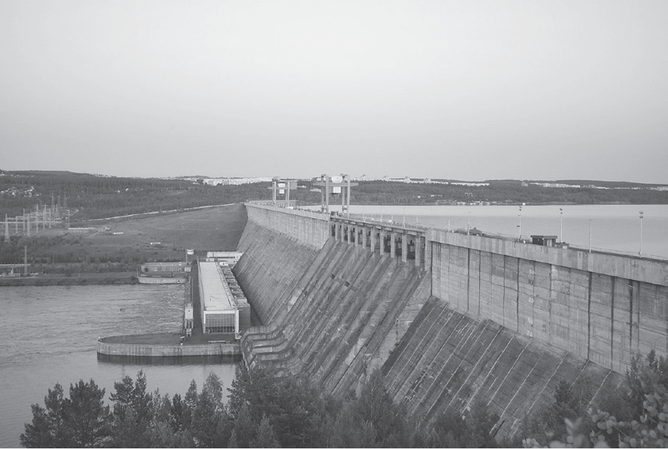
Energy Generation, Transmission, and Distribution
 | It captures the energy of falling water to generate electricity. The kinetic energy of falling water makes the turbine rotate, which in turn powers up the generator to produce electricity.
By Vasily Astanin - Own work, CC BY-SA 4.0, via Wikimedia commons
Hydroelectric power plant

Slide 8
Energy Generation, Transmission, and Distribution
How Is Electricity Transmitted and Distributed?
Electricity transmission is the process of delivering generated electricity, usually over long distances, to the distribution grid located in populated areas. It involves the bulk movement of electrical energy from a generating site, such as a power station or power plant to an electrical substation, where voltage is transformed and distributed to consumers or other substations. In the Philippines, the generation and transmission of electricity are owned and operated by National Power Corporation (Napocor).
During the transmission of energy, some of the transmitted energy is converted to heat in the conductors. In order to ensure that the power loss is minimal without using very thick transmission lines, which are costly, a step-up transformer is used. It is a device that increases the voltage across the electric conductors and reduces the current along the conductors. At power plants, step-up transformers are used to boost the voltage up to 100,000 V and sometimes much higher.

Slide 9
Energy Generation, Transmission, and Distribution
The final stage in the delivery of electric power is distribution, which transports electricity from a substation to consumers. Substations must supply and distribute electric power safely by using insulated distribution cables. Remember that transmission lines have high voltages.
A high voltage requires great insulation, which is very costly. To achieve economically low insulation, from high voltage transmission lines, distribution lines must be of low voltage. This is accomplished by a step-down transformer. At distribution poles, a step-down transformer is mounted to lower the voltage to 110 V–220 V.
Currently, Manila Electric Company (Meralco) is the largest distribution utility in the Philippines. It is responsible for electricity distribution to the entire Metro Manila, to provinces of Bulacan, Rizal, and Cavite, and to some parts in Laguna, Quezon, Batangas, and Pampanga.

Slide 10
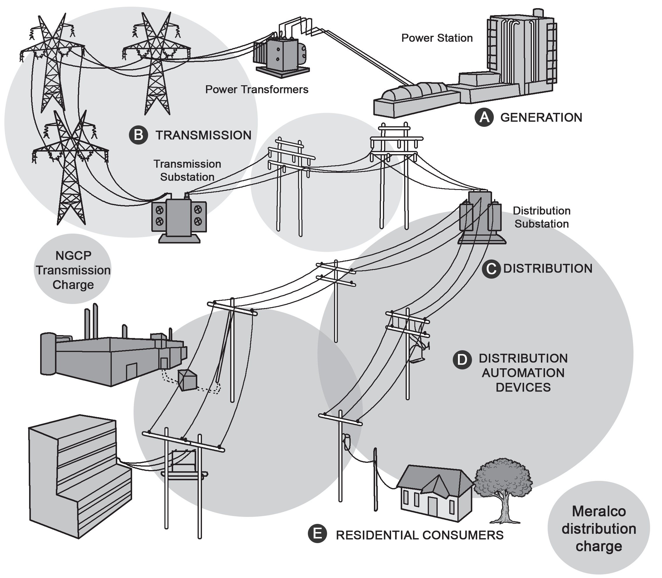
Energy Generation, Transmission, and Distribution
How Does Electricity Reach Our Homes?
Outlines the large-scale transmission and distribution of electrical energy over long distances from the power station or power plant to reach residential consumers. From point A, power plants or power stations generate electricity that goes through high-voltage transmission lines, as shown in point B. Transmission lines are conductors designed to carry electricity or an electrical signal over large distances with minimum loss or distortion.

Slide 11
Energy Generation, Transmission, and Distribution
After passing through transmission lines, the electrical energy then reaches a transmission substation, where the voltage is lowered, so it can be sent to smaller power lines.This lowered voltage goes through a distribution substation, which transfers electricity from the transmission system to the distribution system of an area, as located at point C. From here, the transmitted electricity reaches smaller transformers that reduce its voltage again to make it safe to use before it is carried by distribution automation devices (at point D) to our home. As consumers (point E), we can now use electricity to power up electrical appliances and devices.

Slide 12
Energy Generation, Transmission, and Distribution
Safety Measures When Working with Electricity
The following basic guidelines for safe electricity handling can assist you while dealing with electric circuits and appliances.
1. Never put fingers or other objects in an outlet.
2. Never use anything with a cord or plug around water.
3. Never pull a plug out by its cord.
4. Always use insulated tools while working.
5. Do not use extension cords or multi-outlet converters for appliances.

Slide 13
Energy Generation, Transmission, and Distribution
6. Keep your used and unused cords tidy and secure to prevent damage.
7. Replace or repair damaged electrical cords.
8. Unplug all your unused appliances to reduce potential risks.
9. Always follow appliance instructions for improved electrical safety.
10. Obey warning signs.

Slide 14
Energy Generation, Transmission, and Distribution
Activity
‪Directions: Write True if the given statement is correct. If not, change the underlined word/phrase to make the statement correct.
______________ 1. Electricity is made at a generating station by huge generators.
______________ 2. In the Philippines, the generation and transmission of electricity are owned and operated by Manila Electric Company (Meralco).
______________ 3. The condenser in power plants provides the force to circulate the water to the system.
______________ 4. A nuclear power plant is a steam turbine thermal power station, in that heat from the Earth’s core is used to heat water.
______________ 5. The electrical charge goes through high-voltage transmission lines that stretch across the country.

Slide 15
Energy Generation, Transmission, and Distribution
Answer Key
1. True
2. National Power Corporation (NPC)
3. Pump
4. Geothermal power plant
5. True

