Slide 1


Polygon and Other Related Terms

Slide 2
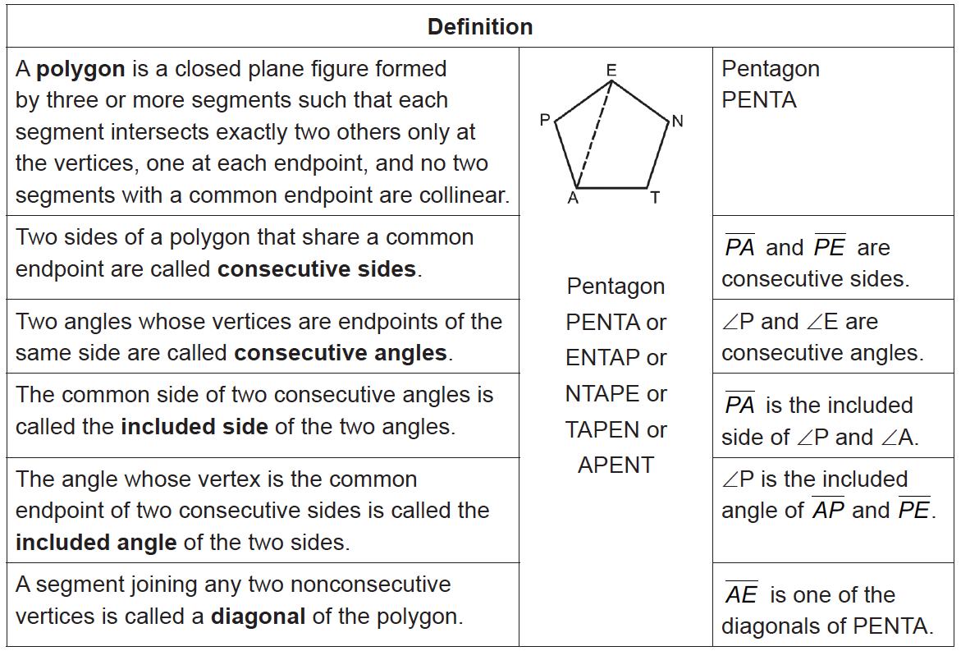
Polygon and Other Related Terms
Plane Geometric Figures
Rex Curriculum Resource
WWW.REX.COM.PH

Slide 3

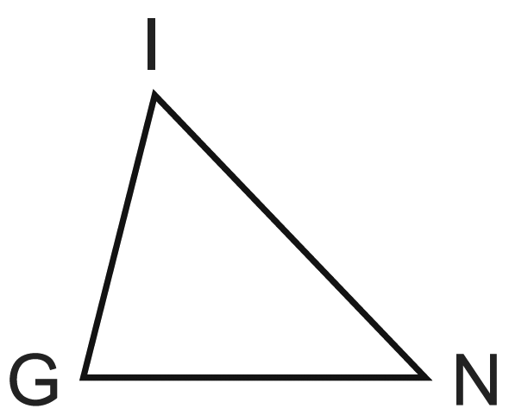
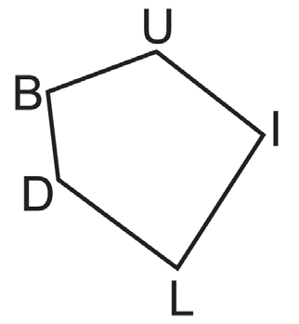
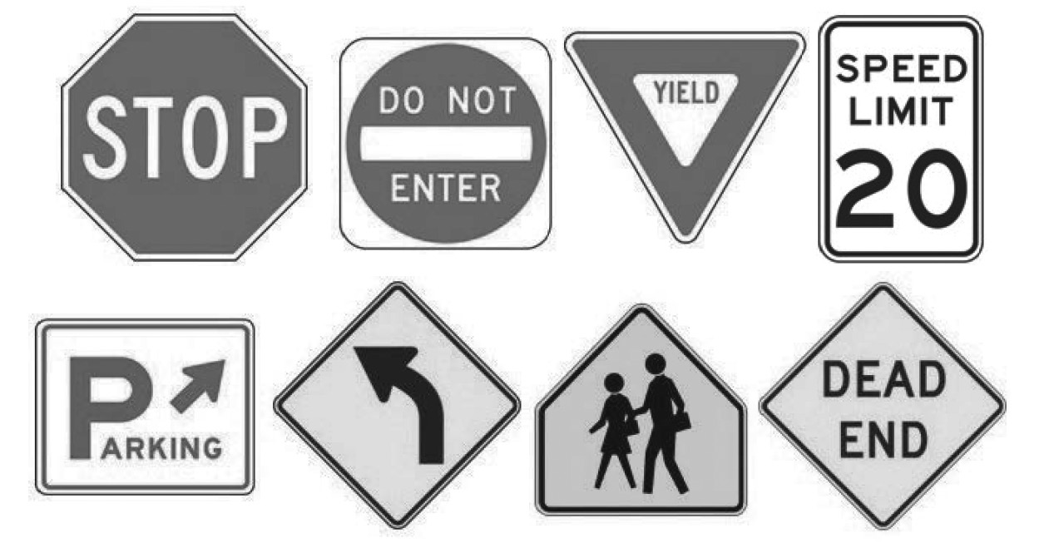
Polygon and Other Related Terms
A regular triangle is called an equilateral triangle. A regular quadrilateral is called a square. No other special names are given to regular polygons with more than four sides. A regular polygon with five sides is known as a regular pentagon; with six sides, a regular hexagon, etc.
The following are not polygons
Example : Polygon
List down the sides, vertices, and number of distinct diagonals of each of the following polygons.
a. b.
Solution:
a. sides: IN, NG, GI b. sides: BU, UI, IL, LD, BD
vertices: I, N, G vertices: B, U, I, L, D
diagonals: None diagonals: 5
The following are some useful polygons.
Rex Curriculum Resource
WWW.REX.COM.PH

Slide 4
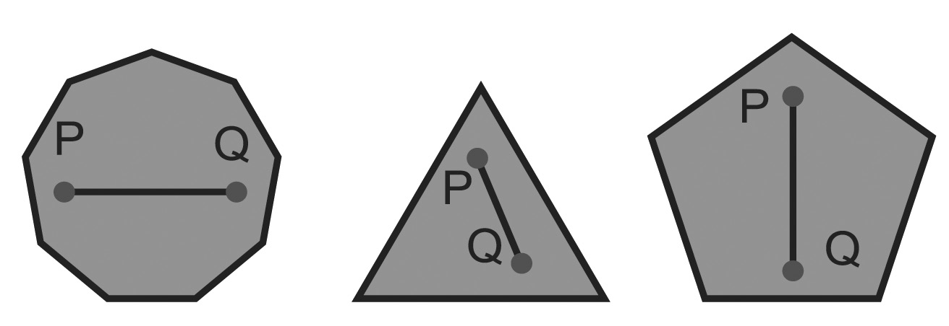
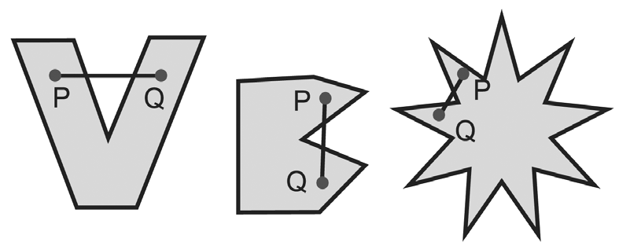
Polygon and Other Related Terms
Polygonal Region
A polygon completely encloses a region of a plane. This region is called the interior of a polygon. A polygon and its interior form a polygonal region. The points of the plane that are not contained in the polygonal region lie on the exterior of the polygon. Some polygonal regions “bend inward” while others do not. The polygonal regions that bend inward are called concave, and those that do not are called convex. The formal definitions of convex and concave polygonal regions are given below:
A polygonal region is said to be convex if segment PQ joining any two points P and Q of the region is a part of the region. If the region is not convex, then it is concave.
Convex polygon regions Concave polygon regions
In general, a polygon that determines a convex region is called a convex polygon. On the other hand, a polygon that determines a concave region is called a concave polygon. Most of the polygons that you will work on are convex polygons. In this module, when the term “polygon” is mentioned, it means convex polygon.
Rex Curriculum Resource
WWW.REX.COM.PH

Slide 5
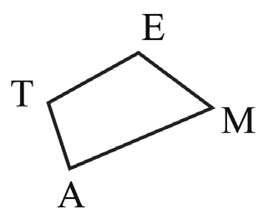
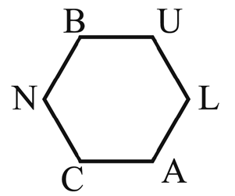
Activity:
List down the sides, vertices, and number of distinct diagonals of each of the following polygons.
A. B.
Rex Curriculum Resource
WWW.REX.COM.PH

Slide 6
Activity: ANSWER KEY
List down the sides, vertices, and number of distinct diagonals of each of the following polygons.
A. B.
ANSWER KEY
a. sides: TE, EM, MA, AT
vertices: T, E, M, A
diagonals: 2
b. sides: BU, LU, LA, AC, CN, NB
vertices: B, U, L, A, C, N
diagonals: 9
Rex Curriculum Resource
WWW.REX.COM.PH

Slide 7


