Slide 1


Regular and Irregular Polygons

Slide 2
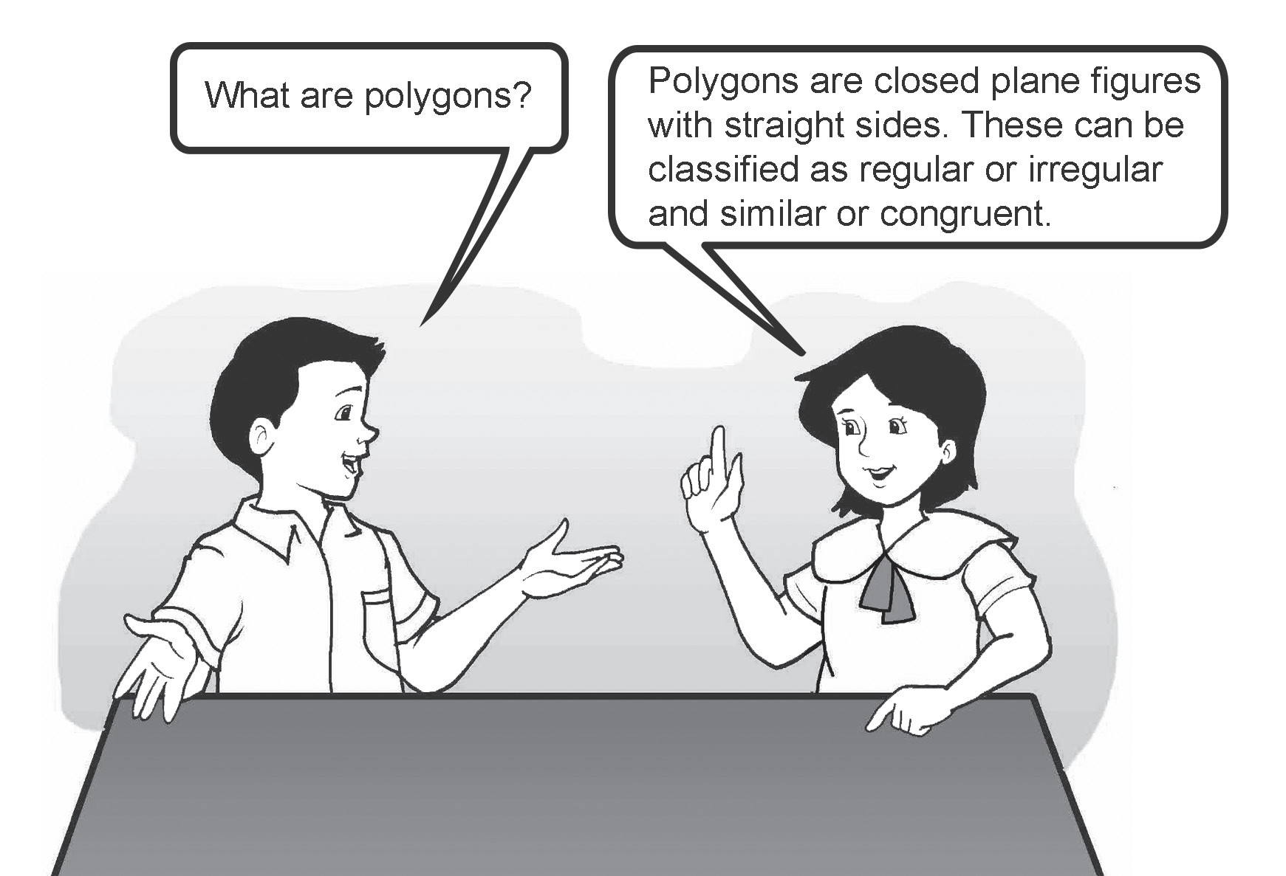
Regular and Irregular Polygons
Regular and Irregular Polygons
A polygon is a closed plane figure formed by three or more line segments that are connected. Each line segment refers to a side of the polygon.
A plane is made up of points on a flat surface that extends in all directions.
A plane figure is a flat or two-dimensional (2D) figure. It can have straight sides or curved sides. A polygon is a closed plane figure with straight sides.
We name a polygon by determining all its vertices. These vertices in a polygon are the points of intersection of the line segments. Through the intersection of line segments, angles are formed.
Rex Curriculum Resource
WWW.REX.COM.PH

Slide 3
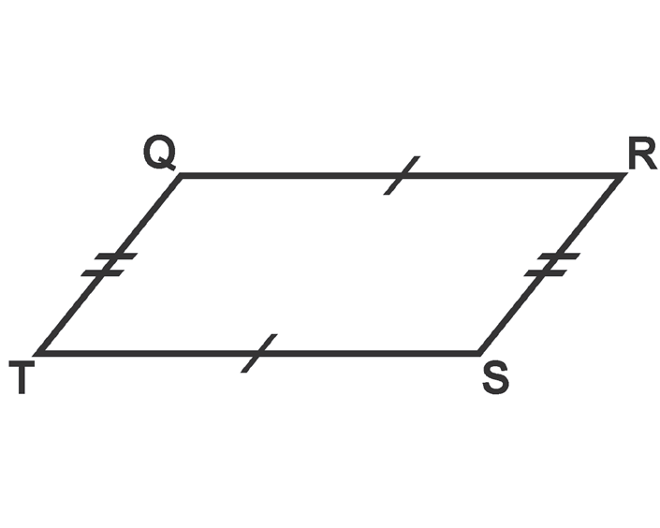
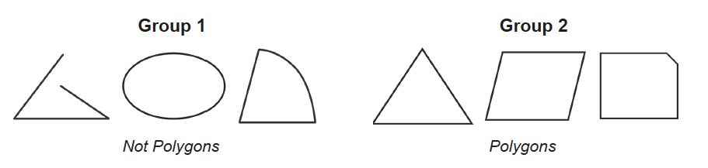
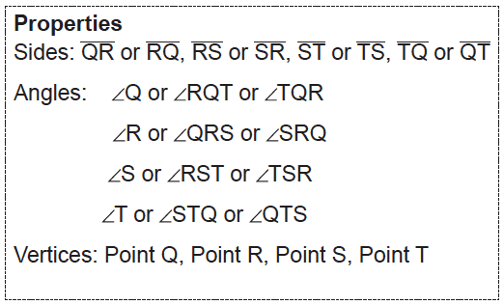
We name a polygon by reading the order of its vertices consecutively in either a clockwise or counterclockwise direction. For example, the following polygon can be named quadrilateral QRST or TSRQ, RSTQ or QTSR, STQR or RQTS, and TQRS or SRQT. Since it has four sides, it also has four angles and vertices.
Based on the definition, which of the following group of figures is
made up of polygons?
The figures in Group 2 are made up of polygons.
All figures in Group 1 are not polygons.
The first figure is not a closed plane figure and one of its vertices is not at the endpoint of the side adjacent to it. The second figure has no straight sides. Lastly, the third figure is also not a polygon because it has a curved side
Rex Curriculum Resource
WWW.REX.COM.PH

Slide 4
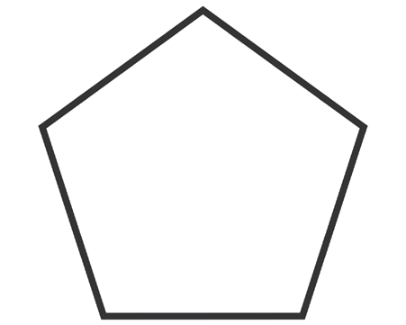
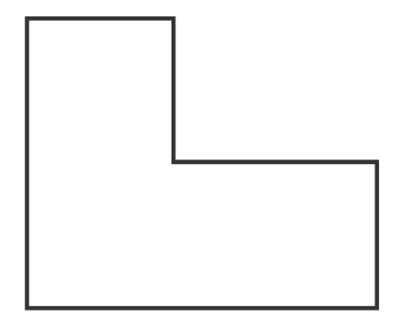
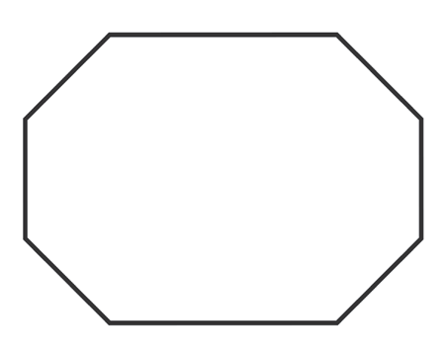
Polygons may be classified according to the number of their sides.
Number of Sides | Name of the Polygon
3 | Triangle or Trigon
4 | Quadrilateral or Quadrigon
5 | Pentagon
6 | Hexagon
7 | Heptagon
8 | Octagon
9 | Nonagon
10 | Decagon
11 | Hendecagon or Undecagon
12 | Dodecagon
N | N-gon
Can you identify what polygons are the following figures based on the number of their Sides?
1.
2.
3.
Rex Curriculum Resource
WWW.REX.COM.PH

Slide 5
Polygons may be classified according to the number of their sides.
Number of Sides | Name of the Polygon
3 | Triangle or Trigon
4 | Quadrilateral or Quadrigon
5 | Pentagon
6 | Hexagon
7 | Heptagon
8 | Octagon
9 | Nonagon
10 | Decagon
11 | Hendecagon or Undecagon
12 | Dodecagon
N | N-gon
Can you identify what polygons are the following figures based on the number of their Sides?
1. PENTAGON
2. HEXAGON
3. OCTAGON
Rex Curriculum Resource
WWW.REX.COM.PH

Slide 6
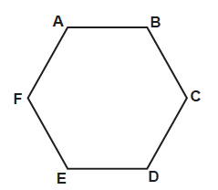
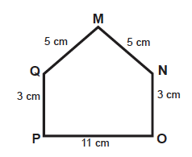
Regular and Irregular Polygons
Regular and Irregular Polygons
A regular polygon is a polygon with all sides and all angles congruent. This means
that all the sides of a regular polygon have the same length and all their angles have
the same measure. For example, hexagon ABCDEF has 3 centimeters in all sides,
and all angles have the same measure. It is an example of a regular hexagon.
It has 6 congruent sides and 6 congruent angles.
On the other hand, an irregular polygon is a polygon with sides and angles that are not congruent. As shown in the figure, pentagon MNOPQ is an irregular pentagon. The measure of its sides and angles are not congruent.
Rex Curriculum Resource
WWW.REX.COM.PH

Slide 7
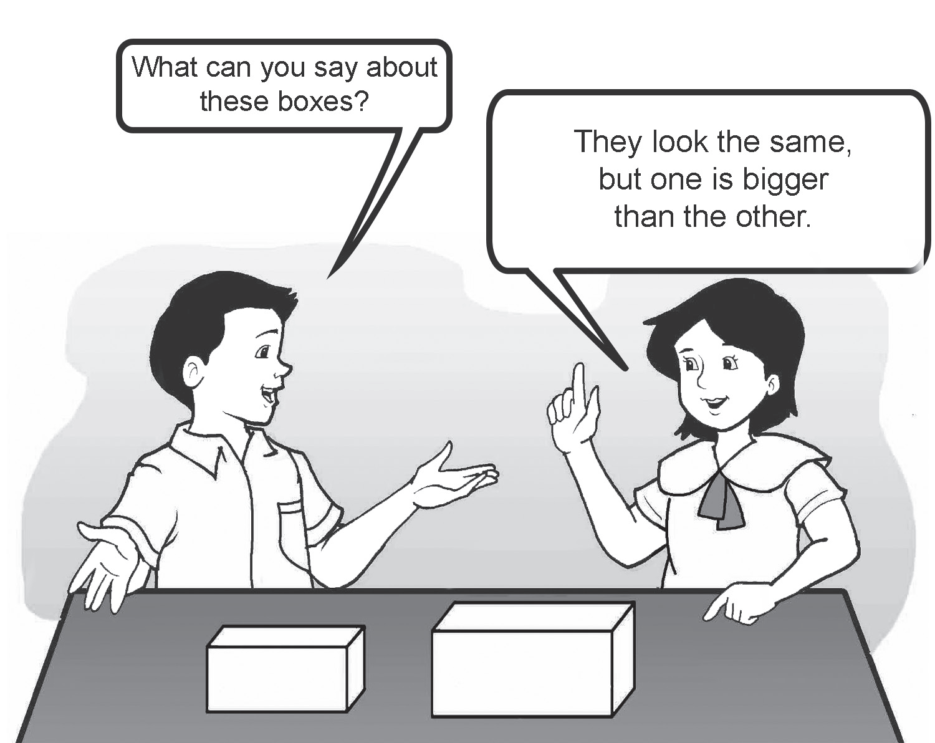
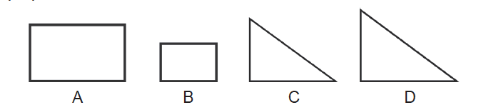
Similar and Congruent Polygons
Similar polygons are polygons with the same shape but not necessarily the
same size. Corresponding angles have the same measure, and their corresponding
sides are proportional.
Figures A and B are similar rectangles. Figures C and D are similar triangles.
The symbol ~ is used to show similarity. We say Figure A is similar to Figure B, and we
write A ~ B.
Rex Curriculum Resource
WWW.REX.COM.PH

Slide 8
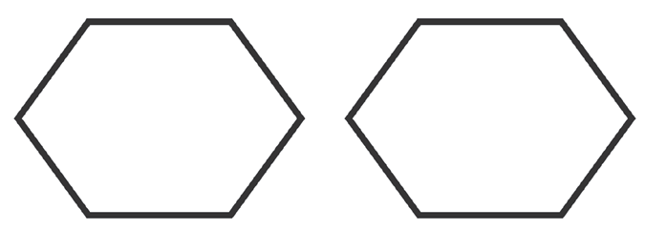
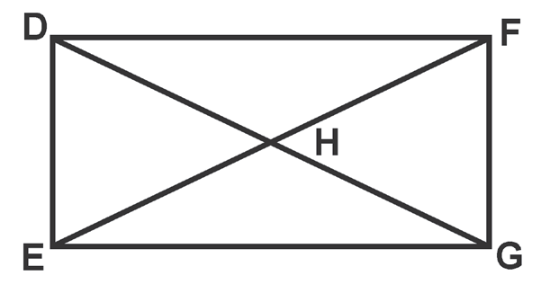
Similar and Congruent Polygons
Look at these figures. What can you say
about them?
These are 6-sided polygons or hexagons.
In the illustration, you can see that the hexagons have exactly the same shape and size. These are examples of congruent polygons.
Congruent polygons are polygons with exactly the same shape and size. This means that their corresponding segments have exactly the same length and their interior angles have exactly the same measure. The symbol for congruency is ≅.
Segment DF in this ﬁgure is congruent to segment EG, and triangle EHD is congruent to
Triangle GHF. We write: DF ≅ EG and ΔEHD ≅ ΔGHF
Rex Curriculum Resource
WWW.REX.COM.PH

Slide 9
KEY TAKEAWAYS
• Polygons are closed plane figures with straight sides. The number of corners in a polygon determines the number of angles in the ﬁgure.
• A regular polygon is a polygon with all sides and angles are congruent. On the other hand, an irregular polygon has sides and angles that are not congruent.
• Similar polygons are polygons with the same shapes but do not have the same exact size. Corresponding angles have the same measure, and their corresponding sides are proportional. The symbol for similarity is ∼.
• Congruent polygons are polygons with exactly the same shape and size. Their corresponding segments have exactly the same length, and their interior angles have exactly the same measure. The symbol for congruency is ≅.
Rex Curriculum Resource
WWW.REX.COM.PH

Slide 10
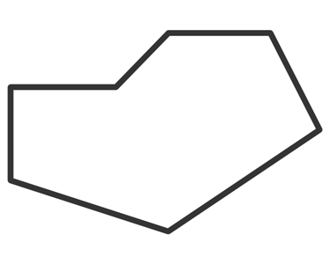
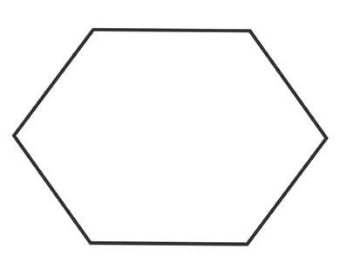
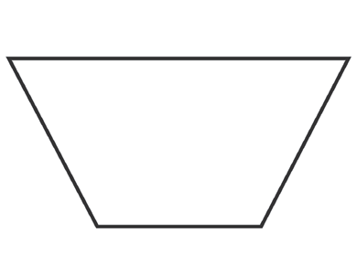
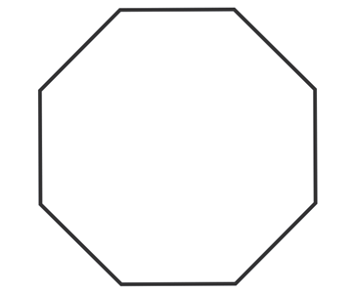
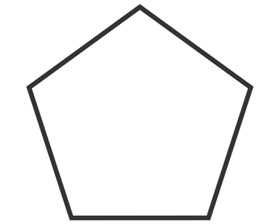
Activity:
Identify the following polygons
1 . 4.
2 . 5.
3.
Rex Curriculum Resource
WWW.REX.COM.PH

Slide 11
Activity: ANSWER KEY
Identify the following polygons
1 . 4.
2 . 5.
3.
ANSWER KEY
1. hexagon
2. quadrilateral
3. pentagon
4. heptagon
5. octagon
Rex Curriculum Resource
WWW.REX.COM.PH

Slide 12


