Slide 1
The Menstrual Cycle

Slide 2
The Menstrual Cycle
Menstruation is one of the most noticeable changes that happens in a female’s body. As their bodies change, females must be aware of their hygiene and understand how to properly care for their reproductive organs.
The menstrual cycle happens in the woman’s body in preparation for pregnancy. It usually begins from 10–13 years of age and continues until women reach their forties and fifties.
When the egg is fertilized by the sperm cell, the egg attaches itself to the lining for nourishment and protection. This time, the woman is pregnant.
If the egg cell is not fertilized, the uterine lining sheds and blood flows out. This is called
menstruation. It happens once a month, which is why it is called a monthly period.
WWW.REX.COM.PH

Slide 3
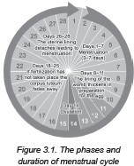
The Menstrual Cycle
The menstrual cycle involves 28 days , in which the female reproductive system prepares for pregnancy
Menstrual cycle has four phases:
➢
menstrual
follicular ovulation luteal
➢
➢
➢
WWW.REX.COM.PH

Slide 4
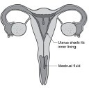
The Menstrual Cycle
Menstrual Phase (Days 1 to 7)
This is the start of the menstrual cycle.
In this phase, when the egg is not fertilized, the thickened lining of the uterus, called endometrium, sheds off in the
form of blood and flows out through the vagina together with the dissolved egg.
This phase is the woman’s monthly bleeding or menstruation. It can last from three to seven days.
WWW.REX.COM.PH

Slide 5
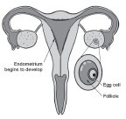
The Menstrual Cycle
Follicular Phase (Days 8 to 13)
After menstruation, the hormone level of the female rises, making the uterine lining thicken as a preparation to receive the fertilized egg cell. It is due to the hormone called estrogen. The ovary prepares to release another egg, and the endometrium starts to develop to receive the fertilized egg.
The follicle-stimulating hormone (FSH) increases and stimulates the ovarian follicles for the preparation of the egg to mature.
WWW.REX.COM.PH

Slide 6
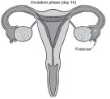
The Menstrual Cycle
Ovulation Phase (Day 14)
When the mature egg is released from the ovary, ovulation takes place. When the ovarian follicle gets matured,it ruptures and releases an egg to the nearest fallopian tube. As the egg cell travels along the fallopian tube for about three to four days, the uterus continuous to thickens. During this time, it can be fertilized by the sperm cell. If not, the egg will start to dissolve.
WWW.REX.COM.PH

Slide 7
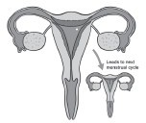
The Menstrual Cycle
Luteal Phase (Days 15 to 28)
If fertilization does not happen, the hormone
level of a female changes. The ovarian follicles produce
a structure called the corpus luteum.This structure produces estrogen and a large amount of progesterone. This hormones signals the uterus lining to thicken in preparation for pregnancy. If no fertilization takes place, the lining of the uterus sheds off in the form of blood, menstruation occurs, and the cycle begins again.
During menstruation, about 30 mL of blood is discharged from a female’s body. A sanitary pad or
napkin is used to catch and absorb the blood flow.
WWW.REX.COM.PH

Slide 8
The Menstrual Cycle
Girls may also experience abdominal cramps or dysmenorrhea during this period. It is due to the contraction of muscles in the uterus to eject blood and tissues.
When the ovaries of a woman stop producing eggs, the menstrual cycle stops. This time of a woman’s life is called menopause. It usually happens between the ages of 45 and 55. When this time comes, the woman will not be able to bear a child.
WWW.REX.COM.PH

Slide 9
The Female Reproductive System
Now, as you reach puberty, which is the onset of having the ability to reproduce, you must take good care of the body’s reproductive system. The organs of boys and girls are active when they reach puberty. At this age, you have to know how to maintain the health and cleanliness of your reproductive system.
What can you do to make your body clean and healthy?
Take a bath every day.
Wash your hair daily with shampoo and rinse well with water.
Brush your teeth three times a day.
Wash your feet before you put on your clean socks and shoes.
Always change your clothes.
Always change your underwear.
Eat a healthy balanced diet.
Exercise regularly and have enough rest and sleep.
Clean your external sex organs after using the toilet.
You may also use personal care products like deodorant, cologne, baby powder, or foot powder.
WWW.REX.COM.PH

Slide 10
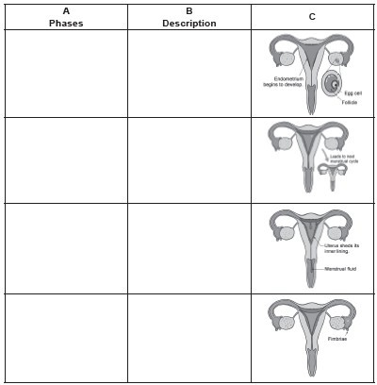
The Female Reproductive System
Directions. Study the illustrations of the menstrual cycle in the third column. Identify what phase of the menstrual cycle is shown and describe what happens in each phase.
WWW.REX.COM.PH

Slide 11
The Female Reproductive System
Answer Key:
Follicular
The ovary prepares the egg for the ovulation process.
Luteal
There is a hormonal change in the female’s body to thicken the lining of the uterus.
Menstrual
The uterus lining breaks down and sheds off in the form of blood.
Ovulation
The ovary releases an egg cell.
WWW.REX.COM.PH

Slide 12


