Slide 1


Angles of a Polygon

Slide 2
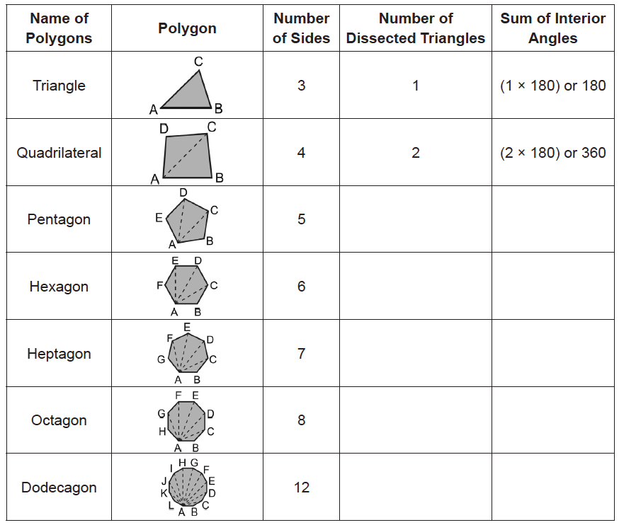
Angles of a Polygon
Guided Activity :
Recall: The sum of the measures of the angles of a triangle is 180°.
Consider each convex polygon with all possible diagonals drawn from one vertex. In each case, the polygon is cut into triangles. The sum of the measures of the angles of each polygon can be found by adding the measures of the angles of the dissected triangles. Complete the table on the right.
1. Is there a connection between the number of sides and the number of dissected triangles in a polygon? What is this relation?
2. How many dissected triangles are there in an n-sided polygon? What is the sum of the interior angles of an n-sided polygon?
Rex Curriculum Resource
WWW.REX.COM.PH

Slide 3
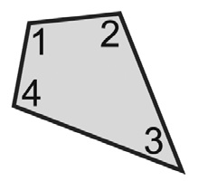
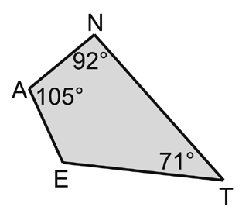
Angles of a Polygon
Solution:
a. m∠A + m∠N + m∠T + m∠E = 360° The sum of the measures of the angles of a convex quadrilateral is 360°.
105° + 92° + 71° + m∠E = 360°
268° + m∠E = 360°
m∠E = 92°
b. Let x = measure of ∠N.
2x = measure of ∠E.
3x = measure of ∠A.
4x = measure of ∠T.
x + 2x + 3x + 4x = 360°
10x = 360°
x = 36°
Use the value of x to find the measure of each angle.
Thus, m∠N = 36°,
m∠E = 2(36°) = 72°, m∠A = 3(36°) = 108°, and m∠T = 4(36°) = 144°
Property 1
The sum of the measures of the angles of a convex quadrilateral is 360°. We have
m∠1 + m∠2 + m∠3 + m∠4 = 360°.
Property 1
The sum of the measures of the angles of a convex quadrilateral is 360°. We have m∠1 + m∠2 + m∠3 + m∠4 = 360°.
Example 1: Angles of a Quadrilateral
Find the measure of:
a. ∠E in the figure on the right.
b. each interior angle in NEAT if the measure of each consecutive angle is a consecutive multiple of x.
Rex Curriculum Resource
WWW.REX.COM.PH

Slide 4
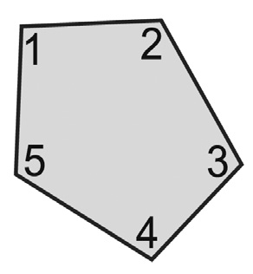
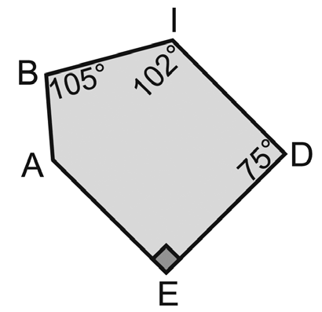
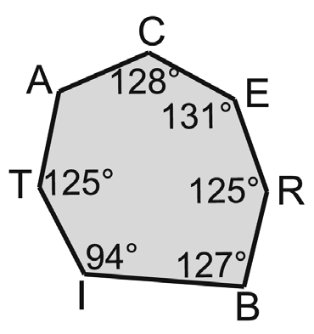
Angles of a Polygon
Solution:
a. The polygon has 5 sides, so the sum of the measures of the interior angles is:
(n – 2)180° = (5 – 2)180° = 3(180°) = 540°.
Add the measures of the given interior angles and set the sum equal to 540°.
m∠A + 105° + 102° + 75° + 90° = 540°
m∠A + 372° = 540° Combine like terms.
m∠A = 168° Subtract 372° from each side.
b. The polygon has 7 sides, so the sum of the measures of the interior angles is:
(n – 2)180° = (7 – 2)180° = 5(180°) = 900°.
Add the measures of the given interior angles and set the sum equal to 900°.
m∠A + 128° + 131° + 125° + 127° + 94° + 125° = 900°
m∠A + 730° = 900°
m∠A = 170°
Thus, m∠A is 170°.
Property 2: Polygon Interior Angle Sum
The sum of the measures of the angles of a convex polygon with n sides is (n – 2)180°. Hence, we have
m∠1 + m∠2 + … + m∠n = (n – 2)180°.
Example 2: Polygon Interior Angle Sum
Find the measure of ∠A in each of the following diagrams.
a. b.
Rex Curriculum Resource
WWW.REX.COM.PH

Slide 5
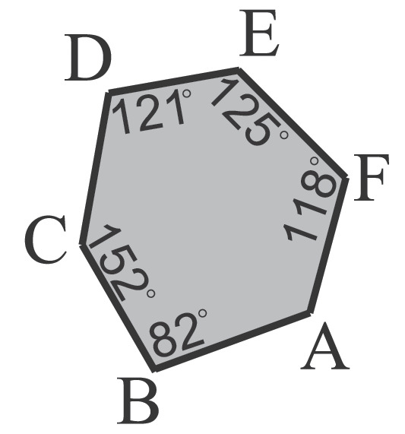
Activity:
Find the measure of ∠A in the figure below.
Rex Curriculum Resource
WWW.REX.COM.PH

Slide 6
Activity: ANSWER KEY
Find the measure of ∠A in the figure below.
ANSWER
A = 122
Rex Curriculum Resource
WWW.REX.COM.PH

Slide 7


