Slide 1


Sides of a Polygon

Slide 2
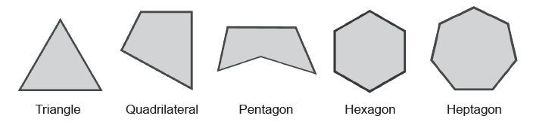
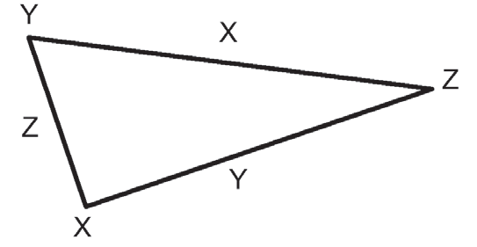
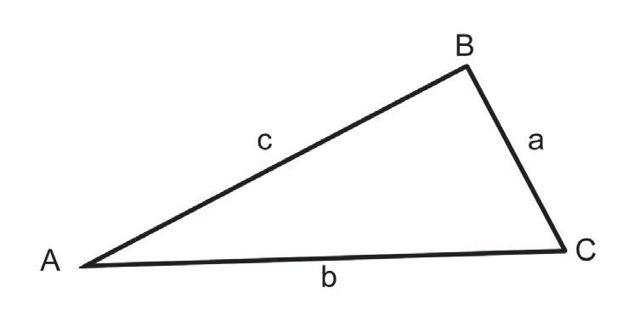
Sides of a Polygon
Aside from classifying polygons as convex or concave, polygons can also be categorized based on the number of sides.
Each of the following polygons is named according to the number of its sides.
Example : Refer to the triangle below to answer the following.
a. Name the sides in two ways.
b. Name the angles in two ways.
Solution:
a. XY, YZ, and XZ; x, y, and z
b. ∠X, ∠Y, and ∠Z; ∠YXZ, ∠XYZ, and ∠XZY
Triangles
A triangle is a polygon with three sides. The primary parts of a triangle are its three sides and three angles. In the figure on the right, the three sides are AB, BC, and CA. Aside from the line segments, a lower-case letter can be used to name each side of a triangle such as a, b, and c in the figure. An angle of a triangle is named by one of its three vertices such as ∠A, ∠B, and ∠C. We can also use all the three vertices of a triangle; ∠A, ∠B, and ∠C can be renamed ∠BAC, ∠ABC, and ∠ACB, respectively.
Rex Curriculum Resource
WWW.REX.COM.PH

Slide 3
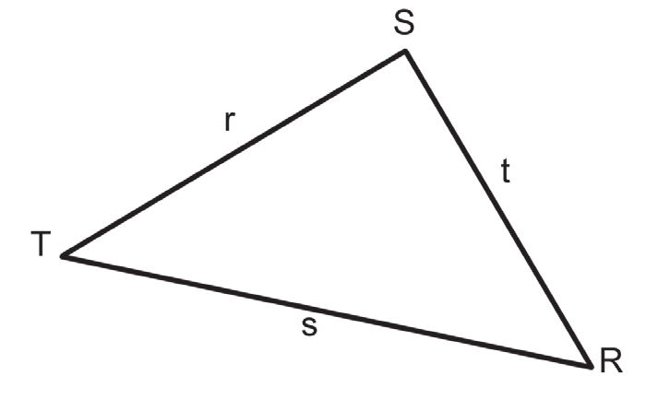
Activity:
Refer to the triangle below to answer the following.
1. Name the sides in two ways.
2. Name the angles in two ways.
Rex Curriculum Resource
WWW.REX.COM.PH

Slide 4
Activity: ANSWER KEY
Refer to the triangle below to answer the following.
1. Name the sides in two ways.
2. Name the angles in two ways.
ANSWER KEY
1. TS, SR, and TR; r, t, and s
2. ∠R, ∠S, and ∠T; ∠SRT, ∠TSR, and ∠STR
Rex Curriculum Resource
WWW.REX.COM.PH

Slide 5
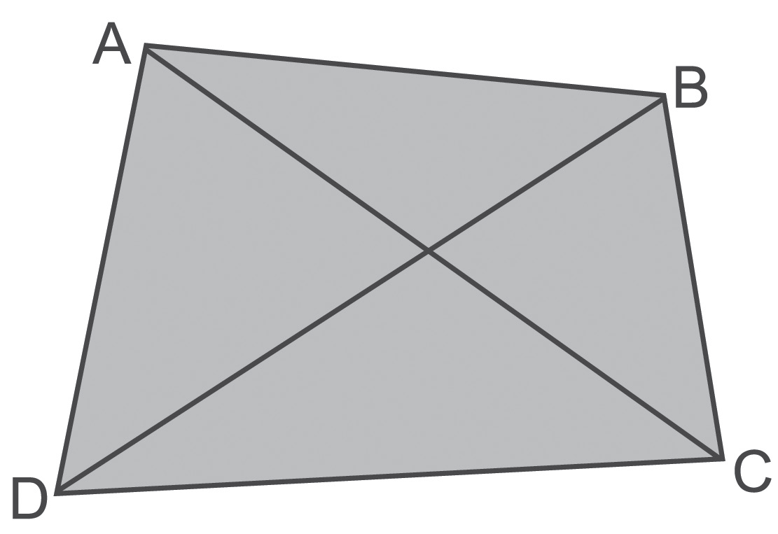
Sides of a Polygon
The figure given on the right shows coplanar points A, B, C, and D such that no three points are collinear. The four points A, B, C, and D are the vertices, which are joined by four segments. The shape formed by the union of these four segments is called a quadrilateral. The given quadrilateral can be named by listing its vertices, starting with any vertex and writing or reading the other vertices in either a clockwise or counterclockwise direction. Hence, this quadrilateral can be named ◻ABCD, ◻BCDA, ◻CDAB, ◻DABC, ◻ADCB, ◻DCBA, ◻CBAD, or ◻BADC. In the same figure, we have two pairs of opposite sides, namely AB and DC, AD and BC, while AD and AB is a pair of consecutive sides.
On the other hand, ∠A and ∠C as well as ∠B and ∠D are called opposite angles, while ∠A and ∠B are a pair of consecutive angles. The segments AC and BD are the diagonals of the given quadrilateral.
Rex Curriculum Resource
WWW.REX.COM.PH

Slide 6
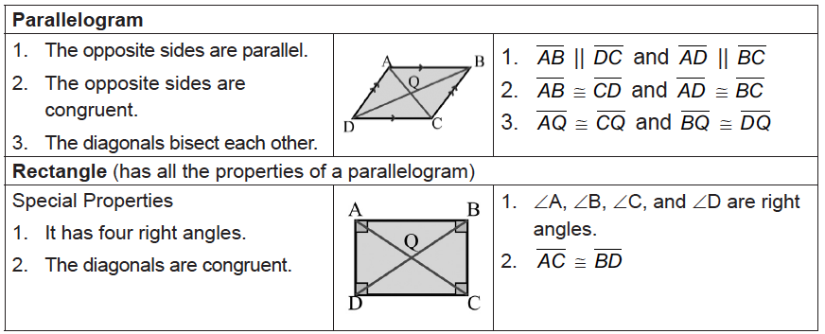
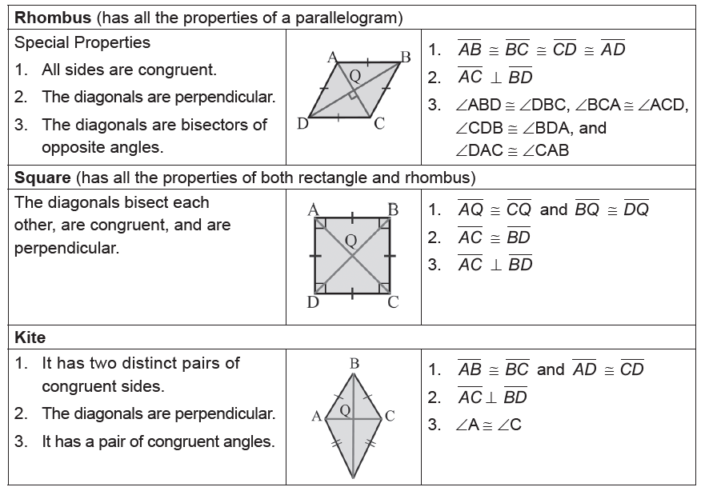
Sides of a Polygon
You may have discovered the following properties about the special quadrilaterals including their definitions.
Rex Curriculum Resource
WWW.REX.COM.PH

Slide 7
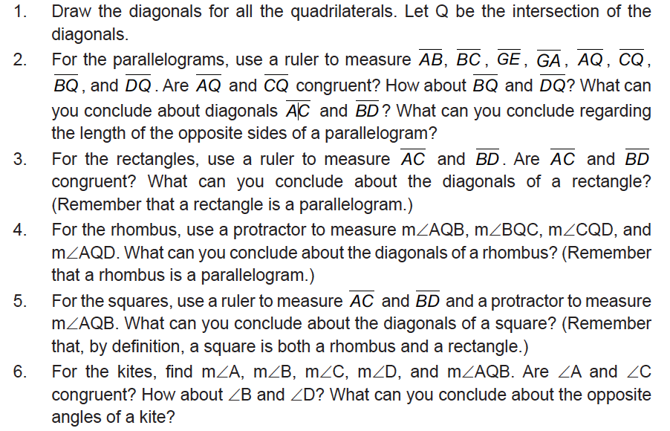
Activity:
To discuss the properties of the quadrilaterals, do the following
Rex Curriculum Resource
WWW.REX.COM.PH

Slide 8
Activity: ANSWER KEY
To discuss the properties of the quadrilaterals, do the following
ANSWER KEY:
2. AQ and CQ are congruent. BQ and DQ are congruent. The diagonals AC and BD are not congruent. The opposite sides of a parallelogram are congruent and parallel.
3. AC and BD are congruent. The diagonals of rectangles are congruent.
4. m∠AQB, m∠BQC, m∠CQD, and m∠AQD are right angles. The diagonals of a rhombus are perpendicular.
5. AC and BD are congruent. ∠AQB is a right angle. The diagonals of a square are congruent and perpendicular.
6. m∠A and m∠C are congruent. m∠B and m∠D are not congruent. m∠AQB is a right angle. One pair of opposite angles of kites are congruent.
Rex Curriculum Resource
WWW.REX.COM.PH

Slide 9


