Slide 1


Interior Angles of a Convex Polygon

Slide 2
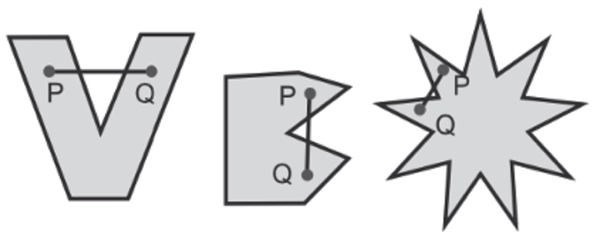

Interior Angles of a Convex Polygon
A polygon and its interior form together a polygonal region. Some polygonal regions “bend inward” while others do not. The polygonal regions that bend inward are called concave, and those that do not are called convex. A more formal definition of convex and concave polygonal regions is given below.
A polygonal region is convex if segment PQ joining any two points P and Q of the region is a part of the region. If the polygonal region is not convex, then it is concave.
A polygon that determines a convex region is called a convex polygon. A polygon that determines a concave region is called a concave polygon. In this module, when a polygon is used, it will mean a convex polygon.
Rex Curriculum Resource
WWW.REX.COM.PH

Slide 3
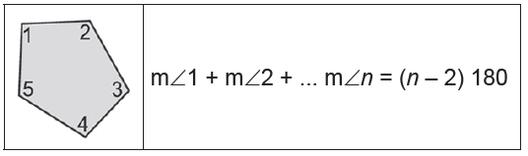
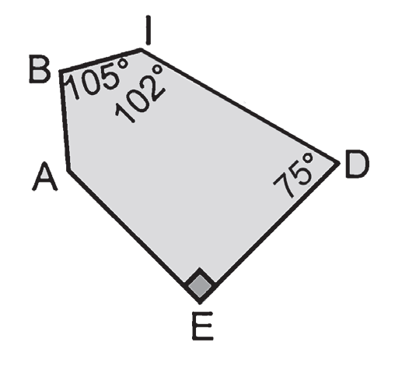
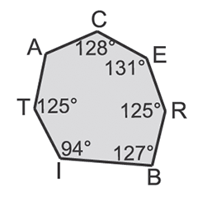
Interior Angles of a Convex Polygon
Property 1
The sum of the measure of the interior angles of a convex polygon with n sides is (n – 2)180°.
Example 1: Polygon Interior Angle Sum
Find the measure of ∠A in the following diagrams.
a. b.
Solution:
a. The polygon has 5 sides, so the sum of the measures of the interior angles is (n – 2)180° = (5 – 2)180° = 3(180°) = 540°.
Add the measures of the interior angles and set the sum equal to 540°.
m∠A + 105° + 102° + 75° + 90° = 540°
m∠A + 372° = 540° Combine like terms.
m∠A = 168° Subtract 372° from each side.
Thus, m∠A is 168°.
b. The polygon has 7 sides, so the sum of the measures of the interior angles is (n – 2)180° = (7 – 2)180° = 5(180°) = 900°.
Add the measures of the interior angles and set the sum equal to 900°.
m∠A + 128° + 131° + 125° + 127° + 94° + 125° = 900°
m∠A + 730° = 900°
m∠A = 170°
Thus, m∠A is 170°.
Rex Curriculum Resource
WWW.REX.COM.PH

Slide 4
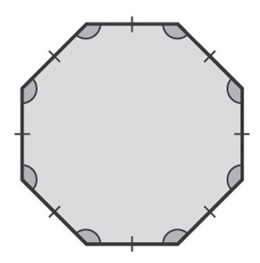
Interior Angles of a Convex Polygon
Example 3: Interior Angle Sum of Regular Polygon
Find the measure of an interior angle of:
a. a regular octagon b. a regular decagon
Solution:
a. The sum of the measures of the interior angles of an octagon is
(n – 2)180° = (8 – 2)180° = 6 · 180° = 1,080°.
Since the octagon is regular, each angle has the same measure. Thus, divide 1,080° by 8 to find the measure of
one interior angle.
1/0808 = 135 ,
Thus, the measure of each interior angle of a regular octagon is 135°.
b. The sum of the angle measures of a decagon is:
(10 – 2)180° = 8 · 180° = 1,440°
Thus, the measure of each angle is:
1/44010 = 144,
Rex Curriculum Resource
WWW.REX.COM.PH

Slide 5
Activity:
Four angles of a hexagon measure 130°, 140°, 150°, and 140°. Find the measures of the other two angles if they are in the ratio 2 : 3.
ANSWER:
64° and 96°
Rex Curriculum Resource
WWW.REX.COM.PH

Slide 6
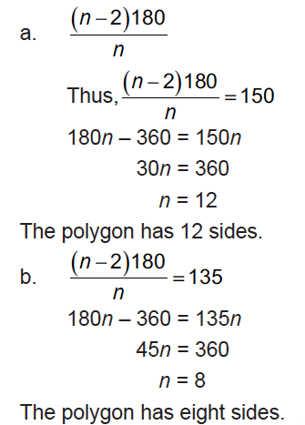
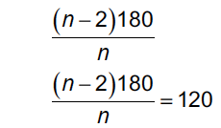
Interior Angles of a Convex Polygon
Example 4: Interior Angle Sum of Regular Polygon
The measure of an interior angle of a regular polygon is given. Find the number of sides in each polygon.
a. 150° b. 135°
Solution:
The measure of each interior angle of a regular polygon is:
Example : Real-life Application
Mr. Aris Reyes is planning to build a gazebo in which its base is a regular hexagon. At what angle should he cut the lumber to frame the base?
Replace by 6.
T_x0000_h_x0000_e_x0000_ _x0000_m_x0000_e_x0000_a_x0000_s_x0000_u_x0000_r_x0000_e_x0000_ _x0000_o_x0000_f_x0000_ _x0000_e_x0000_a_x0000_c_x0000_h_x0000_ _x0000_a_x0000_n_x0000_g_x0000_l_x0000_e_x0000_ _x0000_s_x0000_h_x0000_o_x0000_u_x0000_l_x0000_d_x0000_ _x0000_b_x0000_e_x0000_ _x0000_1_x0000_2_x0000_0_x0000_°._x0000_
Rex Curriculum Resource
WWW.REX.COM.PH

Slide 7
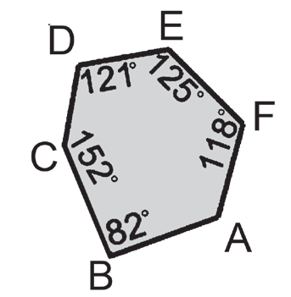
Activity:
Do the following activity:
1. Find the measure of ∠A given the diagram below:
2. Four angles of a hexagon measure 130°, 140°, 150°, and 140°. Find the measures of the other two angles if they are in the ratio 2 : 3.
3. The measure of an interior angle of a regular polygon is 156°. How many sides does the polygon have?
4. An architect is designing a gazebo whose base is a regular octagon. At what angle should he cut the lumber to frame the base?
Rex Curriculum Resource
WWW.REX.COM.PH

Slide 8
Activity: ANSWER SHEET
Do the following activity:
1. Find the measure of ∠A given the diagram below:
2. Four angles of a hexagon measure 130°, 140°, 150°, and 140°. Find the measures of the other two angles if they are in the ratio 2 : 3.
3. Find the measure of an interior angle of a regular nonagon.
4. The measure of an interior angle of a regular polygon is 156°. How many sides does the polygon have?
5. An architect is designing a gazebo whose base is a regular octagon. At what angle should he cut the lumber to frame the base?
ANSWER KEYS
1: 122°
2: 64° and 96°
3: 140°
4: 15°
5: 135°
Rex Curriculum Resource
WWW.REX.COM.PH

Slide 9


