Slide 1


Exterior Angles of a Convex Polygon

Slide 2
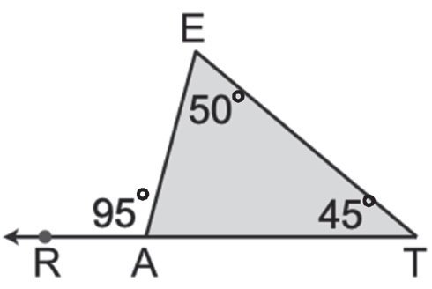
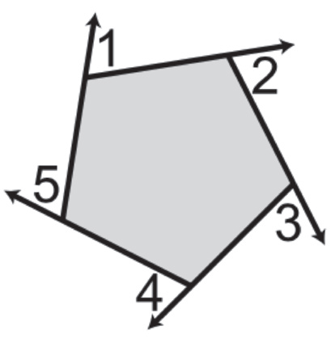
Exterior Angles of a Convex Polygon
An exterior angle is an angle that forms a linear pair with an interior angle of a polygon. In the figure on the right, ∠RAE is an exterior angle of ΔEAT, and ∠E and ∠T are interior angles.
An exterior angle is formed between any extended side of a polygon and another adjacent side. The angle at each vertex, ∠1, ∠2, ∠3, ∠4, and ∠5 are the exterior angles of the pentagon.
Rex Curriculum Resource
WWW.REX.COM.PH

Slide 3
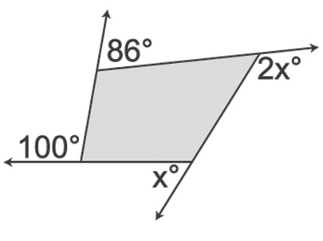
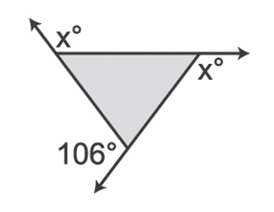
Exterior Angles of a Convex Polygon
Example : Exterior Angle Sum of Regular Polygon
Find the value of x in each of the following figures.
b.
Solution:
x + x + 106° = 360° Polygon Exterior Angle Sum
2x + 106° = 360° 0Combine like terms.
2x = 254° Subtract 106 from each side.
x = 127° Divide each side by 2.
The value of x is 127°.
a.
Solution:
a. Set the sum of the measures of the exterior angles equal to 360°.
x + 2x + 86° + 100° = 360° Polygon Exterior Angle Sum
3x + 186° = 360° Combine like terms.
3x = 174° Subtract 186 from each side.
x = 58° Divide each side by 3.
T_x005F_x0000_h_x005F_x0000_e_x005F_x0000_ _x005F_x0000_v_x005F_x0000_a_x005F_x0000_l_x005F_x0000_u_x005F_x0000_e_x005F_x0000_ _x005F_x0000_o_x005F_x0000_f_x005F_x0000_ _x005F_x0000_x_x005F_x0000_ _x005F_x0000_i_x005F_x0000_s_x005F_x0000_ _x005F_x0000_5_x005F_x0000_8_x005F_x0000_°._x005F_x0000_
Rex Curriculum Resource
WWW.REX.COM.PH

Slide 4
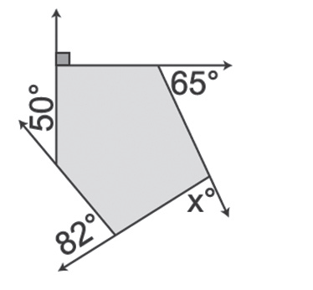
Exterior Angles of a Convex Polygon
Example : Exterior Angle Sum of Regular Polygon
Find the value of x in each of the following figures.
c.
Solution:
X + 65° + 90° + 50° + 82° = 360° Polygon Exterior Angle Sum
x + 287° = 360° Combine like terms.
x = 73° Subtract 287 from each side.
The value of x is 73°.
Rex Curriculum Resource
WWW.REX.COM.PH

Slide 5


