Slide 1


Constructing Polygons

Slide 2
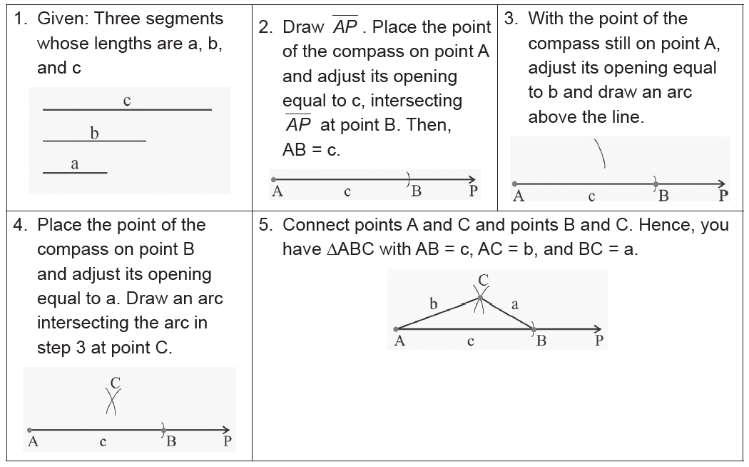
Constructing Polygons
Construction 1: Construct a Triangle with Side Lengths a, b, and c
Rex Curriculum Resource
WWW.REX.COM.PH

Slide 3
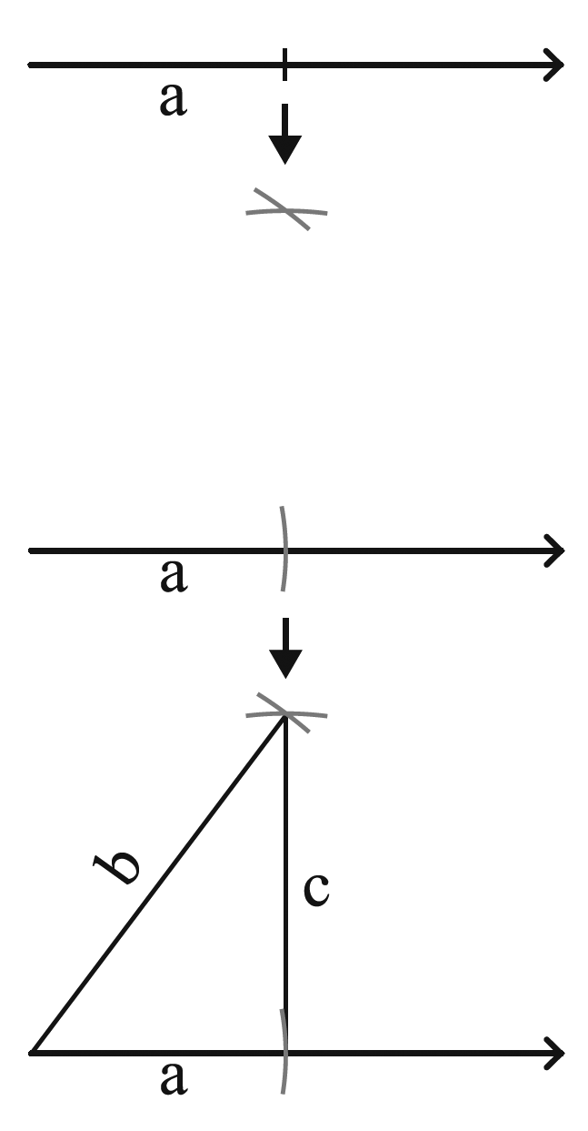
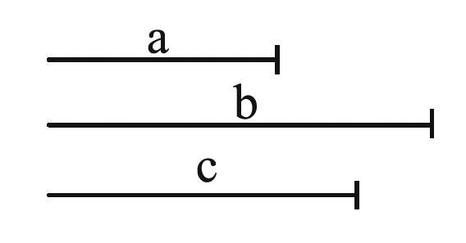
Constructing Polygons
Example 1: Construction
Construct the triangle given three segments with lengths a, b, and c.
Solution:
After constructing a triangle with three given segments, the following
construction will show you how to construct a triangle when its two sides
and an included angle are given.
Solution:
Rex Curriculum Resource
WWW.REX.COM.PH

Slide 4
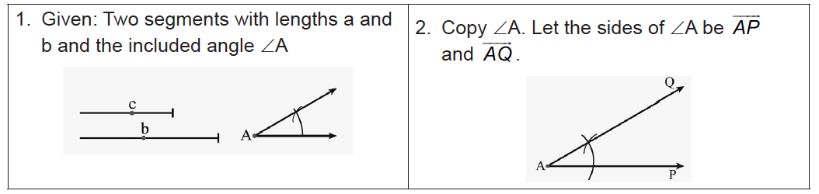
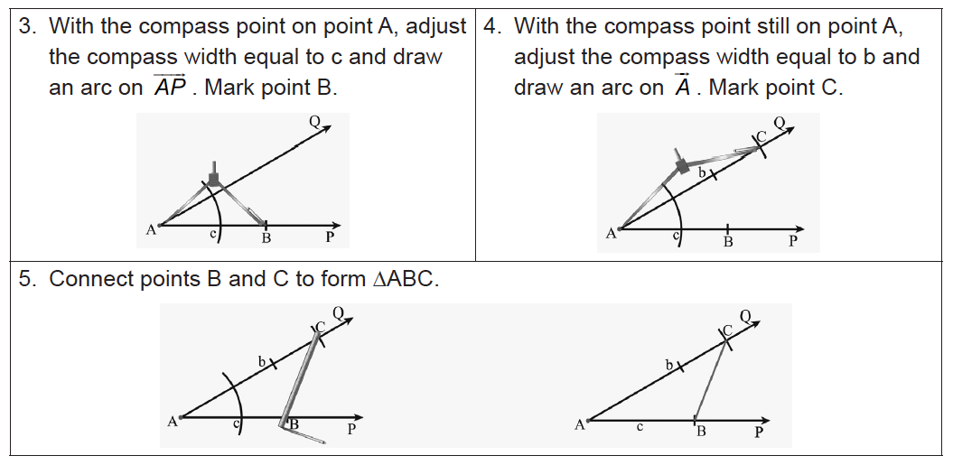
Constructing Polygons
Construction 2:
Construct a Triangle with Side Lengths a and b and the Included Angle ∠A
Rex Curriculum Resource
WWW.REX.COM.PH

Slide 5
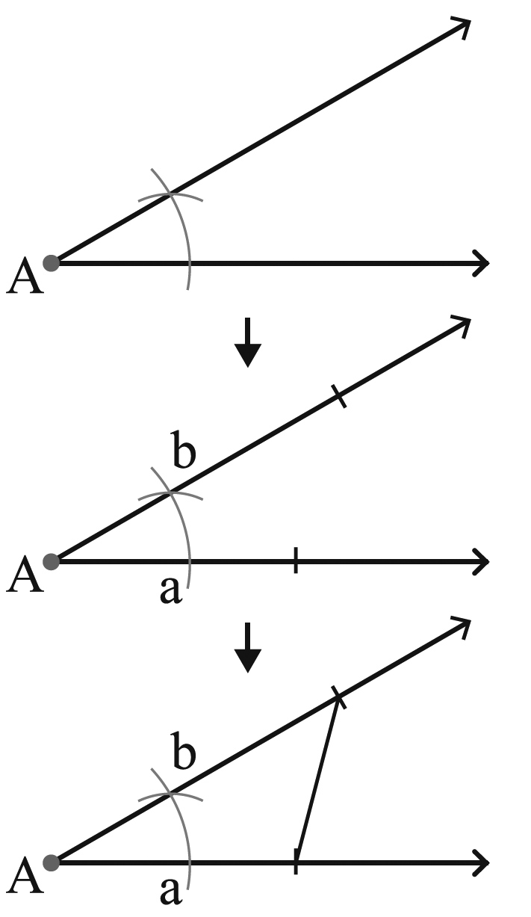
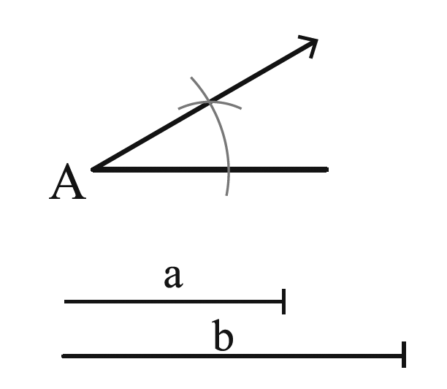
Constructing Polygons
SOLUTION:
Example 2: Construction
Construct the triangle given sides a and b and the included angle ∠A.
Rex Curriculum Resource
WWW.REX.COM.PH

Slide 6
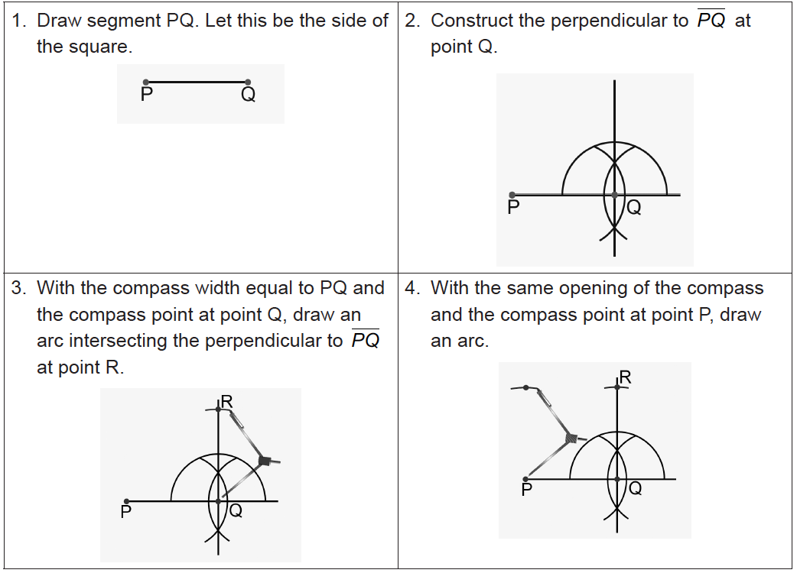
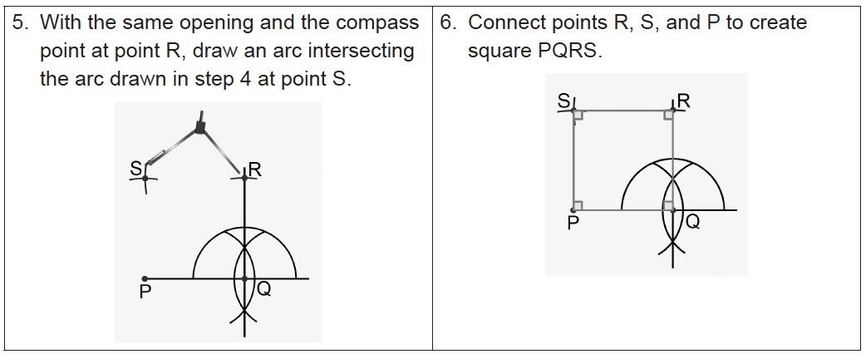
Constructing Polygons
A polygon with congruent sides and angles is called a regular polygon.
This section discusses how to construct such polygons.
Construction 3: Construction of a Square
We will construct regular polygons, starting with a square. Follow the given instructions on how to draw a square using a ruler and a compass. Let the measure of segment PQ be 2 centimeters.
Rex Curriculum Resource
WWW.REX.COM.PH

Slide 7
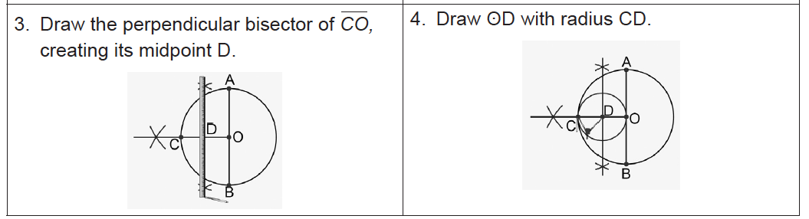
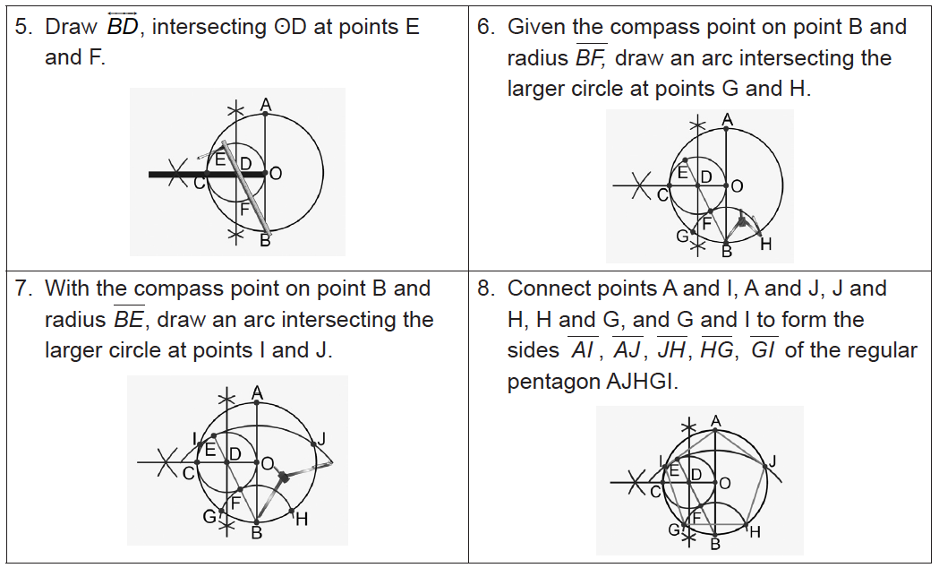
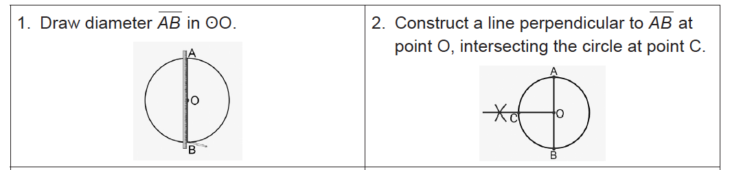
Constructing Polygons
The following sections will discuss how to construct a regular pentagon.
Construction 4: Construction of a Regular Pentagon
Follow the given instructions on how to draw a regular pentagon using a ruler and a compass. Let the measure of segment AB be 2 centimeters.
Rex Curriculum Resource
WWW.REX.COM.PH

Slide 8
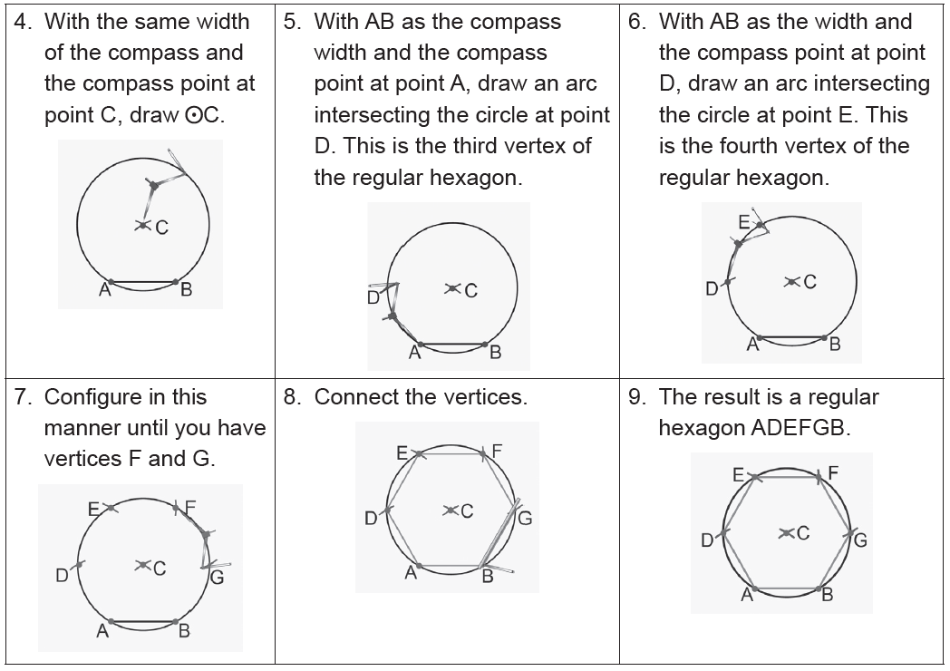
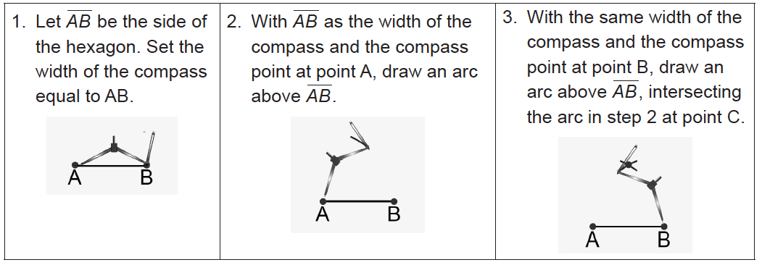
Constructing Polygons
The following section will discuss how to construct a regular hexagon.
Construction 5: Construction of a Regular Hexagon
Follow the given instructions on how to draw a regular hexagon using a ruler and a compass. Let the measure of segment AB be 2 centimeters.
Rex Curriculum Resource
WWW.REX.COM.PH

Slide 9
Activity:
Do the following:
1. Illustrate the steps in constructing a triangle with three given sides.
2. Illustrate the steps in constructing a regular pentagon.
Rex Curriculum Resource
WWW.REX.COM.PH

Slide 10
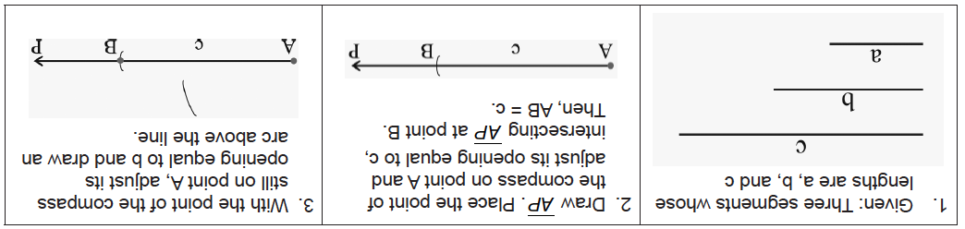
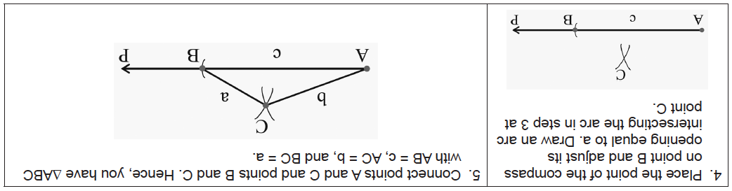
Activity: ANSWER KEY
Do the following:
1. Illustrate the steps in constructing a triangle with three given sides.
2. Illustrate the steps in constructing a regular pentagon.
ANSWER:
1.
Rex Curriculum Resource
WWW.REX.COM.PH

Slide 11
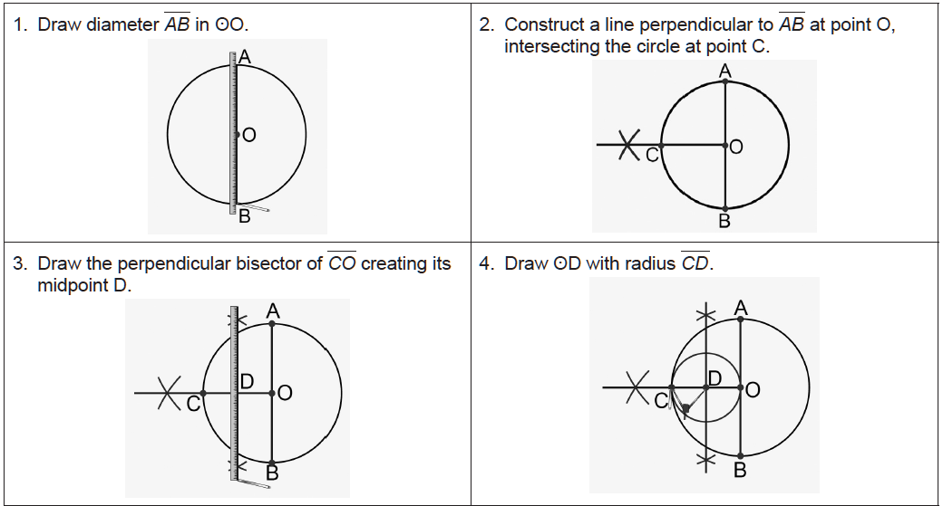
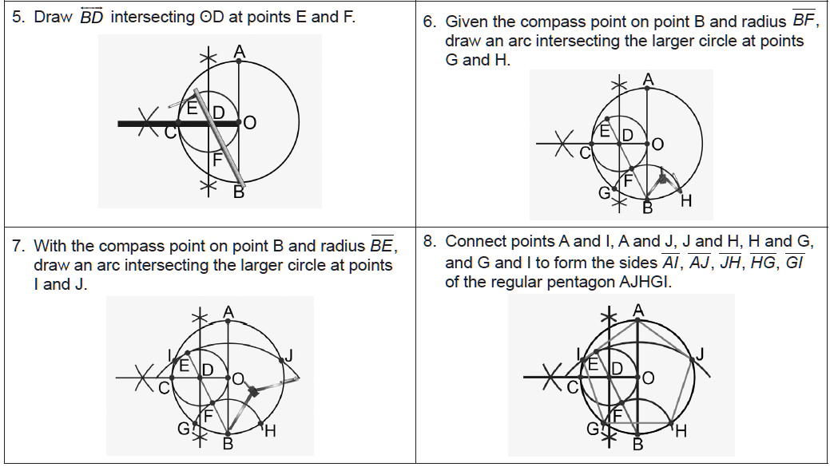
Activity: ANSWER KEY
Do the following:
1. Illustrate the steps in constructing a triangle with three given sides.
2. Illustrate the steps in constructing a regular pentagon.
ANSWER
2.
Rex Curriculum Resource
WWW.REX.COM.PH

Slide 12


