Slide 1


Solving Problems Involving the Sides and Angles of a Polygon

Slide 2
Solving Problems Involving the Sides and Angles of a Polygon
Recall that the sum of the measures of all the angles of a triangle is 180°
Solution:
a. Let x = m∠C, thus,
x + 40° = m∠R
x + 20° = m∠M
x + x + 40° + x + 20° = 180°
b. x + x + 40° + x + 20° = 180°
3x + 60° = 180°
3x = 120°
x = 40° = m∠C
x + 40° = 80° = m∠R
x + 20° = 60° = m∠M
The sum of the measures of all the angles of a triangle is 180°.
Example 2: The Angle Sum of a Triangle
In ΔCRM, m∠R is 40° more than m∠C and m∠M is 20° more than m∠C.
a. Write an equation that relates the given angle measures.
b. Find the measure of each angle.
Rex Curriculum Resource
WWW.REX.COM.PH

Slide 3
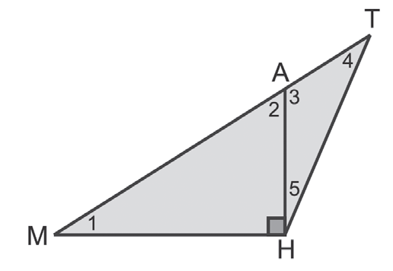
Solving Problems Involving the Sides and Angles of a Polygon
Recall that the sum of the measures of all the angles of a triangle is 180°
Example 1: The Angle Sum of a Triangle
Given: m∠1 = 35° and m∠5 = 25°
Find: a. m∠2 b. m∠3 c. m∠4
Solution:
a. m∠2 + 35° + 90° = 180°
m∠2 + 125° = 180°
m∠2 = 55°
b. m∠2 + m∠3 = 180°
55° + m∠3 = 180°
m∠3 = 125°
c. m∠4 + m∠3 + m∠5 = 180°
m∠4 + 125° + 25° = 180°
m∠4 + 150° = 180°
m∠4 = 30°
Thus, m∠2 = 55°, m∠3 = 125°, and m∠4 = 30°.
Rex Curriculum Resource
WWW.REX.COM.PH

Slide 4
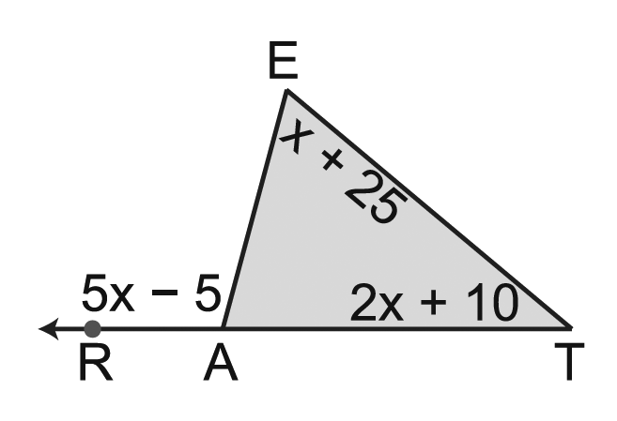
Solving Problems Involving the Sides and Angles of a Polygon
Solution:
a. By the Angle Sum of a Triangle Theorem:
m∠E + m∠T + m∠EAT = 180°
x + 25° + 2x + 10° + m∠EAT = 180°
m∠EAT = 145° − 3x
By the definition of linear pair, the angle properties on linear pair, and the definition of the supplementary angles, we have:
m∠EAR + m∠EAT = 180°
5x − 5 + 145 − 3x = 180° Replace m∠EAR by 5x − 5 and m∠EAT by 145 − 3x.
2x + 140° = 180° Simplify.
2x = 40° Subtract 140° from each side.
x = 20° Divide each side by 2.
b. m∠E = x + 25 d. m∠EAT = 145 − 3x
= 20° + 25° = 145 − 3(20°)
= 45° = 85°
c. m∠T = 2x + 10 e. m∠RAE = 5x − 5
= 2(20°) + 10 = 5(20°) − 5
= 50° = 95°
Example 3: The Angle Sum of a Triangle
Given the figures as marked, find:
a. x
b. m∠E
c. m∠T
d. m∠EAT
e. m∠RAE
Rex Curriculum Resource
WWW.REX.COM.PH

Slide 5
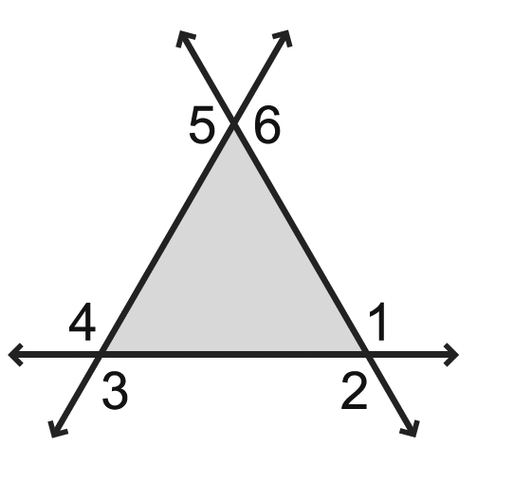
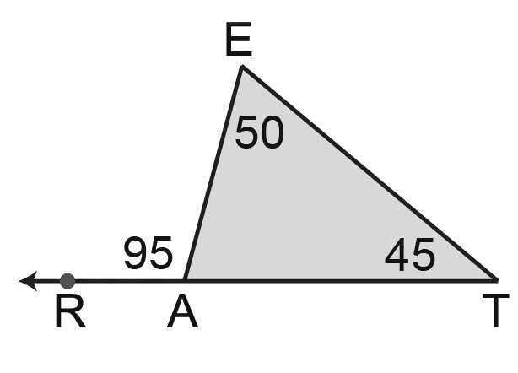
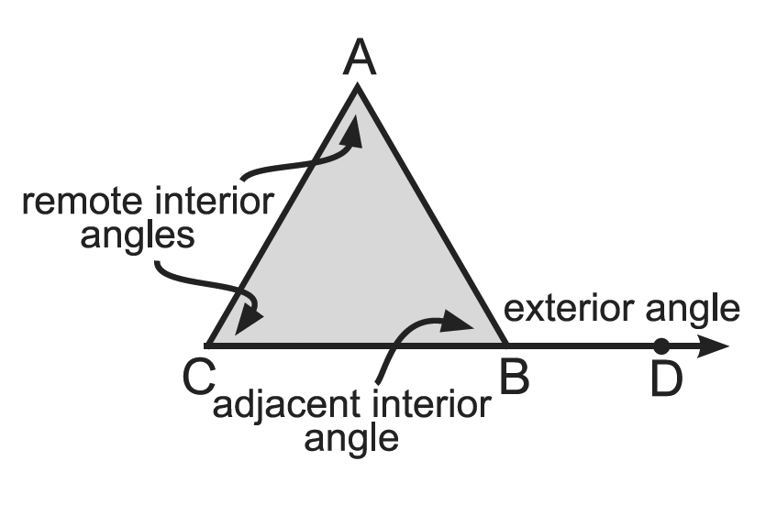
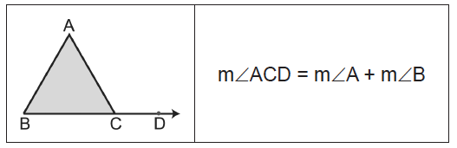
Solving Problems Involving the Sides and Angles of a Polygon
A triangle has six exterior angles.
Definition
An angle that forms a linear pair with an interior angle of a triangle is called an exterior angle.
The remote interior angles of a triangle are the interior angles that are not adjacent to the exterior angle.
By the above definition, it can be seen that an exterior angle is the angle between any side of a polygon and the segment extended from an adjacent side.
For each exterior angle of a triangle, there corresponds an adjacent interior angle and a pair of remote interior angles.
Considering the computed values for ∠E, ∠T, and ∠RAE, we can conclude that m∠RAE = m∠E + m∠T.
On Example in previous slide , ∠RAE is an exterior angle of ΔEAT and ∠E and ∠T are its corresponding remote interior angles. Notice that m∠RAE = 95° is equal to m∠E + m∠T = 45° + 50° = 95°.
On Example in previous slide , ∠RAE is an exterior angle of ΔEAT and ∠E and ∠T are its corresponding remote interior angles. Notice that m∠RAE = 95° is equal to m∠E + m∠T = 45° + 50° = 95°.
The Exterior Angle of a Triangle (EAT) Property states that the measure of an exterior angle of a triangle is equal to the sum of the measures of its two remote interior angles.
Rex Curriculum Resource
WWW.REX.COM.PH

Slide 6
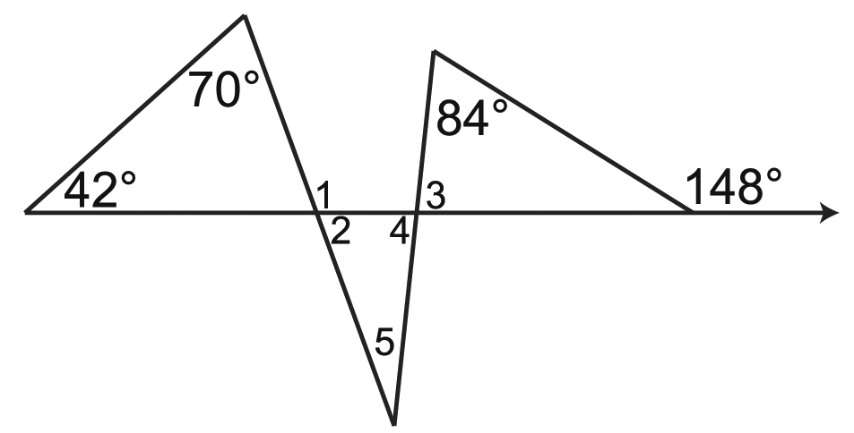
Solving Problems Involving the Sides and Angles of a Polygon
Example : The Exterior Angle of a Triangle
Find the measure of each numbered angle.
Solution:
m∠1 = 42° + 70°
= 112° Exterior Angle Theorem
m∠1 + m∠2 = 180° If two angles form a linear pair, they are supplementary.
112° + m∠2 = 180° Substitute 112° for m∠1.
m∠2 = 68° Subtract 112° from both sides.
m∠3 + 84° = 148° Exterior Angle Theorem
m∠3 = 64° Subtract 84° from both sides.
m∠4 = m∠3 Vertical angles are congruent.
∠4 = 64°
m∠2 + m∠4 + m∠5 = 180° The sum of the measures of the interior angles of a triangle is 180°.
68° + 64° + m∠5 = 180° Replace m∠2 by 68° and m∠3 by 64°.
m∠5 = 48°
Rex Curriculum Resource
WWW.REX.COM.PH

Slide 7
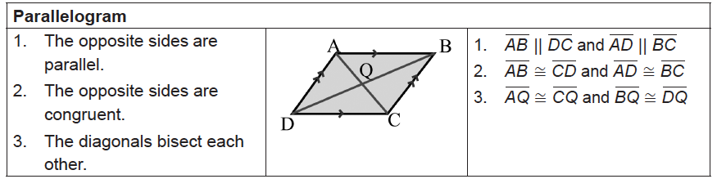
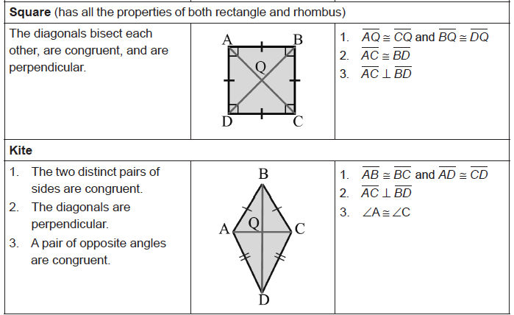
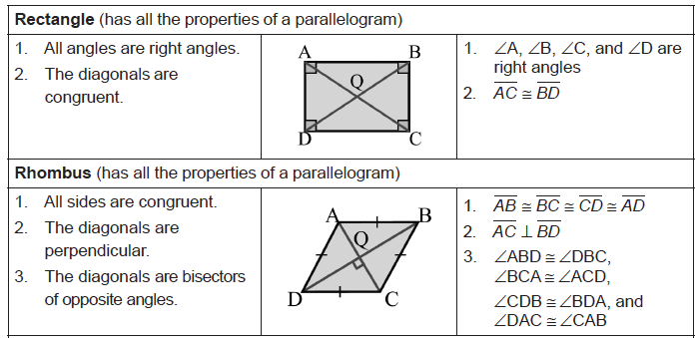
Solving Problems Involving the Sides and Angles of a Polygon
To solve problems involving the sides and angles of different quadrilaterals, let us consider the definitions and properties on the following page.
Rex Curriculum Resource
WWW.REX.COM.PH

Slide 8
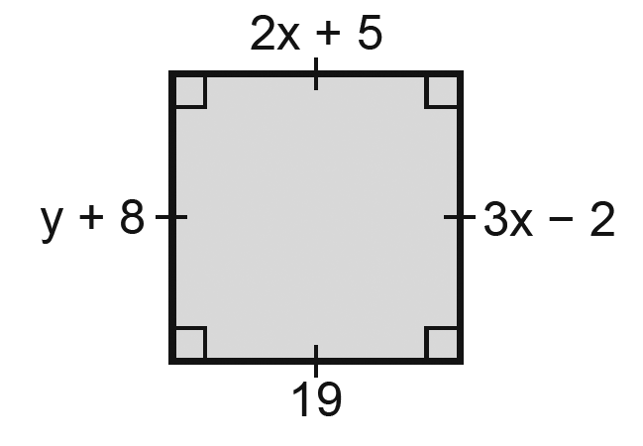
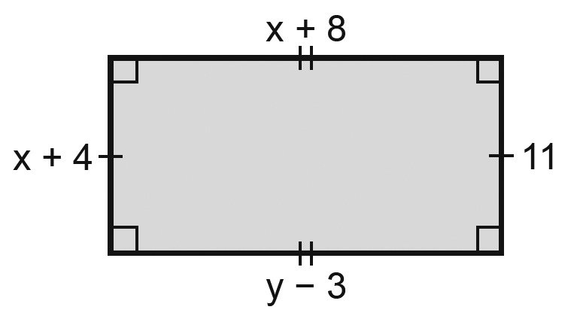
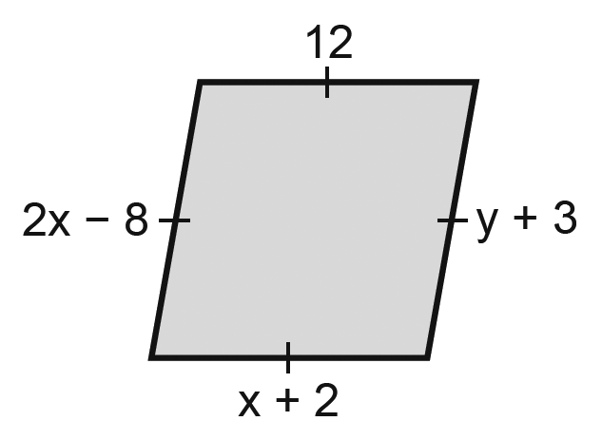
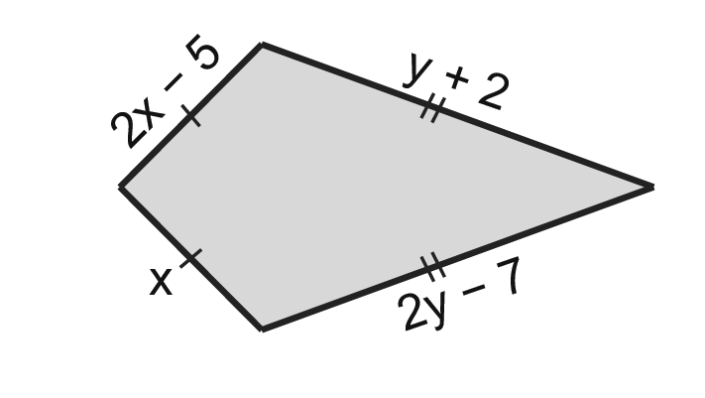
Solving Problems Involving the Sides and Angles of a Polygon
Solution:
a. 2x + 5 = 19 Definition of a square (sides are ≅)
2x = 14 Subtract 5 from both sides.
x = 7 Divide each side by 2.
Also, y + 8 = 3x – 2 Definition of a square
y + 8 = 3(7) – 2 Substitution
y + 8 = 21 – 2
y + 8 = 19
y = 19 – 8
y = 11
b. x + 2 = 12 Definition of a rhombus (sides are ≅)
x = 10 Subtract 2 from both sides.
Also, y + 3 = 2x – 8 Definition of a rhombus (sides are ≅)
y + 3 = 2(10) – 8 Substitution
y + 3 = 20 – 8
y + 3 = 12
y = 9
Example : Properties of Special Quadrilaterals
Use the definition of special parallelogram to solve for the values of x and y.
a. Square b. Rectangle
c. Rhombus d. Kite
Rex Curriculum Resource
WWW.REX.COM.PH

Slide 9
Solving Problems Involving the Sides and Angles of a Polygon
Solution:
c. x + 4 = 11 Definition of a rectangle (opposite sides are ≅)
x = 7 Also, y − 3 = x + 8 Definition of a rectangle (opposite sides are ≅)
y − 3 = 7 + 8
y − 3 = 15
y = 18
d. 2x – 5 = x Definition of a kite
2x = x + 5 Add 5 to each side.
x = 5 Subtract x from each side.
2y – 7 = y + 2 Definition of a kite
y – 7 = 2 Subtract y from each side.
y = 9 Add 7 to each side.
Example : Properties of Special Quadrilaterals
Use the definition of special parallelogram to solve for the values of x and y.
a. Square b. Rectangle
c. Rhombus d. Kite
Rex Curriculum Resource
WWW.REX.COM.PH

Slide 10
Activity:
Answer the following, use rhombus RSVP and the given information to find the indicated measures.
1. If m∠RPV = 72, solve for m∠RPS.
2. If m∠PRS = 110, find m∠RSP.
3. If m∠PTR = 3x + 12, determine the value of x.
4. If m∠PTV = 105 − 3x, what is the value of x?
5. If m∠RPV = 4x − 3 and m∠RSV = 3x + 14, find the value of x.
Rex Curriculum Resource
WWW.REX.COM.PH

Slide 11
Activity: ANSWER SHEET
Answer the following, use rhombus RSVP and the given information to find the indicated measures.
1. If m∠RPV = 72, solve for m∠RPS.
2. If m∠PRS = 110, find m∠RSP.
3. If m∠PTR = 3x + 12, determine the value of x.
4. If m∠PTV = 105 − 3x, what is the value of x?
5. If m∠RPV = 4x − 3 and m∠RSV = 3x + 14, find the value of x.
ANSWER KEY
1. 36°
2. 35°
3. 26
4. 15
5. 17
Rex Curriculum Resource
WWW.REX.COM.PH

Slide 12


